Slide 1
The future IVF lab?
Greta Verheyen
December 2023

Slide 2
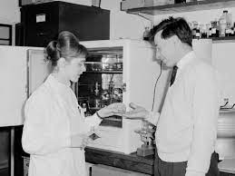
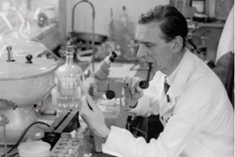
History – the old IVF lab
45 years after the birth of the first IVF baby
IVF lab = regular room
  No guidelines for air quality, equipment, infrastructure
In-house prepared culture media and cryopreservation media
In-house washed and sterilized re-usable material and tools
…
No guidelines, no legislation, no inspections
A WHITE-COATED SCIENTIST EXAMINES A TEST TUBE’S CONTENTS:
IVF IS THE FERTILISATION OF EGG AND SPERM OUTSIDE THE BODY

Slide 3


(R)evolution to the current IVF lab
Must comply with regulations and legislation
  EUTCD, Belgian Royal Decrees, EDQM
  Medical Device Regulations (MDR), In-vitro Diagnostics Regulations (IDR)
  CE
  ISO 15189:2022
Guidelines
  ESHRE
IVF industry: increasing market since the nineties
  Equipment, devices, tools, culture media,…
Mandatory IVF data registration
Over-regulation?
Directive 2004/23/EC of the European Parliament and of the Council of 31 March 2004 on setting standards of quality and safety for the donation, procurement, testing, processing, preservation, storage and distribution of human tissues and cells

Slide 4
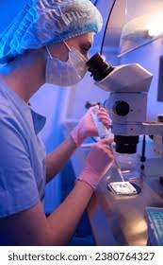
The current IVF lab
Experienced and technically-skilled embryologists and lab technicians
  Oocyte, sperm and embryo handling and manipulations
  Embryo selection for transfer and cryopreservation
  Quality control (KPI) and lab management
  …
Nowadays assisted by new technologies
  Time-lapse imaging with deep learning (DL)
  New sperm processing techniques
  …

Slide 5

What can we expect in the future IVF lab?

Slide 6

Artificial intelligence
Not new at all!
The concept of AI dates back to 1951 (Alan Turing)
Refers to the ability of computers to perform tasks that require human intelligence
Medical world: integrated in the interpretation of medical images (MRI, mammography, pathology, …)
Introduction of AI at different levels in the field of MAR, also in the IVF lab

Slide 7
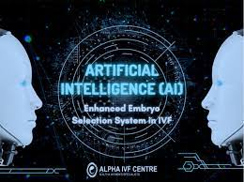
AI for embryo selection
More reliable, objective and consistent embryo assessments
AI algorithms developed to analyze images of embryos (with TL)
Feasibility and usefulness of AI models to predict IVF success
Different models available/described
  KIDScore/iDAScore (Vitrolife)
  STORK - Khosravi et al. 2019
  Life Whisperer - Vermilyea et al. 2020
  AIR E /ERICA - Chavez-Badiola et al. 2020
Systems are trained using large data sets of static embryo images
Trained to predict good-quality blastocyst formation, positive pregnancy or even positive fetal heartbeat

Slide 8
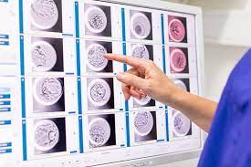
AI for embryo selection
AI and DL can detect differences in morphological features invisible by the human eye
More objective, standardized and consistent embryo scoring
Reduced variability in decision-making among embryologists
Time-saving, allowing more time for other critical lab tasks
Greater assistance to ‘less’ experienced embryologists
Ultimate goal: better IVF outcomes for patients
Promising results, but wide range in association of the models with increased IVF outcomes
More research needed to validate these models before integration in clinical practice
Jiang and Bormann FS 120, 2023

Slide 9
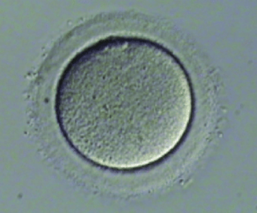
AI for oocyte quality
Development of neural networks to analyze static images of oocytes
Identification of oocyte morphological features
  Classification of oocytes - Manna et al. 2013
  Prediction of fertilization - Kanakasabapathy et al. 2020
  Prediction of developmental potential
Impact of the sperm cell is not considered
Limited predictive power for pregnancy outcome

Slide 10
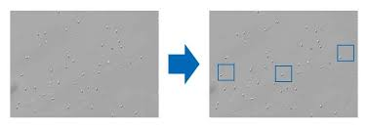
AI for single sperm selection
CASA has become standard for semen analysis in several IVF clinics
Selection of a single sperm for ICSI is operator-dependent and subjective
Advances in development of DL algorithms that track and rank individual sperm in real-time
  Simultaneously track single sperm and perform morphological evaluation - Sato et al. 2022
  Sperm ID (SiD) to evaluate different realtime kinematic parameters of individual sperm - Mendizabal-Ruiz et al. 2022
  The predicted SiD scores were higher for injected sperm that resulted in normal fertilization and blastocyst formation

Slide 11
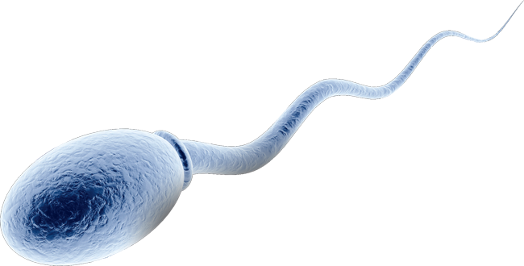
AI for single sperm selection
DL algorithm that can predict the DNA fragmentation of individual sperm from bright-field images - McCallum et al. 2019
Implementation of DL models can assist embryologists to choose the best sperm for ICSI
These models require further investigation and clinical benefits need to be established

Slide 12
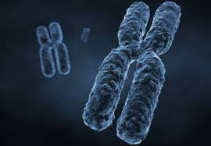
AI for ploidy prediction
Development of a DL model for recognition of ploidy status using TL
Lee et al. 2021
Different ML algoritms for prediction of euploidy including demographic, clinical, morphokinetic and embryo development characteristics
De Gheselle et al. 2022; Liu et al. 2022; Bamford et al. 2023; Jiang et al. 2023
A unique DL model, STORK-A, used 10378 blastocyst images to predict also complex aneuploidy
Barnes et al. 2023

Slide 13

AI for ploidy prediction
However, many algorithms trained on embryos classified as either euploid or aneuploid mask or exclude mosaic embryos
A challenge to include mosaicism in model training as mosaic embryos have reproductive potential – Jiang et al. 2023
Further research and validation needed to ensure the accuracy and reliability
of the AI models

Slide 14
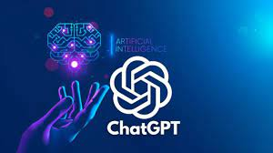
Language-based AI: ChatGPT
The introduction of the Generative Pre-trained Transformer ChatGPT in November 2022 shook the (scientific) world
Earliest programs were written in the mid-60s and progressed exponentially during the last years
Generates human-like responses of text in response to a question, within a few seconds
Might be a great help to researchers in
  Designing a study
  Performing analyses
  Drafting a scientific article
Altmaë et al. 2023

Slide 15

ChatGPT
Many questions raised
  Inaccuracy?
  Misinformation?
  Plagiarism?
What about
  Authorship?
  Intellectual property rights?
  Publication ethics?
Tool to help, not to replace the work of the scientist
Guidelines for its use in scientific writing
To-be-determined role in clinical care – game changer?
Altmaë et al. 2023

Slide 16
ChatGPT
Altmaë et al. 2023
‘Who would not want to co-work or collaborate with ‘somebody’ who is always available, answers your queries within a second and is supportive and positive throughout the process?’

Slide 17

AI - Conclusions
AI introduction in the IVF lab is very promising
Potential to improve the quality and efficiency of various aspects of IVF procedures
Remove subjectivity, increase consistency
Validation by research before clinical implementation
In different patient populations – different IVF clinics?
Not replace but assist embryologists!

Slide 18
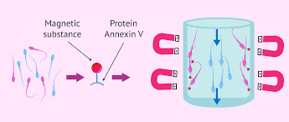
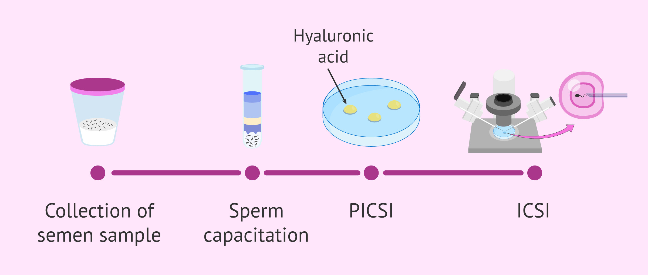
Sperm processing
Many available techniques, advantages and disadvantages - Baldini et al. 2021
SU and DGC are still widely used and provide highly motile sperm populations
Newer methods mimic some of the natural selection processes in the female tract
Some techniques based on membrane integrity, with conflicting study results - Vaughan and Sakkas 2019
  Magnetic activated cell sorting (MACS): eliminates pro-apoptotic sperm cells
  Hyaluronic acid binding (PICSI): selects mature, morphologically normal sperm cells

Slide 19
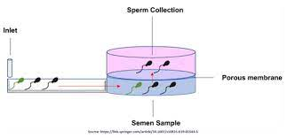
Sperm processing
Microfluidic sperm preparation seems to hold many advantages
  Selection mainly based on motility and morphology
  Highly reduced DNA fragmentation
  Avoid centrifugation
  Decreased intervention and time by lab personnel
  BUT
  Low volume of yield
  High cost of device
  Not standardized
Clinical validation studies needed! Increased success rates?

Slide 20
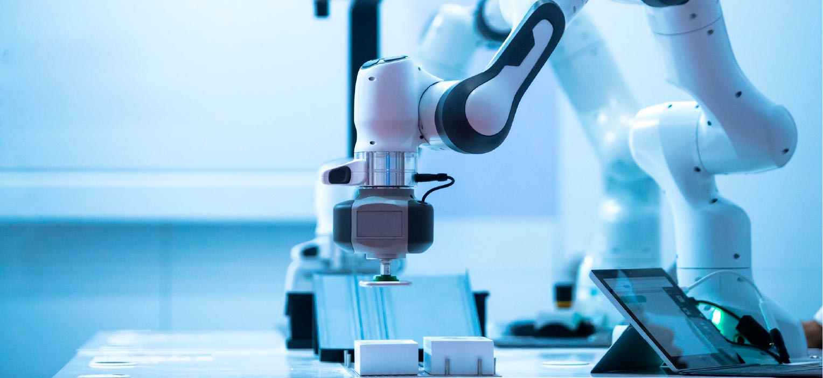
Automation in the IVF lab
Time lapse imaging – IVF witnessing - …
Potential of automation/robotics in various stages of the IVF process
  Sperm sorting
  Oocyte cumulus removal
  Vitrification
  Culture dish preparation
  Cryostorage
  IVF
  ICSI (recently developed)
After extensive research, the first babies are born after automated ICSI (ICSI-A)
Costa-Borges et al. RBMO 2023

Slide 21
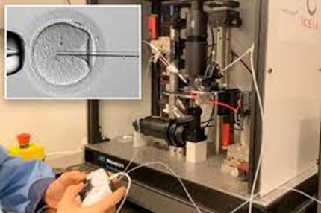
Automation in the IVF lab
The ICSI-A robot – Costa-Borges et al. 2023
  Movement of the injection pipette
  Zona pellucida and oolemma penetration with piezo pulses
  Pipette removal after sperm release
Peliminary studies
  In mouse, hamster and rabbit oocytes
  In discarded human oocytes injected with microbeads
  In a small clinical pilot trial with donor oocytes
Results similar to the manual procedure

Slide 22
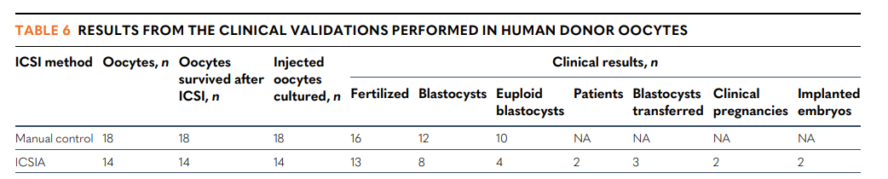
Automation in the IVF lab
Less invasive: no need to aspirate oocyte cytoplasm to break the oolemma
Reduced variability among oocytes and among embryologists
Needs supervision and assistance by experienced embryologists
More lab procedures will be automated in the future
Costa-Borges et al. 2023

Slide 23
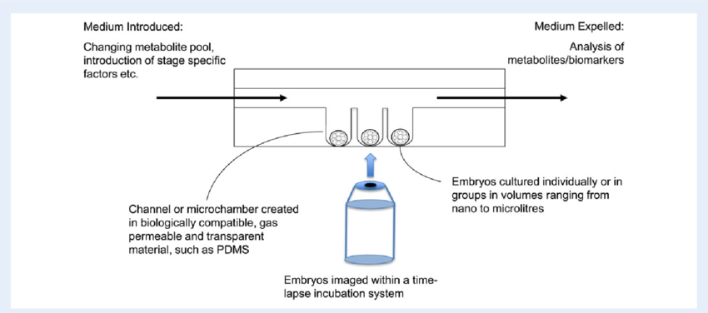
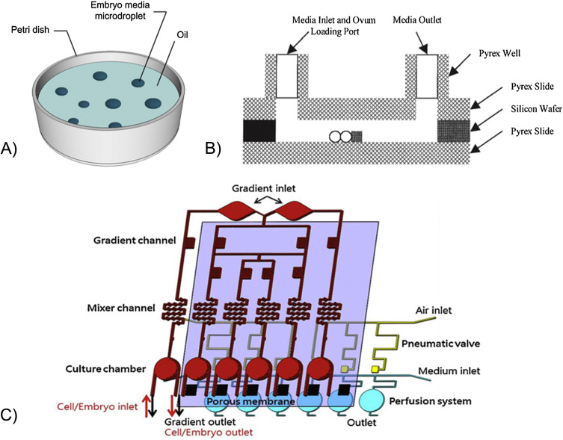
Culture conditions
Change in culture media formulations over the past 40 years
Culture in a dish, in a relatively large volume, in a static state
In the female tract, the embryo
  Is constantly moving
  In a more viscous fluid
  Exposed to a changing environment during progress to the uterus
  Interacts with the female tract
From static to dynamic culture? Not a new concept, research performed (mouse, bovine)
  Perfusion techniques
  Microfluidic culture

Slide 24
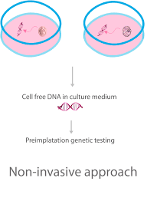
The future of PGT-A
The commonly used source material for PGT are cells biopsied from the blastocyst
Invasive procedure
Research on non-invasive or minimally invasive PGT
Spent culture medium of embryos (NiPGT-A)
  The growing embryo sheds DNA in the culture medium
  Source of DNA? Apoptotic or necrotic material?
  Abnormal DNA discarded by the embryo?
  Limited correlation with biopsy-based PGT-A
Cinnioglu et al. 2023

Slide 25
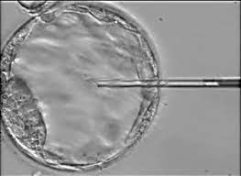
The future of PGT-A
Blastocoel fluid aspiration (MiPGT-A):
  DNA fragments shed in the cavity
  More representative for the embryo than culture medium
  Varying concordance rates with biopsy-based approach among studies
  Highest concordance rate with the biopsy-based method: 97.4%
  Gianaroli et al. 2014
Concordance rates in comparison with biopsy-based PGT-A seem promising
Accuracy and reliability?
Additional research needed before adopting Ni or Mi-PGT-A as gold standard

Slide 26
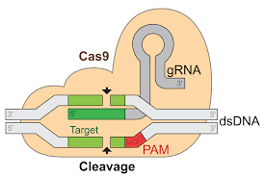
CRISPR gene editing
Is a genetic engineering technique by which the genome of
living organisms can be modified
Application in different fields of agriculture and medicine
In IVF: potential to treat genetic diseases
Its use in human germline genetic modification is still highly controversial
Clinical application is highly premature
Prenatal testing → pre-implantation genetic testing → genome modification?
Acceptable in the future? Or a step too far?

Slide 27
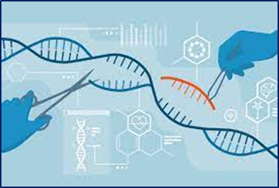
CRISPR gene editing
PROS:
  Removal of mutations responsible for serious inherited disease transmission
  For all future generations
  ‘Rescue’ affected conceptions
  All embryos eligible for transfer
  Many current medical interventions have once been inappropriate and unacceptable
  In research: powerful tool for increasing our understanding of early development
CONS:
  Research tool, not a clinical procedure
  Safety, efficacy, ethical and legal aspects?
  Health and well-being of the offspring and future generations?
  Risk of abuse – employment to modify non-disease characteristics?
If ever applied, not for tomorrow!
Kubikova et al. 2023

Slide 28
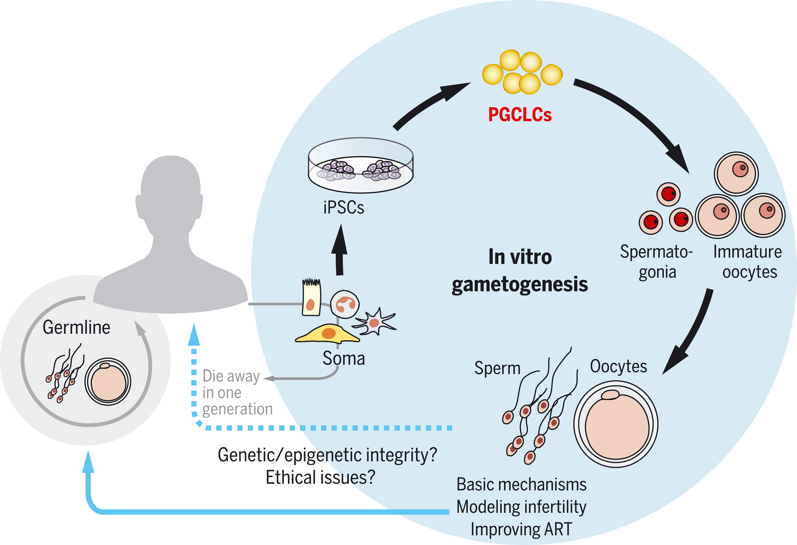
In-vitro gametogenesis
Potential solution for people without functional gametes
Allows everyone to make gametes and become a biological parent
Research in animal models during the past decade on in vitro germ cell development using pluripotent stem cells (PSCs)
In mice: stem-cell derived oogenesis and partial spermatogenesis
In human: many concerns
  Genetic and epigenetic quality of hPSCs and the resultant gametes
  Safety and ethical aspects?
  Health of the offspring?
Saitu and Hayashi, 2021

Slide 29
In-vitro gametogenesis
IVG as an alternative to standard IVF and first treatment option
Avoids ovarian stimulation and invasive oocyte retrieval
Alleviates the physical and psychological burden of standard IVF treatment
Legal and ethical discussions
A ‘bigger’ step too far?
If ever applied, for whatever indication, not for tomorrow!
    Pennings 2023

Slide 30
Other future directions
PGT-A
Oocyte in-vitro maturation?
Add-ons in the IVF lab?
Nuclear transfer?
Metabolomics
…

Slide 31
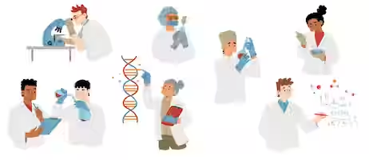
In the future,
AI and technology will inevitably take over more IVF lab tasks
BUT
will never steal the job of the embryologist!

