Slide 1
Effect of abstinence duration on blastocyst development: a sibling oocyte study
BSRM 2023
Mindy Abraham
Head technician LMBV, Brussels IVF
Ileana Mateizel, Juan Van Asbroeck, Céline Schoemans, Matija Krunic, Koen Wouters, Herman Tournaye,
Veerle Vloeberghs, Neelke De Munck

Slide 2
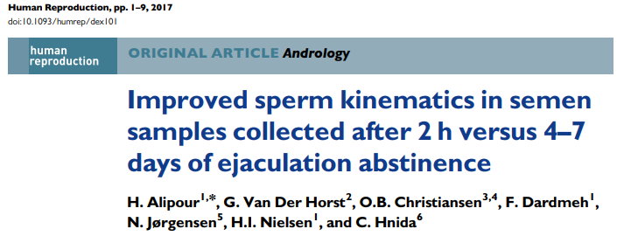
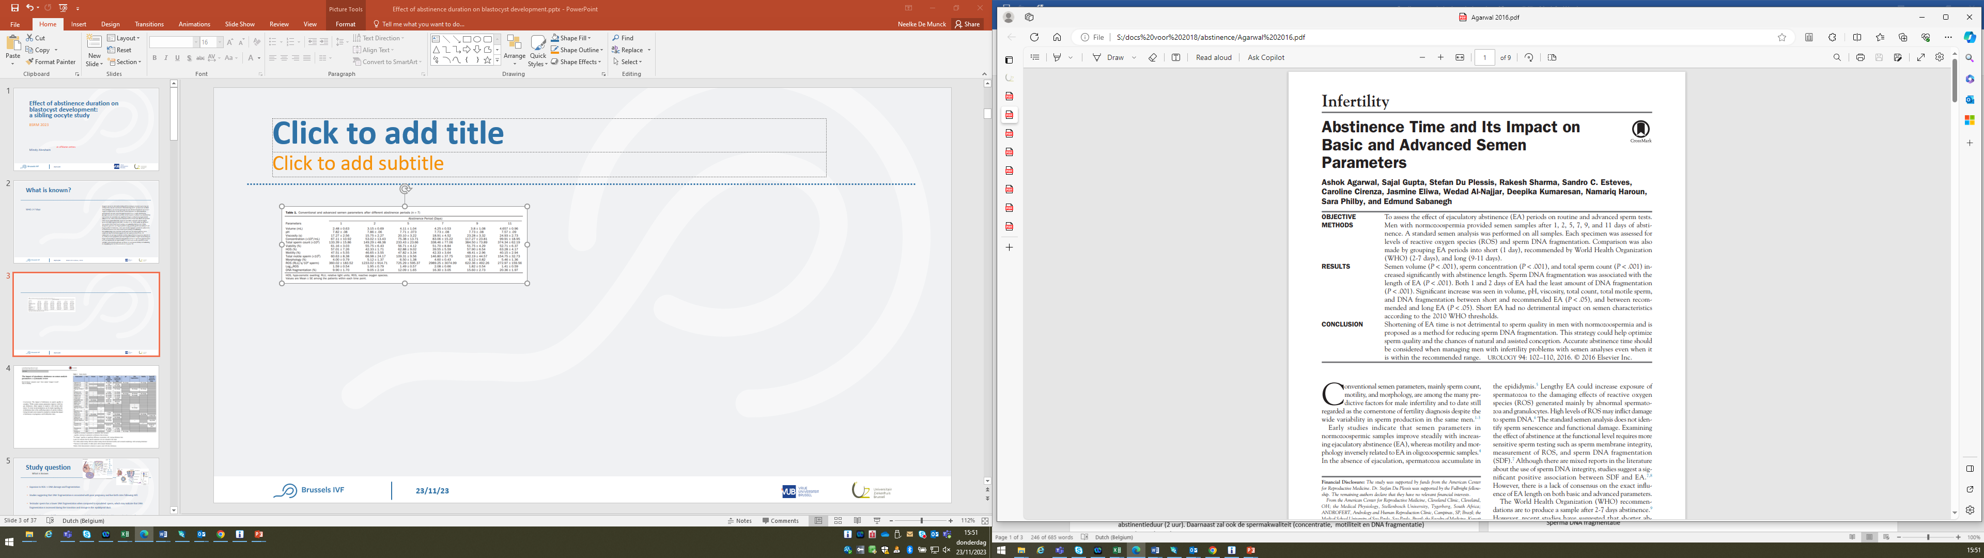
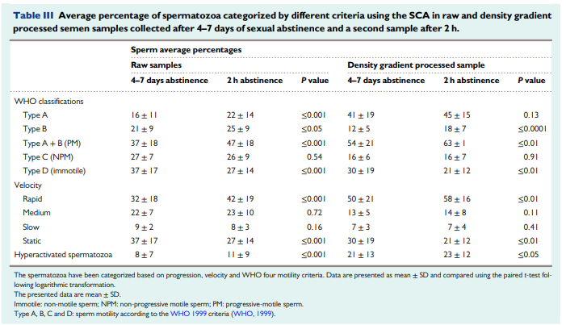
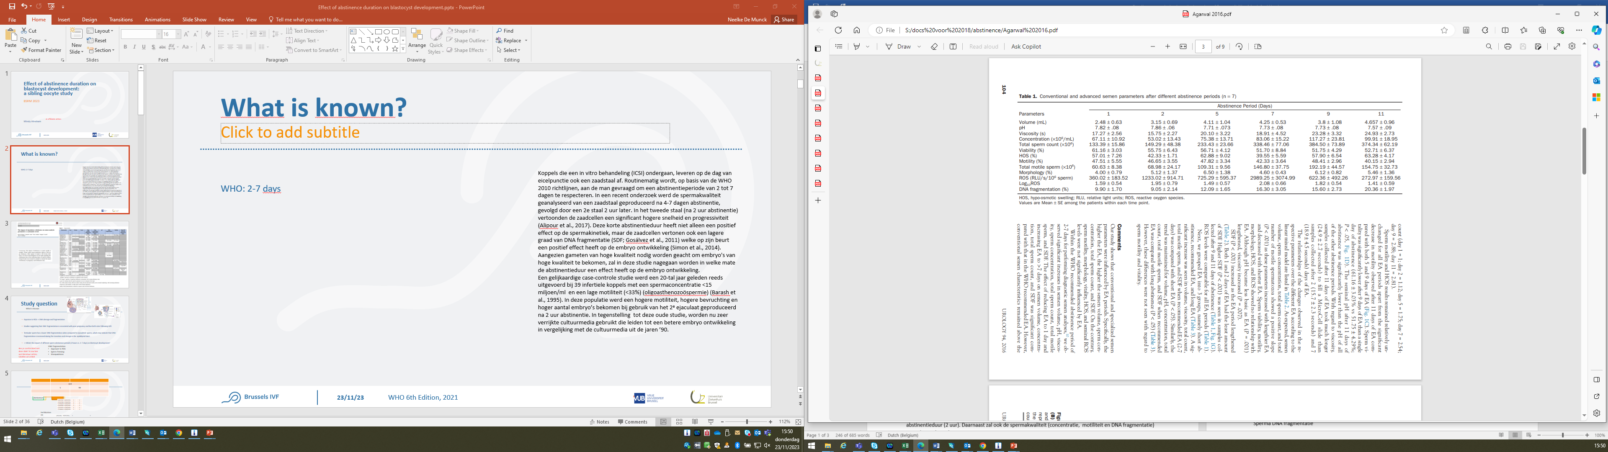
What is known?
Abstinence: 2-7 days*
2016
*WHO 6th Edition, 2021

Slide 3

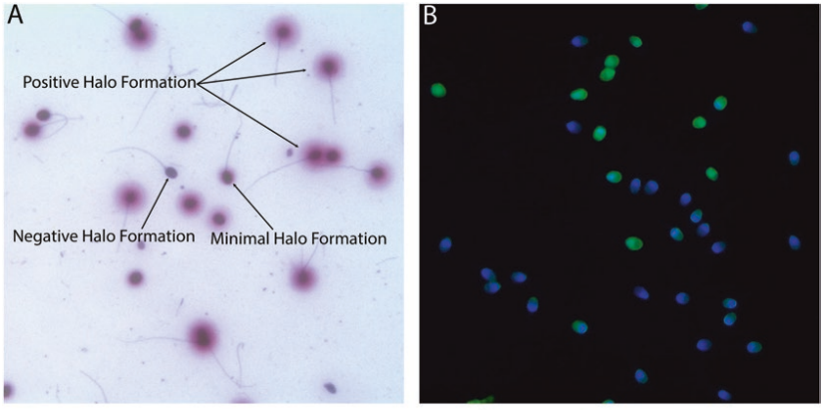
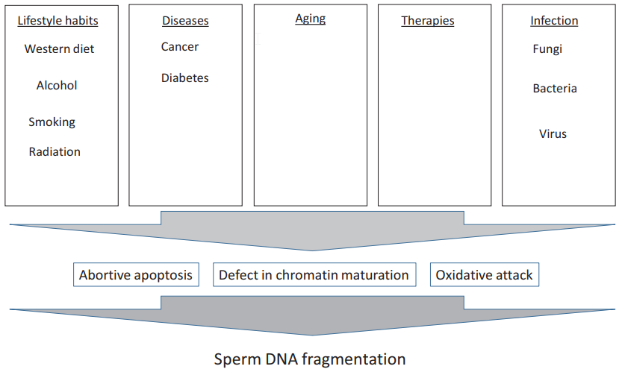
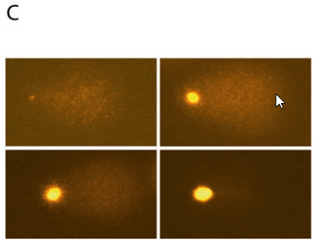
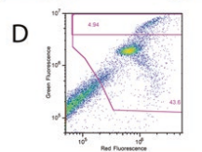
What is known?
Sperm DNA fragmentation: causes & detection
SCD: Sperm Chromatin Dispersion
TUNEL
Comet Assay
SCSA: Sperm Chromatin Structure Assay
*Terminal Deoxynucleotidyl Transferase-Mediated dUTP Nick-End Labeling Assay
Notes:
Vele inducers gekend, sommige met conflicting outcomes
Inducers of Sperm DNA fragmentation:
Nutrition
Alcohol consumption
Smoking
Radiation Exposure
Cell phone use
Diabetes
Varicocele
Cancer
Infections of male genital tract
Age
A number of assays are now available to measure the level of sperm DNA fragmentation. Of these methods, single-cell gel electrophoresis (commonly called as the Comet assay), in situ nick translation assay, and the terminal deoxynucleotide transferase-mediated dUTP nick-end labeling (TUNEL) assays directly measure the level of DNA fragmentation, whereas the Sperm Chromatin Dispersion (SCD) assay (commonly called as the Halo test) and Sperm Chromatin Structure Assay (SCSA) are known to indirectly measure the level of DNA fragmentation in sperm. These assays differ in their ease of use, cost, and the type of DNA strand breakage measured.
Comet Assay
The Comet assay is one of the simplest methods to measure sperm DNA fragmentation and quantifies single- and double-strand breaks (McKelvey-Martin et al. 1997). The principle of the assay is that the sperm nuclear DNA is separated in an electric field based on charge and size, which can be viewed by using a fluorescent dye. The resulting image resembles a comet, with an intact head and tail based on the amount of DNA fragmentation. The intensity of staining determines the extent of DNA fragmentation (Ostling and Johanson 1984). Additional quantitative parameters have been used to increase the efficiency of the test, such as diameter of the nucleus, olive tail moment, and the comet length (Singh et al. 1988). One of the principles of the Comet assay is that the double-stranded DNA remains in the comet head, whereas short fragments of doubleand single-stranded DNA migrate into the tail area (Klaude et al. 1996). Therefore, sperm with high levels of DNA strand breaks would show an increased comet tail which can be measured by its intensity of fluorescence (Hughes et al. 1999) and comet tail length (Singh and Stephens 1998).
Terminal Deoxynucleotidyl Transferase-Mediated dUTP Nick-End Labeling Assay The TUNEL assay quantifies the incorporation of deoxyuridine triphosphate (dUTP) at singleand double-strand DNA breaks in a reaction catalyzed by the template-independent enzyme, terminal deoxynucleotidyl transferase (Gorczyca et al. 1993). The incorporated dUTP which is labeling the breaks can be quantified by flow cytometry, fluorescent microscopy, or even light microscopy (Tarozzi et al. 2007). The TUNEL assay is widely known to measure direct sperm DNA fragmentation. The TUNEL assay resembles the nick translation in situ in a number of technical aspects, but can reveal both single- and double-strand breaks (Tarozzi et al. 2007). The sperm DNA fragmentation measured by TUNEL assay has good stability over time, so it is possible to measure and monitor baseline damage in both fertile and subfertile men (Sergerie et al. 2005a). The assay is broadly used to assess sperm DNA fragmentation as an indicator of male fertility (Sergerie et al. 2005b) and has been demonstrated to predict assisted reproduction outcome (Sun et al. 1997; Lopes et al. 1998; Duran et al. 2002; Benchaib et al. 2003; Borini et al. 2006). The TUNEL assay can simultaneously detect single- and double-strand breaks, unlike other assays that either simply measure sperm susceptibility to DNA damage or require elaborate protocols to study both types of strand breakages (Lopes et al. 1998; Fraser 2004).
Sperm Chromatin Dispersion Assay The Sperm Chromatin Dispersion (SCD) assay has been described as a simple and inexpensive method for the analysis of sperm DNA fragmentation. It is based on the principle that sperm with fragmented DNA fail to produce the characteristic halo that is seen when sperm are mixed with agarose following acid denaturation and removal of nuclear proteins (Fernandez et al. 2003). The methodology of the test includes the following steps. Sperm are immersed in an agarose matrix on a slide, treated with an acid solution to denature DNA that contains breaks, and then treated with lysis buffer to remove membranes and proteins. The agarose matrix allows working with unfixed sperm on a slide in a suspension-like environment. Removal of nuclear proteins results in nucleoids with a central core and a peripheral halo of dispersed DNA loops. Following fluorescent staining, sperm nuclei with elevated DNA fragmentation produce very small or no halos of DNA dispersion, whereas those sperm with low levels of DNA fragmentation release their DNA loops forming large halos. These results have been confirmed by DNA breakage detectionfluorescence in situ hybridization, a procedure in which the restricted single-stranded DNA motifs generated from DNA breaks can be detected and quantified (Fernández and Gosálvez 2002).
Sperm Chromatin Structure Assay The Sperm Chromatin Structure Assay (SCSA) is the most commonly used commercial test to characterize male infertility. It is a flow cytometric method to determine abnormal sperm chromatin which is highly susceptible to chemically induced in situ partial DNA denaturation. The extent of DNA denaturation is determined by measuring the metachromatic shift from green fluorescence to red fluorescence after heat or acid treatment (Evenson et al. 1980). The most important parameter of this test is the DNA fragmentation index (%), which represents the population of cells with DNA fragmentation (Evenson and Jost 2000).

Slide 4
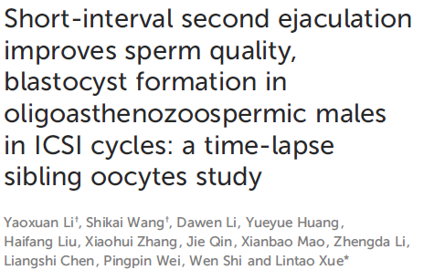
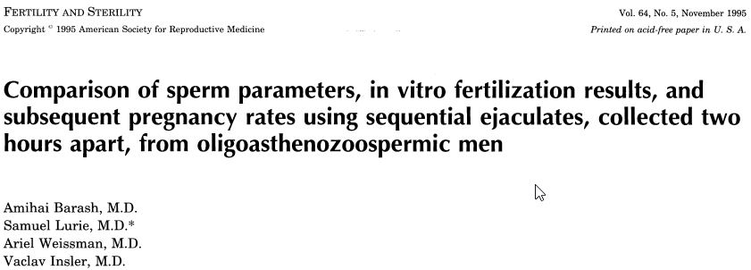
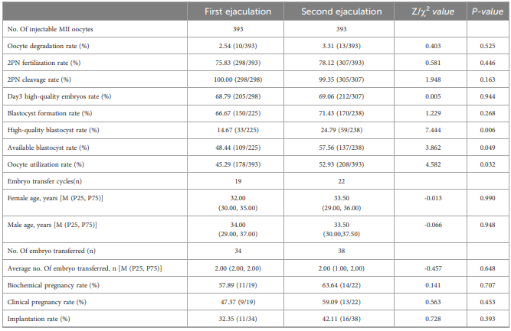
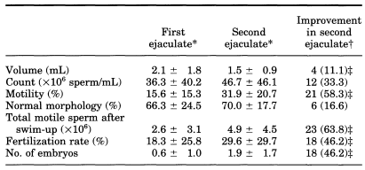

What is known?
Abstinence-Embryology
2023
Notes:
Barash
N=39

Slide 5
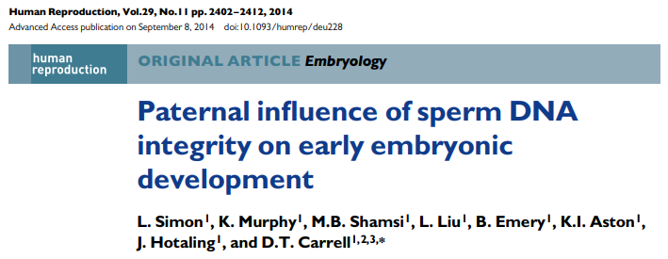
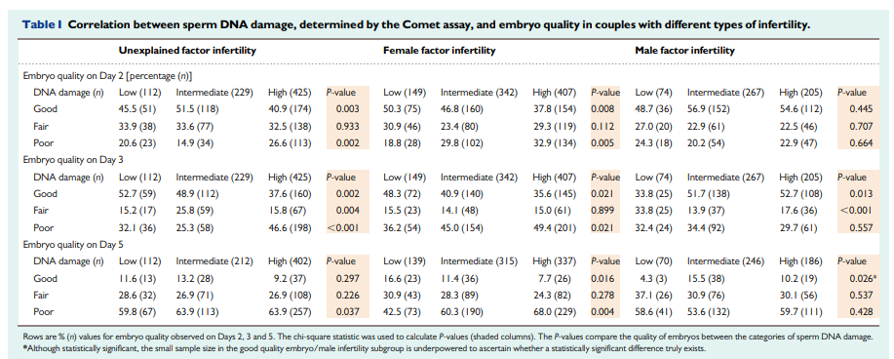
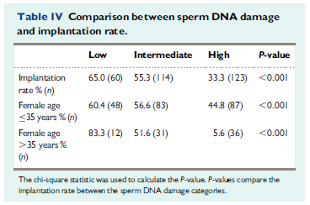
What is known?
Embryo development/Clinical outcomes

Slide 6

Study question
Is there a positive effect on blastocyst development after a shorter (2h) abstinence period?

Slide 7
Study Design
Prospective proof of concept sibling oocyte study
n = 100 patients
Inclusion criteria
  ICSI cycles
  At least 6 mature oocytes
  Fresh ejaculated sperm (>1x10⁶/ml*)
  Blastocyst culture (D5/D6)
  Willing to give 2 sperm samples
Exclusion criteria
  Donor oocytes
  Patients requesting PGT
  IVM
  IVF
* For the first sample

Slide 8


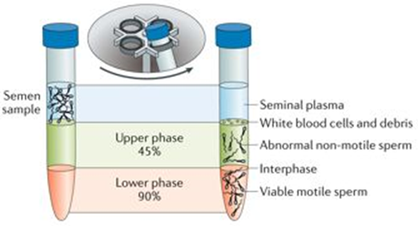


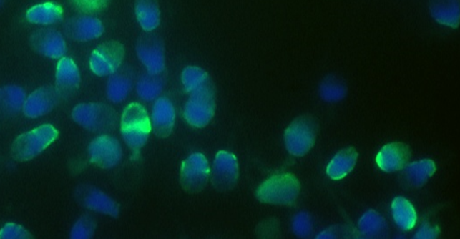
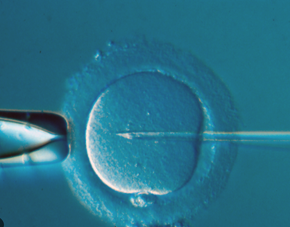
Study Design
WHO abstinence period
2-7days
abstinence period
of 2 hours
DGC + double wash
+
DNA fragmentation index (DFI) – 100µl
ICSI – sibling oocytes

Slide 9
Study Design
Primary endpoint: blastocyst development *
Secondary endpoint:
  Andrology
    DNA Fragmentation Index (DFI) – TUNEL assay
    Sperm concentration
    Sperm motility
Statistical analysis: accounting for female age and clustering
  Significance set at p<0.05.
  Embryology
    Fertilisation
    Cleavage stage development
    Utilization rate
* Gardner and Schoolcraft
Notes:
Tunel detecteert enkel en dubbel strengige dna breuken
2 kleuren: blauw (kleurt kernen aan – dapi kleuring) en groen (hebben DNA schade – in situ cell death kit )
Tunel is de meest praktische voor het labo. Elke techniek heeft voor en nadelen

Slide 10
Results
Sperm parameters
n = 104
DFI: n = 97
No DFI: n = 7
 | WHO abstinence | Short abstinence | P value
Abstinence duration | 4.06 days ± 2.7 | 2:06 hours ± 0:17
DFI (%) | 6.76 ± 7.0 | 5.37 ± 7.2 | 0.024
Raw sample
Concentration (M/ml) | 46.53 ± 39.6 | 37.04 ±37.1 | <0.001
Progressive motility (%) | 52.14 ± 20.1 | 49.79 ± 20.4 | 0.152
DGC sample
Concentration (M/ml) | 2.84 ± 1.8 | 2.43 ± 1.9 | 0.027
Progressive motility (%) | 73.63 ± 21.7 | 72.52 ± 24.4 | 0.488
Notes:
Range duration 1-15 dagen

Slide 11
Results
 | WHO abstinence | Short abstinence | P value
Number of cycles | 93
No. of mature oocytes | 1173
No. of oocytes injected | 580 (6.24 ± 3.0) | 593 (6.38 ± 3.0) | 0.074
No. of fertilised oocytes | 472 (5.08 ± 2.8) | 488 (5.28 ± 2.8) | 0.240
Fertilisation rate (%) | 472/580 (81.4) | 488/593 (82.3) | 0.685
 |  | WHO abstinence | Short abstinence | P value
Number of cycles |  | 93
No. of mature oocytes |  | 1173
No. of oocytes injected |  | 580 (6.24 ± 3.0) | 593 (6.38 ± 3.0) | 0.074
No. of fertilised oocytes |  | 472 (5.08 ± 2.8) | 488 (5.28 ± 2.8) | 0.240
Fertilisation rate (%) |  | 81.4 | 82.3
Day 3 cleavage development
Quality 1+2 (%) | 372/472 (78.8) |  | 387/488 (79.3) | 0.590
Day 5 blastocyst development
Quality 1+2 (%) | 218/472 (46.2) |  | 242/488 (49.5) | 0.534
Utilisation rate (D5/D6)
Per inseminated oocyte (%) | 177/580 (30.5) |  | 212/593 (35.8) | 0.126
Per fertilised oocyte (%) | 177/472 (37.5) |  | 212/488 (43.4) | 0.153
Embryological outcome
Day 3: n = 11
n = 104
Day 5: n = 93

Slide 12
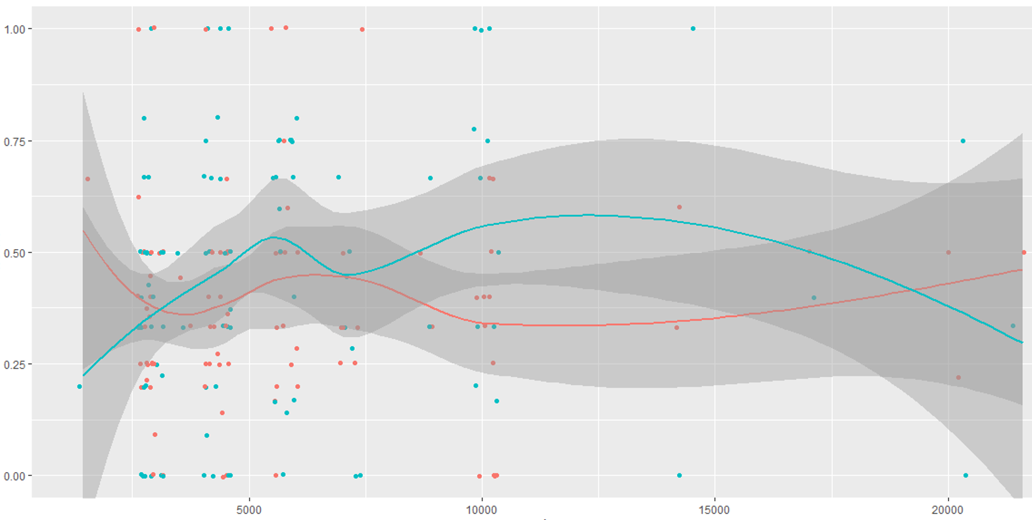
Results
Utilisation
Utilisation per fertilised oocyte (%)
Utilised/Fertilised (%)
Normal abstinence
Short abstinence
Abstinence duration (min)

Slide 13
Conclusion
Short (2h) abstinence
  DFI: significantly reduced
  Day 5 embryology: no difference
  Utilisation rate: no difference
Clinical outcome???
Notes:
The findings suggest that while there was a significant difference in DFI between the two groups, this did not translate into significant differences in utilization rates.

Slide 14




Thank you!

Slide 15
Thank you.

