Slide 1



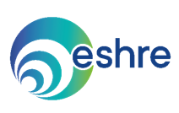
Atlas of EU fertility treatment policies:
Reproductive Medicine and legislation
Carlos Calhaz-Jorge, MD, PhD
BSRM meeting - Mons, Dec 2023

Slide 2
Atlas of EU fertility treatment policies: Reproductive Medicine and legislation
Conflict of interest
None

Slide 3
Atlas of EU fertility treatment policies: Reproductive Medicine and legislation
Outline
● Origin and significance of the European Atlas of Fertility treatment policies
● (Preliminary) Data of a recent survey on ART legislation, regulation, reimbursement and registries in European countries

Slide 4
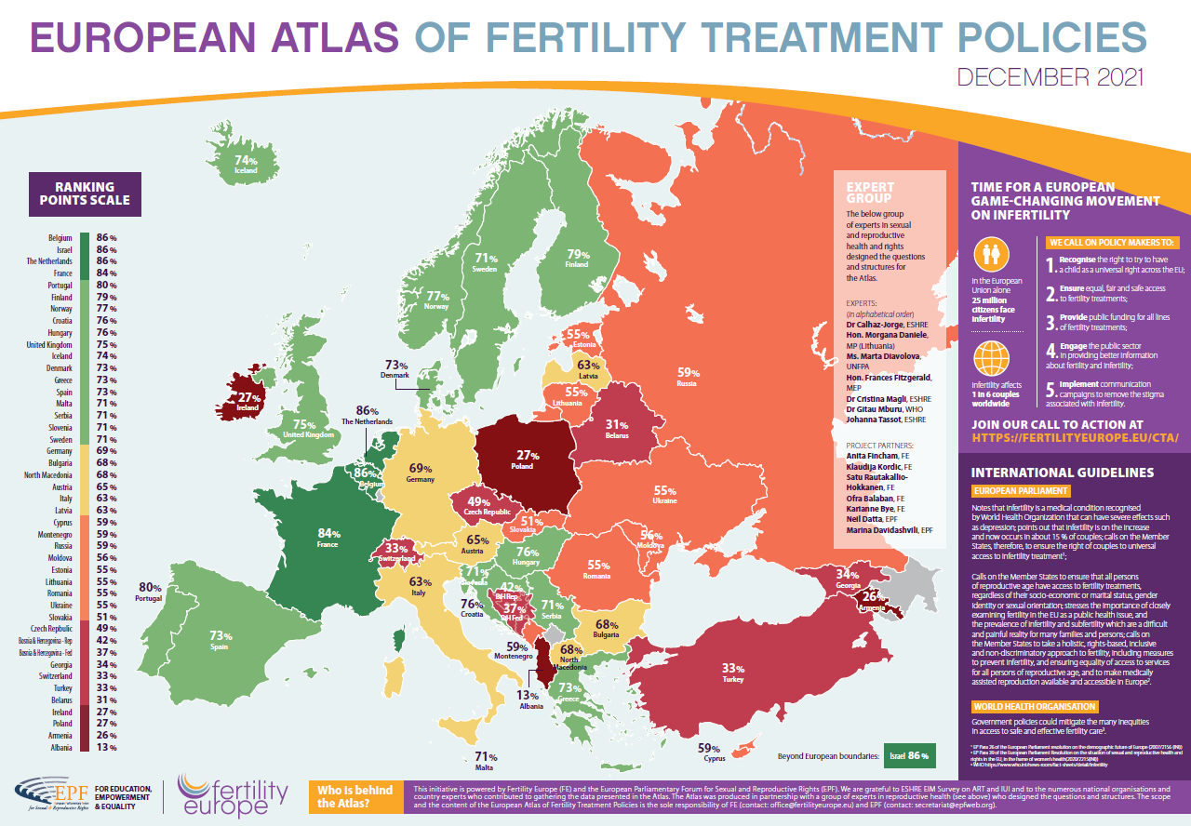
Atlas of EU fertility treatment policies: Reproductive Medicine and legislation

Slide 5
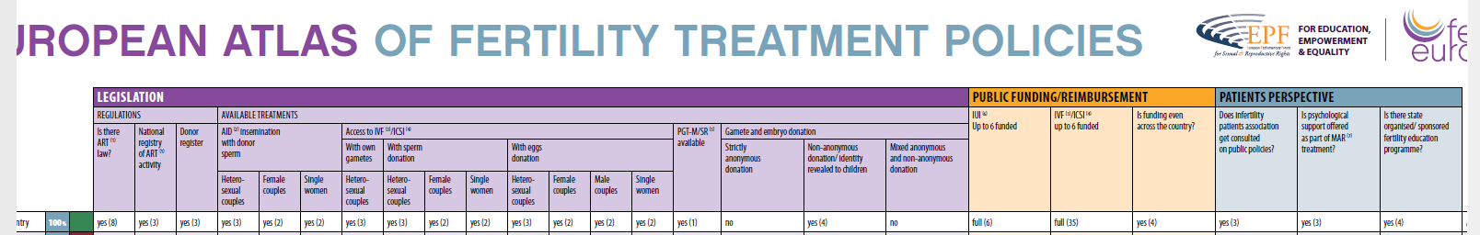
Atlas of EU fertility treatment policies: Reproductive Medicine and legislation
● Legislation
. Regulations
. Available treatments
● Public funding/reimbursement
● Patients perspective

Slide 6
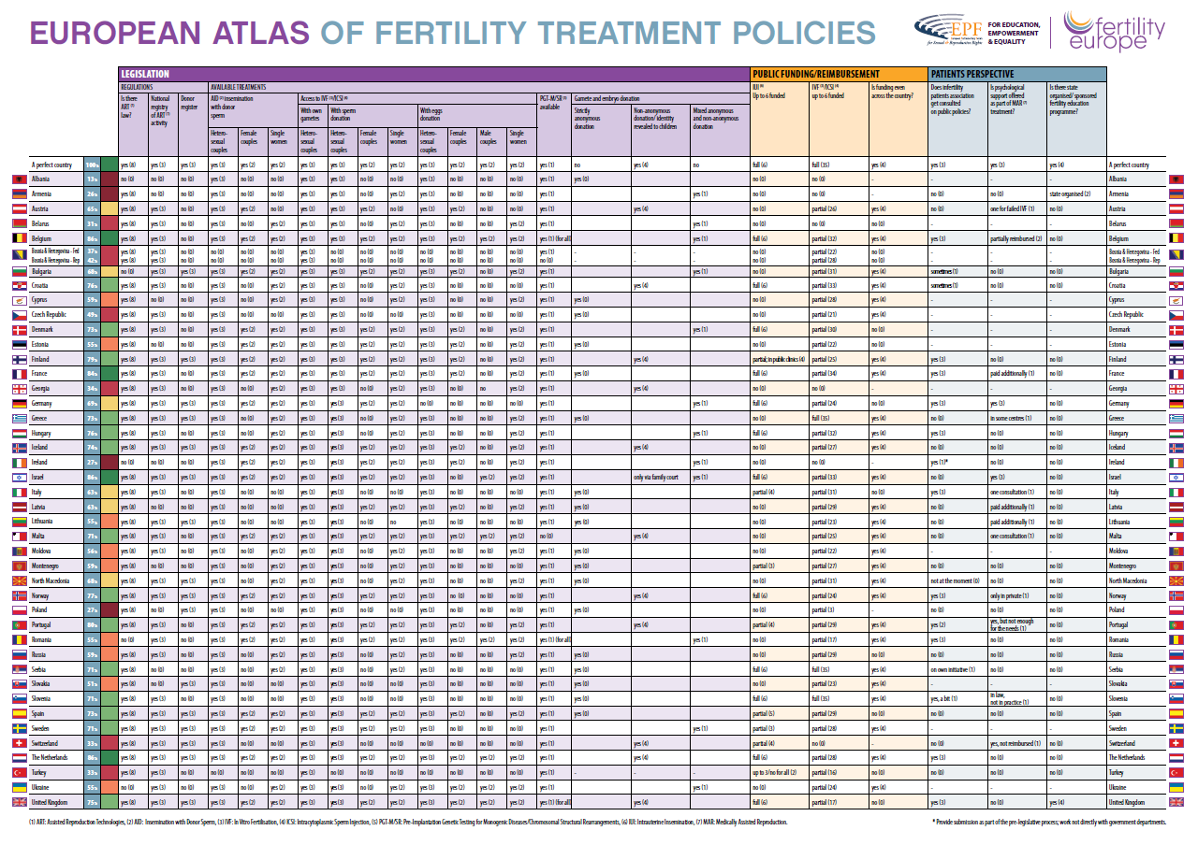
Atlas of EU fertility treatment policies: Reproductive Medicine and legislation

Slide 7
Atlas of EU fertility treatment policies: Reproductive Medicine and legislation

Slide 8
Atlas of EU fertility treatment policies: Reproductive Medicine and legislation
Strengths
Patients perspective
Easy visual comparison
Important advocacy tool
Weaknesses
Waiting lists
Age limits
Regulation on stored embryos
Surrogacy
Donors health checks
Donors protection
Based on the 31st December 2018 legal situation
Several relevant issues not included
Practical application of the legal framework not addressed

Slide 9
Atlas of EU fertility treatment policies: Reproductive Medicine and legislation
Conclusion
● The Atlas is a very relevant advocacy initiative that will benefit from future improvements

Slide 10
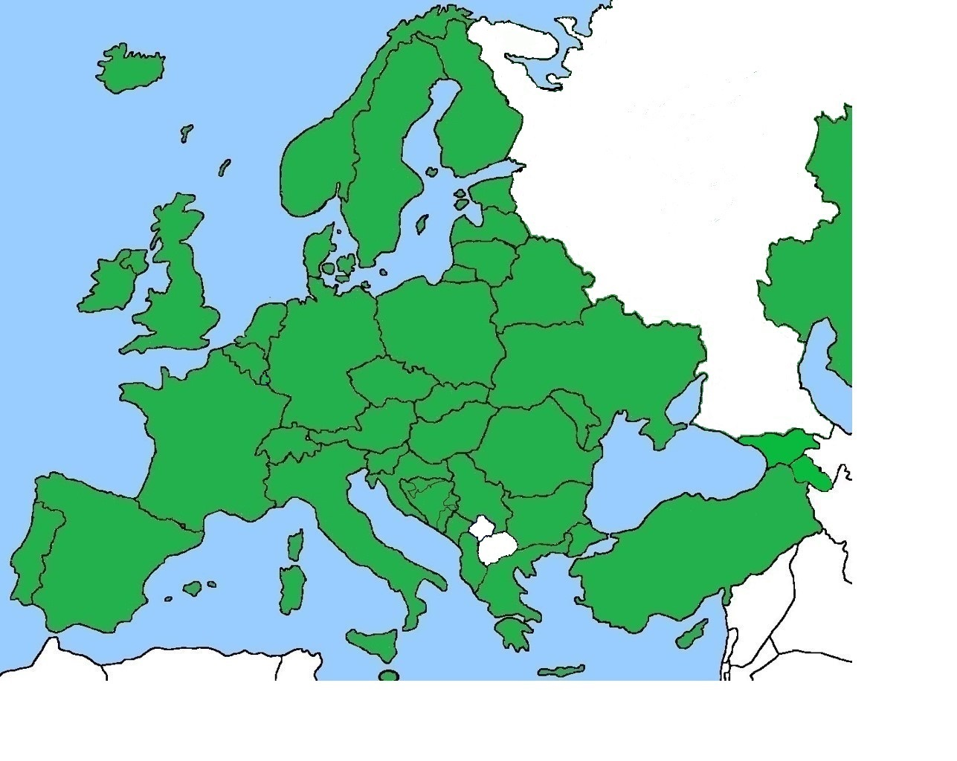
Atlas of EU fertility treatment policies: Reproductive Medicine and legislation
41 countries participated in the survey

Slide 11
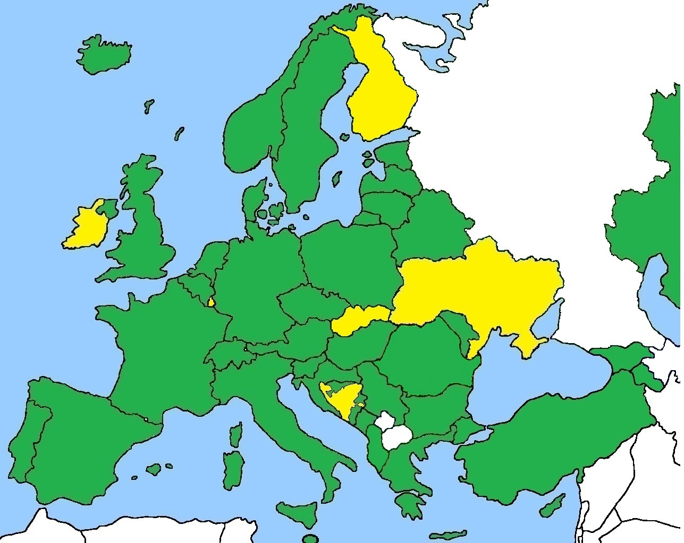
Atlas of EU fertility treatment policies: Reproductive Medicine and legislation
AVAILABILITY - ART legislation
36 countries have a specific ART law
(especial situation of Bosnia and Herzegovina)

Slide 12
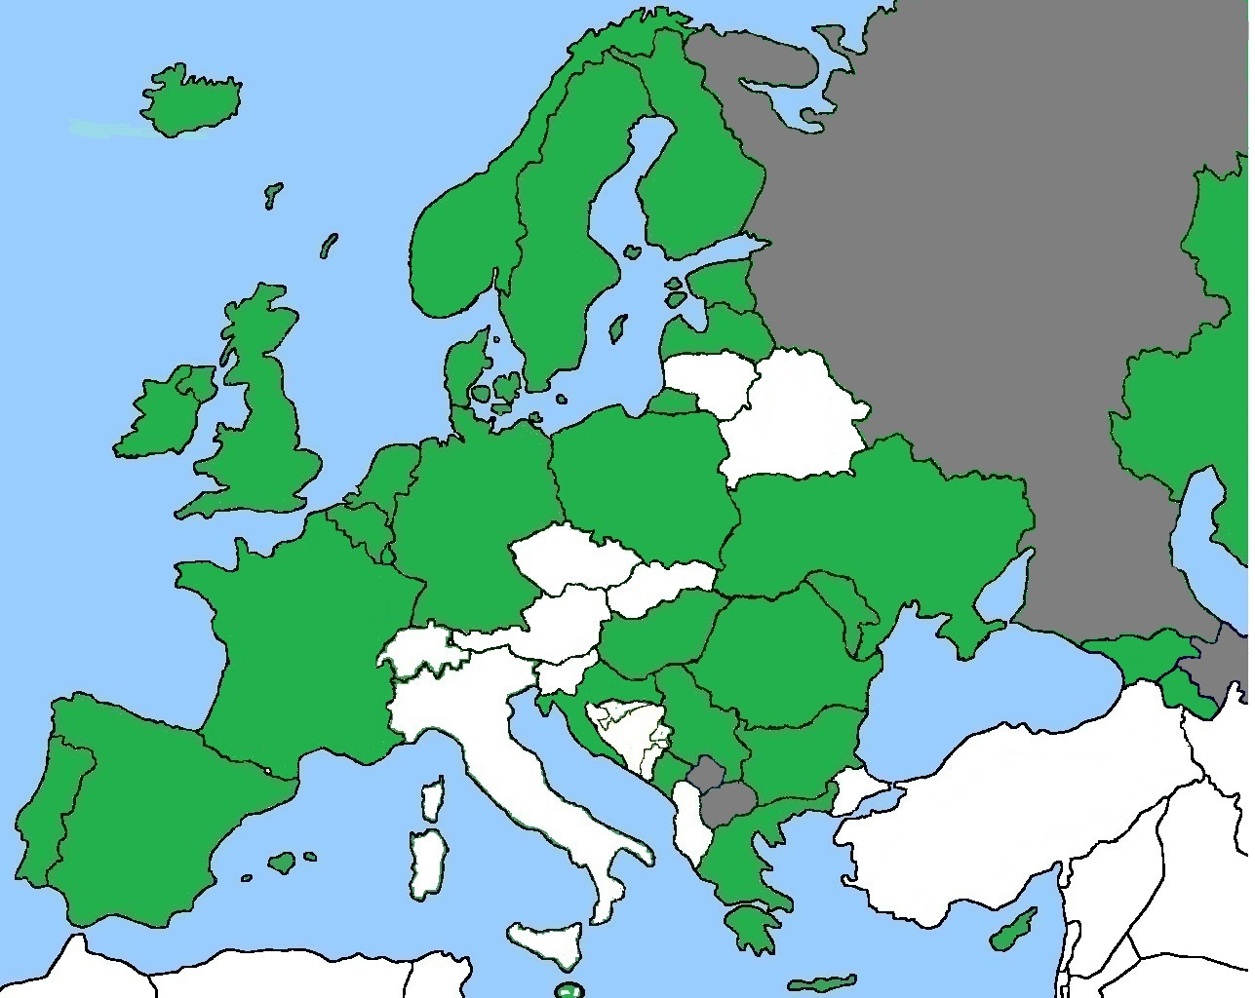
Atlas of EU fertility treatment policies: Reproductive Medicine and legislation
AVAILABILITY - ART legislation
Countries where single women can have access to ART - 30

Slide 13
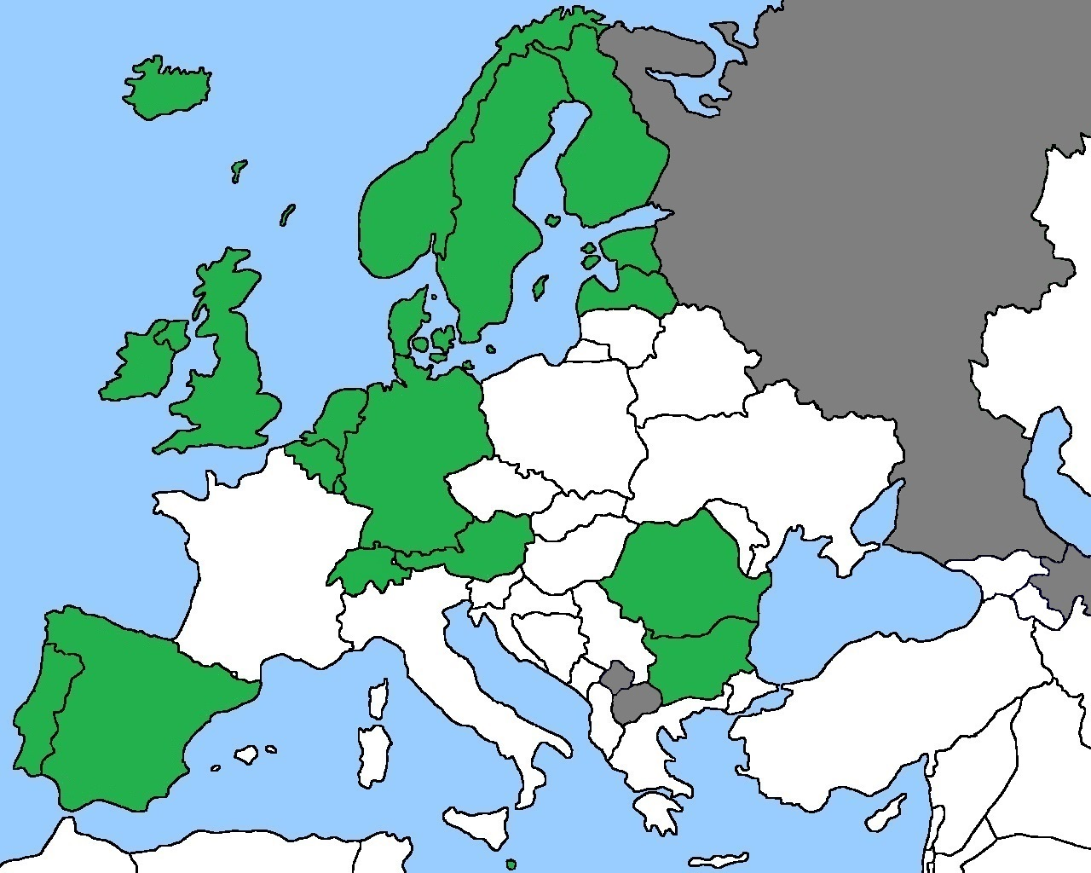
Atlas of EU fertility treatment policies: Reproductive Medicine and legislation
AVAILABILITY - ART legislation
Countries where female couples can have access to ART - 20

Slide 14
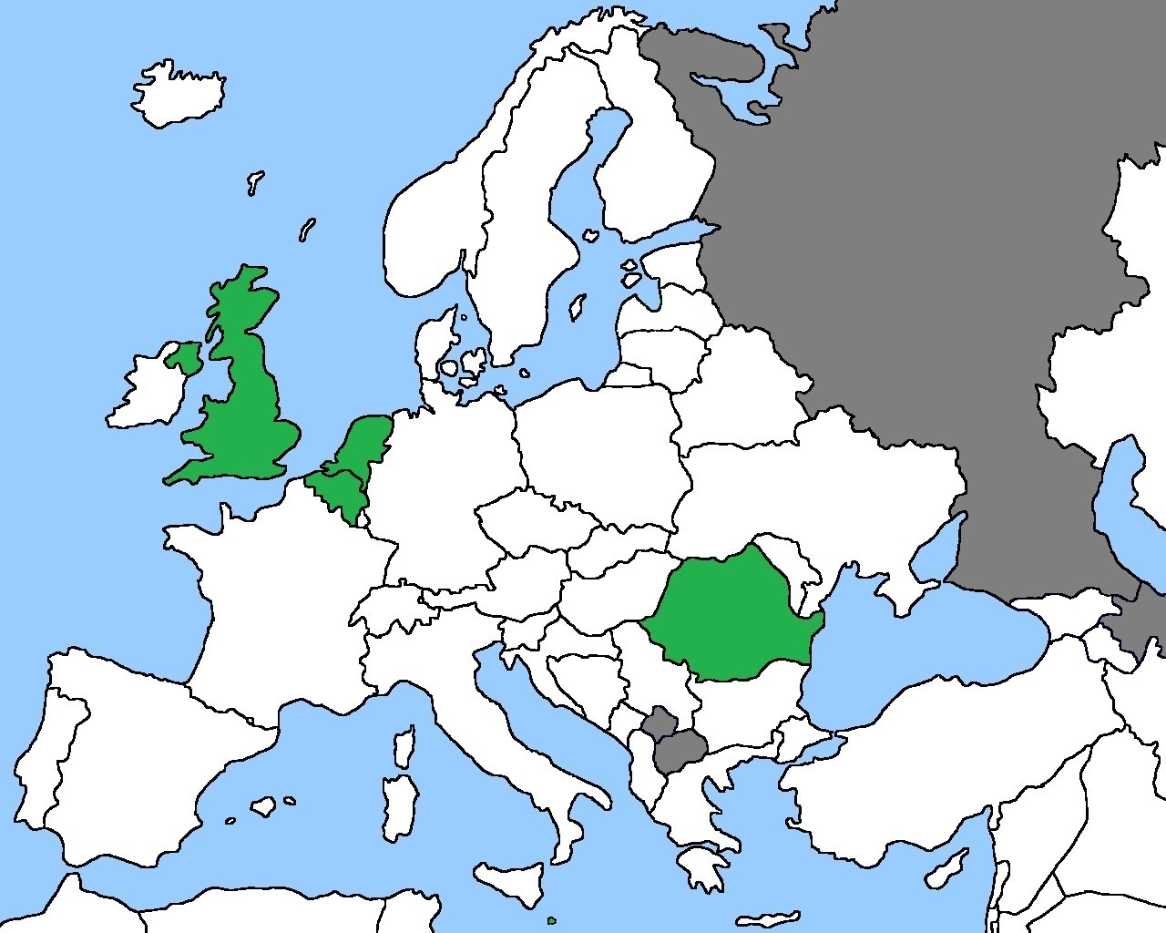
Atlas of EU fertility treatment policies: Reproductive Medicine and legislation
AVAILABILITY - ART legislation
Countries where male couples can have access to ART - 5

Slide 15
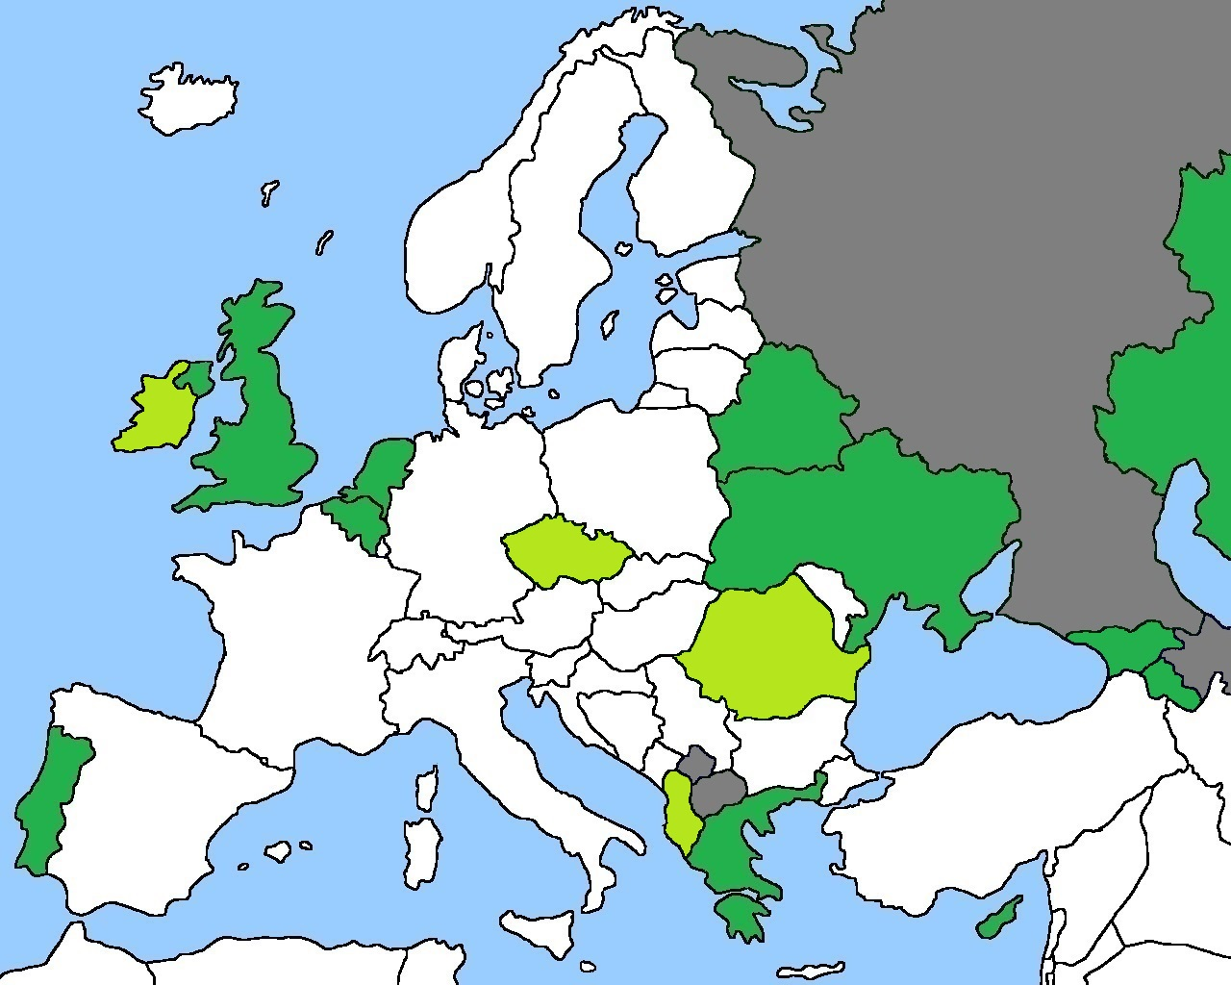
Atlas of EU fertility treatment policies: Reproductive Medicine and legislation
AVAILABILITY - ART legislation
Countries where surrogacy is possible – 15 countries

Slide 16
Atlas of EU fertility treatment policies: Reproductive Medicine and legislation
AVAILABILITY - ART legislation
 | Infertile heterosexual couples | Single women | Female couples | Male couples
Own gametes | 41 | 30 | 20 | 5
Sperm donation | 39 | 30 | 20 | 5
Egg donation | 37 | 27 | 16 | 5
Sperm + egg donation | 32 | 25 | 15 | 5
Embryo donation | 26 | 19 | 10 | 4
PGT-M/SR | 39 | 24 | 17 | 5
PGT-A | 32 | 20 | 12 | 4
Surrogacy | 15 | 8 | 5 | 3

Slide 17
Atlas of EU fertility treatment policies: Reproductive Medicine and legislation
ACCESSIBILITY - public funding/reimbursement
Limiting criteria | Female | Male
Minimum age | 12 countries (18-25y) | 5 countries (18-25y)
Maximum age | 28 countries (39-50y) | 4 countries (49-55y)
BMI | 3 countries (30-35) | --
Previous children | 5
No public funding at all in 4 countries (plus only medication in 2)

Slide 18
Atlas of EU fertility treatment policies: Reproductive Medicine and legislation
ACCESSIBILITY - public funding/reimbursement
Public funding combined with a clinical policy? – 10 countries (mainly eSET)
Public funding combined with success rate? – 4 countries
Is there a limited no. of funded cycles?
Yes, in 33 countries:
1 (2 countries)
up to 6 for first child + 4 for the second one (1 country)
3 cycles (13 countries) – most frequent
Are all ART techniques publicly funded?
Yes, in 21 countries
Are ART techniques publicly funded in a consistent manner across the country?
No, in 7 countries

Slide 19







Atlas of EU fertility treatment policies: Reproductive Medicine and legislation
THIRD PARTY DONATION
Anonymity status
17 countries
Mixed
(anonymous and non-anonymous):
10 countries
11 countries
1 country
Gamete donation not permitted: 2 countries ; 4 countries
Many specific situations:
- Hungary - sperm donation must be anonymous
- egg donor must be a relative of the recipients

Slide 20
Atlas of EU fertility treatment policies: Reproductive Medicine and legislation
THIRD PARTY DONATION
Donor eligibility
Criteria | Sperm | Eggs
Minimum age | 17 countries (18-23y) | 19 countries (17-25y)
Maximum age | 21 countries (35-55y) | 25 countries (30-37y)
Parity | 0 | 2 countries (+1)
Maximum number of donations | 0 | 9 countries (2 – 8; 20)
Maximum number of infants from the same donor | 32 countries (1 – 15 or 1-12 families) | 22 countries (1 – 10 or 1–6 families)
Compensation/reimbursement No Expenses/time Officially defined Amount | 5 20/3 8 40€ - 900€ (per 6 donations) | 6 19/11 9 860 - 3,000€

Slide 21
Atlas of EU fertility treatment policies: Reproductive Medicine and legislation
Final remarks/comments
● Diversity is the European paradigm
● “Classical population” needs are still not answered
● Funding/reimbursement is extremely variable
● Third-party donation is very culturally (and politically) dependent

Slide 22
Atlas of EU fertility treatment policies: Reproductive Medicine and legislation
Thank you!
For any contact: calhazjorgec@gmail.com

