Slide 1

How affordable is ART in Belgium?
Annick Delvigne, CHC MontLégia, Liège

Slide 2

Thanks…
My embryologist’s team :Catherine Maréchal, Francoise Verteneuil, Carine Garnier
Group's management control department: Gaelle mahiels
Quality control specialist: Jérôme Colin
Notes:
I thank de BSRM board to give me a talk completety out of my expertise field and it’s the occasion for me to thanks also all the peaple who helped me to collect the data needed to do this calculation
No conflict of interest even I’ll speak about money during these 20 minutes.

Slide 3



Affordable for Who?
Notes:
The first question I asked myself with this strang title was: affordable for whom, the patient, the hospital or even society?
I’ll try to analyse these three point of view

Slide 4

Affordable for the patient(s)?
Ordinary situation:
  Own gamete
  Social security support
  Classic IUI
  Classic FIV/ICSI
  INAMI/RIZIV Price
  - médecin conventionné
  - geconventioneerd arts
  « to be paid by the patient »= PBP
  - ticket modérateur
  - Remgeld
Notes:
For the patients, I took may calculator and consider an usual situation for IUI and IVF, considering the remboursement in Belgium for peaple with normal social security support.

Slide 5
Affordable for the patient(s) treated with IUI?
BIM : bénéficiaire intervention majorée=BVT: Begunstigde van een Verhoogde Tegemoetkoming
IUI | Total (€) | Paid by patient (€) | by BIM/BVT patient (€)
Consultations (2 per trial) | 30 (60) | 12 (24) | 3 (6)
Echography (2 per trial) | 28.68 (57.36) | 2.48 (4.96) | 0
Blood sample (2/monitoring) | 43.63 (97.26) | 8.7 (17.4) | 8.7 (17.4)
Gonadotrophins | 246.9 | 23.1 | 23.1
(Ovitrelle | 38.87) | 38.87 | 38.87
(Clomiphene | 9.69) | 1.64 | 0.99
IUI | 185.56 | 0 | 0
Progesterone | 23.4 | 6.29 | 3.78
Total/trial | 670.48 (472.14) | 75.75 (93.16) | 50.28 (67.04)

Slide 6
Affordable for the patient(s) treated with IVF?
BIM : bénéficiaire intervention majorée=BVT: Begunstigde van een Verhoogde Tegemoetkoming
IVF | Total Price (€) (per trial) | Paid by patient (€) | by BIM/BVT patient (€)
Consultations (4 per trail) | 30 (120) | 12 (48) | 3 (12)
Echography (4 per trail) | 28.68 (114.72) | 2.48 (9.92) | 0
Blood sample (3/monitoring) | 43.63 (130.89) | 8.7 (26.1) | 8.7 (26.1)
Gonadotrophins | 865,10 | 54,90 | 54,90
Progesterone | 23.4 | 6.29 | 3.78
OPU | 259.79 | 64.94 | 64.94
One day clinic | 270.5 | 0 | 0
Transfer | 185.56 | 0 | 0
US pregnancy | 12.19 | 1.46 | 0
Total/trial | 1982.15 | 211.61 | 161.72

Slide 7
Affordable for the patient(s) treated with IVF?
BIM : bénéficiaire intervention majorée=BVT: Begunstigde van een Verhoogde Tegemoetkoming
FET | Total Price (€) (per trial) | Paid by patient (€) | by BIM/BVT patient (€)
Consultations (2 per trail) | 30 (60) | 12 (24) | 3 (6)
Echography (2 per trail) | 28.68 (57,36) | 2.48 (4,96) | 0
Blood sample (2/monitoring) | 43.63 (87,26) | 8.7 (17,4) | 8.7 (17,4)
Progesterone | 23.4 | 6.29 | 3.78
Transfer | 185.56 | 0 | 0
US pregnancy | 12.19 | 1.46 | 0
Total/trial | 425,77 | 54,11 | 27,18

Slide 8
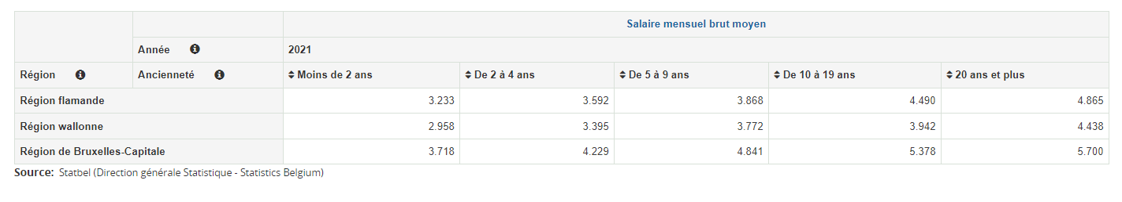

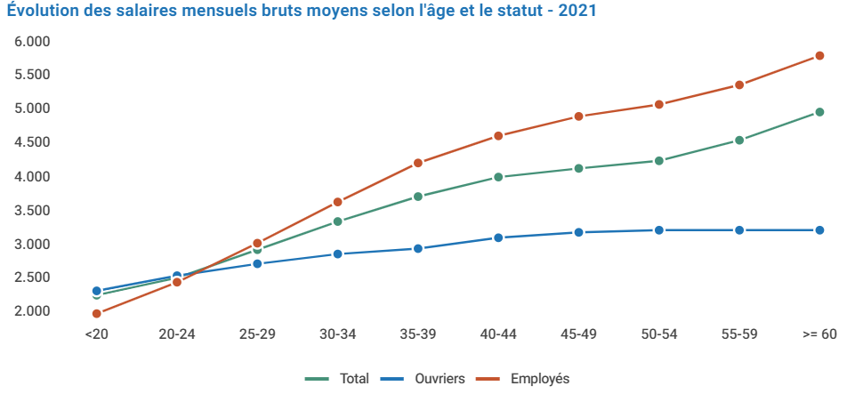
Affordable for the patient(s) treated with ART?
3467 €
≈ 2500 €
Salaire minimum: 1.954,99 €
Net= 1.830,95 €
IVF: 212€
FET: 54 € x 2: 106 €
→ max: 107€/mois
IUI: 76€ (93) /mois
Notes:
Is it affordable for patient, if we look for the average gross salary in belgium for couples of reproductive age, net salary
Sometimes, couples have two incomes to take into consideration

Slide 9
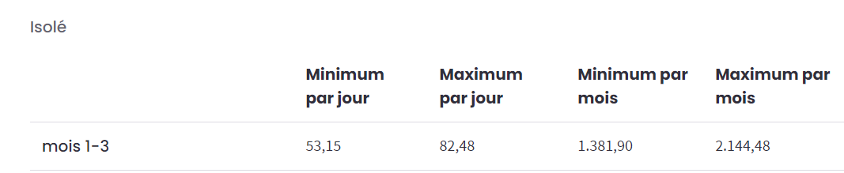


Affordable for the patient(s) treated with ART?
IVF: 161€
FET: 27 € x 2: 54 €
→ max:72 €/month
IUI: 50 (67) €/month
A child costs € 398.65 - 500 per month from 0 to 5 years
Notes:
A child costs €398.65 per month from 0 to 5 years accordind to gezindsbond and Ipsos

Slide 10

Beyond the base price,
what additional supplements are requested?
French speaking centers: 7 B + 1 A → 61,5 %
Dutch speaking centers: 6 B + 0 A → 30 %
→ 72 % of B center
Notes:
To have an idea of the prices, with discrepancy of similarities between center i,n our contry a sent to center an anonymous survey.
A would like to thanks all the faithfull collegues who continue to respond to my questionnaires, even sending me messages
Response rate

Slide 11
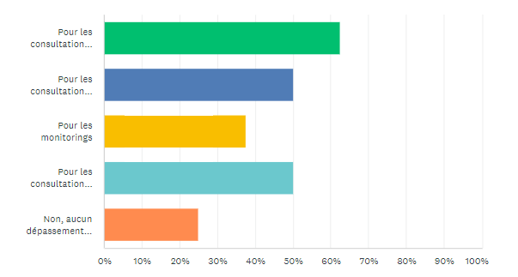
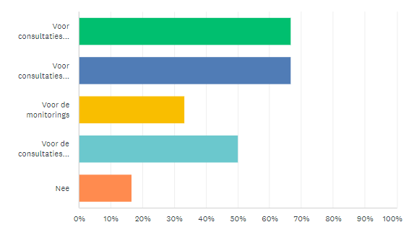
→ Do you charge additional fees for your consultations ?
5
4
8 ART centers
3
4
25 %
2
4
4
6 ART centers
2
3
16 %
1
Notes:
Obviously
psychologist consultation

Slide 12
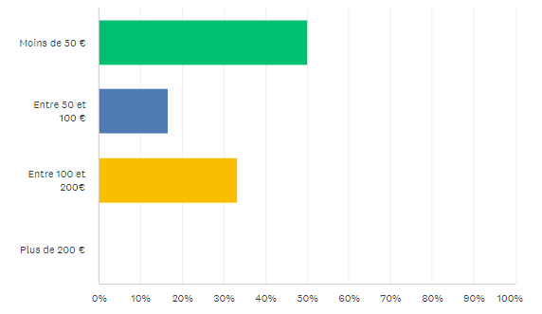
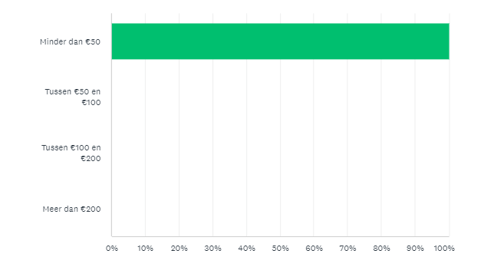
→ Do you have a package for 'administrative fees‘ ?
No for 25 % and yes :
3
1
2
No for 33 % and yes :
4
Notes:
extra charges
Additional fees
it’s quite commun

Slide 13
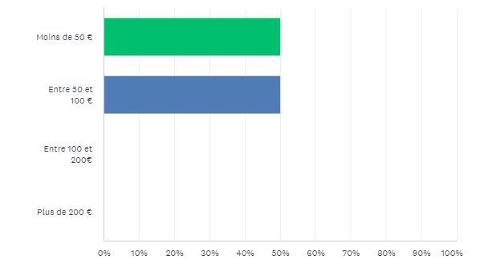
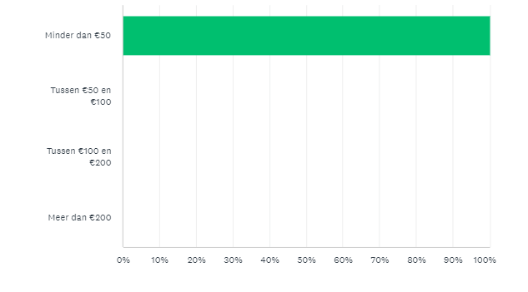
→ Do you have a package for 'hospitalization fees' for your embryo transfers (normally an outpatient procedure)?
No for 50 % and yes :
2
2
No for 50 % and yes :
3

Slide 14
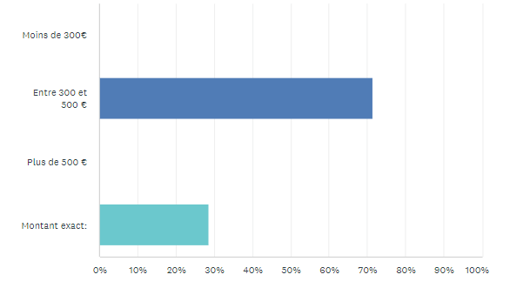
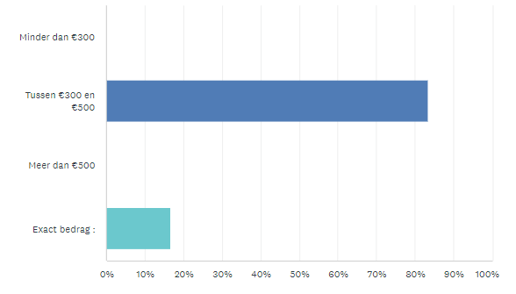
→ How much for donor sperm at your clinic?
1 center: not performed
5
500 €
the amount charged by the external bank without profit
2
≈ 400 €
5
420 €
1

Slide 15
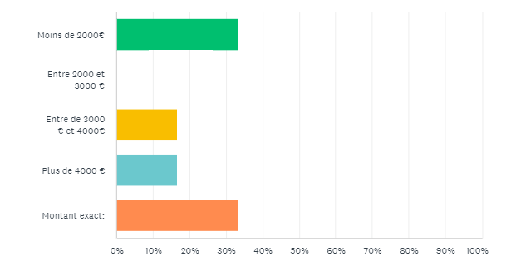
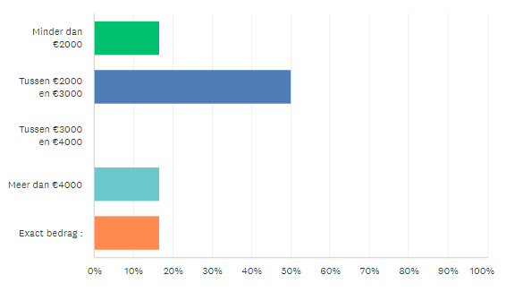
→ How much for donor eggs at your clinic?
3 centers: not performed
2
(No oocytes donor: 1)
- 350 per oocyte
1
1
1
3
1
1 center: alleen gekende donatie, patiënt krijgt rekeningen van donor

Slide 16
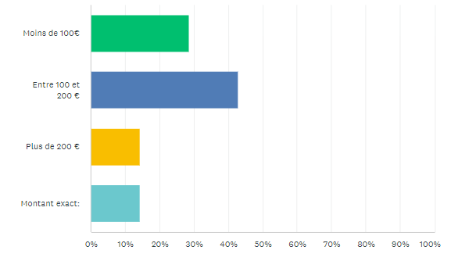
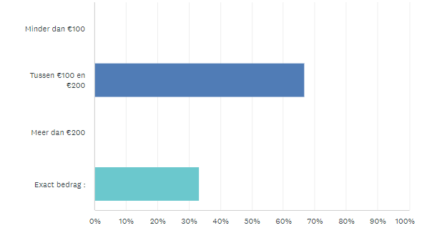
→ How much does sperm freezing cost at your center?
1 center: not performed (A?)
2
125 €/ year
3
1
1
4
100 €/ year
600 € to freeze and keep it 6 years
2
Notes:
The rent for sperm banking

Slide 17
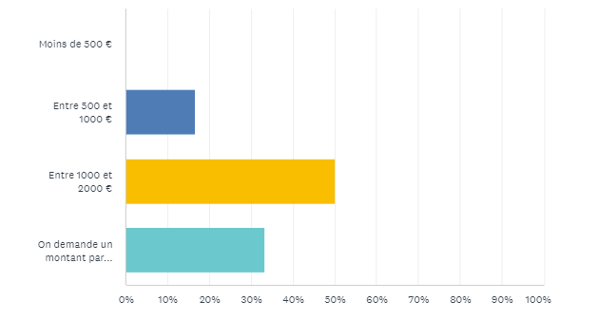
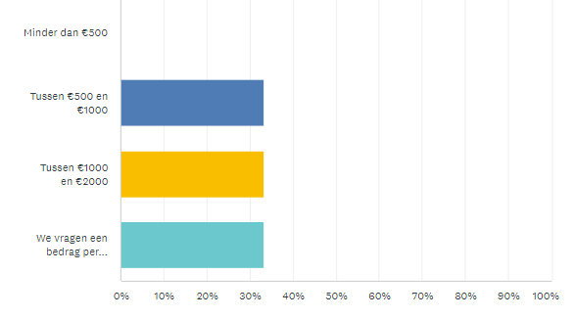
→ What is the cost for egg freezing in your center, excluding hormonal treatment?
3 centers: no oocyte freezing
1
50 €/Egg
3
1 + (1)
2
50 €/Egg
2
2

Slide 18
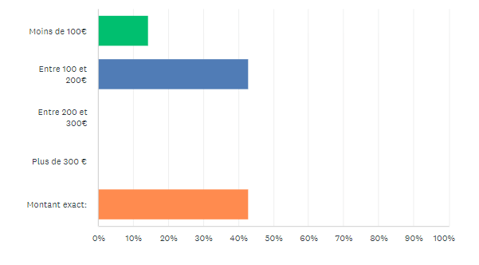
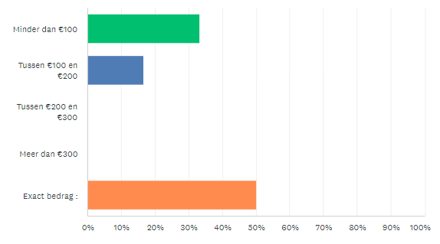
→ Do you charge an annual fee for storing frozen embryos beyond 5 years?
1 center: no answer
No annual fee
50 €/year
250 €/year
1
3
3
2
1
No annual fee
500 €/ 3 years
150 €/year
3

Slide 19
Double standards in ART ?
= a set of principles (here price) that applies differently to one group of people (or circumstances) than to another
IUI
  Donor sperm
  Major the price of ± 300- 500 € per trial
  Why: azoospermic partner, severe male infertility, genetic anomaly
  « Special cases »: no partner ? … Alternative Parenting Project
Notes:
But Finally, are there double standards in ART.
Double standards means …
you must pay an additional 500 €
what I will call.

Slide 20
Double standards in ART ?
= a set of principles (he price) that applies differently to one group of people or circumstances than to another
IVF:
  Oocytes donation
  Why: Turner syndrome, Premature ovarian failure, oocytes quality, X-linked genetic disease
  Ovarian insufficiency for advanced maternal age (AMA)
  Menopause before 48 y
  Alternative Parenting Project
Notes:
But Finally, are there double standards in ART.
Double standards means …

Slide 21
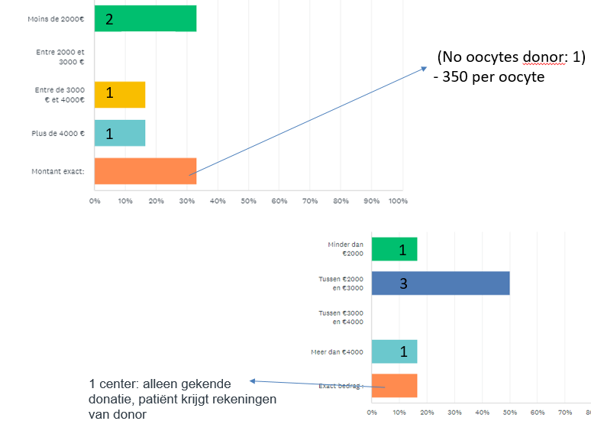
Double standards in ART: Oocytes donation
Oocytes donation and money
≈ 3500 €
Notes:
But Finally, are trhere double standards in ART.
Double standards means …

Slide 22
Double standards in ART: Oocytes donation
Oocytes donation
Basic assessment for the donor: covered by her social security (potential personal benefit)
Treatment to obtain eggs: “for the benefit of a third party”
Using the social security of the donor is prohibited for all the medical procedures as consultation, blood tests, egg retrieval, hospitalization, possibly anesthesia, and related medications (painkiller, disinfecting etc…)
No reimbursement for gonadotropins (gonadotropin package is nominative).
Notes:
why is it so different in the case of egg donation?
"forbidden" ou "prohibited“
Package is only usable for usual IVF

Slide 23
Double standards in ART ?
Conclusion:
Double standards in ART exist and create significant injustices for patients who are already deeply affected by permanent infertility with no other solutions except adoption.
Simple solutions exist, in some cases, based on what is done in the case of live organ donation, with a shift in the social security coverage from the recipient to the donor.
Sperm donation should, at least in cases of permanent and complete infertility, be reimbursed.
Reimbursement for alternative parenting choices remains to be discussed…
Notes:
But Finally, are trhere double standards in ART.
Double standards means …

Slide 24

Affordable for the hospital ?
Situation:
  Sperm capacitation for IUI
  B4 (A2) !! for IVF trials
To pay….
  Embryologists
  Laboratory « equipment »
  Quality control
  …. AFMPS/ FAGG requirements
Notes:
What I ‘ll take intoo account are what we need for daily work, not the major basic equipment such as incubators, hoods, or microscopes
Which are not always necessary or essential for quality work but evidently a conditions our survival.
Are the relationshop or balance between these expenses and revenues..

Slide 25
Affordable for the hospital ?
Situation in Belgium:
IVF cycle → OPU : 20,239 → 18419 (Belrap rapport 2019)
B center (and A center): 18 (16)
OPU/B center: 1023 OPU
Human resources: Belgian law ? Recommendations?
Belgian Royal decree 15.2.1999 : quality requirement for B center (Colla & Galand) - 2 physicians or academics (embryologist)
- « Sufficient number to ensure the quality and continuity of care »
International recommandations for Human resources:
  ASRM guidelines june 2022
  Bradley et al. Fertil Steril 2010
« The cost for 1000 OPU »
Notes:
On what basis?
We have two sources of information, frequently cited and relevant
The needs

Slide 26
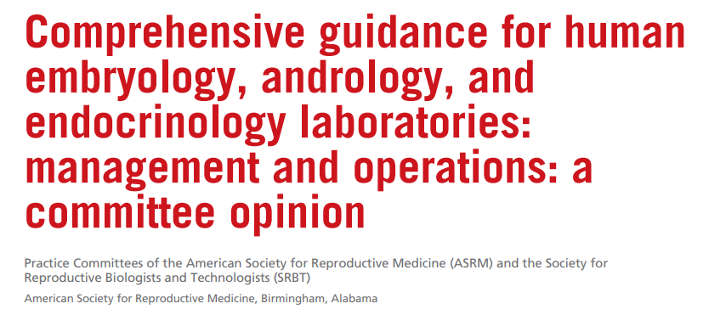

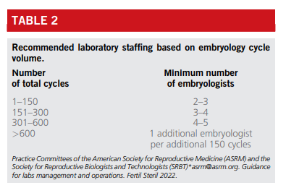
1000 cycles
= 5 + 2 → 7 embryologists

Slide 27
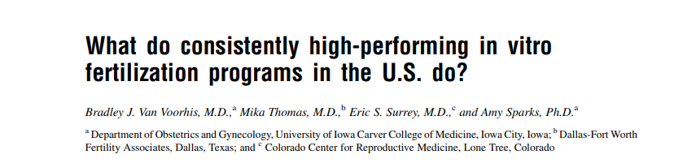
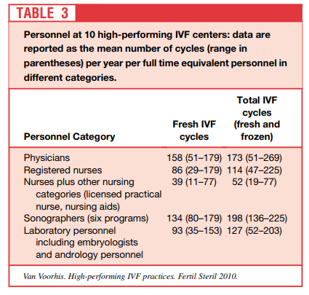
93 IVF/ embryologist
11 Embryologists
Notes:
Another study, anldest on by van voorhis but frequently cited

Slide 28
Affordable for the hospital?
Human resources: 2022 (index 16 %)
7 to 11 embryologist only for IVF → 9
→ Including IUI, vitrification/freezing process of gametes, quality control
Full-time for an academic biologist = 136.516 €/year → Belgian law (2) :
= 273,032 €/year
Full-time for a technologist : 99.557 €/year (7)
= 696,899 €/year
Part-time secretary 2022 (index 16 %)(data manager):
= 39,390 €/year
→ gross salary and social security charges
(Physicians not included → as fees for consultations, OPU,
ET and IUI procedures = incomes)
1,009,321 €
Notes:
A centre that perform
manager

Slide 29

Affordable for the hospital?
Minor equipment and culture media for IVF:
One cycle/one couple or patient with 8-10 oocytes
Sperm capacitation:
Disposable = tubes, sperm pot, syringe, catheter, pipettes: 3 €
Media: 12 €
= 15 €
Oocytes retrieval - embryo culture and transfer: (10 oocytes)
Disposable = more small disposables + specific: strippers, wells-boxes: 21 €
Media: 59 €
FET= 37 (disposable) + 5 (media): 42 €
+ ICSI
Specific disposable = = 21 € → 78 € + Witness system: 50 €
Media: 59 € → 47 €
Total:
145€/190€ without ET, - 187€/232€ with Fresh ET
Notes:
To do the A proportionality rule, rule of 3 for all material and media used in the laboratory, and not take the bill receive from the company divided by number of IVF, to avoid to consider the waste
What I ‘ll take intoo account are what we need for daily work, not the major basic equipment such as incubators, hoods, or microscopes

Slide 30
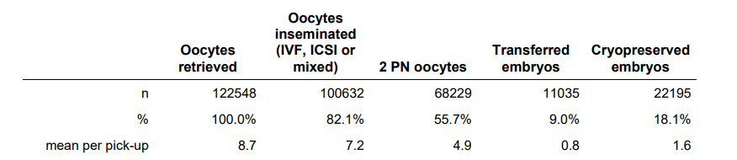
Affordable for the hospital?
Minor equipment and culture media: one cycle/one couple or patient
Belrap 2020: 8-10 oocytes→
Embryo vitrification:
Cost for 1 embryo
Disposable: 24 €
Media: 26 €
= 51 € → 1 cycle (2 E to frozen) = 102 €
Frozen embryo culture and transfer:
- Disposable: 38 € (including the catheter)
- Media: 31€
= 69 €
+ Witness system: 50 €
Total: → SET: 119 €
= 340 € for vitrification and 2 thawed embryo T for 1 OPU
FE X 2/cycles = 240 +100 = 340€ /IVF cyles

Slide 31
Affordable for the hospital?
Minor equipment and culture media for IUI:
One cycle/one couple or patient
Sperm capacitation:
Disposable = tubes, sperm pot, catheter, syringe, catheter, pipettes: 11 €
Media: 12 €
= 23 €
Witness system: 25 €
Total: IUI: 48 €
Notes:
To to the A proportionality rule, rule f 3 for all material and media used in the laboraory

Slide 32
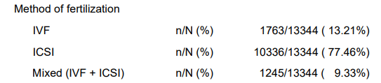


Affordable for the hospital?
For 1000 IVF cycles/year + 1000 IUI :
Means of 10 oocytes, 87 % with ICSI and 13 % simple FIV (Belrap 2020)
1 Fresh ET
2 frozen ET
+ 1000 IUI
      = 1,009,321 € = 226,150 € (fresh)
      + 340,000 (2 frozen)
                + 48,000 € (IUI)
      = 614,150 €
→ 1,623,471 €
Notes:
Together the price of human ressources and consumables:
More or less the same nimbre of IUI
The distribution between IVF and ICSI

Slide 33
Affordable for the hospital?
Quality control of the IVF laboratory:
Maintenance and control of the HVAC system: 1 maintenance and 1 qualification per year minimum → ± 10,000 €/year
Telemetry: to manages and record all critical lab data (t°, CO2, etc.) and broadcasts alerts in case of emergency → ± 20,000 €/year.
Environmental management: microbiological and particle content monitoring as well as control of finished products (sperm and embryonic fluid): with a monitoring plan 3 times a week→ ± 80,000 €/year
Annual maintenance all equipment's (cryogenic system, incubators, hoods, centrifuges, microscopes, laser, various probes) → ± 75,000 €/year
Cleaning and disinfection by qualified cleanroom personnel (daily) →± 50,000 €/year
Software program and its annual maintenance → ± (100,000) + 20,000 €
→ 255,000 €/year
Notes:
The different prices were provided to me from various sources, including quality managers from laboratories dealing with human body materials; I received a a price range, and I took the average

Slide 34
Affordable for the hospital?
The balance?
For 1000 IVF: OPU, embryos freezing and all transfers of the same OPU
B4 = 1754 € →1,754,000 €
For 1000 IUI (capacitation) :
INAMI/RIZIV code for Clinical Biology Laboratory → administrative fees
≈ 115 € → 115,000 €
→ 1,869,000 €
Notes:
remaining amount

Slide 35


Embryologist Procedures Quality control
= 1,878,471 €
B4
Sperm capacitation
= 1,869,000 €
BUT…
9471
Notes:
To function, the balance seems to be achieved, find 15000 € seems faisible

Slide 36
I did not take into account …
→ The « essentials »
the investment and depreciation/amortization of big equipment
the cost of the places allocated to the laboratory
clean room construction
Energy
Laundry, telephony
Liquid nitrogen…
→ The « optional » procedures:
Some works and procedures not reimbursed and not considered by health insurance such as sperm preservation for vasectomy, gender transition, before usual ART.
Rare and specific genetic procedures:
PGD and PGS, artificial oocytes activation, IMSI etc..
The hospital deficit
Notes:
I did not take into account the investment and depreciation of heavy equipment, the cost of space, and energy
The deficit or what the hospital is willing to invest in order to have its own ART center

Slide 37
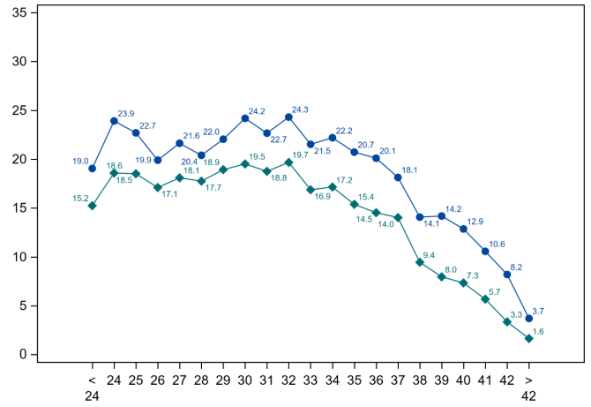
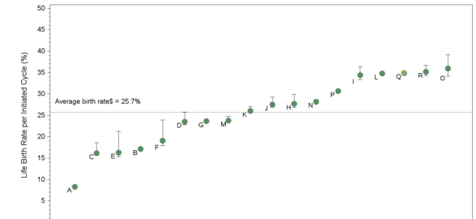
Affordable for the society?
What is the cost of a birth? (IVF)
- Patient + social security: 1982 € x 1000 : 1,982,000 €
- Hospital: 1,807,271 € + ?
(Government: 1.754.000 €)
3,789,271= ± 3789 €/IVF
Depending on maternal age:
From: 1,6 to 19,5 % of BTH (x 10)
Depending on the center:
1 Trial : 8 or 36 % BTH (x 4,5)
USA for BTH < 35Y: 9 to 50 %
(Bradley et al., Fertil. Steril)
Notes:
Lowest approximation
Belgium do not make an exception
Ten times higher

Slide 38
"
Affordable for the society?
Economic impact of birth?
PIB: ↑ gross domestic product (GPD)→Stimulating consumption and demand
Pensions are paid by the workers
→ Contribution to economic growth in a Capitalist society

Slide 39

Affordable for the society?
Socioeconomic impact of birth?
PIB: ↑ gross domestic product (GPD)→Stimulating consumption and demand
Pensions are paid by the workers
→ Contribution to economic growth in a Capitalist society
BUT…
Notes:
whatever the cost in a capitalist society one birth is always positive

Slide 40





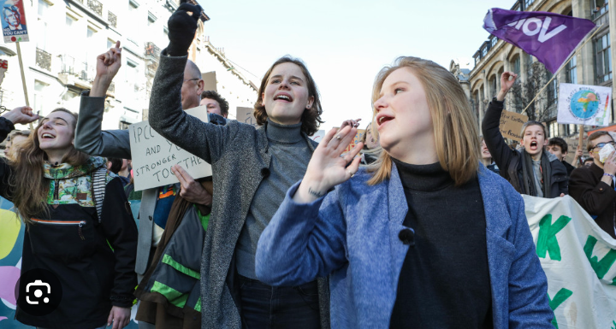
Affordable for the society?
Environmental impact? (federal planning office)
→ Carbon impact/person/year: +/- 10 tones CO2/year
Walloon: 9,5 tones CO2/year 11,1 tones CO2/year
Notes:
By promoting births through our profession, we have a bad CO2 impact, which is costly for our society. It appears that the activity of Walloon centers in this regard is to be promoted…LOL
What kind of people are born after IVF? If it a generation of activist like than we
But it is obviously not so simplistic because if we promote the birth of a generation of activists, then we will be contributors to a better world

Slide 41



Conclusion
ART is affordable for the “ordinary” patients but double standards remain problematic
The price difference between hospitals for the 'non-refundable' procedures is significant
ART contributes to the hospitals' deficit
ART is a challenge for the society and planet

Slide 42
I hope that these calculations can be usefull to advocate for an improvement, an upgrade of the reimbursements from our government. This is important that hospitals stop losing money every day because they are involved in addressing a real public health issue, as you know, affecting one in six couples. And this issue is only likely to worsen in the context of water pollution, which is currently making headlines."
Notes:
I am aware that this presentation is truly boring in a scientific meeting, but I hope that these calculations can be usefull to advocate for an improvement, an upgrade of the reimbursements from our government. This is important that hospitals stop losing money every day because they are involved in addressing a real public health issue, as you know, affecting one in six couples. And this issue is only likely to worsen in the context of water pollution, which is currently making headlines."

Slide 43
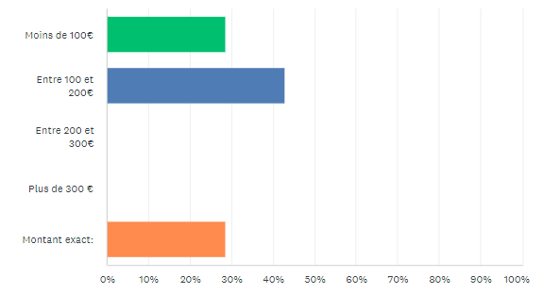
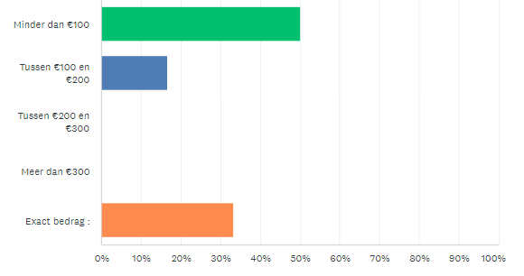
→ Do you charge an annual fee for storage of frozen sperm?
1 center: no answer
2
50€/year
250 €/year
3
2
3
1
300 €/2 years; 500€/5years; 800€/10 years
150€/year
2

Slide 44
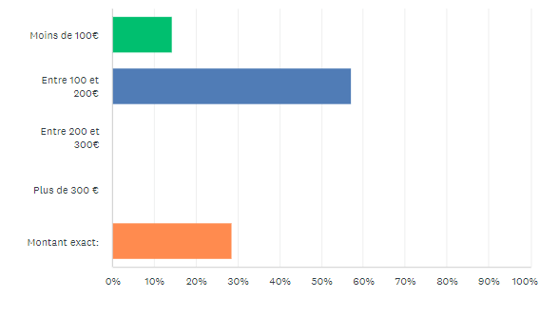
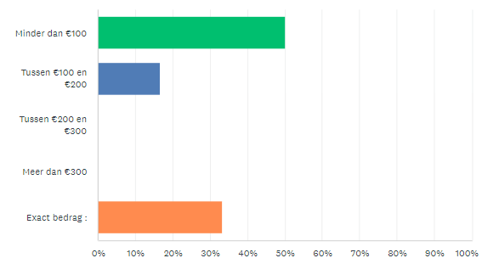
Do you charge an annual fee for storage of frozen eggs?
1 center: no answer
1
Not performed
250 €/year
4
2
3
1
300 €/2 years; 500€/5years; 800€/10 years
150€/year
2

Slide 45

Double standards in ART: Oocytes donation
Oocytes donation and case report:
A 42-year-old woman, mother of 2 children, in a blended family with a man who is himself a father of 2 children, they do IVF due to idiopathic infertility mainly related to the woman's age.
They will pay 212 € by IVF trials with 1FET.
A 25-year-old woman, known for Turner syndrome, with no children, in a relationship for 4 years, seeking IVF, will pay 212 + 3500 € by IVF trials with 1 FET.
Notes:
But Finally, are trhere double standards in ART.
Double standards means …

Slide 46

."
Other current expenses paid by the patient
Sperm freezing
sperm (and oocytes) preservation rent fees
administrative fees
fees for the embryo transfer (outpatient procedure with admission near of the culture room)
Oocytes freezing:
  Bilateral endometriomas at 22 years old with an AMH of 4 ng/ml, unilateral endometrioma at 35 years old with an AMH of 0.7 ng/ml….

