Slide 1
Is there still an indication for GnRH-agonist in IVF?
Madelon van Wely
Belgian Society Reproductive Medicine, Mons. 1-2 December
Notes:
Thank you for the kind introduction.

Slide 2






Disclosure statement
No commercial conflicts of interest
  No travel grants
  No consultancies

Slide 3

De Kwakzalver, Jan Steen (1626-1679) Rijksmuseum Amsterdam
Notes:
The quack, Jan Steen (1626-1679) Rijksmuseum Amsterdam

Slide 4

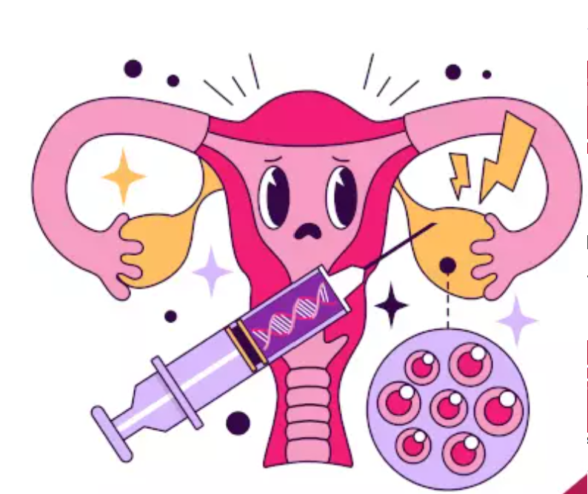






Decision-making
Effectiveness
Safety
Burden
Costs
Environment
Evidence
Clinical
effectiveness
BSRM 2023

Slide 5

Decision-making
Effectiveness
Safety
Burden
Costs
Environment
Evidence
Clinical
effectiveness
BSRM 2023

Slide 6

Evidence
Clinical
effectiveness
BSRM 2023

Slide 7

BSRM 2023

Slide 8
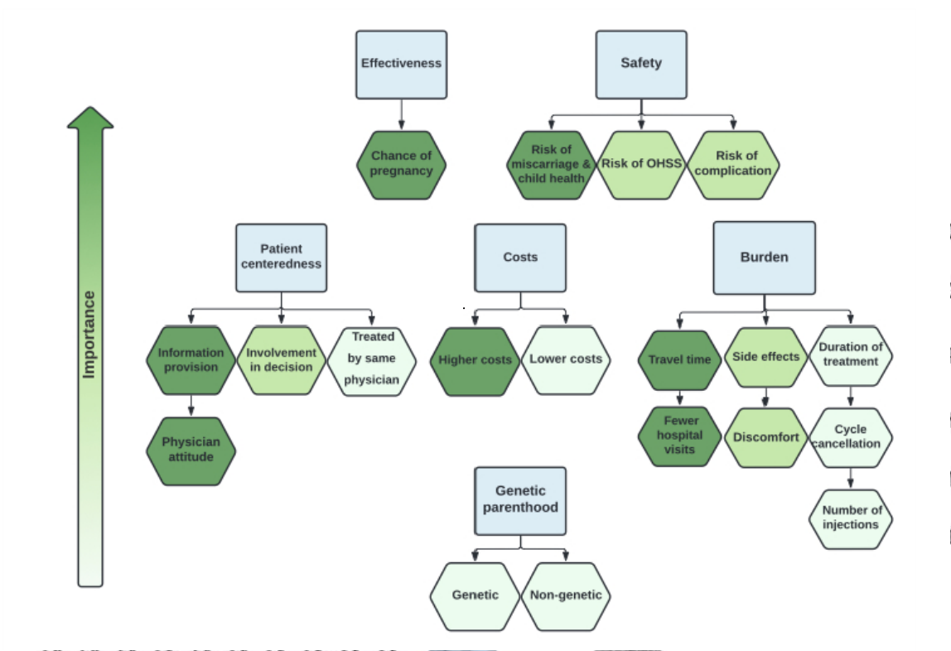
Decision-making
Effectiveness
Safety
Burden
Costs
Environment
Evidence
Clinical
effectiveness
Driving factors in decision-making of patients seeking medically assistance for involuntary childlessness. A systematic review. HRU
BSRM 2023

Slide 9
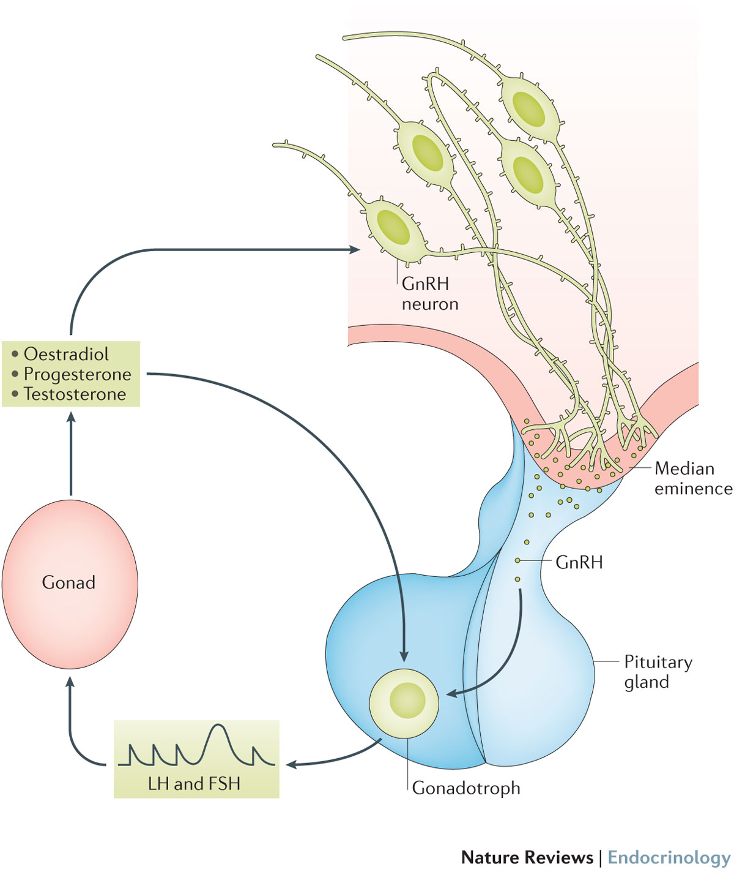
GnRH hormone
The hypothalamic–pituitary–gonadal axis
Herbison, A. E. (2016) Control of puberty onset and fertility by gonadotropin-releasing hormone neurons
Nat. Rev. Endocrinol. doi:10.1038/nrendo.2016.70
BSRM 2023
Notes:
Gonadotropin-releasing hormone (GnRH) is a decapeptide that is a part of the hypothalamic-pituitary-gonadal axis, and being a part of this system makes it vital for human reproduction. Since its discovery by a group of Nobel laureate Andrew V. Schally in 1971 from porcine hypothalamus as one of the earliest hypothalamic releasing hormones, it has been a center of attention of research scientists because of its central role in reproduction not only in humans but also in all vertebrates.
This picture shows the hypothalamic–pituitary–gonadal axis. The gonadotropin-releasing hormone (GnRH) neurons are shown here, they release GnRH that results in pulsatile surge release of gonadotropins in a feedback system

Slide 10
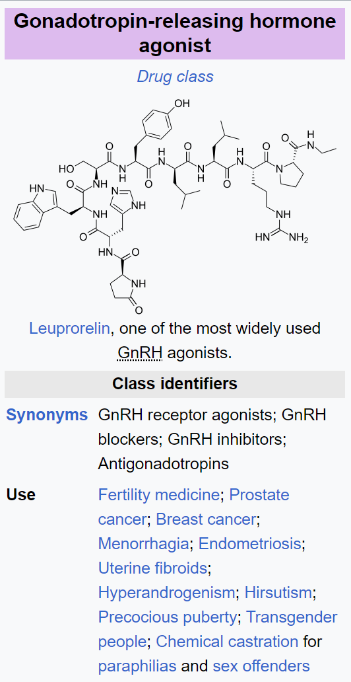
GnRHa
GnRH was discovered in 1971
GnRH agonist medical use 1980s
Down-regulation - artificial menopause
Avoid a premature (LH) surge
Favor follicle development
Synchronize growth of follicles and endometrium
Treatment scheduling
BSRM 2023
Notes:
So lets look at the GnRH agonist. This is from the Wikepedia page. It goes under several names ….
This lecture will be about its role in IVF but it has many other applications and will remain an important drug.

Slide 11
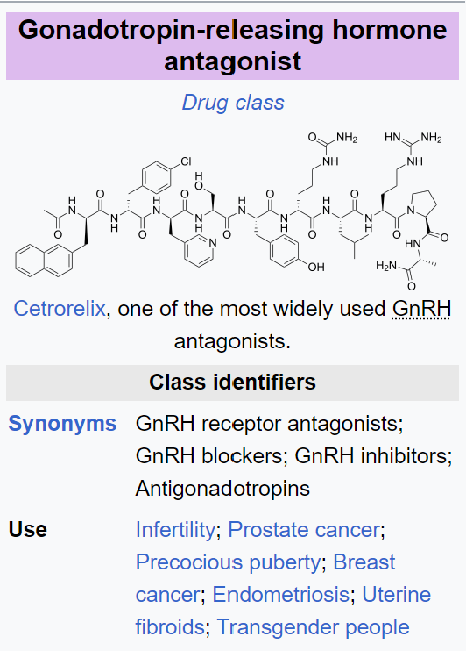
GnRH
GnRH antagonist used since 1999
BSRM 2023
Notes:
GnRH antagonists compete with natural GnRH for binding to GnRH receptors, this way they block GnRH action in the body. The antagonist has a direct blocking effect where the agonist works indirect

Slide 12
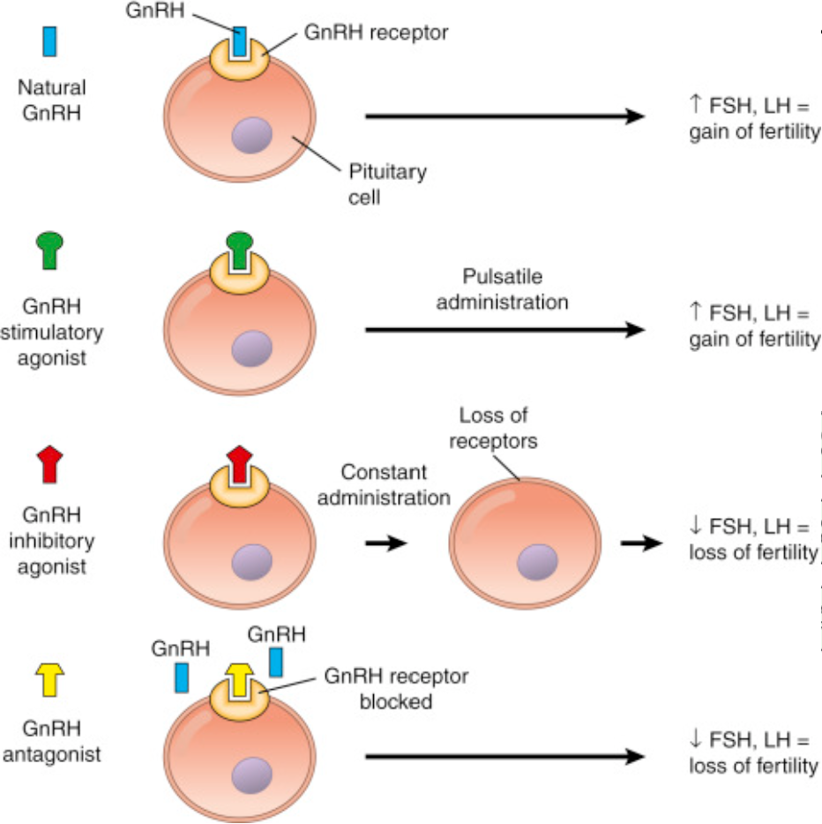
GnRH
BSRM 2023

Slide 13
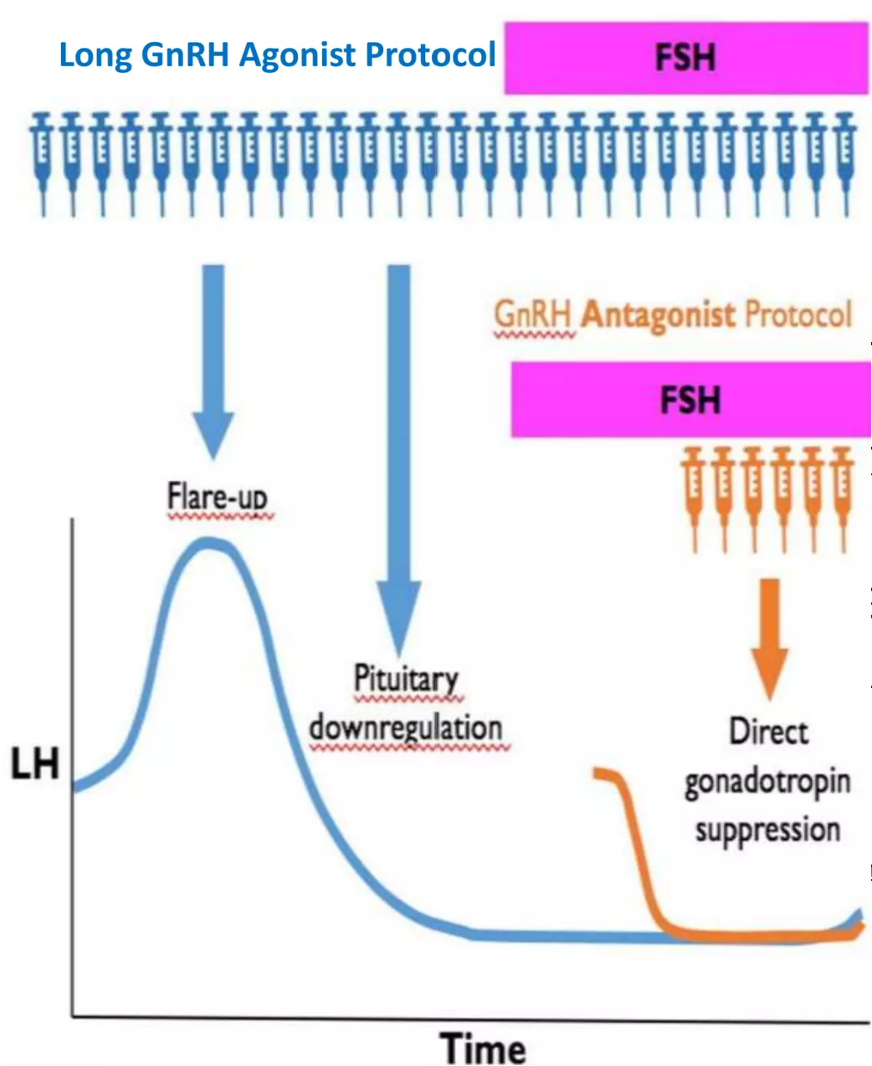
GnRH
BSRM 2023

Slide 14
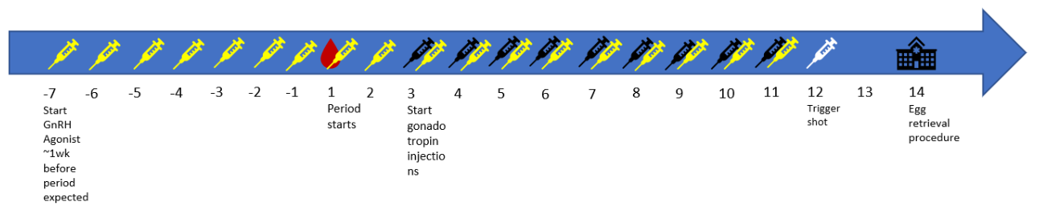
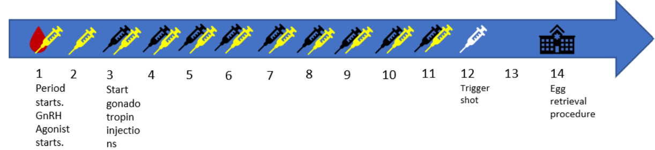
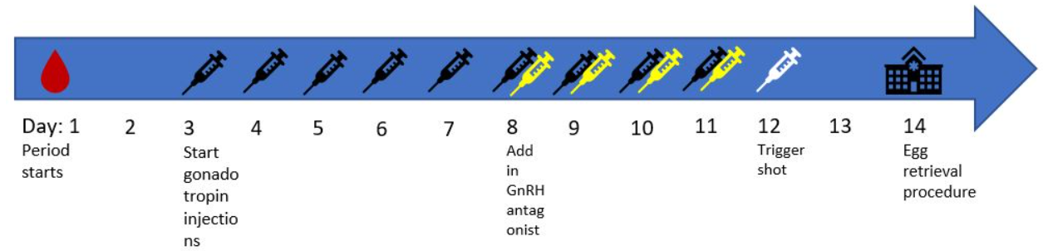
GnRH
Long agonist
Long duration
hypoE
Short agonist
Antagonist
BSRM 2023

Slide 15
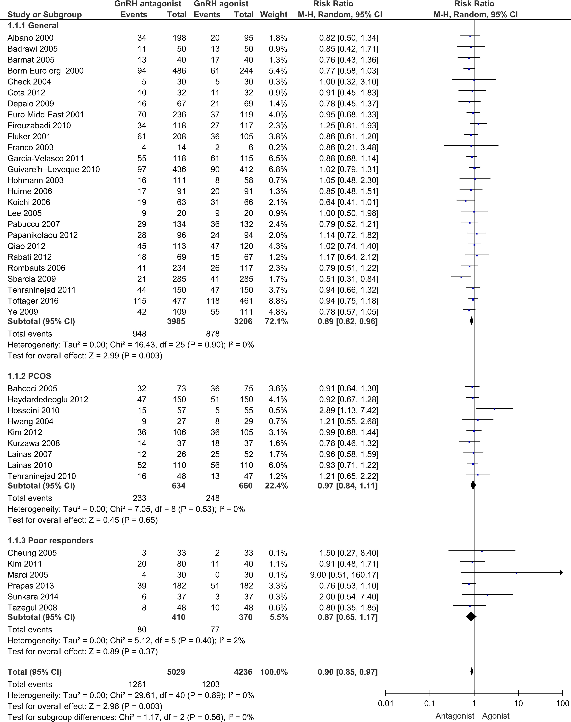
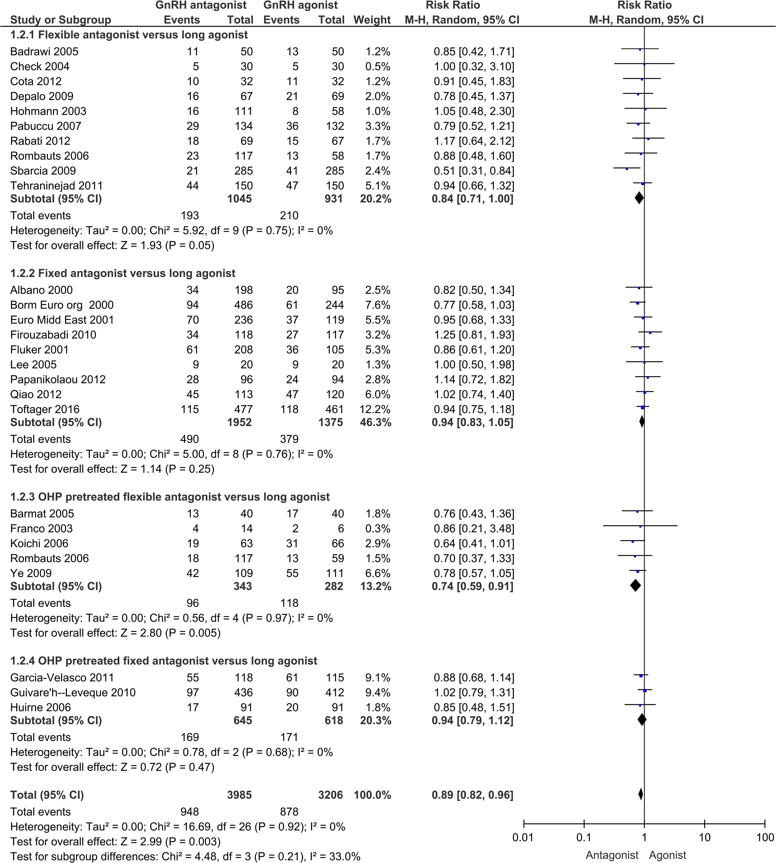
Effectiveness – ongoing pregnancy
favours long agonist favours antagonist
favours long agonist favours antagonist
BSRM 2023
Notes:
Figure 3 Ongoing pregnancy rate per patient population.

Slide 16
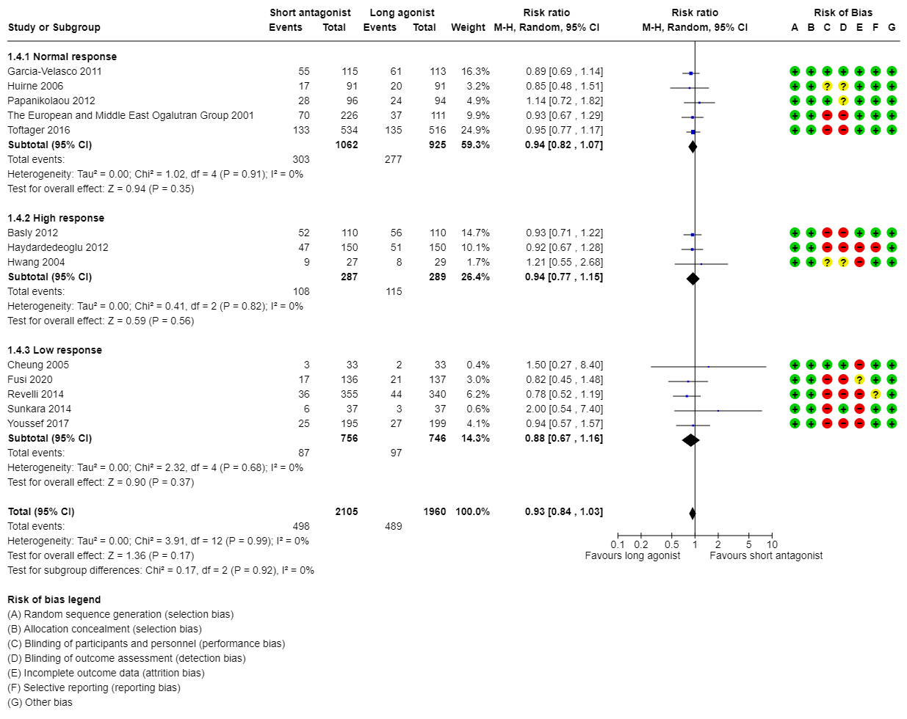
Effectiveness – ongoing pregnancy
BSRM 2023
Notes:
Figure 3 Ongoing pregnancy rate per patient population.

Slide 17
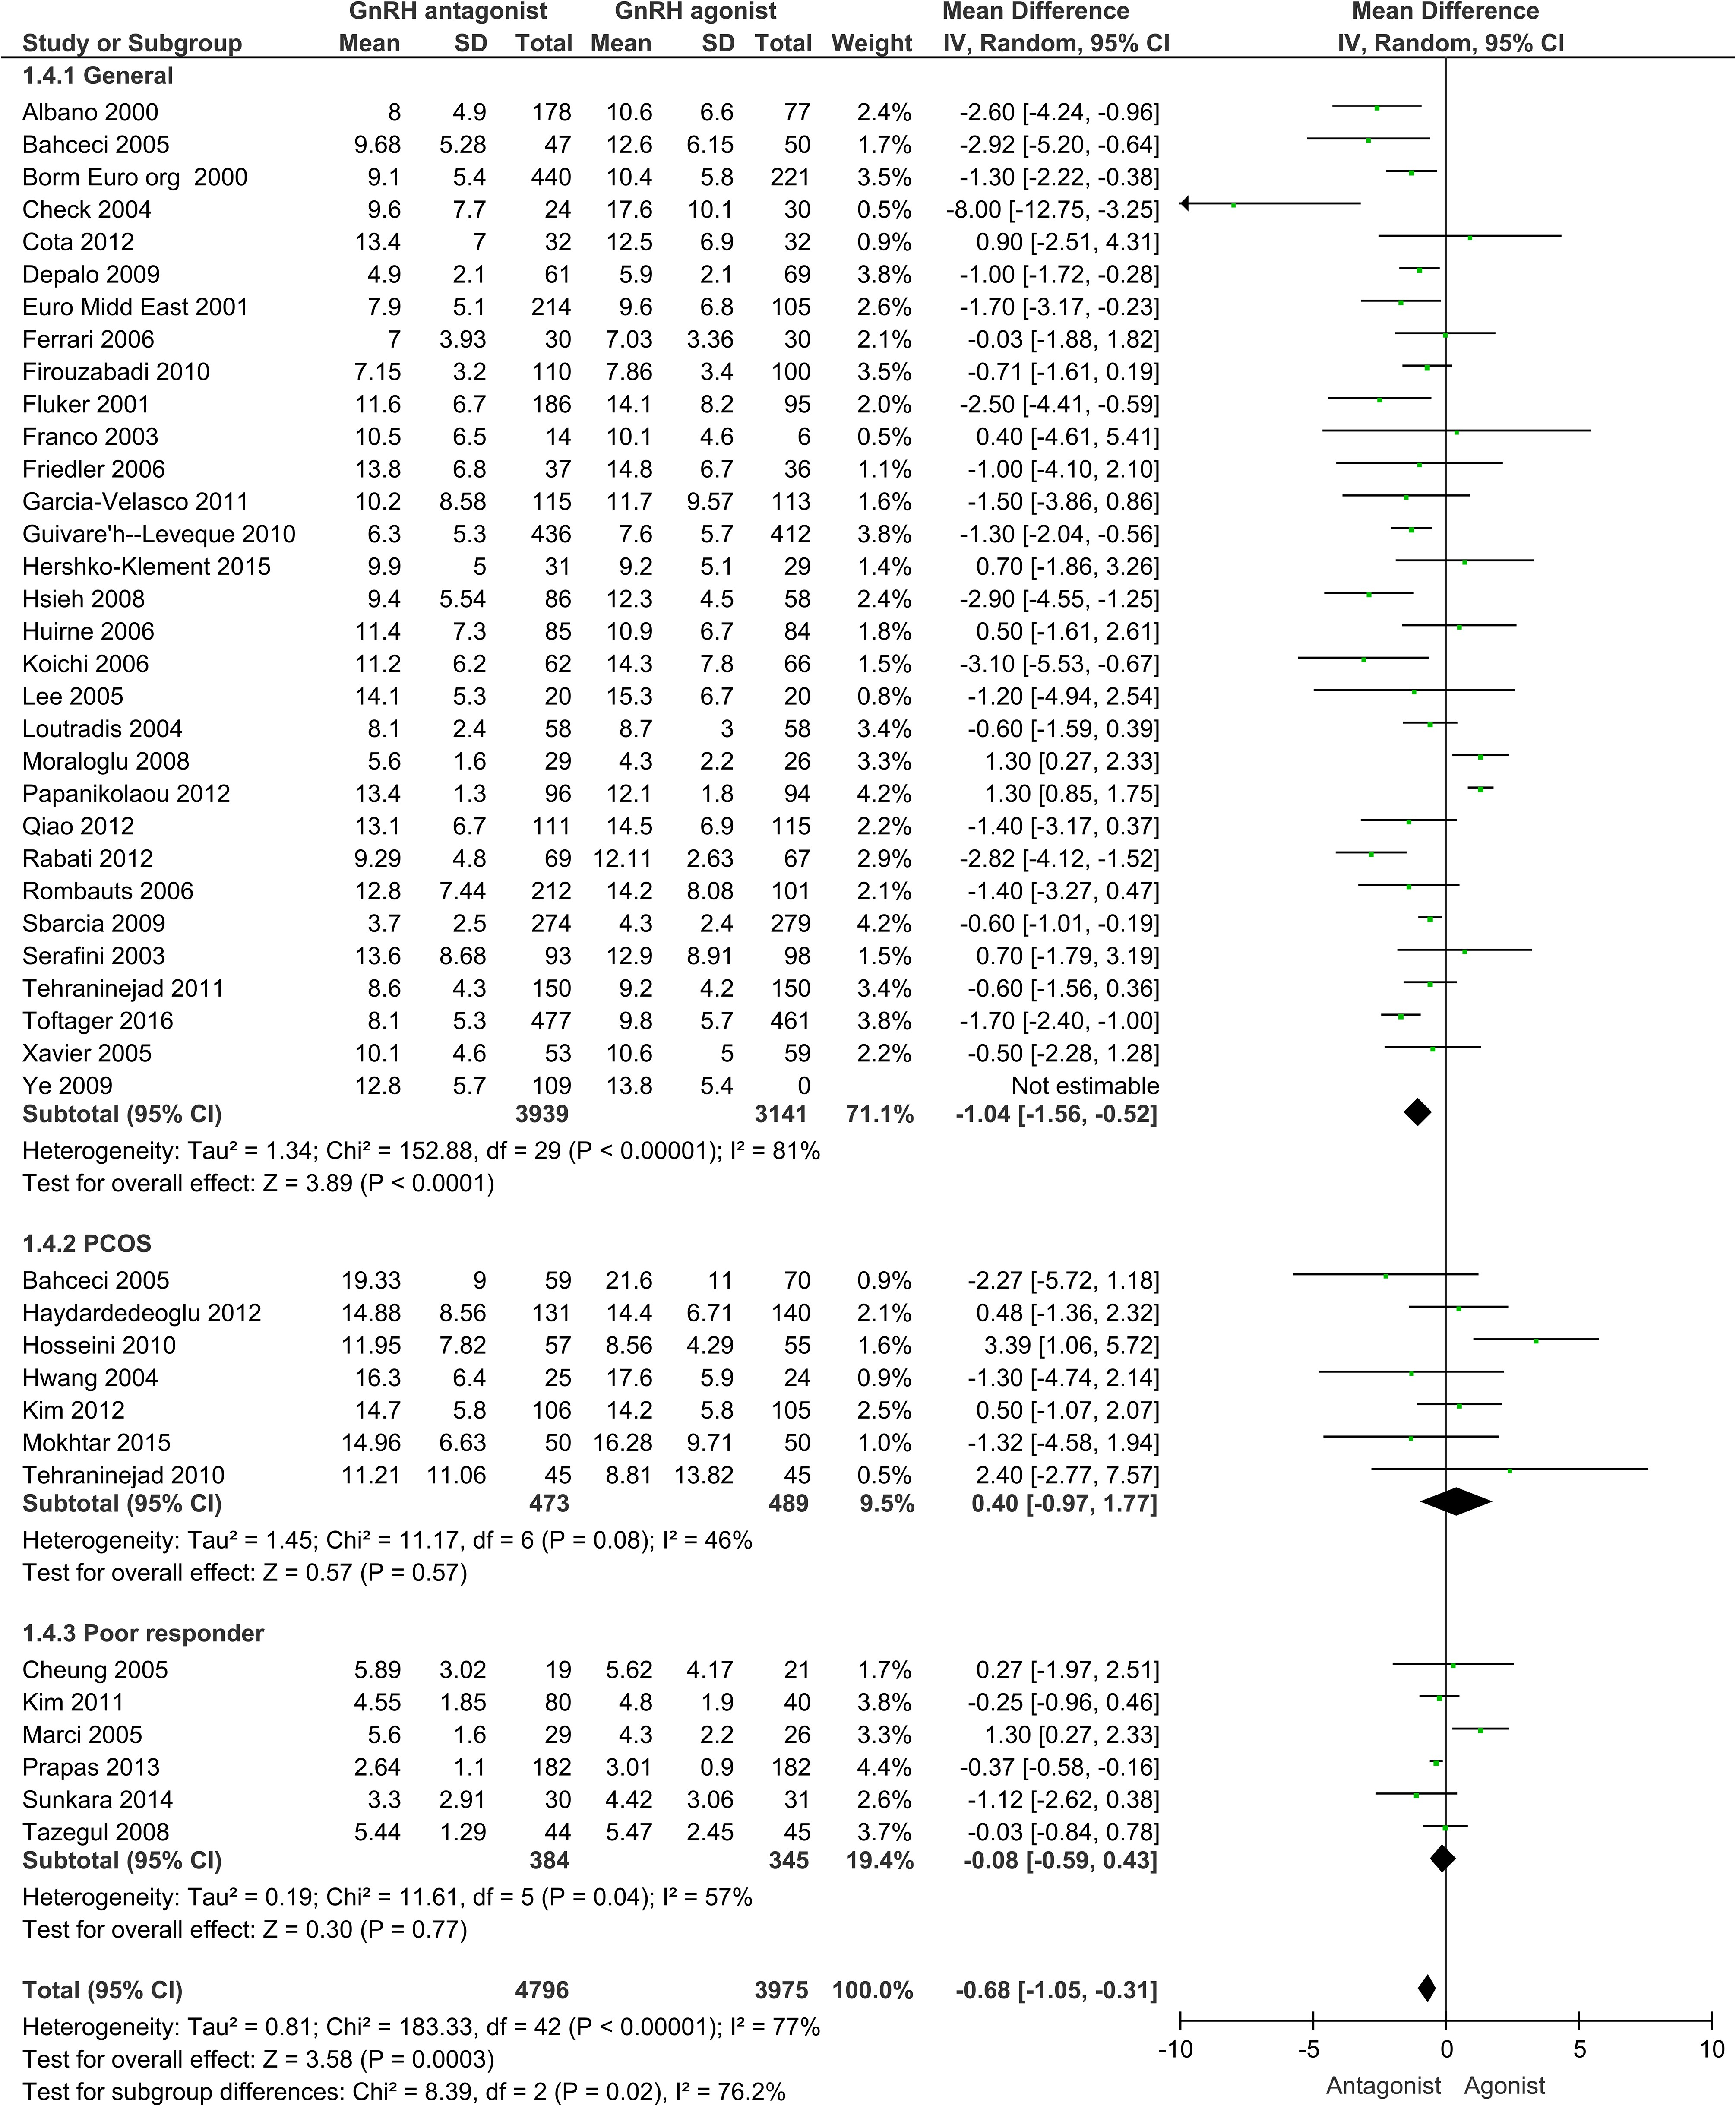
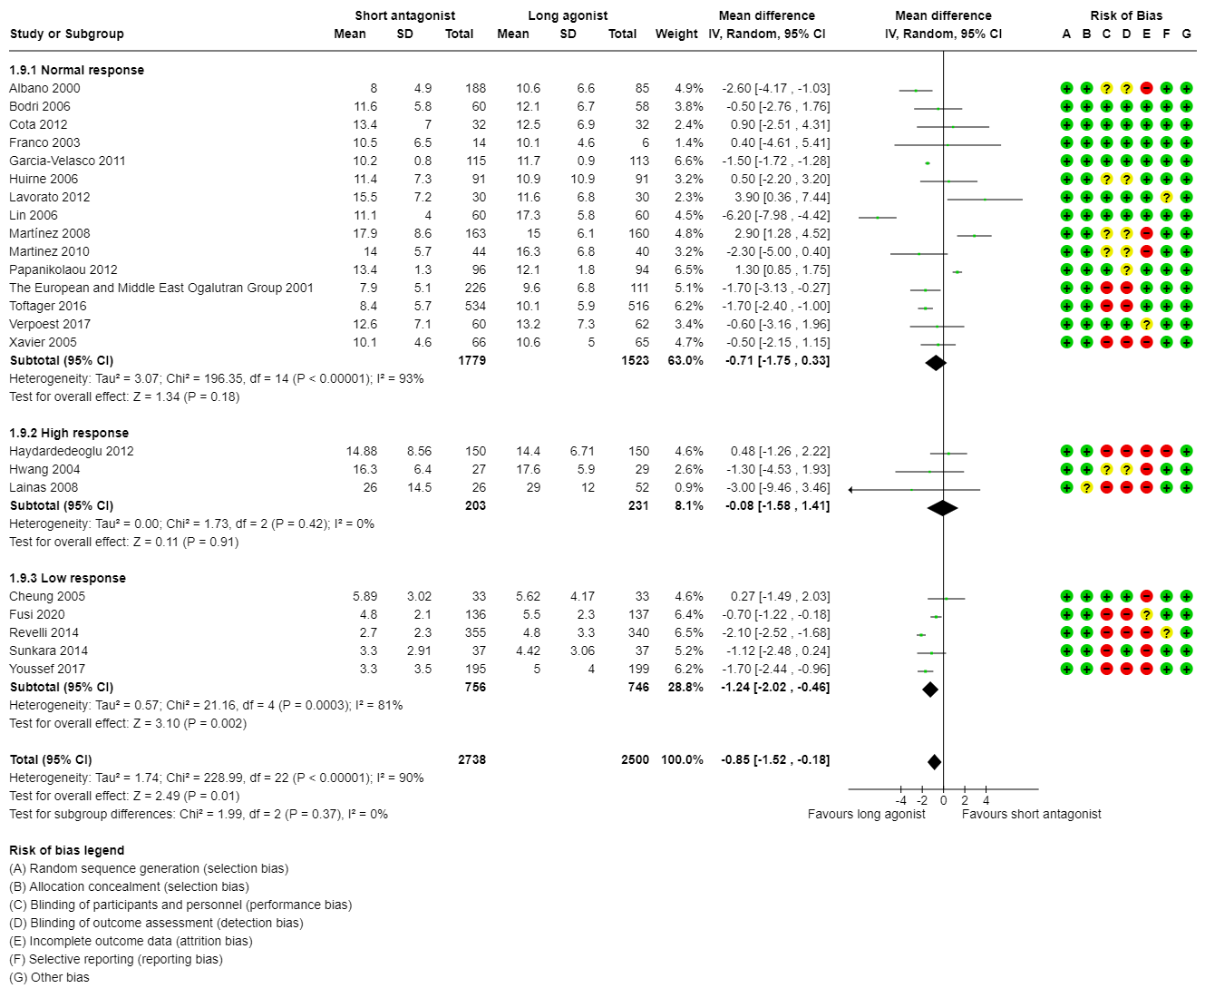
Effectiveness – oocytes retreived
favours long agonist favours antagonist
Cochrane review. Melo et al., 2024. Controlled ovarian stimulation protocols for assisted reproduction: a network meta-analysis
Hum Reprod Update, Volume 23, Issue 5, September/October 2017, Pages 560–579, https://doi.org/10.1093
BSRM 2023

Slide 18
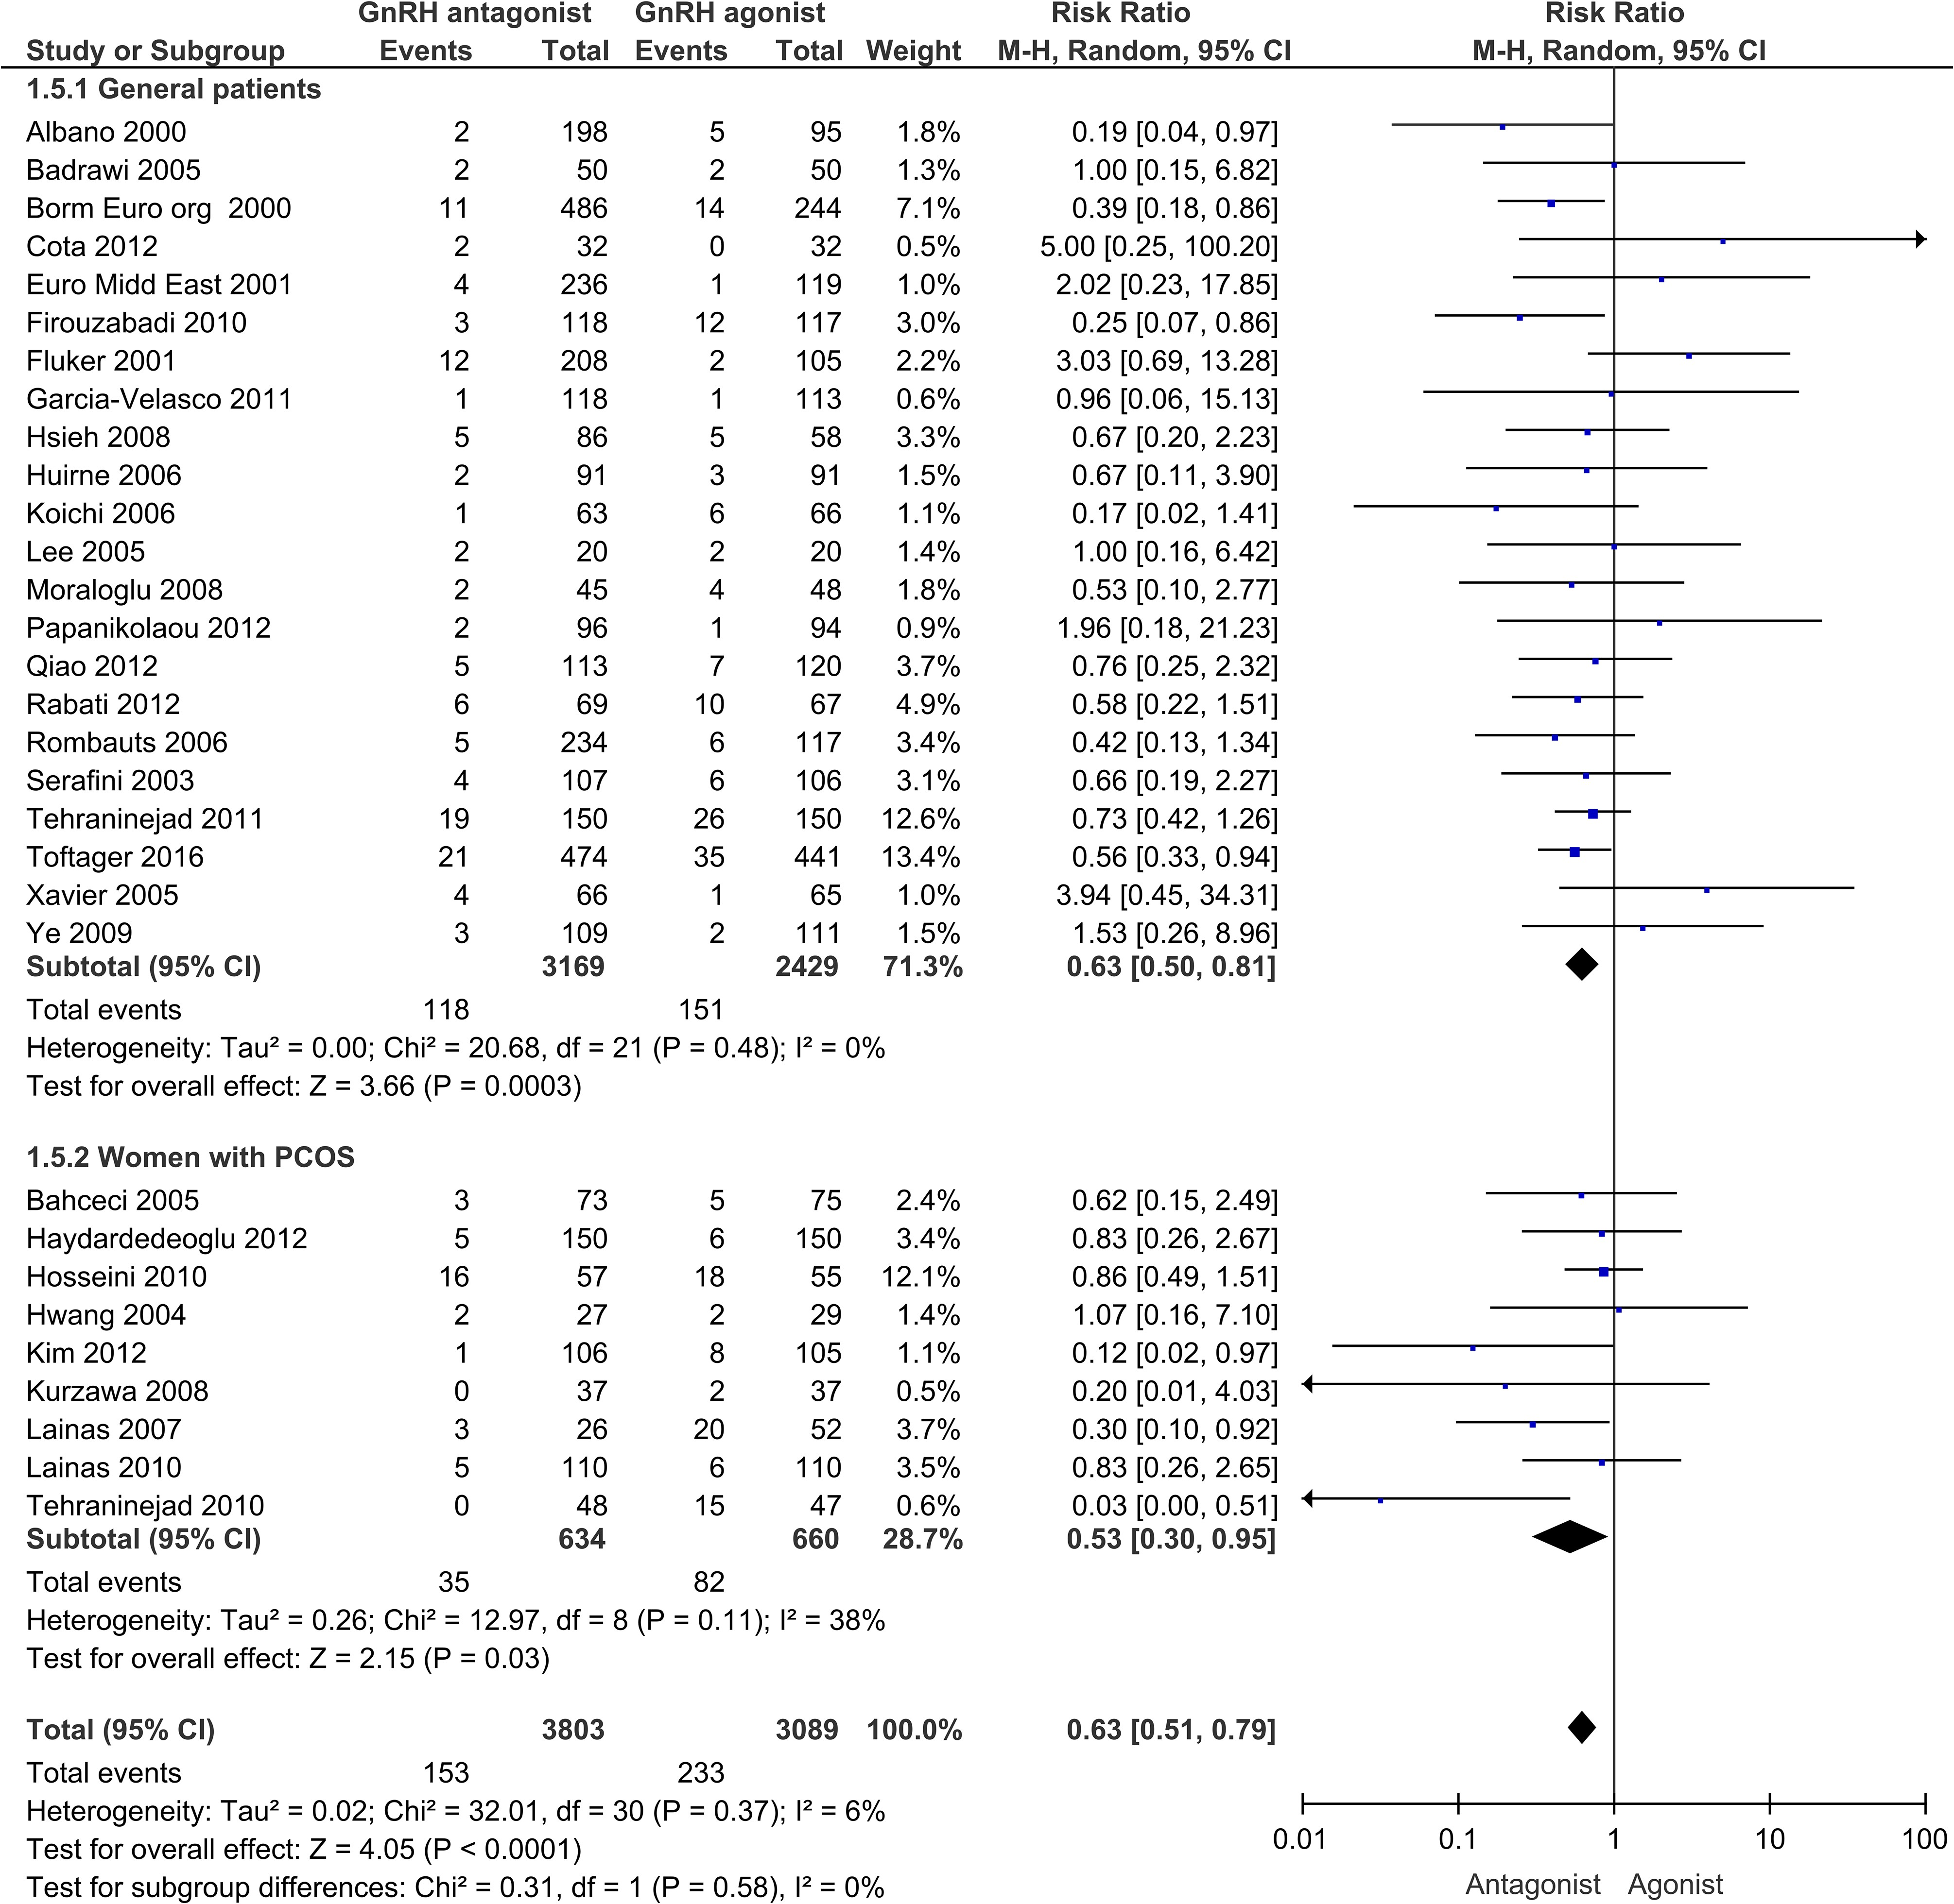
Safety – OHSS
favours antagonist favours long agonist
BSRM 2023
BSRM 2023

Slide 19
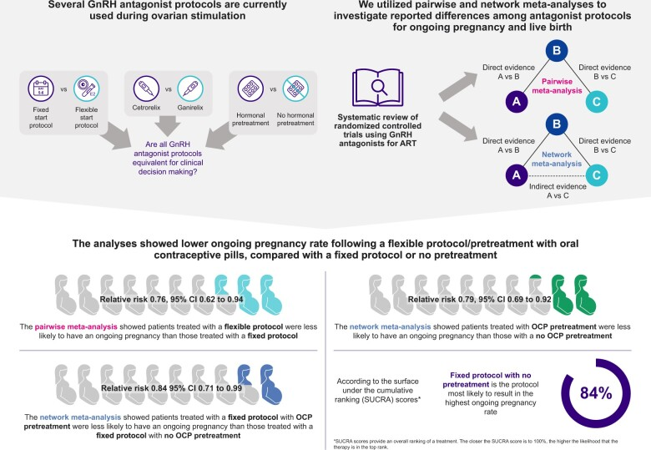
Optimal GnRH antagonist protocol
Hum Reprod Update, Volume 23, Issue 3, 2023, Pages 307–326, https://doi.org/10.1093/humupd/dmac040
BSRM 2023
Notes:
This meta-analysis showed lower ongoing pregnancy rates (OPRs) following controlled ovarian stimulation (COS) using a flexible GnRH antagonist protocol or pretreatment with an oral contraceptive pill (OCP) compared with COS using a fixed protocol or no OCP pretreatment, respectively.

Slide 20
Optimal GnRH antagonist protocol
Hum Reprod Update, Volume 23, Issue 3, 2023, Pages 307–326, https://doi.org/10.1093/humupd/dmac040
BSRM 2023
Notes:
This meta-analysis showed lower ongoing pregnancy rates (OPRs) following controlled ovarian stimulation (COS) using a flexible GnRH antagonist protocol or pretreatment with an oral contraceptive pill (OCP) compared with COS using a fixed protocol or no OCP pretreatment, respectively.

Slide 21
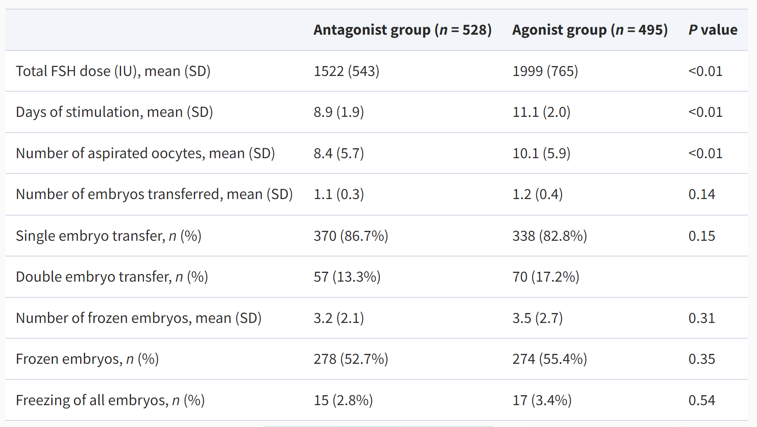
Fixed GnRH antagonist vs long agonist
Ovarian stimulation characteristics
Hum Reprod, Volume 31, Issue 6, 2017, Pages 1253-1264, https://doi.org/10.1093/humrep/dew015
BSRM 2023
Notes:
The trial by Toftagel used antagonist in a fixed protocol and was the largest trial.

Slide 22
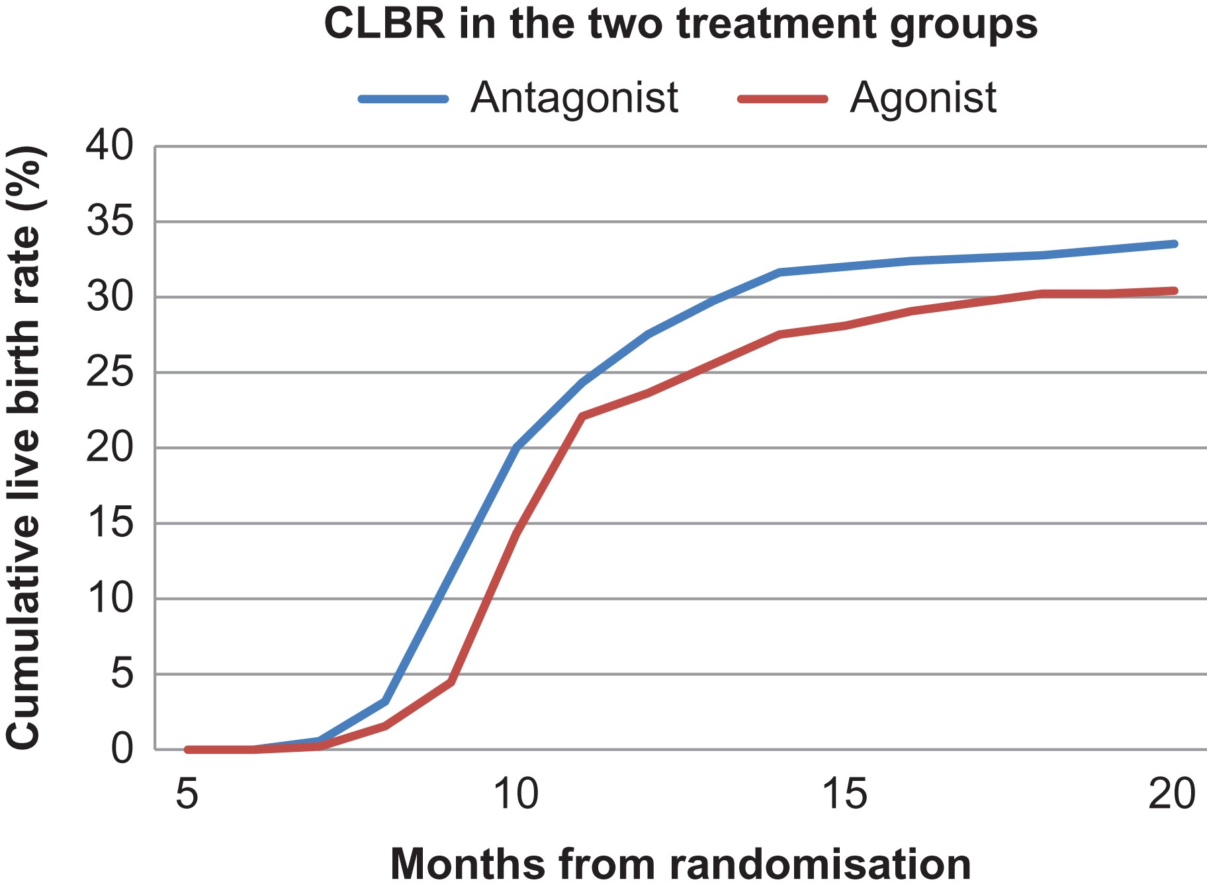
Cumulative live birth rates (CLBRs) in the two treatment groups after one started cycle
Fixed GnRH antagonist vs long agonist
BSRM 2023
Notes:
The trial by Toftagel used antagonist in a fixed protocol
Figure 2 Cumulative live birth rates (CLBRs) in the two treatment groups GnRH-antagonist versus GnRH-agonist, including all first deliveries during a minimum of 2-year follow-up. A competing risk method has been used to test for difference between the treatment groups, Gray's test P = 0.18.
Cumulative reproductive outcome from one complete cycle including fresh and frozen–thawed embryo transfer till first live birth in women treated either withe GnRH-antagonist or GnRH-agonist treatment.

Slide 23
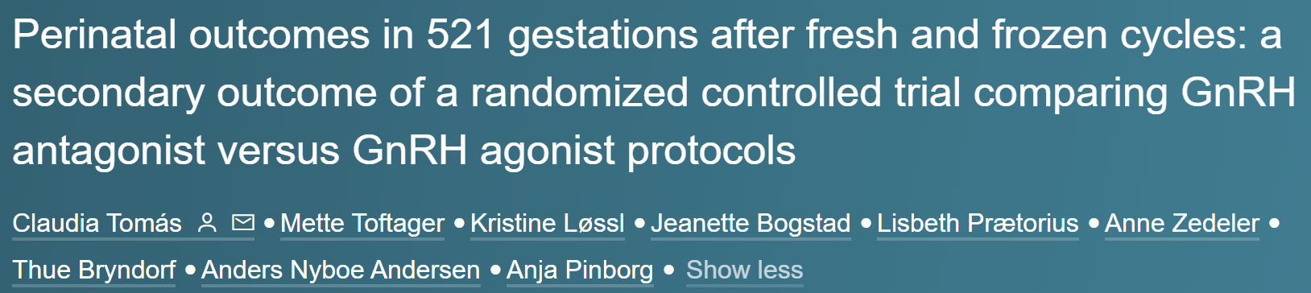
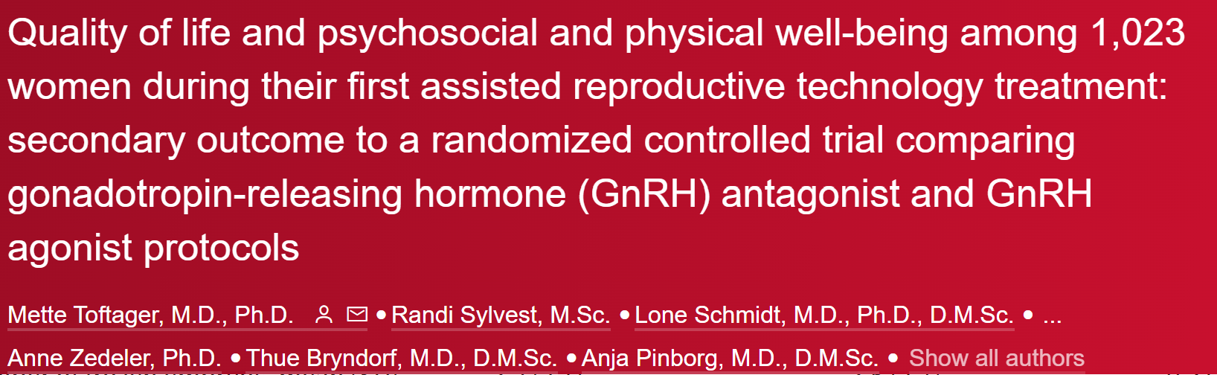
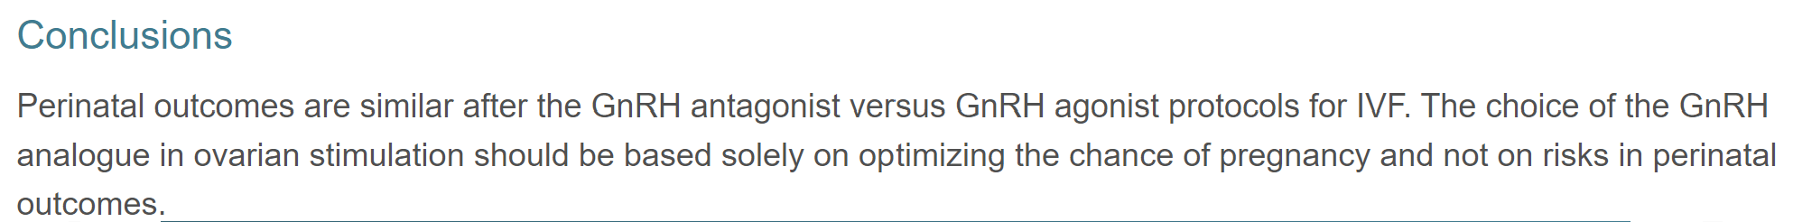
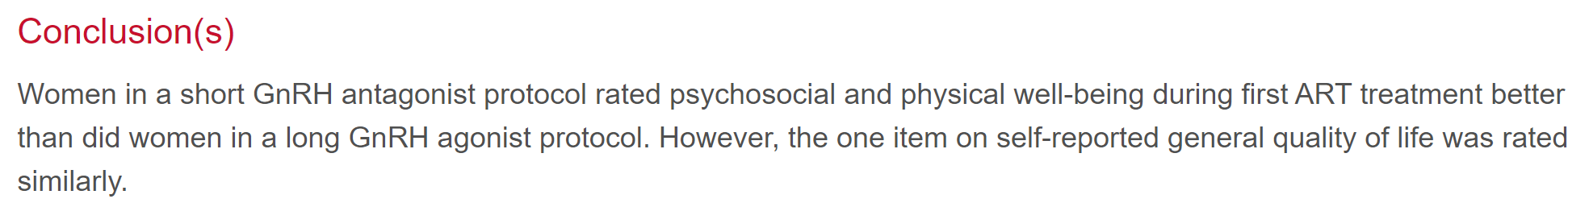
Fixed GnRH antagonist vs long agonist
FertiQoL self-reported quality of life was rated similar
Compared to GnRH agonist, women in the GnRH antagonist group:
felt less emotional (adjusted odds ratio [AOR] 0.69)
were less limited in their everyday life (AOR 0.74)
had less unexpected crying (AOR 0.71)
rated quality of sleep better (AOR 1.55)
RBMO 39 Issue 4, 2019 https://doi.org/10.1016/j.rbmo.2019.05.010
BSRM 2023
Notes:
The trial by Toftagel used antagonist in a fixed protocol

Slide 24
Effectiveness and safety
GnRH antagonist protocols probably reduces OHSS rates in women with predicted normal or high response to COS without compromising live birth rates
Unclear in poor responders
GnRH antagonist requires less days of stimulation and less gonadotrophins
GnRH antagonist requires less hospital visits and had less impact on well-being
Burden, cost and environment
BUT mostly young women in the trials
BSRM 2023

Slide 25
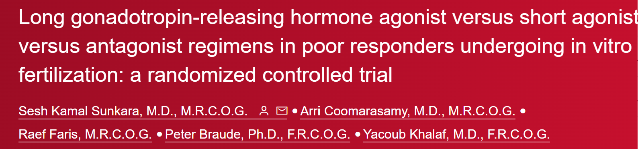
What about poor responders?
Long GnRH agonist and antagonist regimens offer a suitable choice for poor responders, whereas the short agonist regimen may be less effective because of fewer eggs retrieved.
Fertil Steril. 2014 Jan;101(1):147-53. doi: 10.1016/j.fertnstert.2013.09.035.
BSRM 2023

Slide 26
What about endometriosis?
Evidence lacking
Often practical decisions
agonist taken for pain – continue in IVF cycle
OCP taken for pain – in view of potential negative impact in antagonist cycle often agonist used
New development oral antagonist (Elagonix), could be more patient friendly
Some evidence that it could be an alternative to standard antagonist injections but low quality evidence
BSRM 2023

Slide 27
Decision-making
 | Normal responders | High responders/ PCOS | Poor responders/ older women
Effectiveness | equal | equal | Long agonist?
Safety: OHSS | antagonist | antagonist | antagonist
Burden: days, nr of injections, emotional impact | antagonist | antagonist | antagonist
Cost | antagonist | antagonist | unclear
Environment* | Probably antagonist | Probably antagonist | unclear
In practice: planning | OCP use to plan the cycle followed by agonist
Evidence
Clinical
effectiveness
BSRM 2023

Slide 28
Alternative – progestin primed protocol
+
-
The hypothalamic–pituitary–gonadal axis
Herbison, A. E. (2016) Control of puberty onset and fertility by gonadotropin-releasing hormone neurons
Nat. Rev. Endocrinol. doi:10.1038/nrendo.2016.70
BSRM 2023

Slide 29
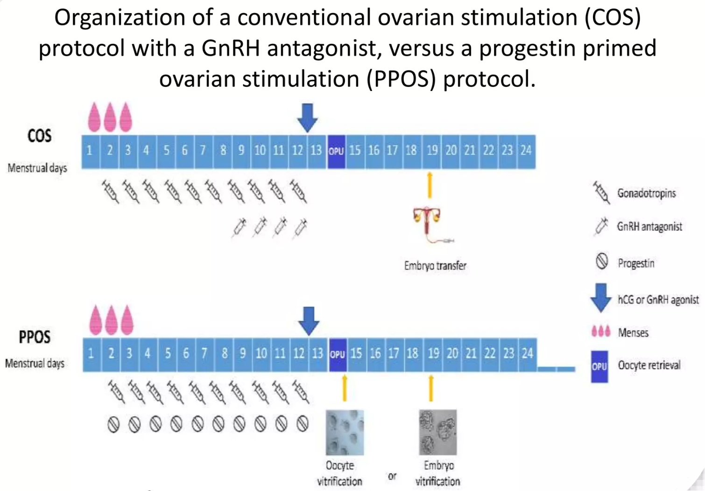
Alternative – progestin primed protocol
BSRM 2023

Slide 30
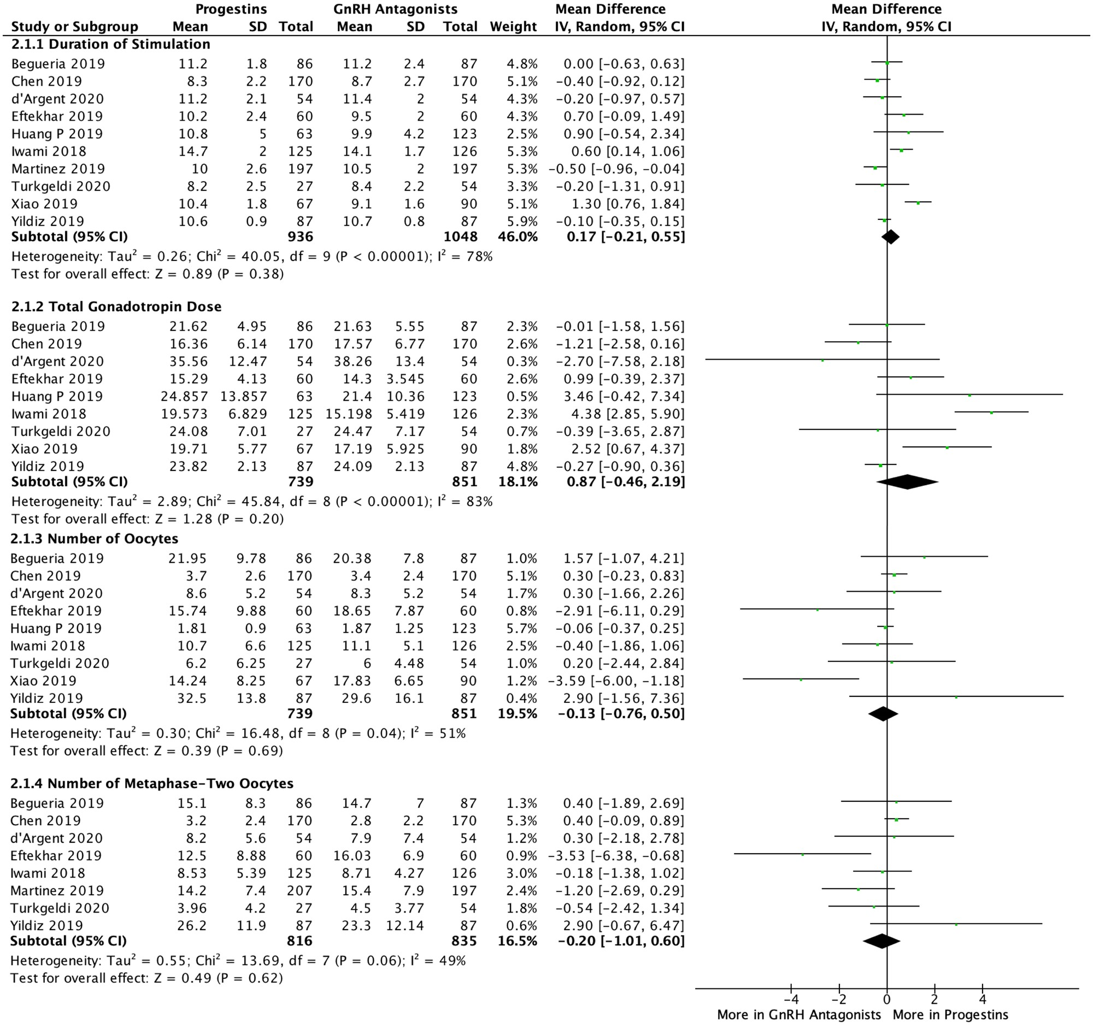
Progestins versus GnRH antagonists: response to ovarian stimulation.
Alternative – progestin primed protocol
BSRM 2023
Notes:
Progestins versus GnRH antagonists: response to ovarian stimulation.

Slide 31
My peers
I use agonist only for poor responders and some endometriosis patients
I would standardly use agonist for most IVF cycles as it results in more oocytes
We often use agonist as we need to plan the oocyte retrieval, we use OCP to facilitate planning
For endometriosis we often use agonist as most of our patients are already on OCP or agonist
BSRM 2023
Notes:
Progestins versus GnRH antagonists: response to ovarian stimulation.

Slide 32

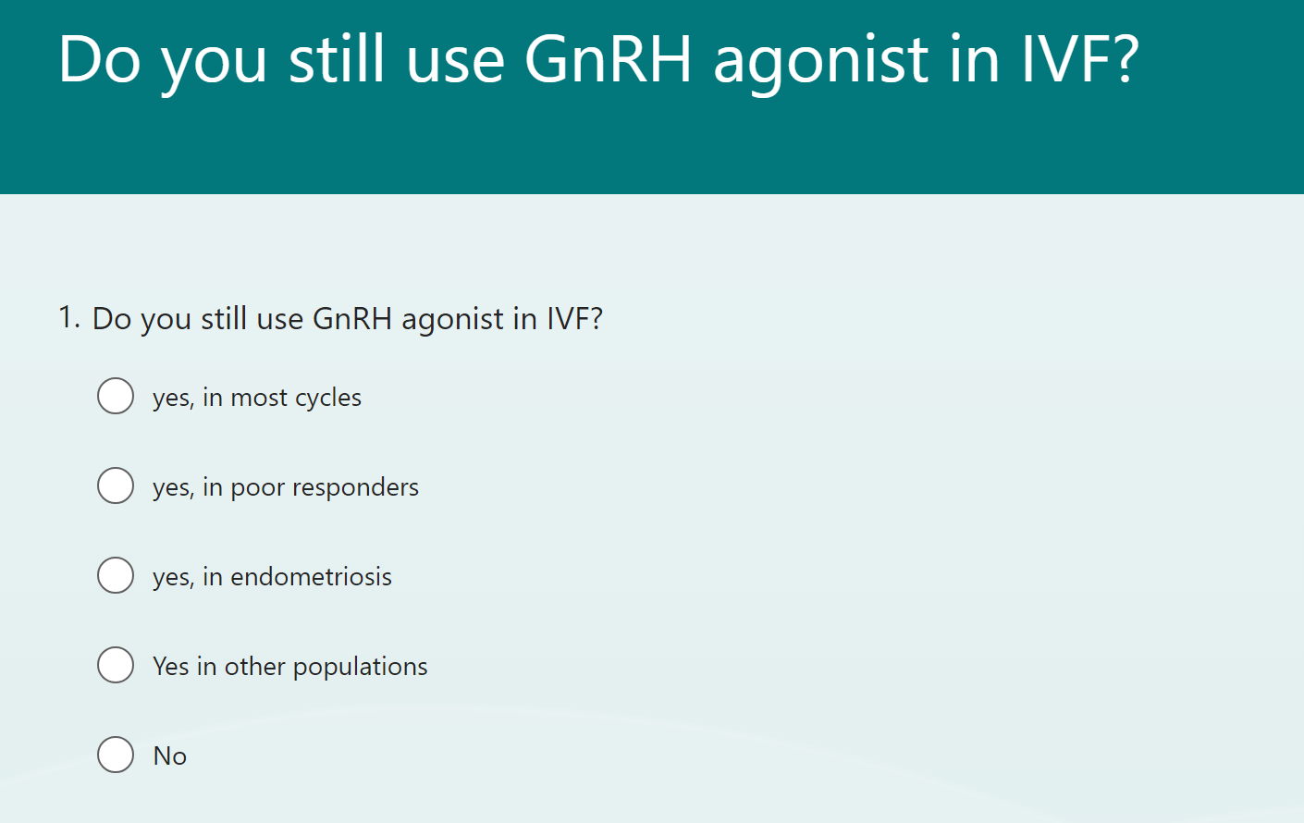
Is there still a place for GnRH agonist in IVF?
BSRM 2023
Notes:
Progestins versus GnRH antagonists: response to ovarian stimulation.

Slide 33
Is there still a place for GnRH agonist in IVF?
BSRM 2023
Notes:
Progestins versus GnRH antagonists: response to ovarian stimulation.

Slide 34

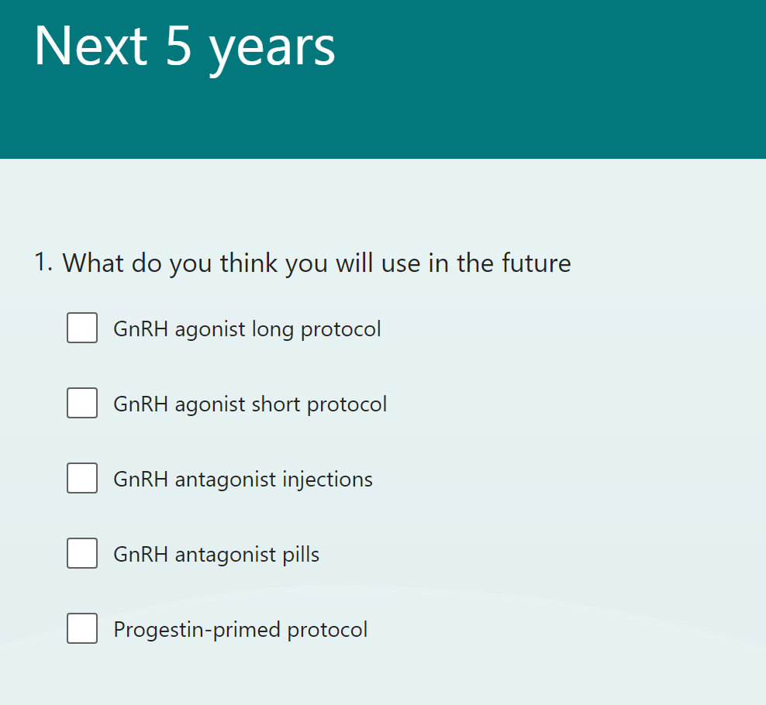
Is there still a place for GnRH agonist in IVF?
BSRM 2023
Notes:
Progestins versus GnRH antagonists: response to ovarian stimulation.

Slide 35
Is there still a place for GnRH agonist in IVF?
BSRM 2023
Notes:
Progestins versus GnRH antagonists: response to ovarian stimulation.

Slide 36
Thank you
BSRM 2023

Slide 37
Acknowledgements
Nils Lambalk
Laura van Loendersloot
Basil Tarlatzis
Femke Mol

