Slide 1
UNLOCKING THE MAGIC OF PROGESTERONE
The luteal phase
Samuel Santos-Ribeiro

Slide 2
Conflicts of interest
Honoraria
MSD/Organon, Ferring, Theramex, Gedeon-Richter, Abbott and Besins
Research grants
MSD/Organon, Theramex, Gedeon-Richter and Roche

Slide 3
Do we need progesterone supplementation?
In the fresh cycle?
In the artificial FET cycle?
In the natural cycle?
To improve perinatal outcomes?

Slide 4
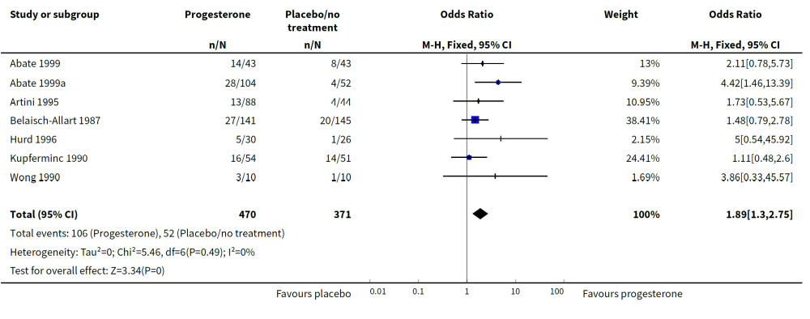
Why is LPS needed in fresh cycles?
Van der Linden et al, 2015

Slide 5
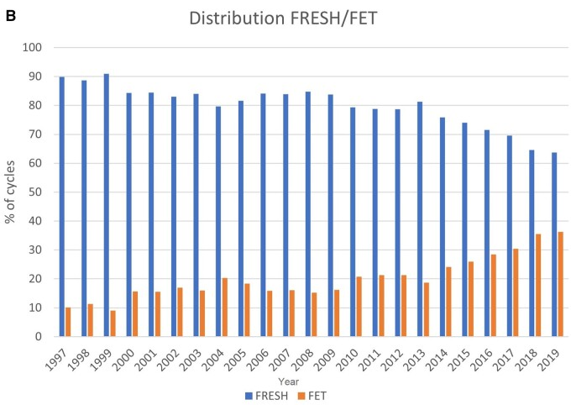
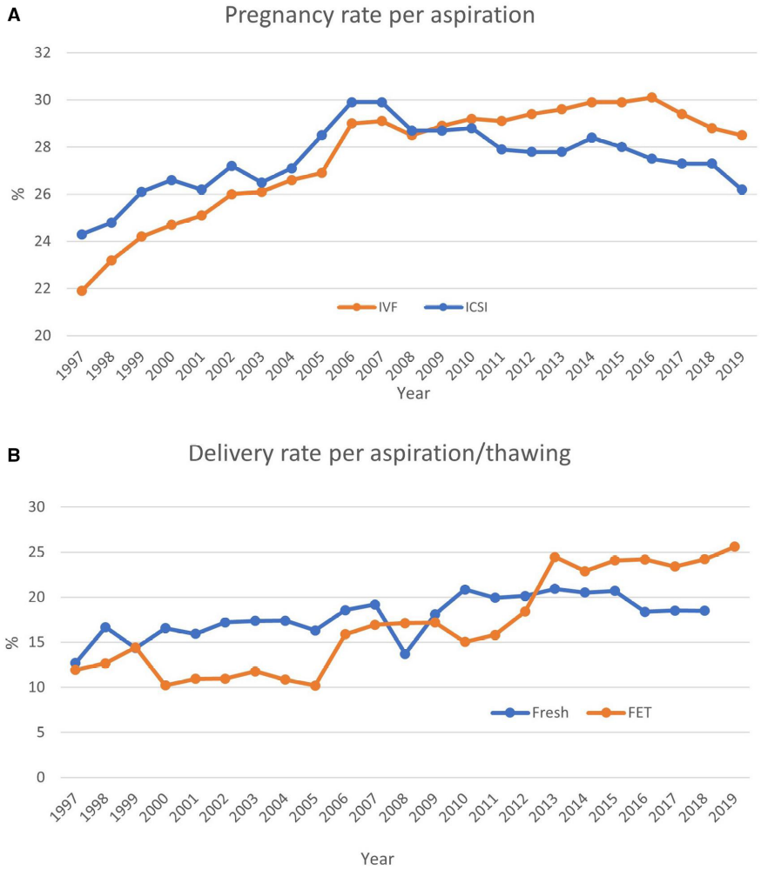
Frozen embryo transfers are on the rise
Latest ESHRE-EIM registry data analysis
Smeenk et al, 2023

Slide 6
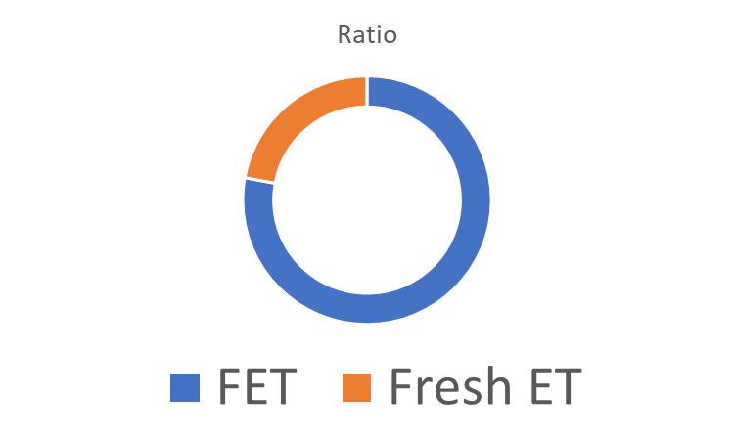
How well are we performing?
Cycles
performed
Soares et al, 2024 (ESHRE)

Slide 7
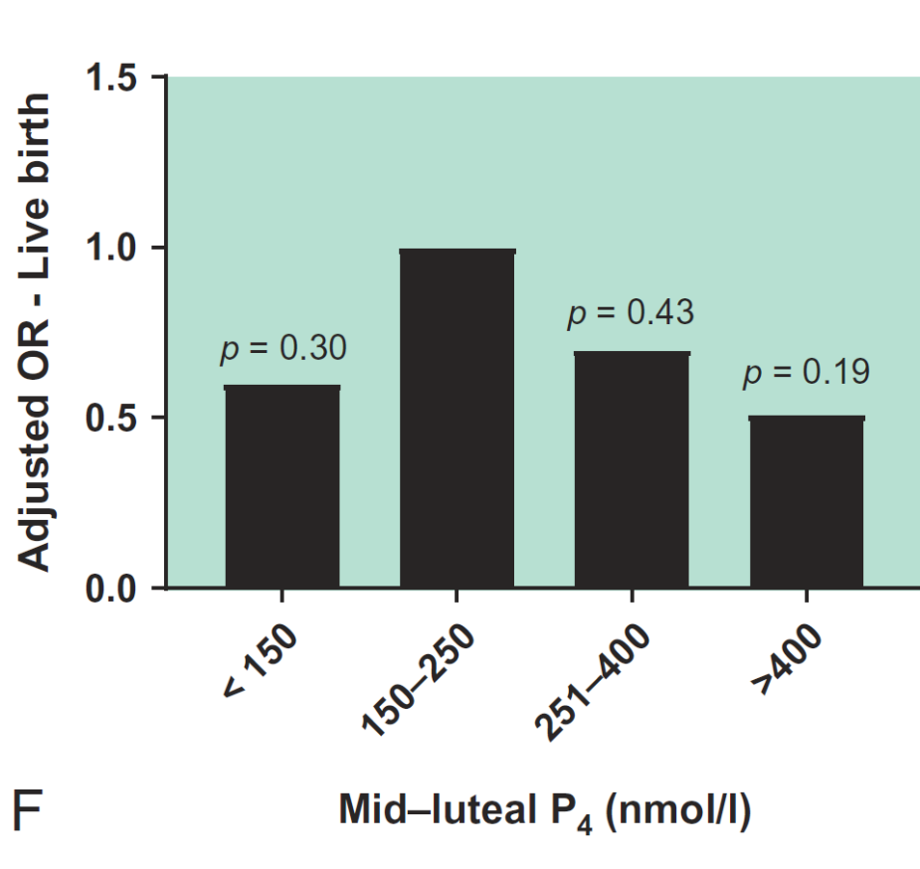
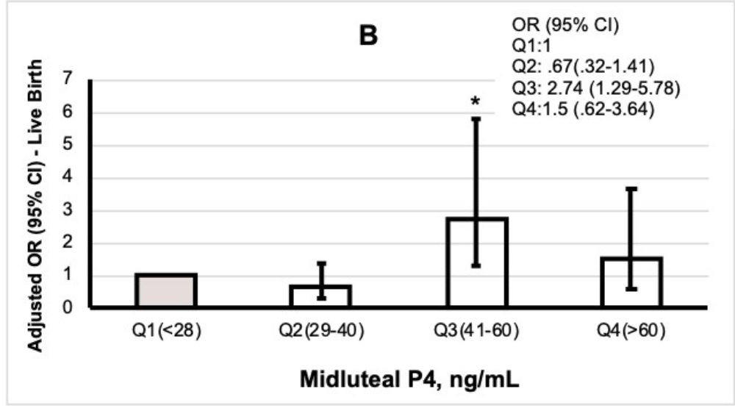
Does one-size fit all?
Thomsen et al, 2018, Benmachiche et al, 2021

Slide 8
Possible reasons for the weak relationship
Non-exclusion of elevated trigger day P cycles?
 | Trigger day P (ng/mL) |  |  |  | P-value
 | <0.74 | 0.75-0.94 | 0.95-1.30 | >1.30
Mid-luteal P (ng/mL) | 38.81 | 36.20 | 40.00 | 49.00 | 0.02
Benmachiche et al, 2021

Slide 9
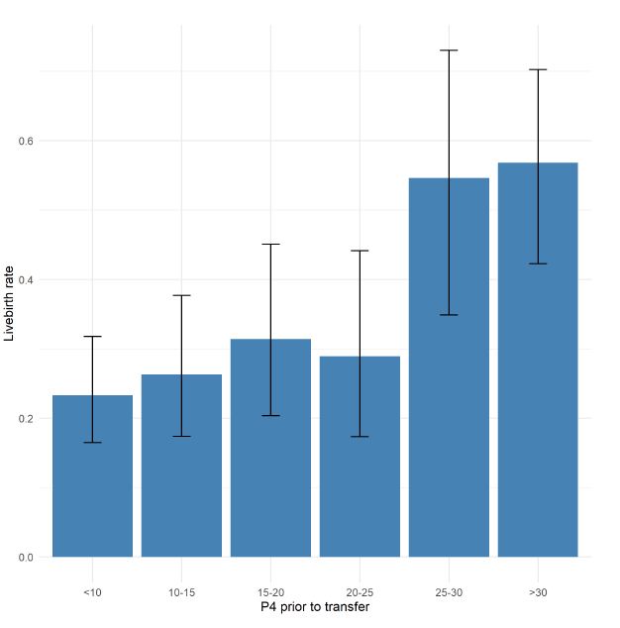
What if we account for that?
Clinical miscarriage
aOR 0,49 (0.27-0.87)
Livebirth
aOR 2.29 (1.51-3.45)
<30.0%
Despite rescue therapy
17.9%
Soares et al, 2024 (ESHRE)

Slide 10
Do we need progesterone supplementation?
Yes (and possibly measurement as well)
In the fresh cycle?
In the artificial FET cycle?
In the natural cycle?
To improve perinatal outcomes?
Yes, more info soon (next lecture)

Slide 11
Do we need LPS (and to measure transfer day P)?
Study | n | Outcome | Measurement | Cut-off | LPS | Normal P | Low P
Gaggiotti-Marre et al. 2020 | 294 | LBR | Day before ET | 10 ng/mL | No | 41.1% | 33.0%
Saupstad et al., 2022 | 170 | OPR | ET day | 9.25 ng/mL (p25) | hCG | 60.6% | 56.1%
Labarta et al., 2022 | 244 | OPR | ET day | 20.2 ng/mL (p25) | Yes | 47.5-51.7% | 56.7%
2 cases <10.0 ng/mL: 0% OPR

Slide 12
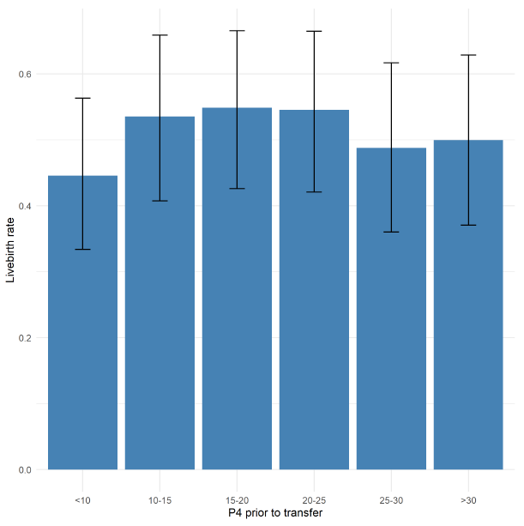
Do we need to measure transfer day P in natural cycles?
Livebirth (n=2292)
Only 3,1% with P4<10 ng/mL
But OR 0,568, IC 95% (0,330-0,977)
Despite rescue therapy!
Santana et al, 2024 (ESHRE)

Slide 13
Do we need progesterone supplementation?
In the fresh cycle? Yes (and possibly measurement as well)
In the artificial FET cycle? Yes, more info soon (next lecture)
In the natural cycle?
To improve perinatal outcomes?
If you want to avoid low-levels, yes!

Slide 14
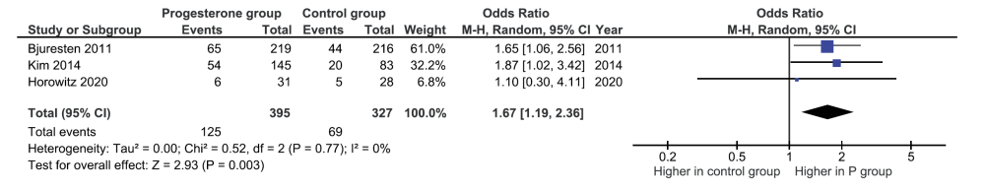
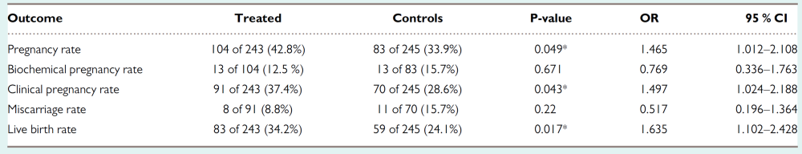
Does LPS improve livebirth rates?
Mizrachi et al. 2021, Wanggren et al. 2022

Slide 15
Does LPS improve livebirth rates?
beyond
 | LPS | No LPS | P-value
Gestational hypertensive disorders | 6/136 (4.4%) | 10/91 (11.0%) | 0.058
Normal range birthweight | 112/136 (82.4%) | 64/91 (70.3%) | 0.033
Elenis et al. 2025

Slide 16
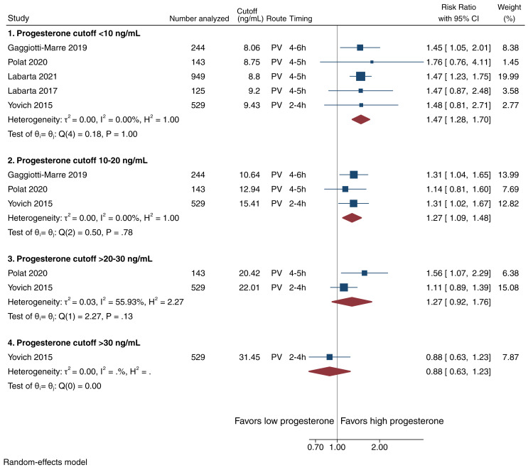
Possible solution for HRT cycles – measuring P?
Could rescue therapy be enough?
Melo et al. 2021

Slide 17
Is rescue therapy enough?
Maybe not…
Rafael et al. 2024 (under review)
Notes:
Present ORs

Slide 18
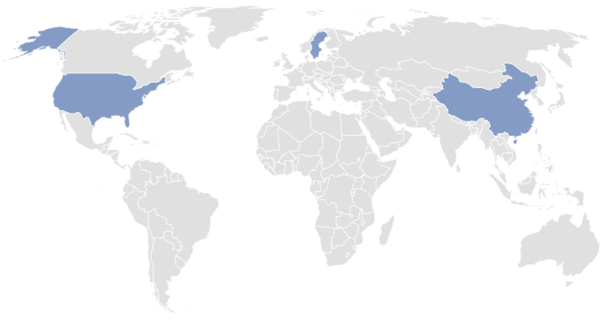
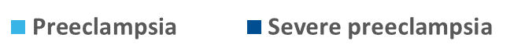
What about hypertensive disorders?
Also true in the oocyte donation model!
  von Versen-Höynck et al, 2018 Gingstrom Ernstad et al, 2019, Jing et al, 2019, Rafael et al. 2021, Zaat et al. 2023
Notes:
Were also on average 100 g heavier

Slide 19
Why use the natural cycle?
Pros
Lower miscarriage risk
Less gestational hypertension
PE/miscarriage are rare events!
Give aspirin and you are good!
Just give even more progesterone?
Personalize LPS with obesity, PE risk and endometriosis/adenomiosis?

Slide 20
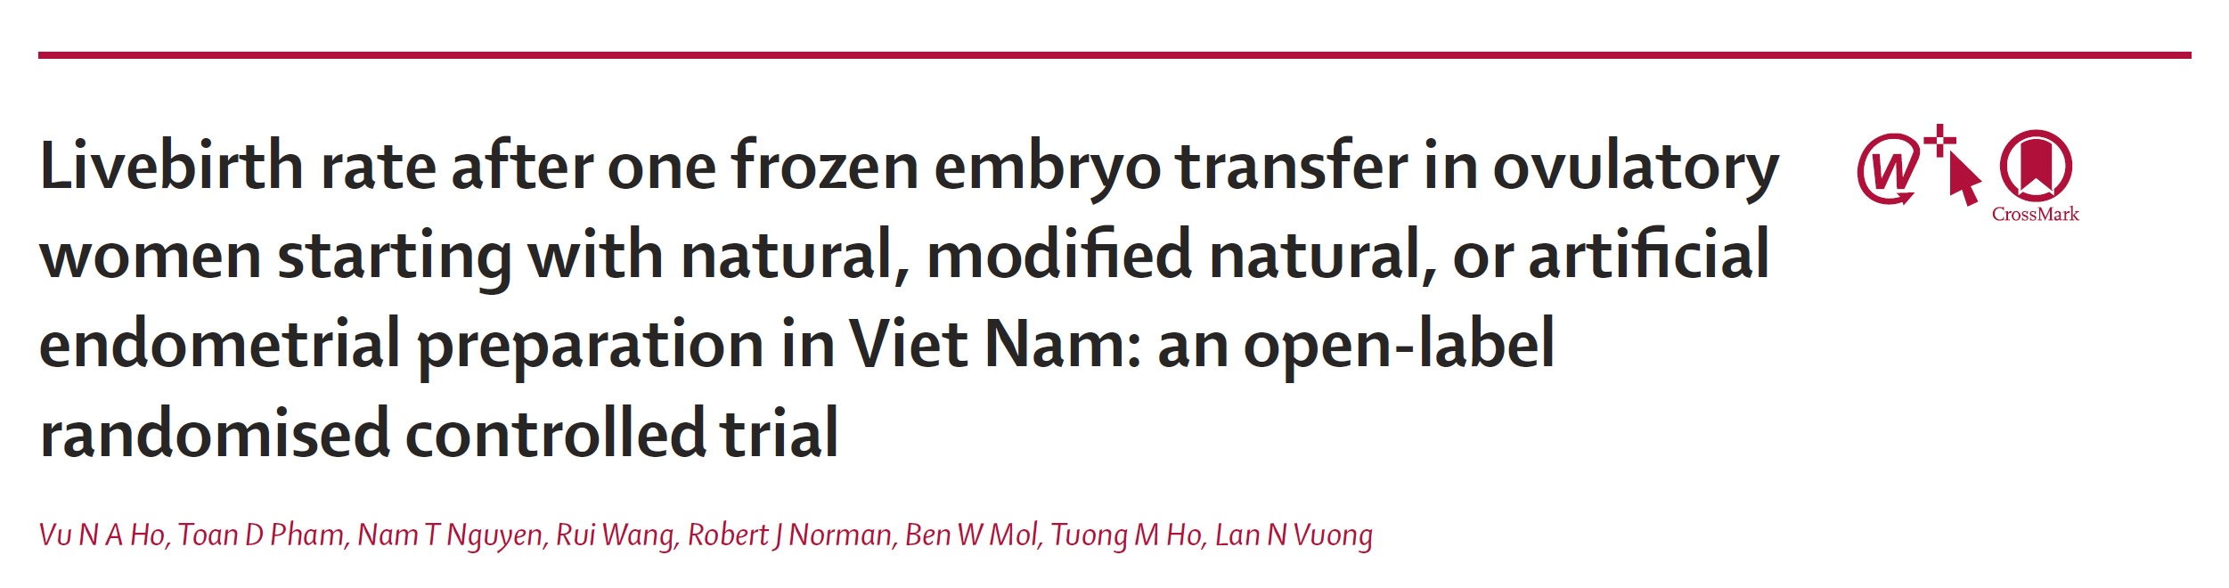
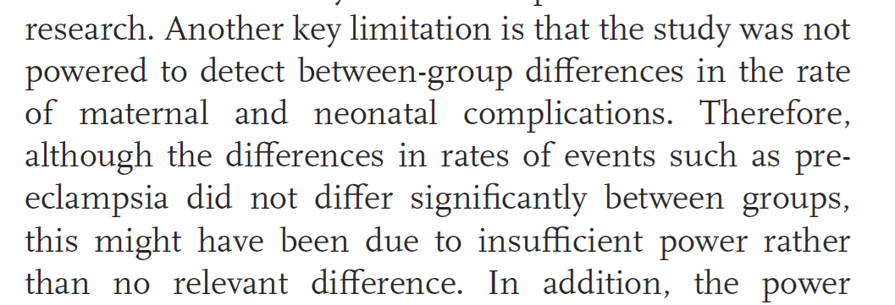
New data just out – the MONART Study
 | Natural n=476 | Modified natural n=476 | Artificial n=476
hCG+ pregnancy | 48% | 47% | 49%
Livebirth | 37% | 33% | 34%
Miscarriage | 6% | 5% | 8%
HDP | 2% | 2% | 3%
Can we end this discussion already?
I would wait for the (larger) ongoing RCTs…
Ho et al. 2024

Slide 21
MONART and perinatal outcomes?
Ideal population with average age of 33 yrs-old (lower risk of adverse outcomes)
Data presented per randomized patient (>50% have 0% risk of perinatal outcomes)
Intention-to-treat (20% in the NC arms actually perform an artificial cycle)
Ho et al. 2024

Slide 22
“Reverse-engineering” the MONART trial
 | mNC | AC | RR (94% CI) | p
Miscarriage <12 weeks
ITT | 24/476 (5.0%) | 36/476 (7.6%) | 0.67 (0.40-1.10) | 0.14
ITT per hCG+ pregnancy | 24/224 (10.7%) | 36/232 (15.5%) | 0.69 (0.43-1.12) | 0.17
PP/crossover per hCG+ pregnancy | 14/160 (8.8%) | 46/296 (15.5%) | 0.56 (0.32-0.99) | 0.04
Hypertensive disorders
ITT | 8/476 (1.7%) | 12/476 (2.5%) | 0.67 (0.27-1.62) | 0.50
ITT per ongoing pregnancy | 8/164 (4.9%) | 12/165 (7.3%) | 0.67 (0.28-1.60) | 0.49
PP/crossover per ongoing pregnancy | 4/122 (3.3%) | 16/207 (7.7%) | 0.42 (0.15-1.24) | 0.15
From “rare events with only 1-2% difference”… to “common events with double the risk in ACs”
Ho et al. 2024

Slide 23
The “rare event” argument… revisited
OHSS also occurs in 2-3% of the ART population
GnRH antagonists reduce the risk in 50%
Still, it took us >10 years to accept this because OHSS “was rare”…

Slide 24
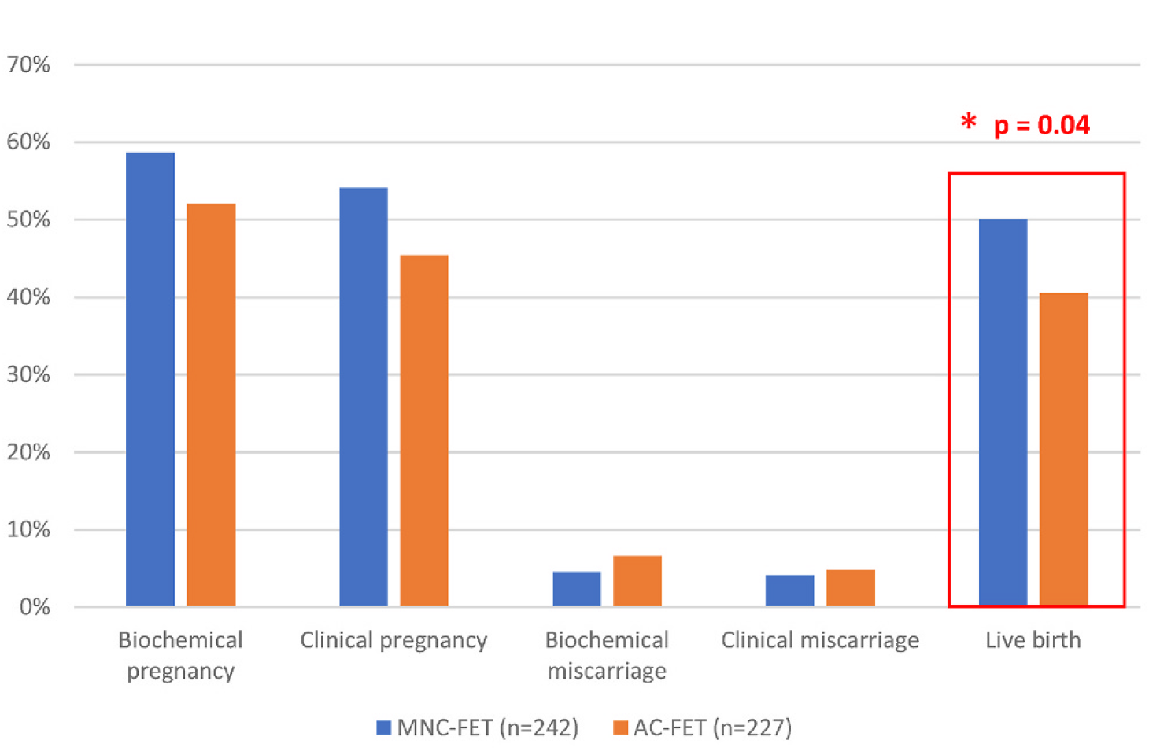
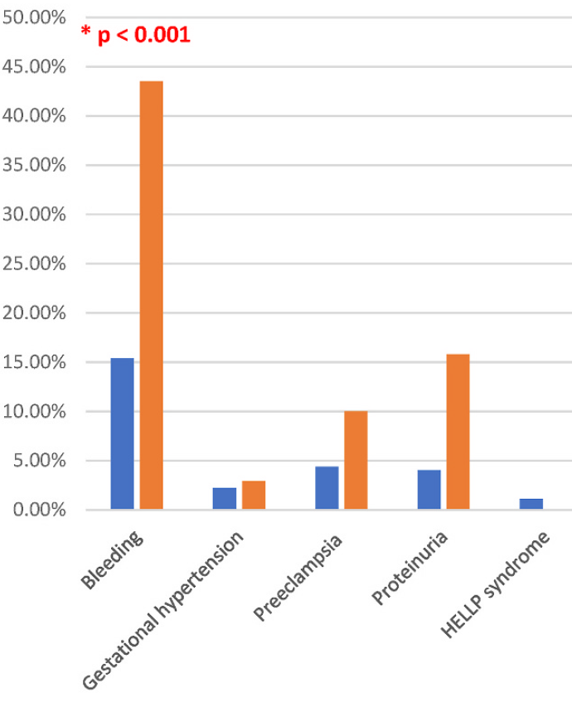
New RCT
Bellver et al. 2025

Slide 25
Does aspirin work?
N=343 (18-48 years-old)
May 2021 and June 2023
 | ORec n = 96 | PCOS n = 111 | AC-FET n = 136 | General population (Rolnik et al., 2017)
Positive screening + aspirin, n (%) | 28 (29.2) | 21 (18.9) | 20 (14.7) | 10.5%
Preeclampsia, n (%) | 11 (39.3) | 6 (28.6) | 7 (35.0) | 8.3%
  Moeykens et al, 2024 (under review)

Slide 26
Why use the natural cycle?
Pros
Lower miscarriage risk
Less gestational hypertension
PE/miscarriage are rare events!
Give aspirin and you are good!
Just give even more progesterone?
Personalize LPS with obesity, PE risk and endometriosis/adenomiosis?

Slide 27
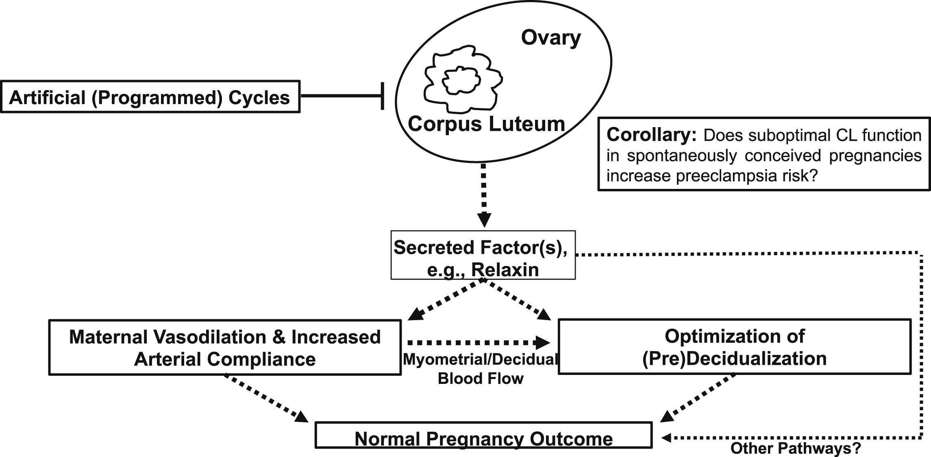
The corpus luteum may do more than we think…
  Conrad et al. 2022

Slide 28
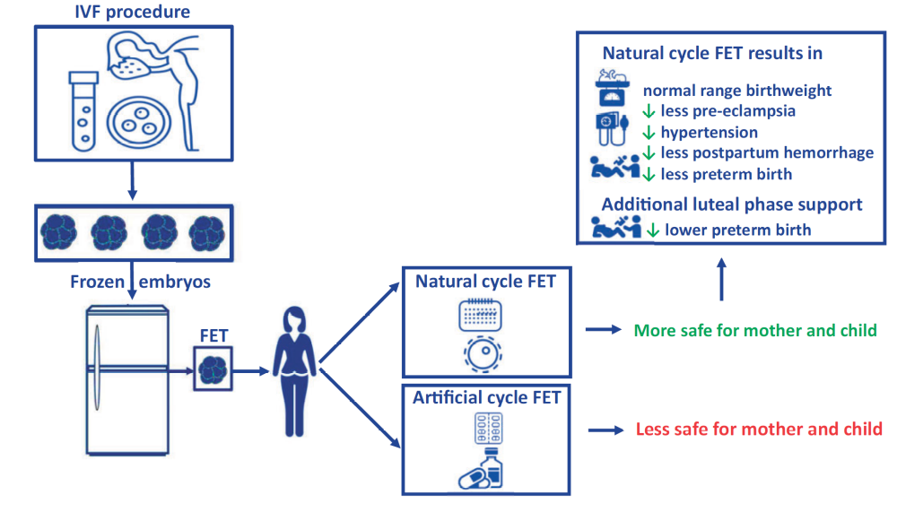
The corpus luteum may do more than we think…
  Zaat et al. 2023

Slide 29
Why use the natural cycle?
Pros
Lower miscarriage risk
Less gestational hypertension
Cons
Only for cycling women
Less flexibility/control
Higher cancelation rates
How can we tackle these issue?

Slide 30
One possible solution for non-cycling women?
Artificial cycle versus letrozole in women with PCOS (n=2664)
 | OR (95% CI) | aOR (95% CI)
Biochemical pregnancy | 0.88 (0.73-1.06) | 0.97 (0.79-1.19)
Clinical pregnancy | 0.94 (0.79-1.13) | 1.04 (0.86-1.27)
Miscarriage | 0.49 (0.35-0.69) | 0.51 (0.35-0.74)
Ongoing pregnancy | 1.08 (0.91-1.29) | 1.24 (1.02-1.51)
Live birth | 1.16 (0.97-1.38) | 1.33 (1.09-1.61)
  Zhang et al, 2019

Slide 31
Possible solutions for cycling women… the NPP-FET cycle
  Mendes Godinho et al, 2018 (ASRM), 2023 (ESHRE)

Slide 32
New data from the NPP-FET cycle
P<0.05
P<0.05
P<0.05
P<0.05
  Mendes Godinho et al, 2024

Slide 33
New data from the NPP-FET cycle
 | NPP n=369 | Natural n=3771 | Artificial n=2527 | p value
Number of visits | 1.8ª | 2.1ª | 1.3ª | <0.01
P4 transfer day | 20.6ª | 20.5^{b} | 10.4^{a,b} | <0.01
Rescue P4 | 2.9%ª | 1.3%^{b} | 26.1%^{a,b} | <0.01
Hypertensive disorders | 9.4% | 8.6%ª | 14.5%ª | <0.01
  Mendes Godinho et al, 2024

Slide 34
Not ready to hop on the NPP train yet?
Smart idea…always wait for prospective studies!
Maybe you would be more comfortable with one of these approaches
Low dose ovarian stimulation/antagonist suppression
At least you avoid the weekends…

Slide 35
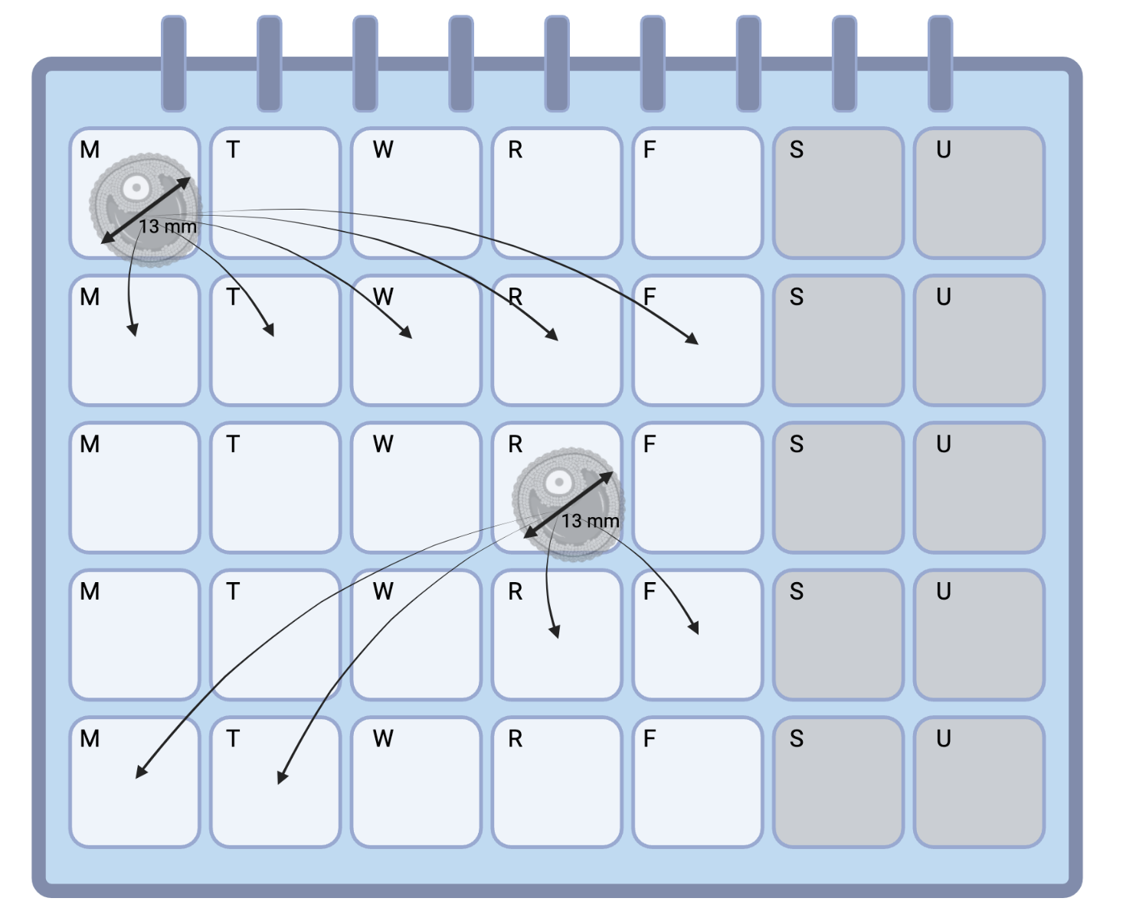
Not ready to hop on the NPP train yet?
Maybe you would be more comfortable with one of these approaches
Low dose ovarian stimulation/antagonist suppression
Flexible hCG triggering (e.g. smaller follicles)
  Alonso-Mayo et al, 2023

Slide 36
Not ready to hop on the NPP train yet?
Maybe you would be more comfortable with one of these approaches
Low dose ovarian stimulation/antagonist suppression
Flexible hCG triggering (e.g. smaller follicles)
Flexible LPS (sooner after hCG triggering/LH peak)
For those of you that are weary of not giving hCG just yet…

Slide 37
Take-home messages
We still have a lot to learn from the luteal phase
Personalization is key – say “no” to one FET strategy for all!

Slide 38
Thank you

