Slide 1
Rapid vitrification and warming
Progress in cryopreservation of embryos, blastocysts and oocytes
Lisbet Van Landuyt
Brussels IVF
Notes:
Good morning
I will talk today about rapid vitrifcation and rapid warming which is a new development in cryopreservation of…

Slide 2
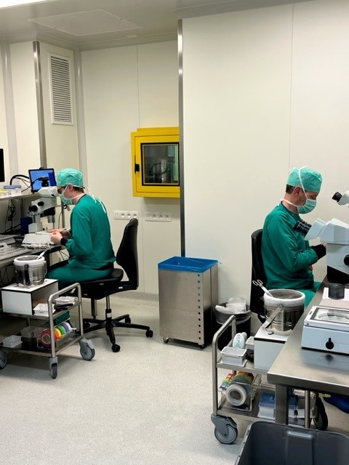

Introduction
Progress in cryopreservation methods
Last decade: development of vitrification as the standard method for cryopreservation of oocytes, embryos and blastocysts
higher survival rates compared to slow freezing protocols
increased efficiency of warming cycles: 1thaw = 1ET
High pregnancy rates (~ fresh cycles)
High efficiency of the current vitrification protocols!
Notes:
During the last decade, vitrification became the standard method worldwide to cryopreserve oocytes, cleavage stage embryos and blastocysts
After Vitrification there is a higher survival rate compared to This higher surv rate leads to increased efficiency of a warming cycle. In 99% of cycles we only have to warm 1 embryo to be able to transfer it. We also obtain high pregencyc rates comparable to fresh cycles. All this resulted in a high efficiency of our current vitrification protocols with almost 100% satisfaction guaranteed. We thought….BUT

Slide 3
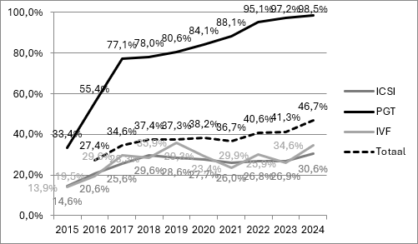

Introduction
Rationale for shorter vitrification and warming protocols
Number of freeze all cycles with postponed frozen embryo transfer has increased (46,7 % of cycles in 2024 in Brussels IVF)
2024: 4677 vitrified blastocyst transfers at BrusselsIVF
High impact on the daily organization of the IVF lab
  We would benefit from a reduction in procedure time
  It would simplify the workflow
Vitrification is a highly operator dependant procedure
Simplification would reduce inter operator deviations
Notes:
But, is there than a rationale for …
Well, as we all experience in our labs, the number of FA cycles has increased. As you can see in this graph, this is 46,7% overall In brussels IVF, for PGT cycles it is almost 100%) resulting in 4677 blastocyst transfers in 2024. it is a fact that vit and warming cycles have a high …. And therefore we would benefit… and it would… Moreover, it is highly operator dependant procedure and simplification wuld reduce…. So, there is room for simplification and who knows maybe improvemnet as well?

Slide 4
New developments in cryopreservation
Overview of new protocols in literature
Rapid warming
Rapid vitrification
One-step warming of blastocysts
One-step warming of cleavage stage embryos
One-step warming of oocytes
Ultra-fast (direct) warming of blastocysts
Rapid vitrification of oocytes
Rapid vitrification of blastocysts
Notes:
What are now these new developments in cryopreservation?
On the one hand, ther is the development og rapid-warming of bl, cl, oocytes
But also the ultra fast direct warming of blastocyst (this will be explained later on)
On the other hand there is the development of rapid vitrification protocols for

Slide 5
Rapid warming of blastocysts
Early data on rapid warming of vitrified research blastocysts
Validation of a new ultra-fast blastocyst warming technique reduces warming times to 1 min and yields similar survial and re-expansion compared to blastocysts warmed using a standard method. Manns et al. ASRM 2021
Manns et al. 2022 (ASRM 2022), Taylor et al. (ASRM 2022)
Multicenter preclinical validation of warming procedures for human blastocysts involving a short exposure to a single sucrose solution shows promising survival, re-expansion and continued development. Gunst and Ahlstrom 2022, abstract BSRM
Rapid warming of human blastocysts: Is 1M sucrose the only choice? Liebermann, Abstract CRB Symposium 2023, Las Vegas
Rapid warming of non-biopsied vs. biopsied blastocysts: Is there a need for assisted hatching? Liebermann, Abstract CRB Symposium Las Vegas 2023
Ultra-Rapid Warm: A preclinical comparative analysis of the effects of different sucrose concentrations on blastocyst survival, re-expansion and development post-warm. Emeny-Smith, Vitrolife Sweden/USA, abstract
Effect of reducing the vitrification and warming times on blastocyst survival and pregnancy rates. Kaskar et al. Abstract ASRM October 2023 (Texas, Fujifilm reference center)
Notes:
I will start with literature on the rapid warming of blastocysts;
These are the early data presented as oral or poster presenttions, mostly at american congresses.
The first one to introduce rapid warming the abstract of manns et al ASRM 2021and in 2022 as well, Followed by other abstracts. I will come back to some of them later in the presentation
But the generalThere was also the Abstract of Gunst et al at the BSRM meeting in 2022; then 2 abstracts of the group of Lievbermann, one on the sucrose cocn and the second on the difference between biopsie and non-biopsied blastocysts. There was an abstract of Vitrolife on the effects of different sucrose conc. Then there is a study on the combination of rapid vitrification and rapid warming of blastocysts by kaskar. I will come back later to some of these abstracts in detail but in general…

Slide 6
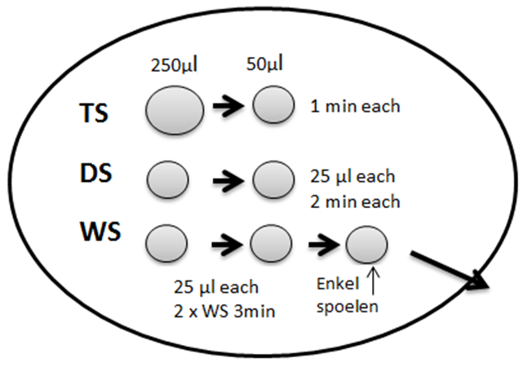
Rapid warming of blastocysts
Standard protocol versus rapid warming protocol
Standard protocol: 12’
Decreasing sucrose/trehalose conc (1M-0,5M-0M)
Rapid warming: 2’
1 droplet sucrose/trehalose conc (1M-0,5M-0,25M)
1 or 2 minutes
1 ML/500µl/250µl
No dilution!
No washing!
+ extra rinsing droplets blastocyst culture medium
droplet in culture dish
Culture dish
Notes:
I will first explain you what is the difference between the conventional standard method and the rapid protocol that is now introduced.
In the standard protocol a decreasing sucrose or trehalose conc (depending on the warming kit you are using) is applied before transferring the embryo to the culture dish. This is the classic 12 min protocol. Wheras In the rapid protocol there are no dilution and washing steps. There is only 1 droplet with a certain sucrose/trehalose cocn (and this differs in the different studies but everything works) is used and depending on the con it is exposed 1 or 2 min. Also the size of the droplet can vary from 1 ml (or even more) to 250 µl. After the 1-2 min incubation the embryo is rinsed in pre-incubated droplets of culture medium before culture in blast medium.

Slide 7
Rapid warming of blastocysts
Early data on rapid warming of vitrified research blastocysts
Manns et al. ASRM 2021: Validation of a new ultra-fast blastocyst warming technique reduces warming times to 1 min and yields similar survial and re-expansion compared to blastocysts warmed using a standard method.
Comparison of ultra-fast protocol on research blastocysts
TS 1 min 37°C with 1M (Fujifilm) or standard warming
 | Standard (32) | Ultra-fast (39)
Survived | 32(100) | 39 (100)
Re-expanded after 24h | 31 (96,9) | 39 (100)
Conclusion: no significant differences in survival and re-expansion
Notes:
So i come back now to the first abstracts of Manns et al on the validation of an ultra-fast warming technique. They reduced warming time to 1 min incubation with1M sucrose conc and obtained survival rates of 100%,

Slide 8
Rapid warming of blastocysts
Early data on rapid warming of vitrified research blastocysts
Multicenter preclinical validation of warming procedures for human blastocysts involving a short exposure to a single sucrose solution shows promising survival, re-expansion and continued development. Gunst et al BSRM 2022
Effect of sucrose conc? Comparison of 2min 37°C with low (0,25M) or 1 min with high (1,0M) sucrose (RapidWarm Omni, Vitrolife)
 | Low sucrose (0,25M) | High sucrose (1,0M)
Survived | 50 (100) | 49 (98)
Re-expanded | 49 (98) | 47 (94)
24 h hatching/hatched | 37 (74) | 38 (78)
Time to re-expansion | 1,64 ± 0,61h | 2,2 ± 1,41h
Time to hatching | 5,1 ± 0,8h | 7,82 ± 13,51h
Conclusion: use of low sucrose tends to result in faster re-expansion
Notes:
This is the poster of Gunst et al presented at the BSRM meeting in 2022. They investigated the effect of the sucrose conc and compared a short protocol 2 min low sucrose with 1 min high sucrose in 2x 50 blastocysts. Similar survival and re-expansion rates were obtained. But the use of low sucrose tended to result in faster re-expansion and hatching rates.

Slide 9
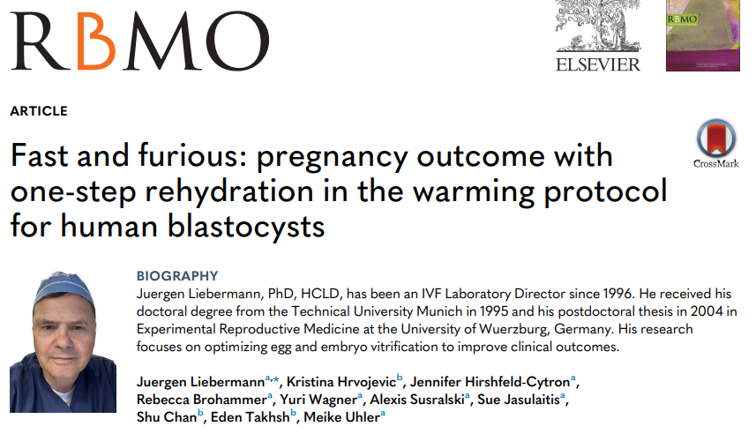
Rapid warming of blastocysts
Liebermann et al. 2024: clinical application
Notes:
Then there was a first real publication of Liebermann et al in 2024 who reports on the clinical implementation after a pilot study on research blastocysts

Slide 10
Rapid warming of blastocysts
Liebermann et al. 2024: clinical application
Closed stepwise vitrification (HSV straw CBS)
1-step rehydration in droplet 400µl 1M sucrose 1 min 37°C (Fujifilm)
preclinically validated in biopsied and non-biopsied research blastocysts
Clinical outcome | Standard (833 cycles) | 1-step (2606 cycles) | P value
Survived | 99,5% | 99,5% | 0,9
Pos hCG rate | 69,8% | 72,9% | 0,094
Clinical pregnancy rate | 59,9% | 62,9% | 0,11
Implantation rate | 57,0% | 63,6% | 0,00055
Ongoing pregnancy rate | 55,4% | 60,4% | 0,011
Miscarriage rate | 7,6% | 4,0% | 0,0001
Independent of age, PGT, day of cryo, embryo grade
Notes:
Blastocysts were vitrified with conventional stepwise vitrification using a closed system. The warming protocol was 1step rehydration in 400 µl droplet with high sucrose for 1 min with Fujifilm media. This protocol was preclinically validated on biopsied and non-biopsied blastocysts. The clinical outcome was evaluated in 833 standard warming cycles and 2606 1-step warming cycles. Survial was 99,5% in both protocols. high pregnancy and clinical pregency rates were obtained. But implantation rate and ongoing pregnancy rates were significantly higher after rapid warming. Also lower miscarriage rate was seen. This was independent of age, etc; they did not adjust for endometrial prpeparation of the FRET cycle but most cycles an artificial cycle was used.

Slide 11
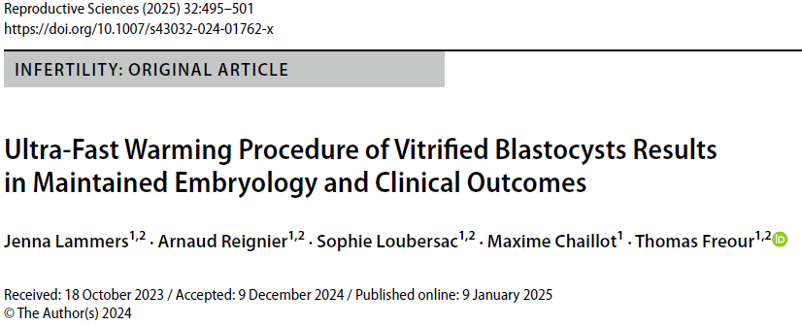
Rapid warming of blastocysts
Lammers et al. 2024: clinical application
Notes:
a second paper with clinical results was published by Lammers et al. (this is the lab of Thomas freour from Nantes)

Slide 12
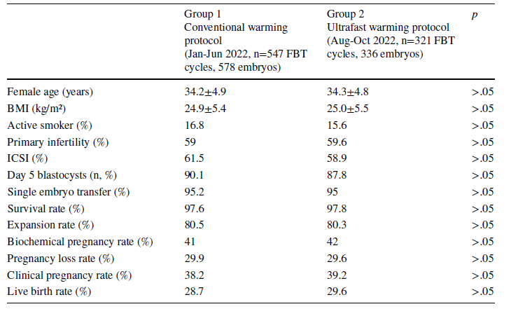
Rapid warming of blastocysts
Lammers et al. 2025
Vitrification in closed Rapid-I straw (Vitrolife, Rapid Vit Blast kit)
Rapid warming protocol: 2 min Warm 1 Blast sucrose 37°C (0,25M) (Vitrolife)
Prospective clinical pilot study (comparison 3 months rapid warming with preceeding 6 months standard warming)
Notes:
But with a different protocol, they used a 2 min incubation in low sucrose 0,25M from vitrolife. They compared 3 months of rapid warming with preceeding 6 months of standard warming. With both protocols, survival of 97, was obtained,. There was no sign difference in pregn and live births.

Slide 13
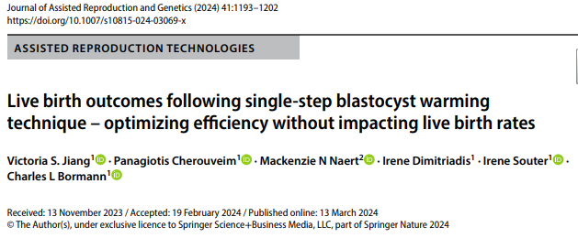
Rapid warming of blastocysts
Jiang et al. (2024): Neonatal outcomes
Notes:
The last paper on rapid warming of blastocyst by Jiang et al; from Boston focused on live births and neonatal outcomes

Slide 14
Rapid warming of blastocysts
Jiang et al. 2024
Rapid warming protocol 1 min 1M trehalose 37°C (FujiFilm NX) + 5 rinsing droplets culture medium
 | Standard (376) | 1-step (376) | P value
Survived | 100% | 100%
Clinical pregnancy rate | 52,7% | 54,0% | 0,715
Multiple pregnancy rate | 5,6% | 10,8% | 0,054
Live birth rate | 43,1% | 44,4% | 0,713
Birth weight | 3385,6 | 3325,2 | 0,374
After adjusting for age, FET preparation, day of transfer, PGT, …
→ no difference in pregnancy and live birth rates or birthweight
→ higher multiple pregnancy rate/multiple live birth rate after single-step warming
No difference in gestational age, preterm delivery rate, apgar scores (when adjusted for number of live births/delivery)
No congenital malformations
Notes:
Cryolock closed device (Fujifilm).
They used a1 min 1 M trehalose incubation followed by 5 rinsing droplets.
They compared 376 warming cycles in each group and obtained 100% survival.
Multiple pregnancy rates 10,8% after 1step warming compared to 5,6% with borderline significance. When they adjusted for several parameters like age, FET preparation, day of cryo etc they founf a sign higher multiple pregn rate fater rapid warming.
But there was no difference in Lbrate and birthweight.
Obstetrical outcomes were similar like gestational age, preterm delevery rate and apgar scores and no congenital malformations were found
April 2021-apr22 std warming, rapid warming apr 2022-dec22

Slide 15
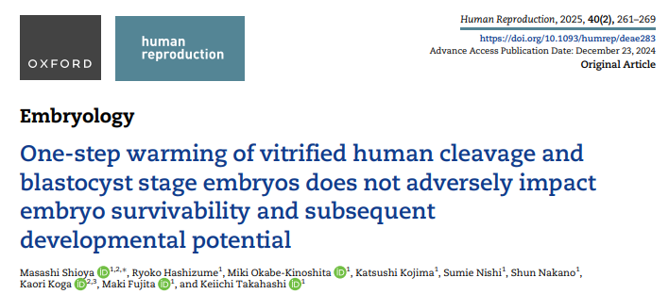
Rapid warming of cleavage stage embryos
Shioya et al. (2025): Research embryos
Notes:
All the time I was talking about blastocyst warming but what about cleavage stage embryos? But here it is, a recent Japanese paper from 2025 with good survival after rapid warming of both blasyoctsts and day 3 embryos
In fact, worldwide and especially in the States there is no interest anymore in those embryos because everybody is transferring blastocysts these days. However, in Europe, we still cryopreserve day 3 embryos or at least we have still day 3 embryos frozen in our storage tanks.

Slide 16
Rapid one-step warming of cleavage stage embryos
Shioya et al. 2025
Vitrified leftover research embryos and blastocysts (STD/CryoTOP)
Standard multistep warming
Rapid 1-step warming
1 min trehalose 1M 37°C (Fujifilm NX)
5 x rinse in culture medium
89 embryos
100 blastocysts
88 embryos
100 blastocysts
Survival cleavage stage embryos > 50% cells intact!!
Survival blastocysts = presence of blastocoel expansion
Survival 100%
Survival 99%
Survival 100%
Survival 99%
Notes:
The paper only reports a study on research blastocysts with a rapid warming protocol 1M trehalose.
They obtain 100% survival but a small remark on the definition of the survival rate, because they define survival as embryos that are more than 50% intact, so we don’t know how many were 100% intact.

Slide 17
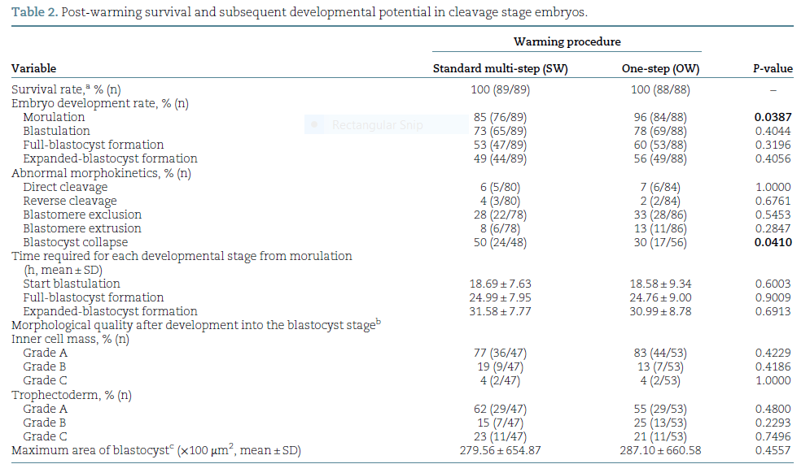
Rapid one-step warming of cleavage stage embryos
Shioya et al. 2025
Notes:
This table shows us the subsequent developmental potential of embryos which was not different except from more embryos in the compacted morula stage on day 4 after rapid warming. The % expanded blastocysts was the same. But then, at the blastocyst stage they observed lower blastocyst collapse rate(which is considered to have a negative correlation with implantation)

Slide 18
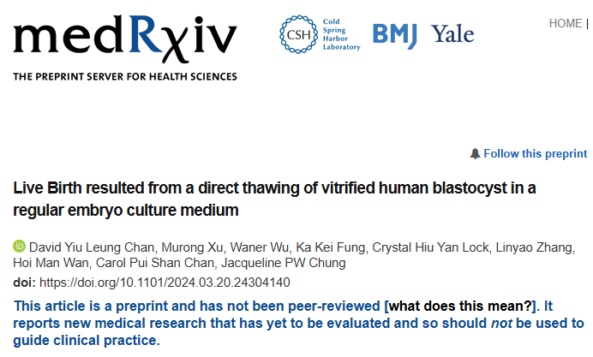
Direct warming in culture medium
Chan et al. (2024): pilot study/clincical application
1 min 37°/1ml culture medium
No intermediate solution with cryoprotectant!
Notes:
All the previous papers report on rapid 1-step warming but it seems that there is also the possibility to directly warm the blastocyst in culture medium without any intermediate solution with cryoprotectant, like in this paper of Chan et al. 2024. this is a preprint and not peer revised yet.

Slide 19

Direct warming in culture medium
Chan et al. 2024
Direct thawing is known from animal embryos (bovine blastocysts)
Pilot study on 63 human research blastocysts:
  Testing of 4 commercially available one-step media and PBS
  Repeated direct warming and repeated biopsies were tested
  Blastocysts were vitrified with conventional VIT (Fujifilm/Rapid-I)
Clinical study:
  20 patients direct warming
  96 patients conventional warming
MARA
Notes:
The direct thawing protocol is actually known from animal breeding, especially bovine blastocysts. Let me introduce you to MARA, this is a Brazilian cow from which most embryos have been thawed for the total amount of 1,3 milj euro’s
But back to the study of Chan, they tested 4 different commercial media on 63 human blastocysts, they also tested the protocol after repeated direct warming and repeated biopsies. And blast were previously vitrified with conventional method using rapid I carrier. They also show some clinical results on small number of patients.

Slide 20
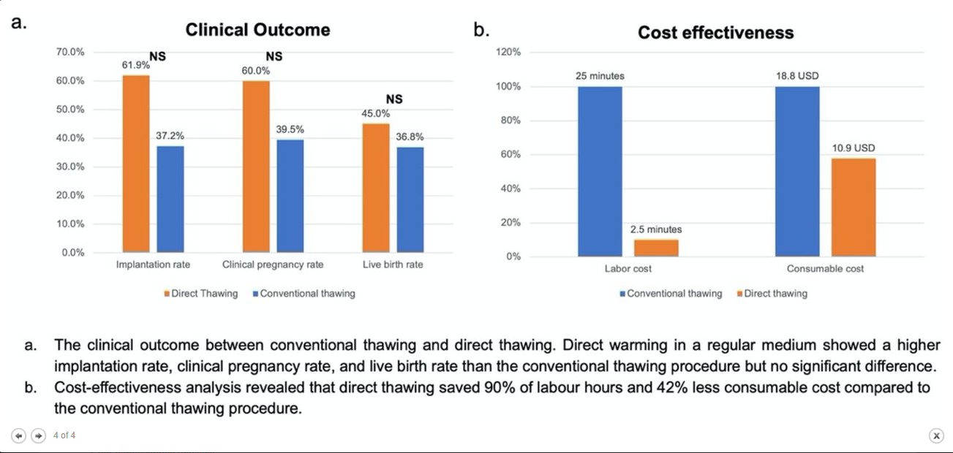
Direct warming in culture medium
Chan et al. 2024
Notes:
This graph shows us the implantation rate clin P rate and live birth rates which is higher for the direct thawing but not significant because of very small patient number. And of course labor and consumable cost are also diminished after direct thawing

Slide 21
Rapid warming
Discussion
Major concern = embryos move directly from TS to culture medium (dilution and washing steps are eliminated)
Potential damage to plasmamembrane caused by rapid water influx due to abrupt changes in osmotic pressure
→ decreased survival in mouse embryos and blastocysts (Pedro et al. 1997)
Similar survival, development, re-expansion rates
  → Sensitivity to osmotic stress may vary amongst species (1step warming established protocol in bovine, donkeys, porcine)
  → osmotic stress reduction is less necessary than previously thought
Reduced handling time, manipulations
Reduced exposure to suboptimal conditions
  → Positive effect on morphokinetics (morulation rate, collaps)
Notes:
Some points of discussion then. Our major concern of course with rapid warming in general is that embryos are moved directly…without dilution and washing steps and this may cause potential damage to…. This is what has been studied and observed in mouse embryos and blastocysts in the past.
But howver, we sobserve similar survival and development re-expansion rates afyter apid warming. So perhaps this sensitivity may vary … we know that 1step warming is an established protocol in bovine, also in donkeys and porcine. Perhaps osmotoc stress reduction is less necessar than previuosly thought
The rapid warming procedure also benefits from reduced handling time and less manipulations and reduced exposure during the procedure to suboptimal conditions and this may lead to pa postive effect on morphokinetics

Slide 22
Experience with rapid warming @BrusselsIVF
Rapid one-step warming of blastocysts: pilot study on 120 research blastocysts (NonPGT/PGT)
Rapid one-step warming of blastocysts: clinical outcome after 6-months use of rapid warming (Jan-June2024) compared to 1-year period before with conventional warming (2023)
Notes:
What is our own experience with rapid warming? First We did pilot study on 120 research blastocysts, both on PGT and nonPGT blastocysts and we implemented rapid warming in the routine IVF lab In january 2024. We did an evaluation of clinical outcome after 6 months of use of the rapid warming prot compared to 1 year period before using conventional warming.

Slide 23
Rapid warming blastocysts Brussels IVF
Short warming of blastocysts (SHOW study May 2023)
Pilot study, proof of concept, D5/6 research blastocysts, biopsied and non-biopsied
Protocol: 2 min 0,25M sucrose 37°C (OmniWarm 3 Vitrolife) + 4 rinses in culture medium
Warming droplet of 250 µl versus 500 µl
Closed device, CBS-HS-VIT straw
Notes:
I will go aover this briefly because I already presented the data on the last BSRM meeting in novmebr last year.
The protocol that we use is the 0,25 M 2 min protocol and 4 rinses in culture medium

Slide 24
SHOW study
Results IVF/ICSI blastocysts (without PGT)
 | D5D6 standard | D5D6 short | D5D6 250µl short | D5D6 500µl short
N warmed | 20 | 40 | 20 | 20
N survived (%) | 20 (100) | 40 (100) | 20 (100) | 20 (100)
N fully intact (%) | 20 (100) | 32 (80) | 16 (80) | 16(80)
N re-expanded 2h (%) | 15 (75) | 27 (67,5) | 13 (65) | 14 (70)
N re-expanded 4h (%) | 20 (100) | 38 (95) | 19 (95) | 19 (95)
N no re-expansion (%) | 0 | 2 (5) | 1 (5) | 1 (5)
N hatching 4h (%) | 6 (80) | 23 (57,5) | 12 (60) | 11 (55)
N fully hatched 24 h (%) | 6 (30) | 5 (12,5) | 2 (10) | 3 (15)
N hatching/hatched | 19 (95) | 38 (95) | 19 (95) | 19 (95)
Notes:
We obtained good survival rates in all groups tested similar re-expansion rates after 4h and hatching rates after 24 h, both in standard ICSI blastocysts

Slide 25
Rapid warming blastocysts Brussels IVF
Clinical study: Survival and re-expansion at the moment of transfer
Table I. Post-warming survival and re-expansion of 6742 blastocysts.
 | IVF/ICSI patients |  |  | PGT patients
 | Standard | SHOW | P value | Standard | SHOW | P value
N warmed | 3698 | 1914 |  | 734 | 396
N survived (%) | 3663 (99.0) | 1898 (99.2) | 0.791 | 722 (98.4) | 395 (99.8) | 0.074
N fully intact (%) | 2819 (76.2) | 1426 (74.5) | 0.163 | 486 (66.2) | 284 (71.7) | 0.068
N not re-expanded (%) | 171 (4) | 87 (4.6) | 0.940 | 67 (9.3) | 29 (7.3) | 0.314
N signs of re-expansion (%) | 352 (9.6) | 160 (8.4) | 0.163 | 43 (6.0) | 16 (4.1) | 0.218
N fully re-expanded (%) | 3140 (85.7) | 1651 (87.0) | 0.210 | 612 (84.8) | 350 (88.6) | 0.091
N hatching/hatched (%) | 621 (17.0) | 310 (16.3) | 0.582 | 582 (80.6) | 327 (82.8) | 0.404
N transferred (% per warmed) | 3663 (99.0) | 1894 (99.0) | 0.832 | 722 (98.4) | 395 (99.8) | 0.074
Notes:
These are post warming survival and re-expansion results from 6742 blastocysts , in IVF/ICSI patients and patients with PGT treatment. Total Survival rates were around 99% after standard and short warming, also %intact blastocysts was not different. Percentage of fully re-expanded blastocysts at the moment of transfer was 87% and 88; 6 % after short warming and arpund 85% after rapid warming but not significantly different.

Slide 26
Rapid warming blasytocysts Brussel IVF
Clinical outcome
Normal IVF/ICSI patients | Standard protocol (2023) | Short warming (Jan-June2024) | P value
N transfers (SET) | 3037 | 1564
N pos hCG (%)/ET | 1565 (51,5%) | 853 (54,5%) | 0,056
N clin P with FHB/ET | 1124 (37,0%) | 625 (40,0%) | 0,054
PGT patients | Standard protocol (2023) | Short warming (Jan-June 2024) | P value
N transfers (SET) | 722 | 393
N pos hCG (%)/ET | 474 (65,7%) | 267 (67,9%) | 0,479
N clin P with FHB/ET | 391 (54,2%) | 223 (56,7%) | 0,588
Notes:
This table presents the clincial outcome in both patient grouyps. We obtained 54% poshCG rate and 40% clin P rate after short warming compared to 51 and 37% with borderline significance.
However, when we adjusted for confounders, like age, EQ, endometrial preparation, no sign impact of warming protocol was found on clin P rates
In PGT patients, we obtained clin P rate of …was 67,9% and 56,7% compared to 65,7 and 54,2% after PGT treatment, but not significantly different

Slide 27
Rapid warming blasytocysts Brussel IVF
How does it impact our workflow?
Reduces time needed to finish our daily warming program in the IVF lab
More warming procedures can be performed by 1 operator
  Weekdays: ± 25 warming cycles on average performed by 2 operators (instead of 3) (patients arrive for transfer @10 am)
  Weekend: 1 operator (± 5-10 warming cycles)
Higher flexibility in case an extra blastocyst has to be warmed
Notes:
How does it impact our workflow?
It reduced time
We can perform

Slide 28
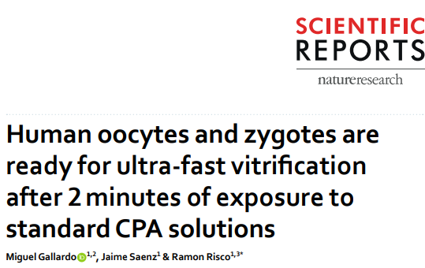
Rapid vitrification of oocytes
Gallardo et al. 2019: research oocytes
Ultra-fast, non-equilibration vitrification protocol
Closed device
Vitrification: 1 min ES +1 min VS (including loading/plunging) instead of gradual equilibration from 8-15 min in ES
Warming with gradual rehydration in 1M-0,5M-0M sucrose
All oocytes (30/30) and 3PNzygotes (27/27) survived and 24 resumed development
  After 29,4 sec in ES in both protocols, oocyte reached minimal volume point of 44,8%
  → Intracellular H2O ejection is complete
  End of ES exposure: volume increased to 48,6% in short protocol and to 79,4% standard protocol
  But! Intracellular osmolarity was very similar after 1 min or 10 min exposure to ES!
    → Prolonged exposure to CPA not necessary and will not improve cytosolic glass formation
Notes:
On the hand we had new developments in rapid warming, but what about rapid vitirication?. This was first established in oocytes. First one to propose an ultrafast vitrification protocol was Gallardo in 2019. They tested an ultrafast vit proto using closed device 1 min ES and max 1Min VS…. Warming was still done with conventional gradual rehydration. Yhis was tested in small number of research oocytes and 3PN zygotes.
What did they see?

Slide 29
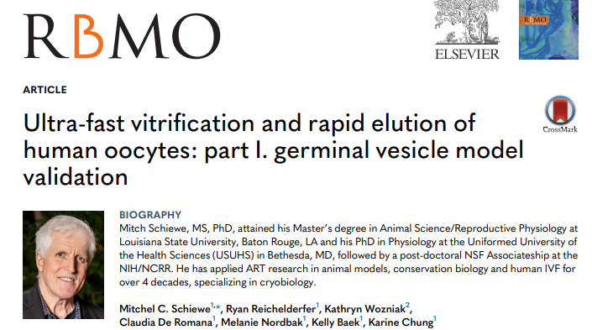
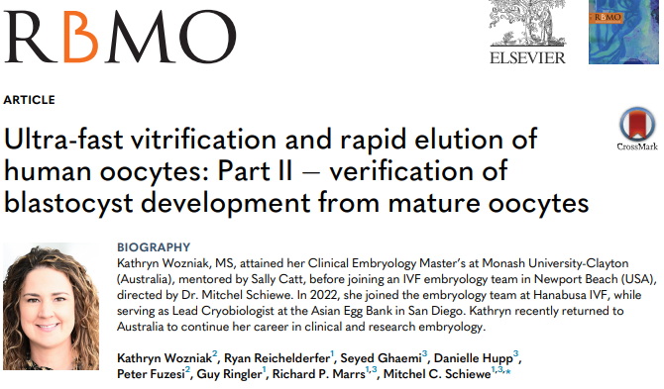
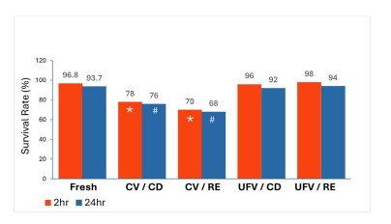
Rapid vitrification and warming of oocytes
Studies on research oocytes
Dec 24
Part I
Schiewe et al. 2024: Pilot study on GV oocytes
Ultra-fast VIT protocol (UFV): 1 min ES/1 min VS (~Gallardo)
Rapid warming (RE): 1 min 1M sucrose, 37°C
Oct 24
Notes:
Then other studies on research oocytes followed, published in the end of 2024 from the same group of schiewe et al. First pilot study on GV oocytes performing ultrafast protocol based on the Gallardo paper but they combined it with rapid warming. They compared different combinations with conventional vitiri and convand rapid warming and vitrification but the group where both rapid VIT as rapid warming was done resulted in the highest survial rates.

Slide 30
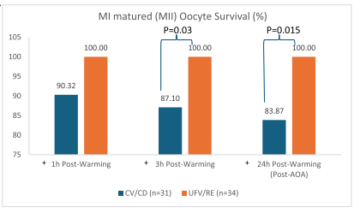
Rapid vitrification and warming of oocytes
Studies on research oocytes
Part II
Wozniak et al. 2024: study on matured oocytes
CryoTOP open device, Kitazato
Ultra-fast VIT: 1min ES/1min VS
Rapid warming: 1 min 1M at 37°C (2 ml Kitazato Rapid thaw)+ 3-4 ml culture medium (!)
Higher survival after ultra-fast VIT and warm
Notes:
Second part of this study published by Wozniack where they dtudied matured oocytes, same protocol 1 min 1 M but i have to mention that it is a very exoensive protocol because they warm in 2 ml thwaing medium and 3-4 ml culture medium.

Slide 31
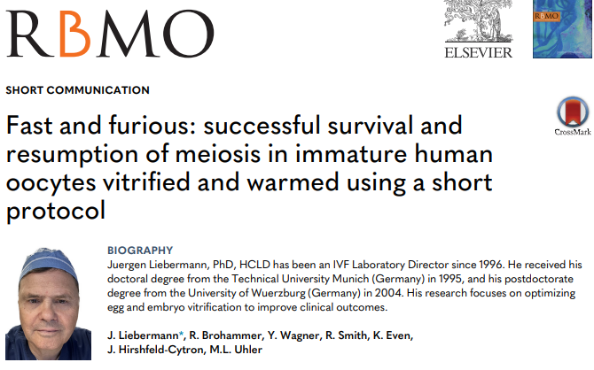
Rapid vitrification and warming of oocytes
Studies on research oocytes
Liebermann et al. 2024: study on fresh immature research GV/MI oocytes (short communication)
Cryolock device (Biotech)
Ultra-fast VIT: 1min ES/1min VS with 2 commercial media (FujiFilm/Vitrolife)
Rapid warming: 1 min 0,5M at 37°C (500µl FujiFilm/Vitrolife))+ 1 min Washing medium (0M) (2 drops 200 µl)
Survival and maturation after 24-48 h
Dec 24
No significant difference in survival of GV/MI oocytes between Fujifilm and Vitrolife media (94,9% vs 95,0% and 95,7 vs 95,0%)
92% of GV matured into MI (24h) and 54,4% to MII (48h)
84,1% of MI matured into MII (24h)
Notes:
Finally, Liebermann published short communication on rapid VIT and warm of immature GV and MI oocytes. They used the same rapid VIT protocol but with different commercial media., (Fujifilm with DMSO and Vitrolife without DMSO but with PROH.)
For rapid warming the 0,5M conc was used in 500 µl drops (is a more economical protocol)

Slide 32
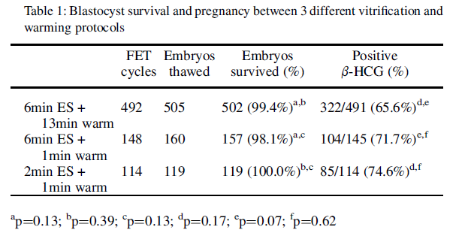
Rapid vitrification of blastocysts
Kaskar et al. 2023 (poster ASRM): clinical application
Retrospective comparison of FET according to 3 different treatments
  Standard vitrification and warming (492 FET)
  Standard vitrification and rapid warming (148 FET)
  Rapid vitrification and rapid warming (114 FET)
Protocol rapid VIT: 2 min ES/30-60 sec VS (FujiFilm NX)
Protocol rapid warming: 1 min 1M 37°C (FujiFilm NX)
Notes:
Finally, what about rapid Vit of blastocysts? In the abstract of Kaskar et al 2023 at ASRM, a retrospective comparision was done of FET according to 3 different treatments. In the first group, standard VIT and warming was done, in the second st vit and rapid w and in the 3rd group combination rapid vit and warming in 114 FET.
The proto used was 2 min ES and..
Simalr survival rates were obtained, with the highest in the rapid vit:rapid warm group. But not signifcantly different.

Slide 33
Conclusions
Blastocysts rapid warming
High blastocyst survival and re-expansion rates
Comparable clinical pregnancy and live birth rates, and reassuring neonatal outcomes
Implemented in our lab for more than 1 year now with satisfactory results
Oocyte rapid vitrification and warming
Pilot studies on immature and mature oocytes report higher survival rates than conventional vitrification and warming
Clinical application has not been published yet?
Brussels IVF: pilot study
Blastocys rapid vitrification
It is possible but published data are scarce
Brussels IVF: Pilot study to test different timings/devices to establish optimal protocol
Notes:
My general conclusion would be that
Hfor blas rapid warming high blas and can be obtained. Comparable clin P rates Lbrates are published with reassuring neonatal outcomes
We impl in our lab
For oocyte rapid vit and warm severla pilot studies on imm and mat ooc report, however the clin application has not been published yet and in our center we are currently busy with a pilot study on oocytes as well
For blast vit, I expect that many centers are already busy with this but published data are scarce

Slide 34
Conclusions
Advantages of one-step protocols
Drawbacks?
Time saving procedure, less steps, less manipulations, less handling risks
Allows flexibility in planning extra warming
Minimizing procedure time in suboptimal conditions
Operator friendly and simple protocol, easy to train to other lab technicians
Better clinical outcome? (cfr Liebermann, RCT trial needed)
Complementary with re-vitrification? In case of re-testing for PGT diagnosis
Are poor quality embryos more sensitive to rapid protocols?
Is it really time-saving?
  Starting vitrification of different oocytes/blastocysts (of same patient) in series is less feasible
  Administration in between is not feasible
Strong focus during the procedure!
Notes:
The adavntages are that it is a time…

Slide 35
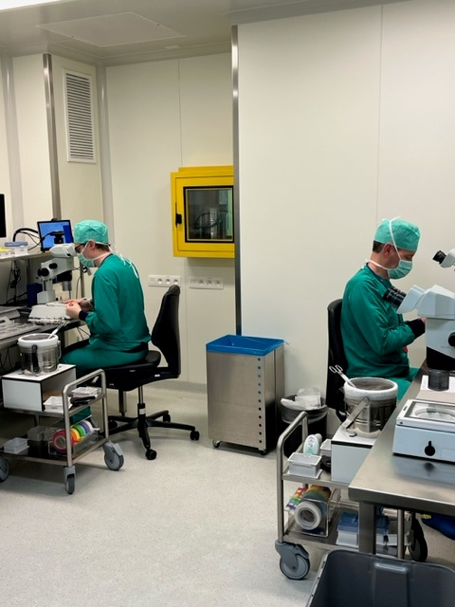
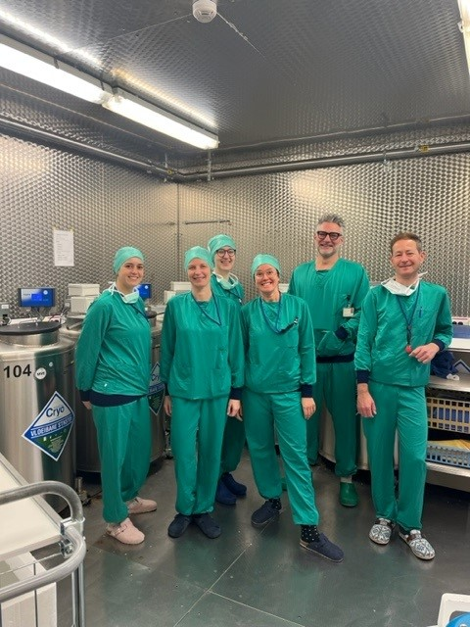
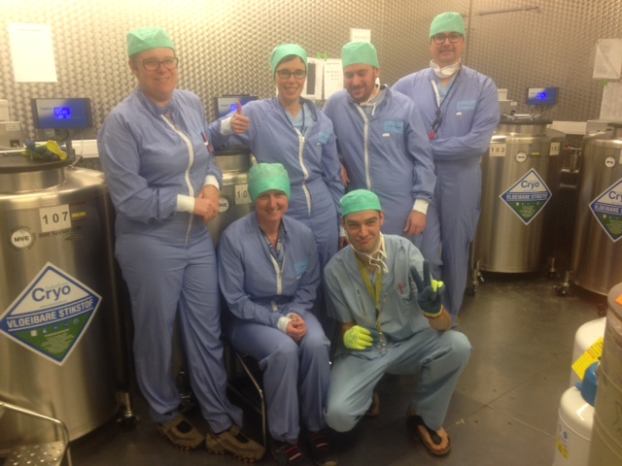
Thank you
  23 x !
Notes:
We are at the end of mu presentation
Finally a big thank you to all my IVF collegues but especially to the 23 collegues of the cryo team!

Slide 36
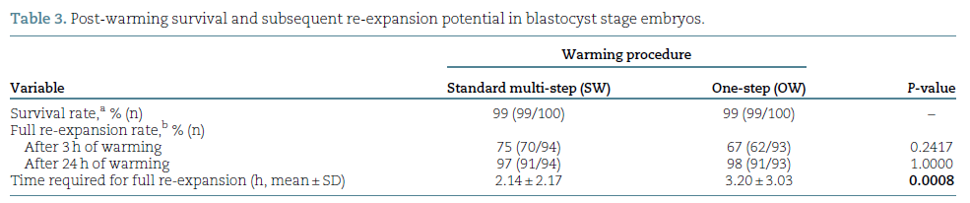
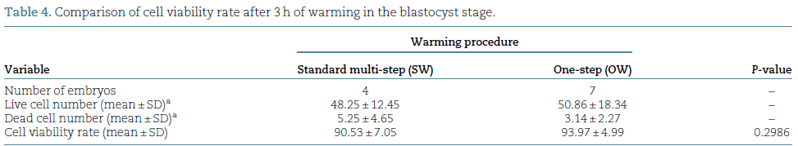
Rapid one-step warming of cleavage stage embryos
Shioya et al. 2025

Slide 37
Rapid warming Brussels IVF
Clinical application
From 15th January 2024: start with short warming protocol with OmniWarm 3
For all blastocyst warming cycles (after standard IVF/ICSI and PGT cycles)
Opted for 250 µl protocol warming droplet (similar to standard protocol)

Slide 38
Rapid warming blasytocysts Brussel IVF
Logistic regression analysis for clinical pregnancy rate
After adjustment for confounding factors, no significant impact of the warming protocol on clinical pregnancy rate was found (OR 1.11, 95% CI 0.85 – 1.45, p=0.43)
In both patient groups, significant impact was found for
  day of vitrification (OR 0.58, 0.49-0.68, p<0.001)
  embryo quality (OR 0.56, 0.49-0.65, p<0.001)
In regular IVF/ICSI patients, significant impact was found for
  female age (OR 0.95, 0.93-0.96, p<0.001)
  endometrial preparation in favor of natural cycles (OR 0.72, 0.62-0.81, p<0.001)
Notes:
When we adjusted for confounders, no sign impact of warming protocol was found on clin P rates
But in both patient groups we found correlation for
And in regular ICSI patients, there was a correlation with age and endotrial preparation in favor of natural cycles

Slide 39
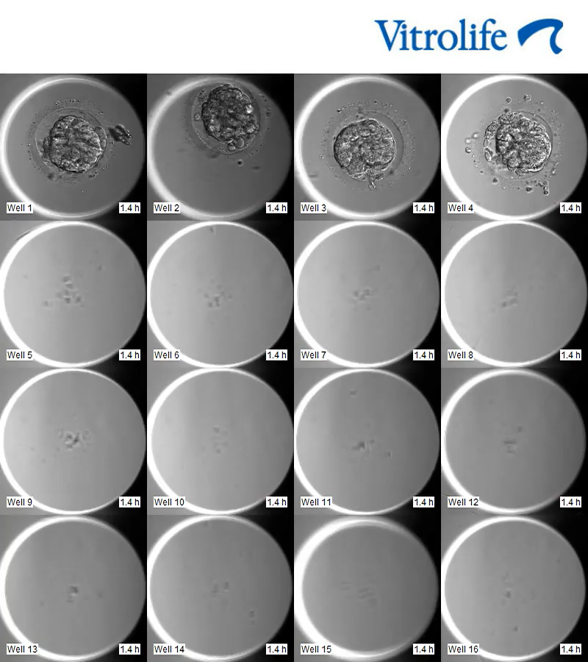
ICSI blastocysts
Short warming
250 µl
24 hours Embryoscope

Slide 40
Retrospective study to evaluate 6 months of clinical use of the SHOW warming protocol
Comparison of a 6-month period (Jan-July 2024) using SHOW protocol and 1-year period (2023) using the standard warming protocol
Survival was assessed in 6742 blastocysts warmed
Clinical outcome was assessed in 5716 single frozen embryo transfers (with known pregnancy outcome)
Results were analysed separately for normal IVF/ICSI warming cycles and PGT warming cycles
Logistic regression analysis to adjust for the following confounders: female age at freezing, endometrial preparation (artificial or natural cycle), embryo quality and day of vitrification

Slide 41
Rapid warming of blastocysts
Lammers et al. 2025
Rapid warming protocol: 2 min Warm 1 Blast sucrose 37°C (0,5M?) (Vitrolife)
  27 research blastocysts: 100%survival, 82%re-expansion
  Pseudo-randomized (weekly) pilot study: 52 standard warming/42 rapid warming
    100% survival
    80% versus 76% re-expansion
    Clinical P: 29,8% versus 38,4%
  Prospective monocentric clinical pilot study (comparison 3 months rapid warming with preceeding 6 months standard warming)

Slide 42
SHOW study
Results PGT blastocysts
 | D5D6 standard | D5D6 short | D5D6 250µl short | D5D6 500µl short
N warmed | 20 | 40 | 20 | 20
N survived (%) | 20 (100) | 40 (100) | 20 (100) | 20 (100)
N fully intact (%) | 16 (80) | 31 (77,5) | 15 (75) | 16(80)
N re-expanded 2h (%) | 14 (70) | 26 (65) | 14 (70) | 12(60)
N re-expanded 4h (%) | 17(85) | 28 (70) | 15 (75) | 13(65)
N no re-expansion (%) | 2(10) | 8 (20) | 2 (10) | 6 (30)
N hatching 4h (%) | 16 (80) | 31 (77,5) | 15 (75) | 13 (65)
N fully hatched 24 h (%) | 10 (50) | 20 (50) | 11 (55) | 9 (45)
N hatching/hatched | 19 (95) | 32 (80) | 16 (80) | 16 (80)
Notes:
And in PGT blastocysts
We concluded that results were promising and decided to go for it in the clinic

Slide 43
Automated vitrification
GAVI: semi-automated closed system for up to 4 embryos simultaneously (Roy et al 2014)
Monitors temperature, volume, concentration, exposure time to CPA

