Slide 1

Endocrinology of the transgender patient
- a clinical approach -
Departement of endocrinology and metabolic bone diseases
  Research unit endocrinology
BSRM 53rd Scientific Meeting – Jeroen Vervalcke MD 2025-03-21

Slide 2
Lexicon
Gender incongruence (GI): misalignment between sex assigned at birth and desired gender
Gender dysphoria: distress due to GI
Cisgender: identifying with the assigned sex
Transgender: genderID does not match with sex assigned at birth

Slide 3
I. Rationale

Slide 4
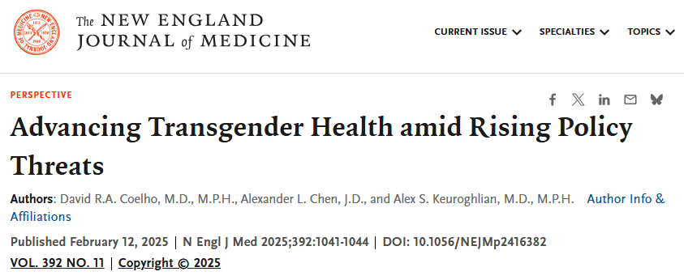
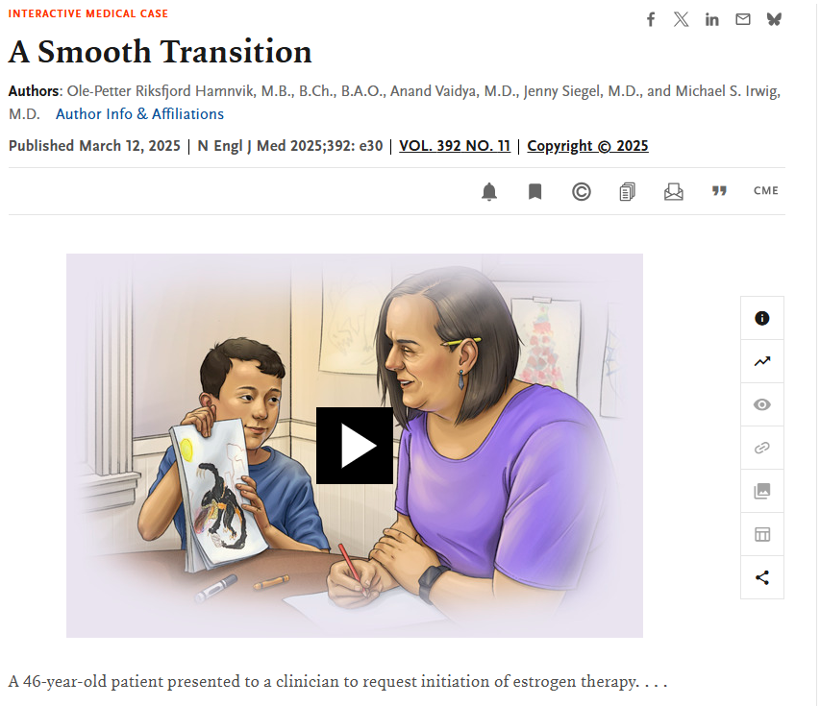
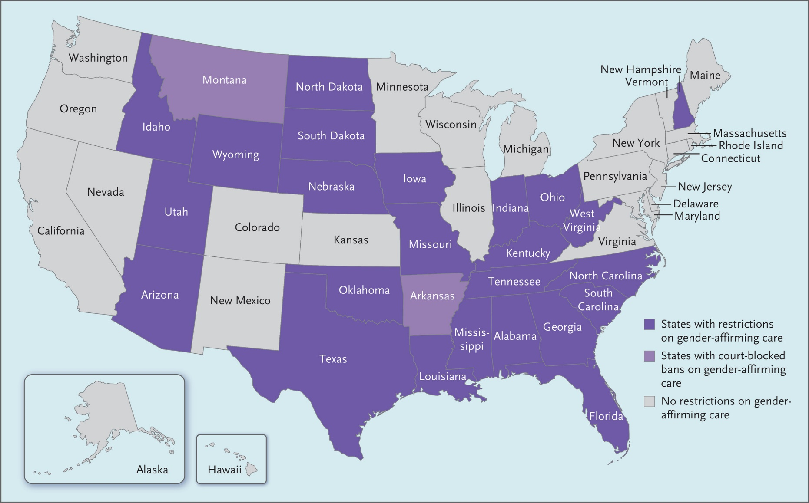

Slide 5
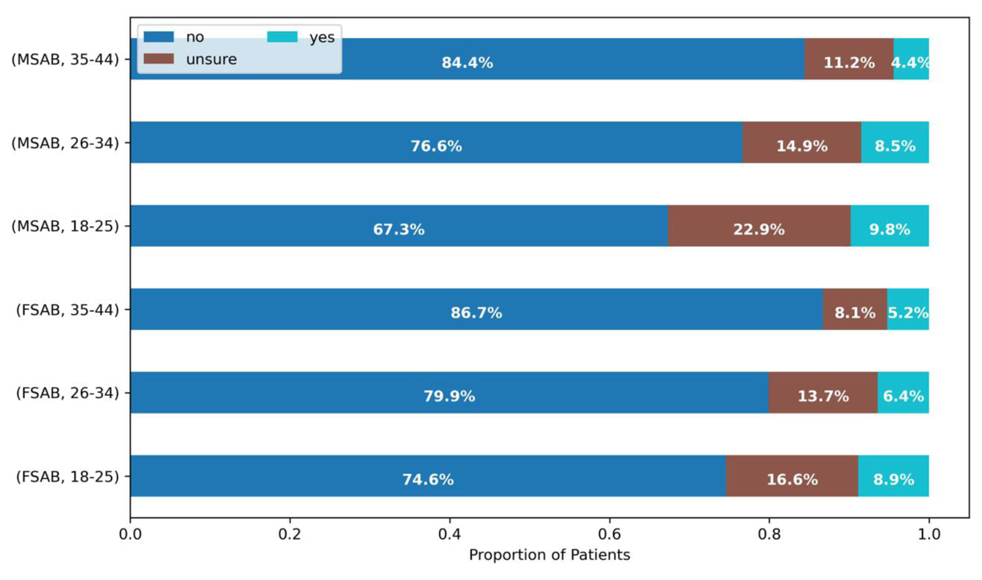
Source: Desire for genetically related children among transgender and gender-diverse patients seeking gender-affirming hormones. Kyweluk, Moira A. et al.. F&S Reports, Volume 4, Issue 2, 224 - 230
Notes:
The majority of the TGD adolescents’ participants reported to have a future desire for children (48.7%–67%)
Only one study from the Netherlands reported high FP utilization, 91% of AMAB TGD adolescents received FP counseling, and 38% attempted FP
Sixty-seven (39.0%) respondents had a current/future parental desire. Parental desire rates did not differ between TM and GNB persons. Barriers for fulfilling the parental desire (multiple response) included assumed difficulties in the adoption procedure (41.3%), fear of discrimination against the child (38.0%) or being discriminated against as a transgender parent (32.6%), and the cost for using personal genetic material (32.6%). Nine percent had cryopreserved reproductive cells or tissue.
Defreyne 2020 (172)

Slide 6
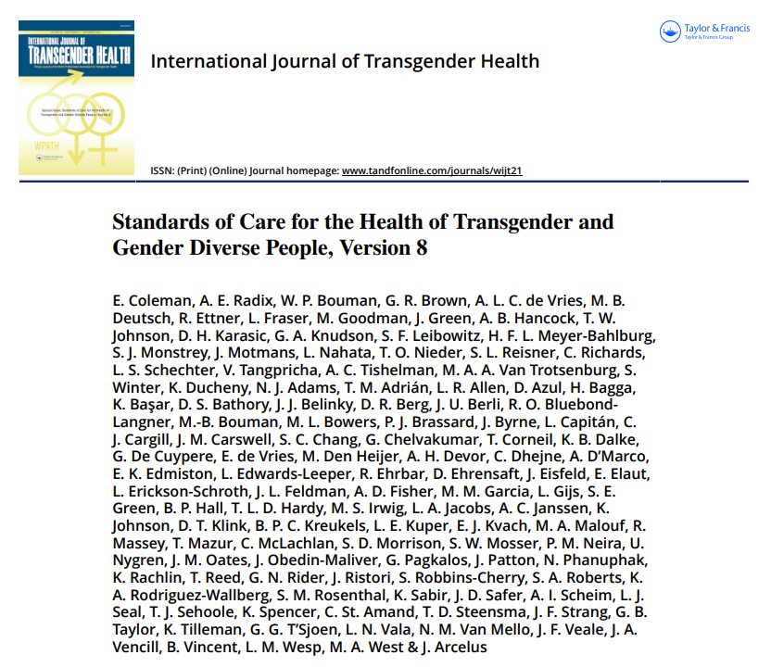
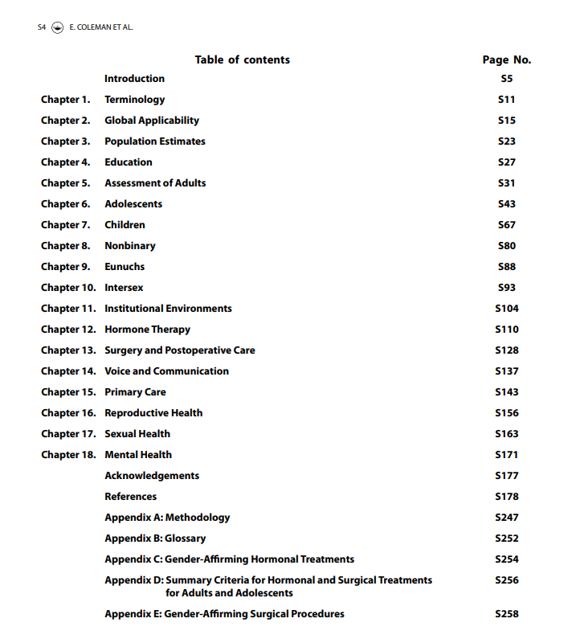
Source: https://doi.org/10.1080/26895269.2022.2100644

Slide 7
II. Gender-affirming hormone therapy

Slide 8
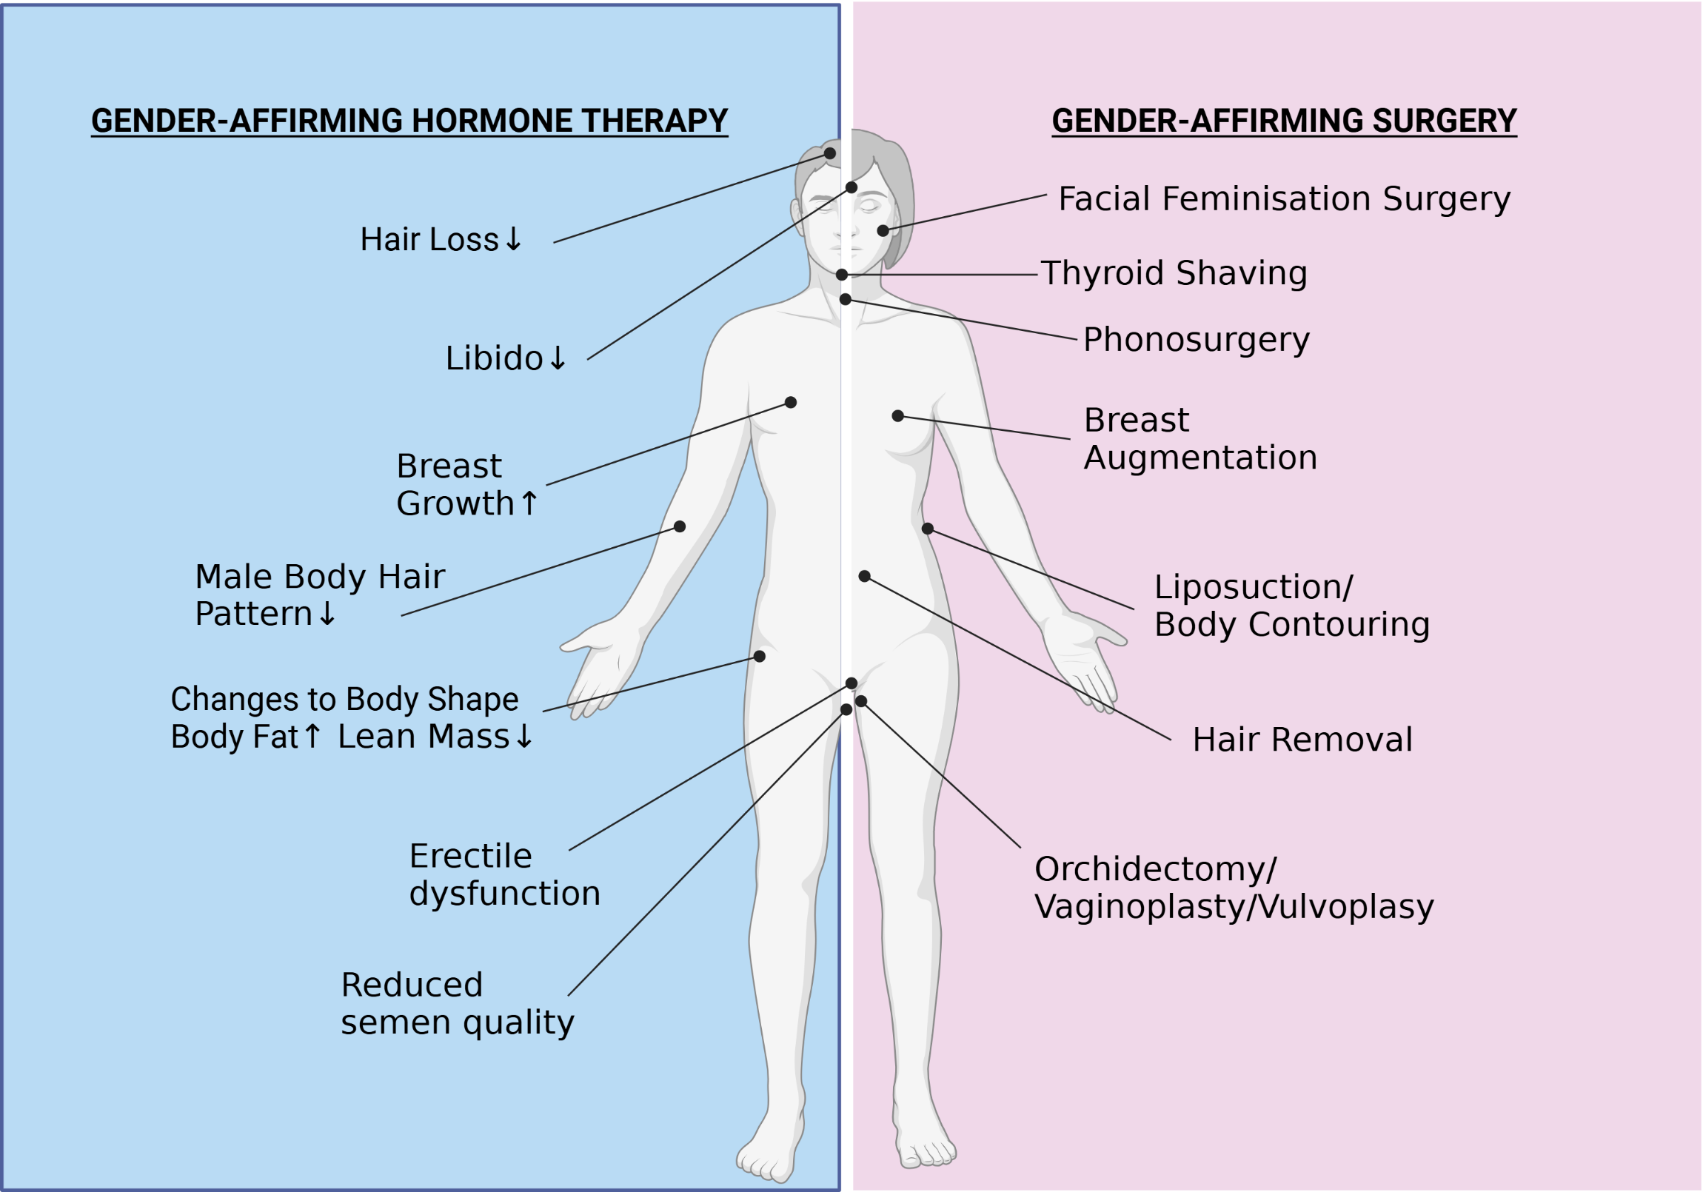
Feminizing therapy
TRANSGENDER WOMAN
ASSIGNED-MALE-AT-BIRTH

Slide 9
Feminizing hormone therapy
Estradiol
Estradiol valerate, estradiol hemihydrate
Patches (Dermestril®), gel (Oestrogel®), tablets (Progynova®), sprays (Lenzetto®)
Target values contested
2. Anti-androgens
Cyproterone acetate (Androcur®), spironolocatone, bicalutamide (Casodex®), GnRH-agonist (Decapeptyl®)
Target <50ng/dL total testosterone
Notes:
Future: pellets? Geen IM E2 in BE, afgevoerd in FR
Lab values based on sex on id, can cause problems

Slide 10
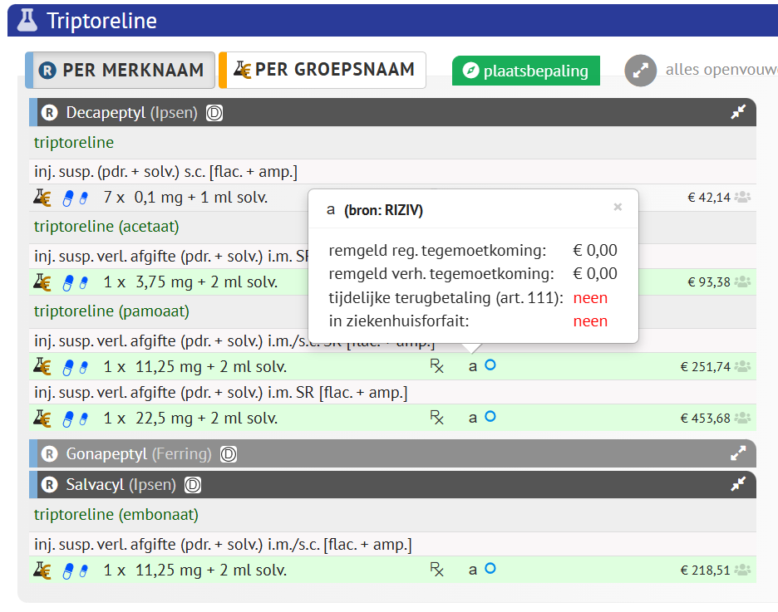
Gnrh-agonists
Completely reimbursed in BE!
Notes:
Indications: ovarian stimulation, prostateCA, endometriosis, ‘hypersexuality’, puberty blockers ….

Slide 11
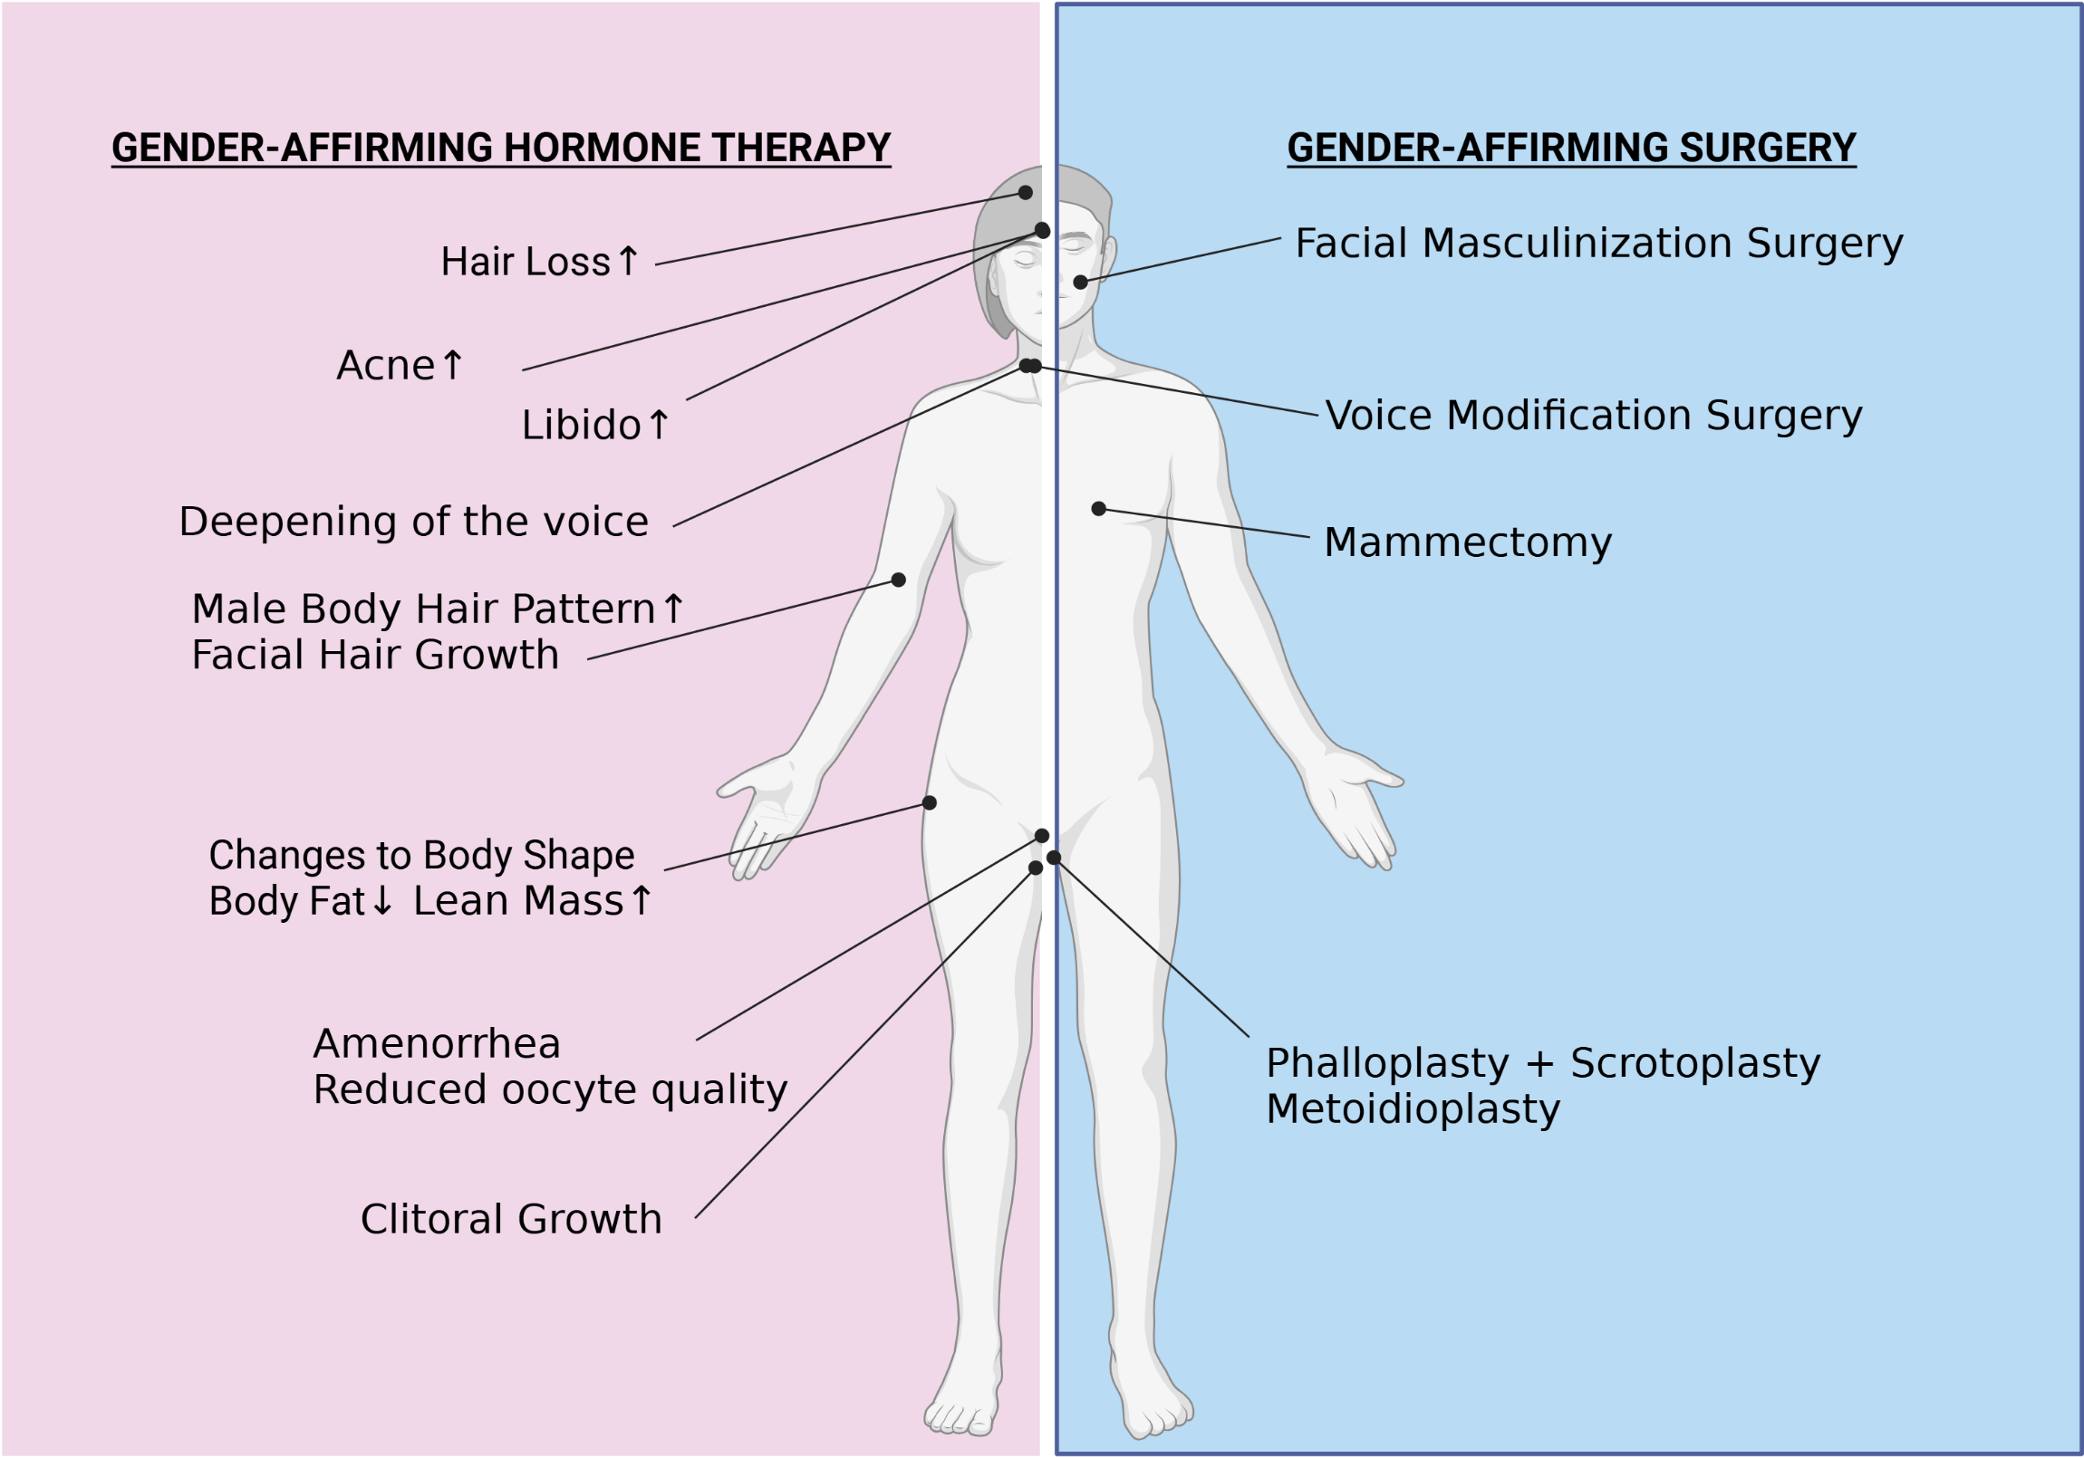
Masculinizing therapy
TRANSGENDER MAN
ASSIGNED-FEMALE-AT-BIRTH

Slide 12
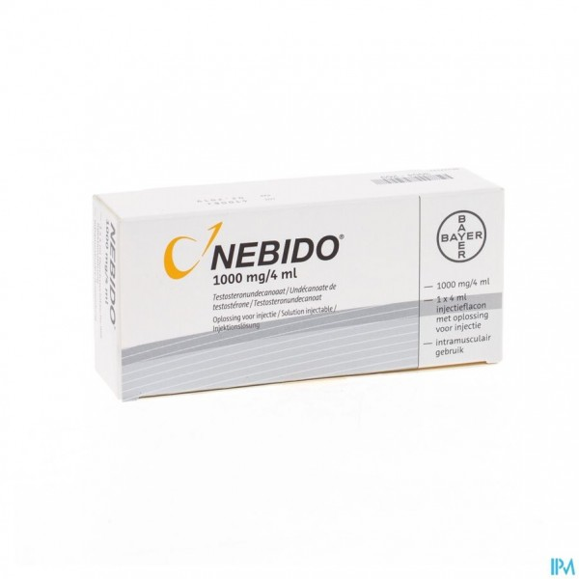
Testosterone undecanoate
1g/4mL IM injections q12w
Loading dose at 6w
Injections in gluteal region: assistance required
Pk: avoid peaks
Fewer adverse effects, in particular mood swings, Hct↑
Not reimbursed in BE (€73.80-116.20)

Slide 13
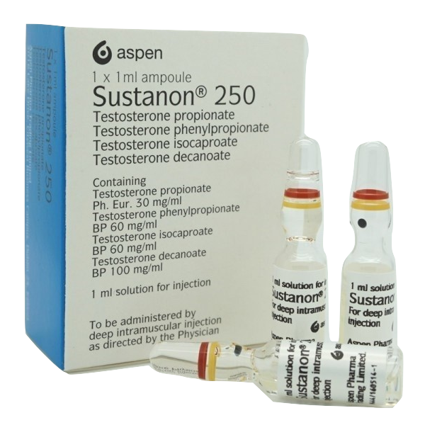
Testosterone esters
250mg IM injections q2-3w
Contains peanut oil
Self-injections possible
Pk: saw-tooth pattern
Reimbursed in BE (€2.02) if prescribed by pediatrician, urologist or endocrinologist

Slide 14
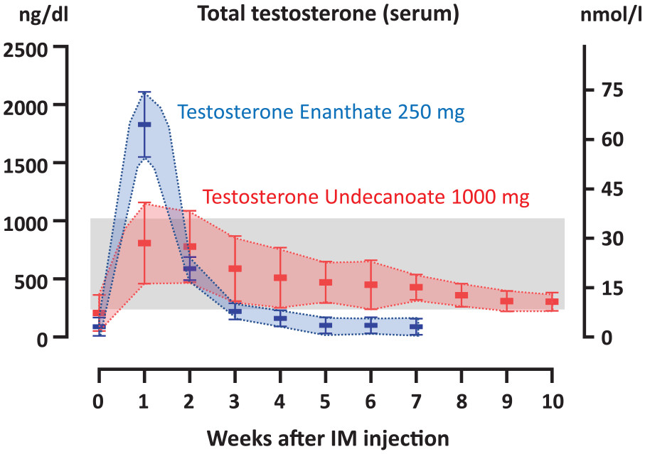
Pharmacokinetics (I)
?

Slide 15
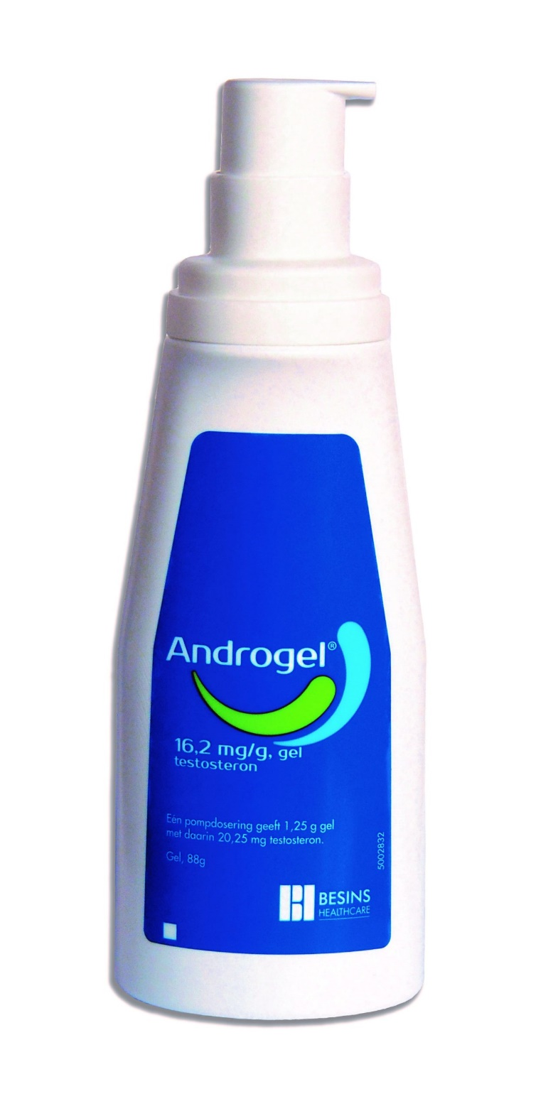
Testosterone gel
Androgel®, Testarzon®
Daily use: 2-3puffs
Most expensive option (±€50/month)
Flexibility
Patches: not in BE
Notes:
Testosterone is an ‘old’ product. Long regarded as a universal panacea. Has been available in caps, as inhalant drugs etc. -> oral formulations not available in BE

Slide 16
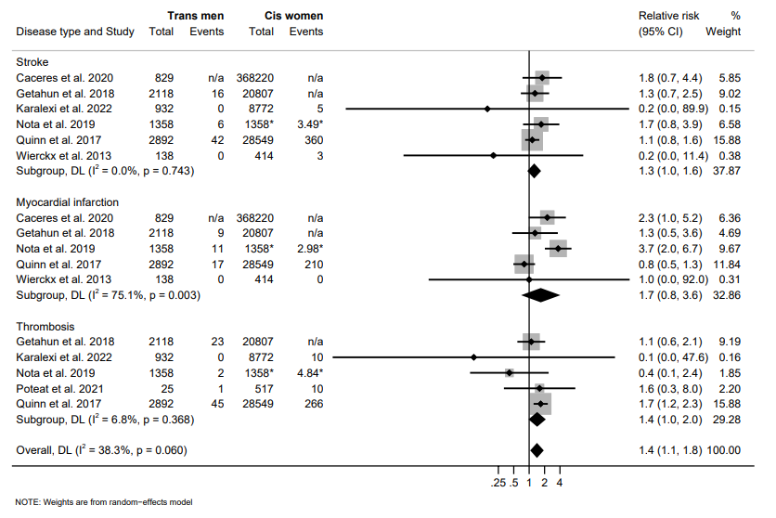
Gaht and cvd risk
MACE +40%↑
Source: van Zijverden (2024). https://doi.org/10.1093/ejendo/lvad170

Slide 17
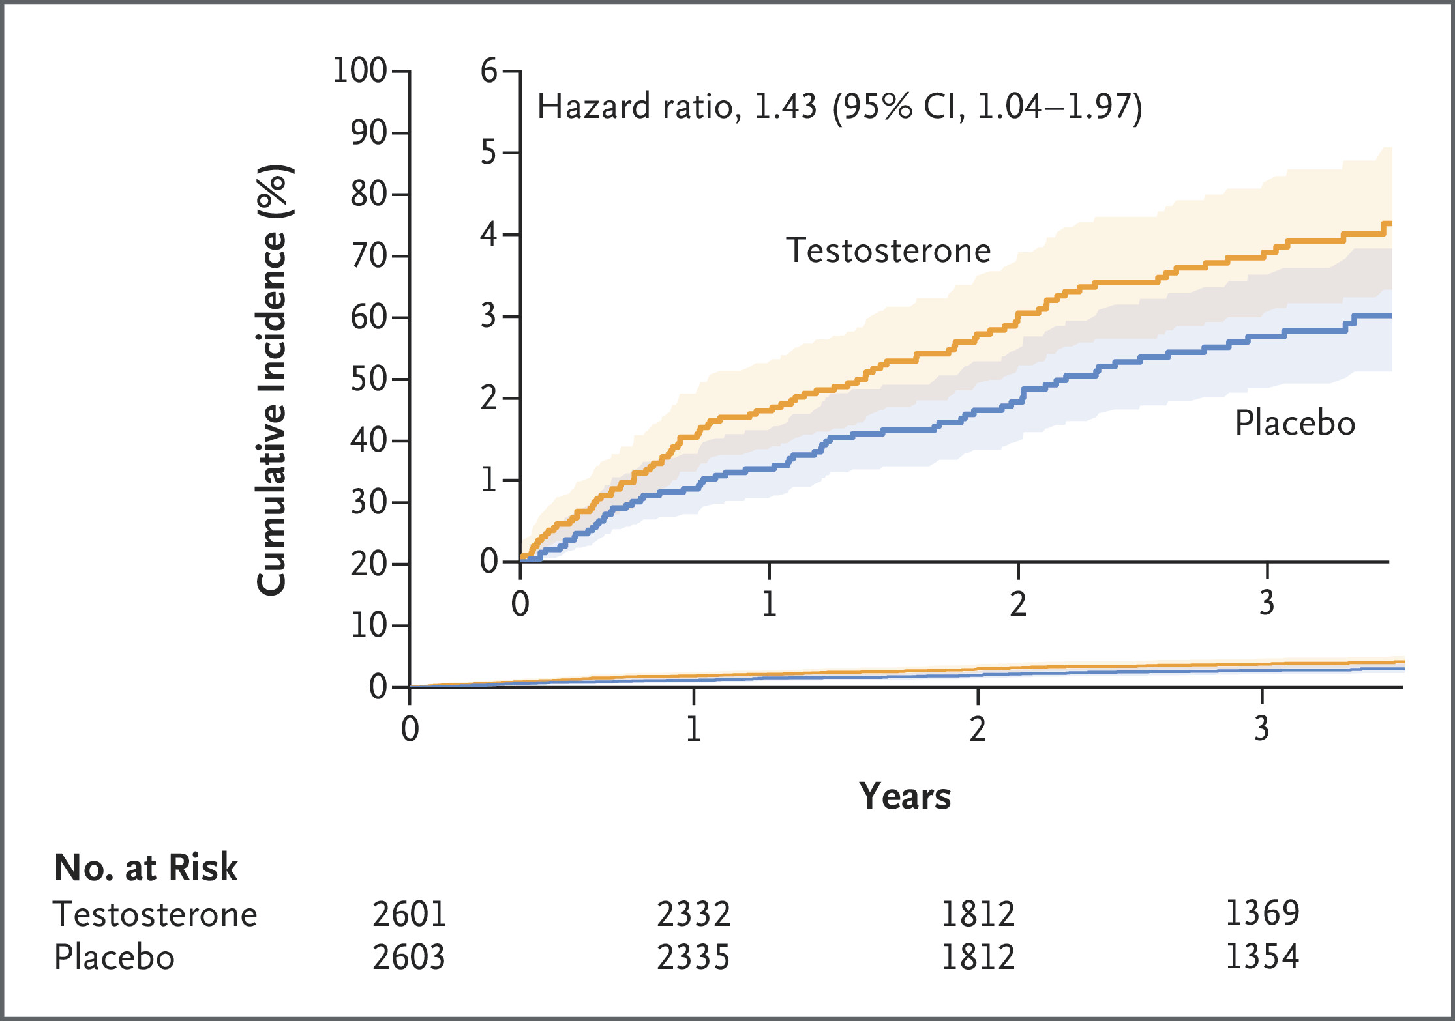
Testosterone and fractures
Source: DOI: 10.1056/NEJMoa2308836
Notes:
Unexpected
Behavioural?
Ageing: can be ad vitam, covering menopausal age

Slide 18
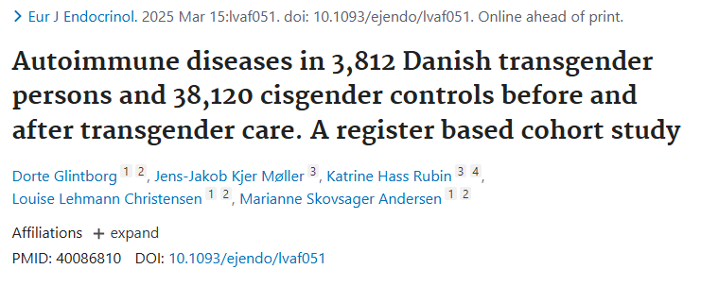
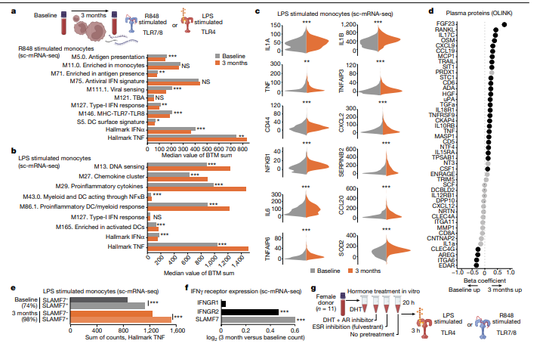
GAHT AND AUTO-IMMUNE DISEASES
SOURCE: Lakshmikanth, T., Consiglio, C., Sardh, F. et al. Immune system adaptation during gender-affirming testosterone treatment. Nature 633, 155–164 (2024). https://doi.org/10.1038/s41586-024-07789-z

Slide 19
II. FERTILITY

Slide 20
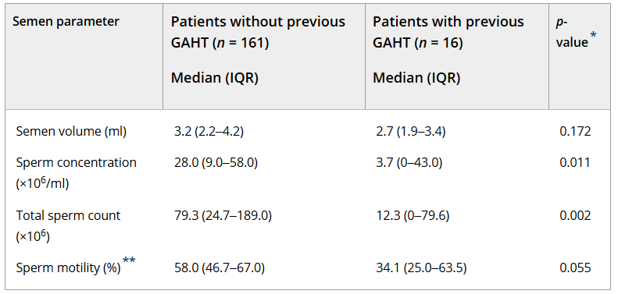
Feminzing gaht
Stop GAHT, fertility restored after >3m
Hormone-naïve poor quality? -> lifestyle, tucking
Source: Rodriguez-Wallberg (2021). https://doi.org/10.1111/andr.12999

Slide 21
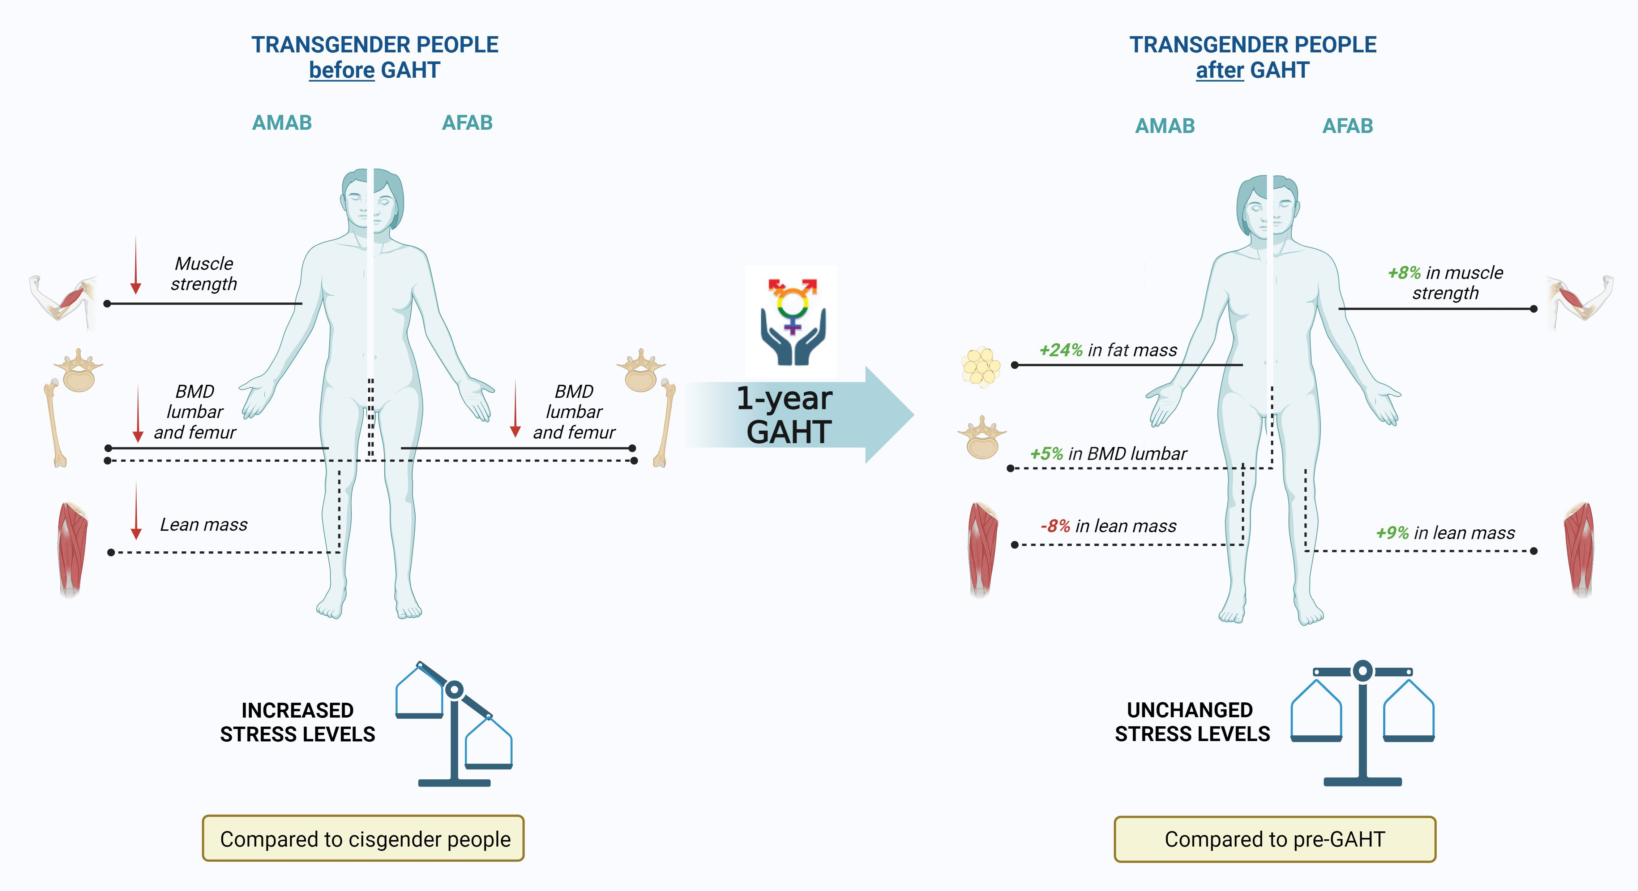
Source: Ceolin, C., Scala, A., Scagnet, B., Citron, A., Vilona, F., De Rui, M., Miscioscia, M., Camozzi, V., Ferlin, A., Sergi, G., Garolla, A., & GIIG group (2024). Body composition and perceived stress levels in transgender individuals after one year of gender affirming hormone therapy. Frontiers in endocrinology, 15, 1496160. https://doi.org/10.3389/fendo.2024.1496160

Slide 22
masculinizing GAHT
No detrimental effects on live birth rate, conception chance, oocyte harvest … irrespective of T type, dose or duration
Neonatal outcomes? Developmental milestones?
DOI: 10.1001/jama.2023.7688, DOI: 10.1016/j.xfre.2023.10.006

Slide 23
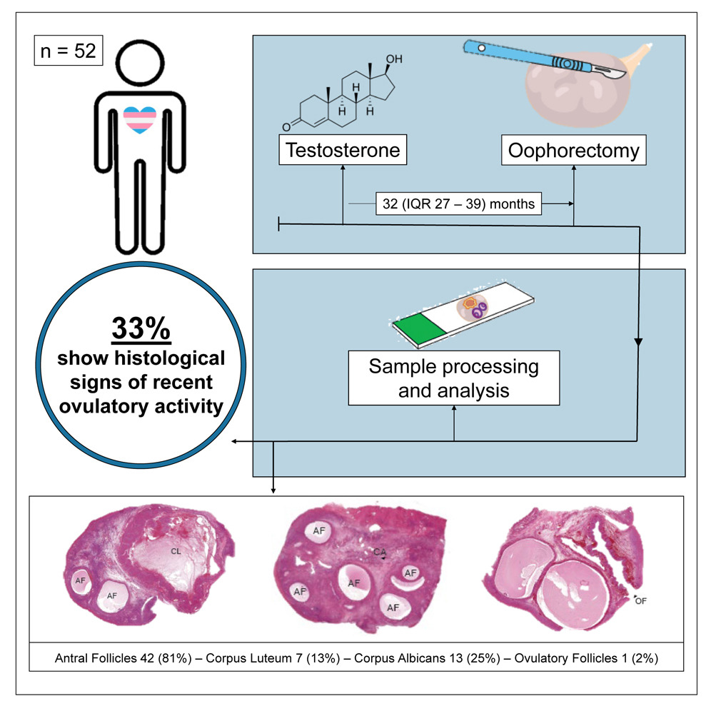
Contraceptive counseling!
NO ethinyl-E2!
Source: Asseler (2024). https://doi.org/10.1016/j.xcrm.2024.101440
Notes:
Medroxyprogesteron acetaat, implanon, Kyleena, cerazette
50% of participants erroneously believe testo to be contraceptive agent

Slide 24
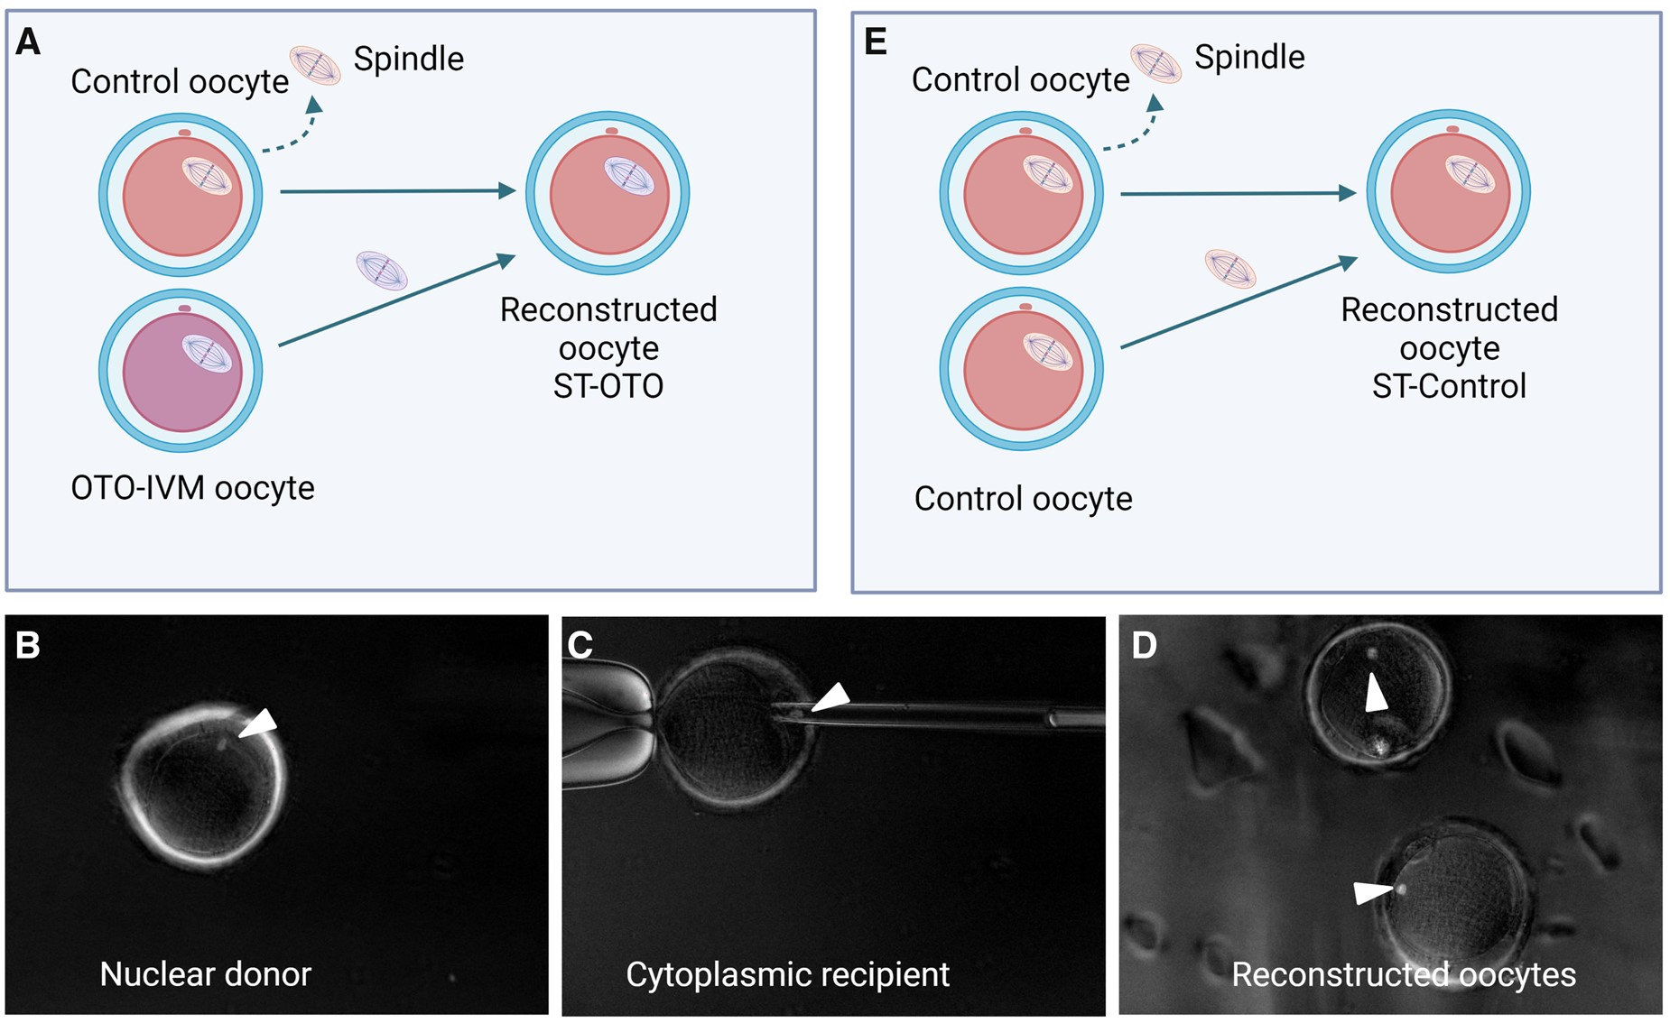
Source: A Christodoulaki. Characterization of ovarian tissue oocytes from transgender men reveals poor calcium release and embryo development, which might be overcome by spindle transfer, Human Reproduction, Volume 38, Issue 6, June 2023, Pages 1135–1150, https://doi.org/10.1093/humrep/dead068
Notes:
Both ovaries from 18 transgender men undergoing oophorectomy were collected for the purposes of this study, from November 2020 to September 2022. The patients did not wish to cryopreserve their tissue for fertility preservation and donated their ovaries for research. All patients were having testosterone treatment at the time of oophorectomy and some of them were also having menses inhibition treatment.
Results from IVF cycles of transgender patients have demonstrated that oocyte quality and embryo development in these patients are similar to that observed in for women of the same age (Leung et al., 2019; Amir et al., 2020). However, the transgender patients undergoing ovarian stimulation have previously ceased testosterone treatment for several months beforehand (De Roo et al., 2016).
To confirm the cytoplasmic inferiority of the OTO-IVM oocytes, we performed ST. NT has been considered as means to overcome poor cytoplasmic quality of oocytes causing failed fertilization
In the current study, we demonstrate the low quality of OTO-IVM oocytes originating from transgender men. The limited calcium releasing ability and poor embryo development point towards a cytoplasmic factor responsible for the inferior oocyte quality, for which the collection temperature of ovarian tissue did not seem to play an important role.

Slide 25
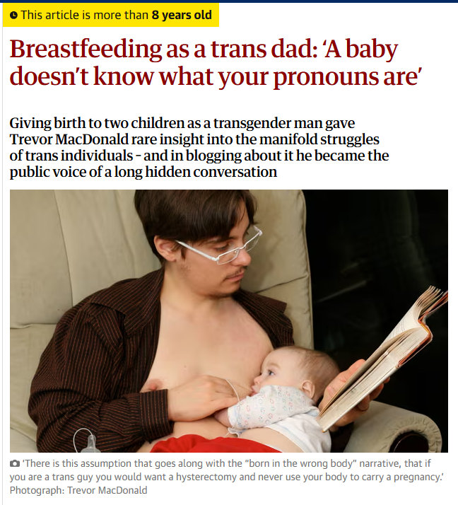
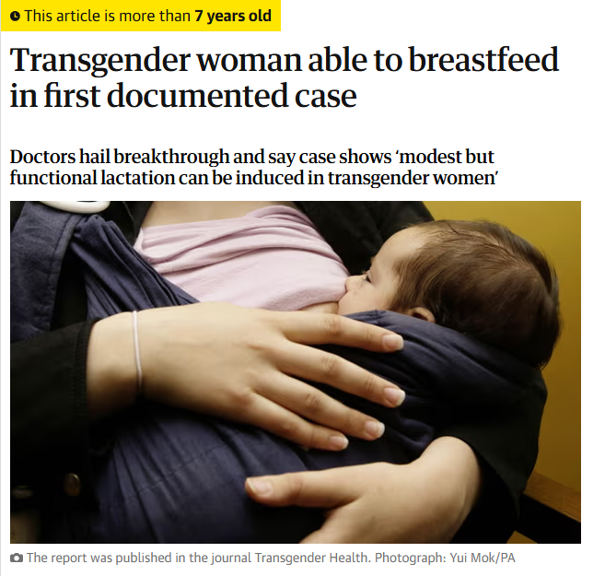
Source: Reisman, T., & Goldstein, Z. (2018). Case Report: Induced Lactation in a Transgender Woman. Transgender health, 3(1), 24–26. https://doi.org/10.1089/trgh.2017.0044
Notes:
Testo passes into milk (human milk)
Volume small but nutritional
Can occur after top surgery, although often hampered
Can be induced in trans women
Too small to sustain infant long term, nutritional composition unsure
Domperidone qtc prolongation

Slide 26
III. PELVIC HEALTH

Slide 27
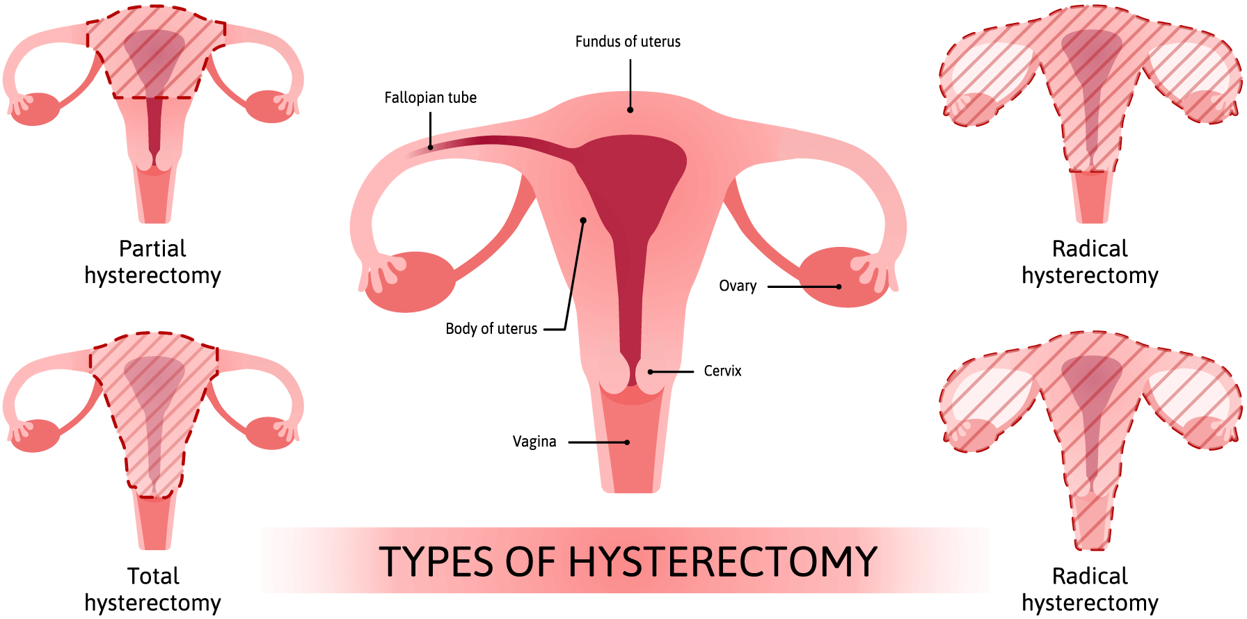
Gonadectomy no longer required for legal sex change – BE 2018
Notes:
Review of pitfalls

Slide 28
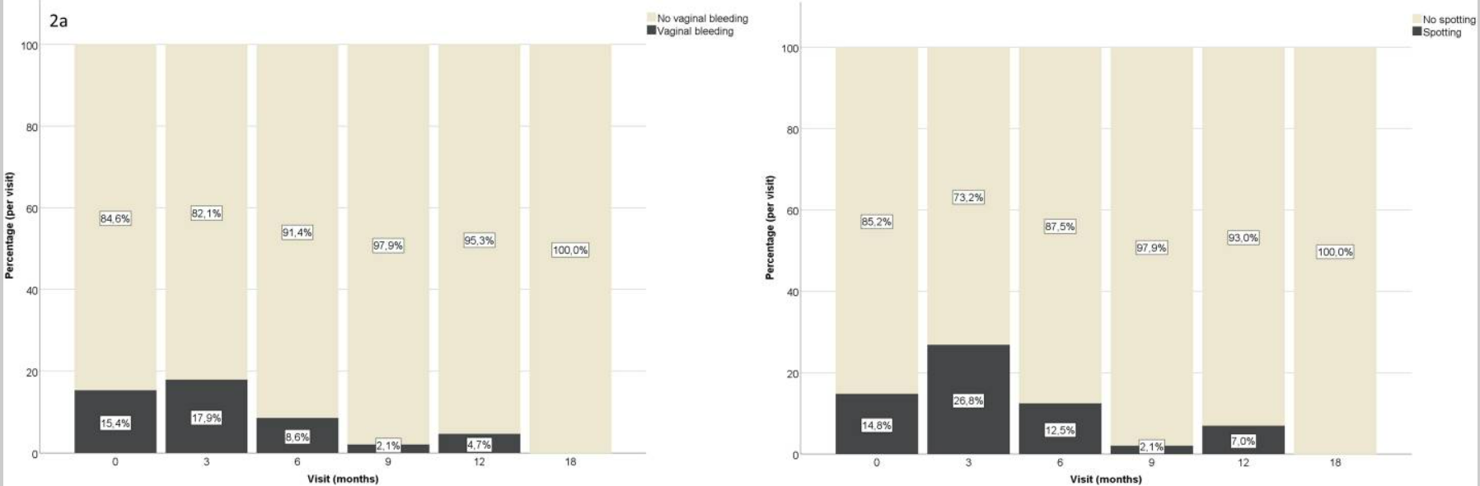
Bleeding and spotting after GAHT
Source: Defreyne (2020). doi: 10.1080/26895269.2020.1719951
Notes:
Factors associated with vaginal bleeding or spotting included lower serum testosterone levels and being on testosterone gel as compared to injections (e.g., esters or undecanoate preparations)

Slide 29
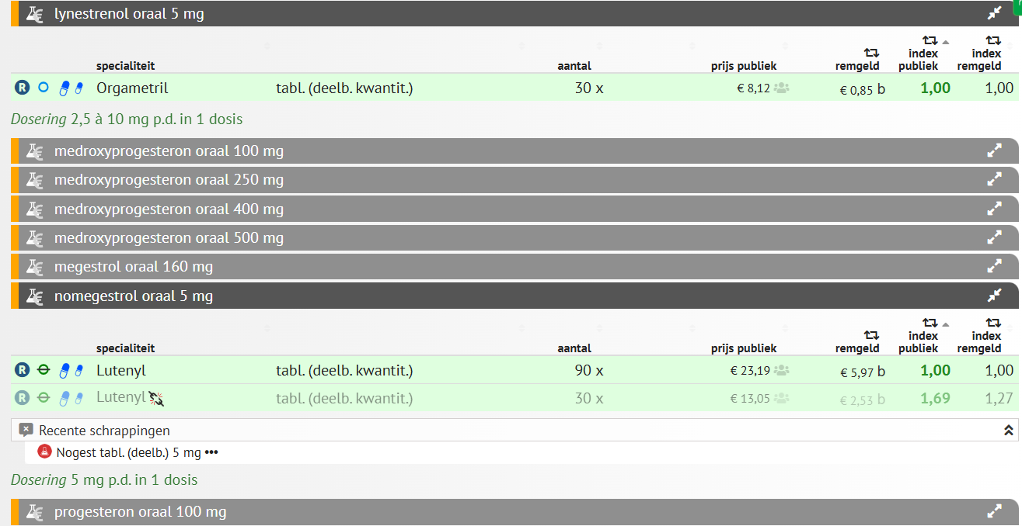
Posology: 5mg 1dd, 2comp 1dd if bleeding
Interference with LC-MS/MS
Not a contraceptive
Notes:
Interferentie LCMS met orgametril, interferentie IA met biotine

Slide 30
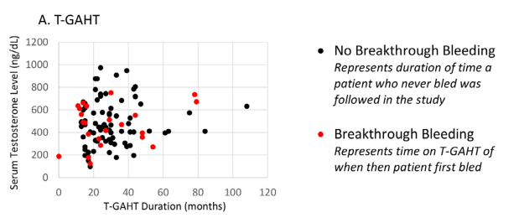
Source: Grimstad (2021). doi: DOI: 10.1016/j.jpag.2021.04.004
Notes:
more likely to have endometriosis (P = .049).
Breakthrough bleeding began at a mean of 24.3 ± 17.2 months after T-GAHT initiation.
80% had no known cause,
15% bled only with missed TGAHT doses
5% bled only when withdrawing from concomitant menstrual suppression.
No breakthrough bleeding management method was found to be superior.

Slide 31
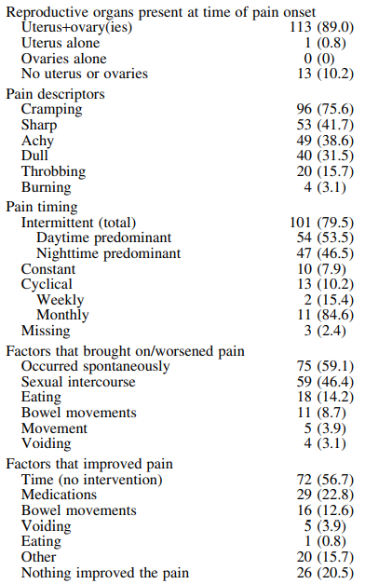
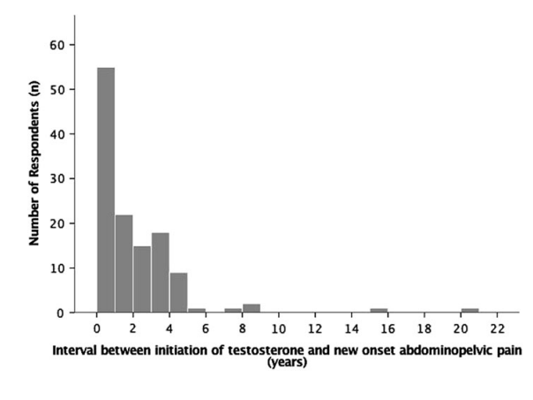
Abdominal cramping
Source: Grimstad (2020). https://doi.org/10.1089/lgbt.2019.0258

Slide 32
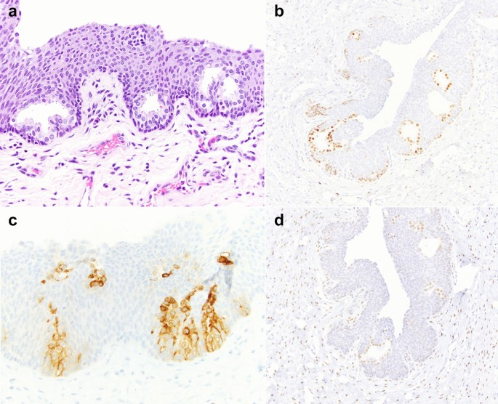
PROSTATIC METAPLASIA
Source: Xu (2019). https://link.springer.com/article/10.1007/s00345-021-03907-y
Notes:
Glandular proliferation, PSA staining + and androgen receptor +

Slide 33
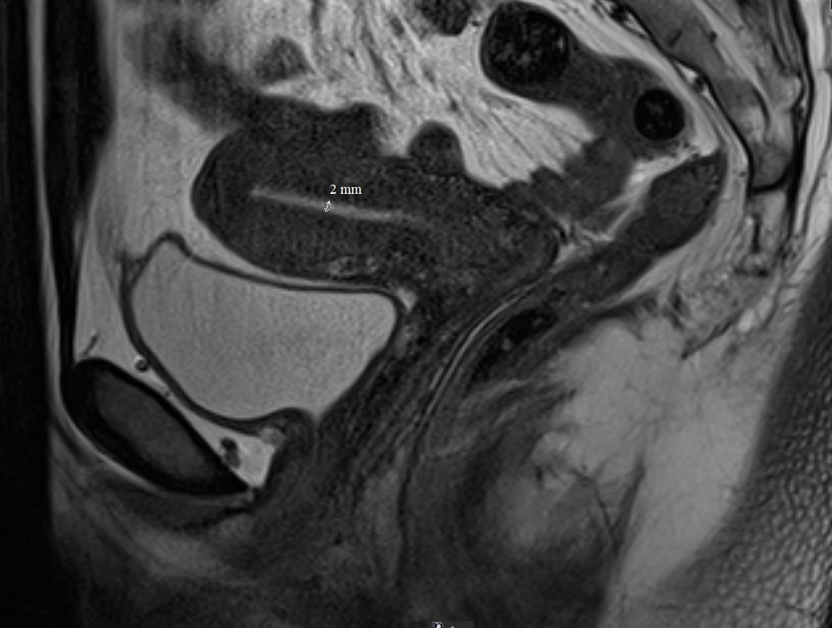
Uzgent house recipe
Pelvic NMR every 5 years
Pilot study (n=24):
Atrophic endometrium
No PCOS
Overshooting?

Slide 34
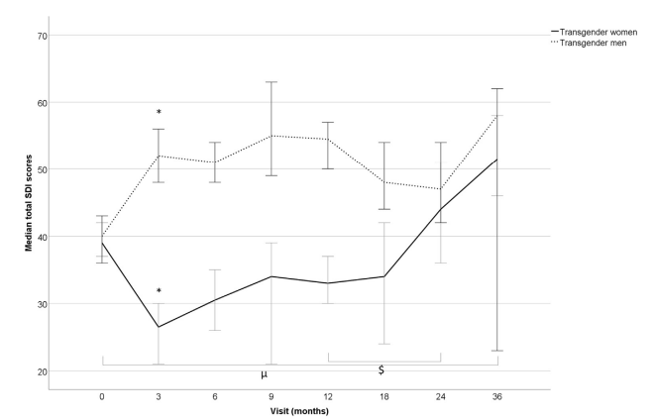
Sex drive
Source: Defreyne (2020). https://doi.org/10.1016/j.jsxm.2019.12.020
Notes:
Testo driven
Also affected by surgery
Self exploration ↑ as GAHT duration ↑

Slide 35
Contact bleeding
Probably underreported
Atrophy-related: UTI, foetor, discharge, itch …
R/ vaginal E2 (e.g. Vagifem®)
R/ vaginal E3 (e.g. Aacifemine®)
R/ vaginal DHEA (e.g. Intrarosa ®)
Notes:
Dehydroepiandrosterone sulfate DHEAS

Slide 36
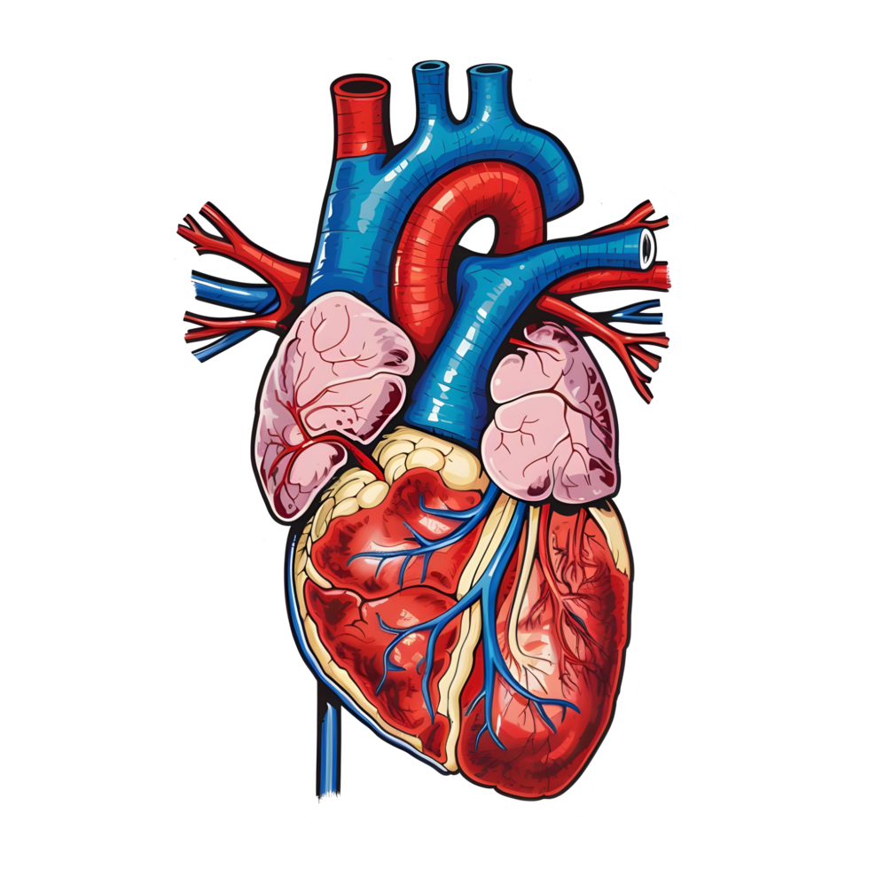
Jeroen Vervalcke
MD, PhD-student
ENDOCRINOLOGY RESEARCH UNIT
E jeroen.vervalcke@uzgent.be
T +32 9 332 18 78
M +32 470 73 53 06
Thank you for your attention!

