Slide 1

53rd BSRM Scientific Meeting
Transgender care and fertility
Mauro Kerckhof (he/him)
Clinical psychologist, Centre for Sexology & Gender, UZ Ghent
21/03/2025
Notes:
25 minutes for your lecture and 5 minutes for Q&A
Pronouns vermelden!

Slide 2
Overview
Introduction
Transition
Fertility counseling
Trans person as a fertility patient

Slide 3
1. Introduction in concepts & language: what’s what?

Slide 4
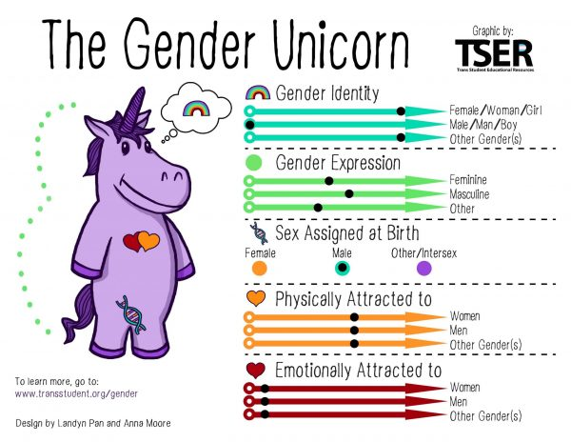
“Sexual identity” model (Shively & De Cecco, 1977)
Sex assigned at birth: upon inspection primary sex characteristics, assigned by others: ‘doctor, do we have a boy or a girl?’
Gender identity: subjective experience of feeling of belonging: male, female or otherwise: ‘do you feel male, female, non-binary..?’
Gender expression: characteristics, behaviors and expressions, associated with men/women (time/culture!) :‘how do you want to express yourself to others?’ ‘how are you read by others?’
Physical/emotional attraction: ‘who do you feel physically/romantically attracted to?’
Notes:
Can you raise you hands if you have never seen this idea of the genderunicorn before? Just to know how much time to give to it.
It is a version of the genderbread cookie that you might know.
This one is developed by transgender students.
It explains different components of our sexual identity, all of us have a sexual identity.
The components are manifold. The first component that we all know is sex assigned at birth, “is it a boy or a girl?”, it is already within the gender binary in our culture. Question asked to the doctor, and it is on your identity card. It is chosen by others, based on what is between the legs. We don’t base it on other genetics. Although 1,7% of people are born with an intersex condition.
The second layer is your gender identity, what is your experience of gender, “are you a boy or a girl”, or something else. Subjective experience of how you live your gender. Belonging to female, male or non-binary group. In some cases they don’t align -> that is what we talk about today.
Gender expression: what we show to others, (based on cultural standards and norm) most of us adhere to culture norms, they shift throughout time. We use this cues to assign a gender to a person.
Last are physical or emotional attraction.
And as you can see there are different lines on which you can position yourselves.

Slide 5


Western European & North American Historical Cultural Narrative
Male
Sex Assigned At Birth
Female
Man
Gender Identity
Woman
Masculine
Gender Expression
Feminine
Women
Sexual Attraction
Men
Notes:
What we learn today in our western culture, are the pilars of heteronormativity.
We learn there are only boys and girls.
When born with a penis, we assign as a boy, he will think of himselve as a boy, will behave masculine and will be attracted to women.
People who do not fit this norms, risk negative reactions because you cross a certain line. They call this the “gender police”.
(e.g. gender expression)

Slide 6
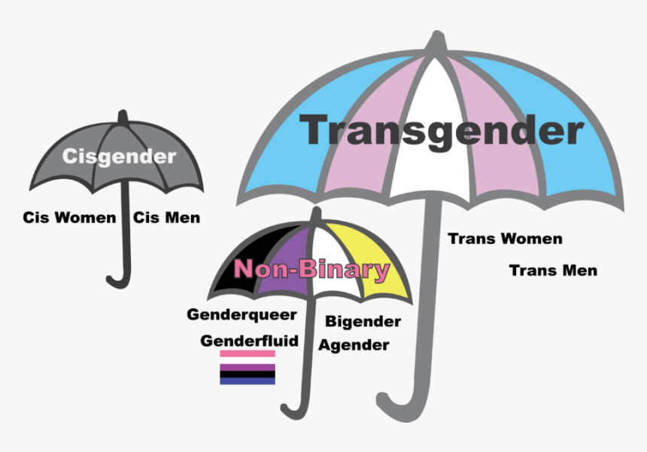
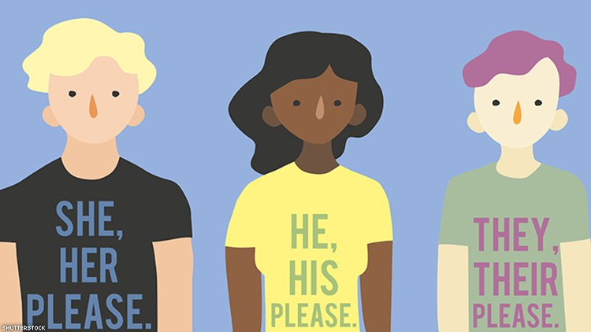
Transgender and gender diverse people
Notes:
Transgender is an umbrella term, with a lot of diversity in the group.
Transgender people are then people for who the sex assigned at birth does not completely match with their gender identity.
Non-binary is also an umbrella for diverse identities such as genderfluid, agender.
And we use our pronouns to introduce ourself, because we understand that what we see (gender expression) does not tell how someone feels (gender identity).
Using pronouns when you introduce yourself is nice thing to do as an ally.
Pronouns:
they/them/theirs

Slide 7
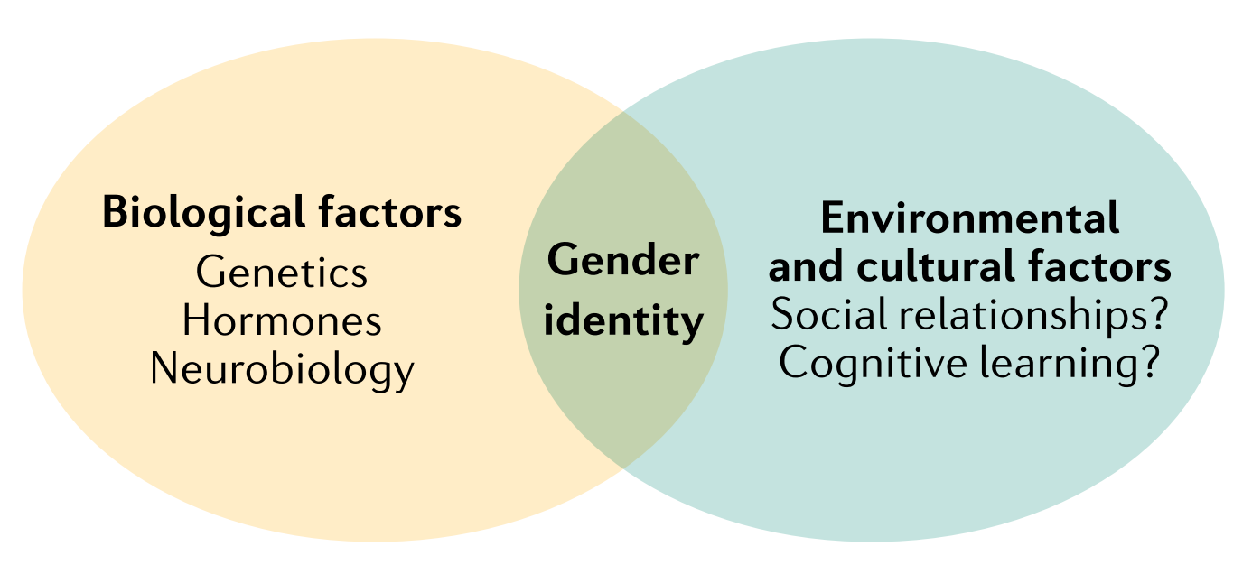
Etiology?
62%?
38%?
Rosenthal (2021); Coolidge, Thede & Young (2002).
Notes:
How is it possible that gender identity does not allign with sex assigned at birth? That is question about etiology?
Well there is no fixed clear answer yet.
In most research today we understand etiology of GI from biopsychosocial model, that there are not only biological factors playing a role, but also environmental factors.
Recent studies in twin studies, they estimated that around 60% is to be attributed to biological factors; but it is only one study of Rosenthal.
And ofcourse, etiology can be different for different people.
(Nature nurture discussion, we know it is very complex)
(but we know it is complex process, and not one way street,)
Gender identiteit’: cognitieve, sociale en psychologische factoren (Ref. Ruble, Martin & Berenbaum) (bio-sociaal-medisch model),
Een onderzoek bij tweelingen suggereert dat de ontwikkeling van de genderidentiteit meer een zaak is van genetisch-biologische factoren dan dat het een keuze zou zijn van de persoon zelf. Het aandeel van erfelijkheid werd in dit onderzoek geschat op 62%, en het aandeel van (ongedeelde) omgevingsfactoren op 38%. Net zoals bij vele zaken heerst hierover een nature (natuur)/nurture (opvoeding) debat. Meer uitgebreid onderzoek is evenwel nodig om een eenduidige visie te krijgen over welke erfelijkheidsfactoren welke rol spelen in het ontstaan van genderidentiteitsconflicten (Coolidge, Thede & Young, 2002).

Slide 8

Transgender care: multidisciplinary centres in Belgium
Convention on transgender care
Since 1/1/2025:
UZ Gent
C.H.U. Luik
ZOL (Genk)
ZNA (Antwerpen)
VITAZ (Sint-Niklaas)
Erasmus (Brussel)
UZA (Antwerp)
CeKSS (UPC, KU Leuven)
! No national guidelines – most follow SOC8
Notes:
Only full multidisciplinary team: UZ Gent
Only multidisciplinary team for children & youth -17y
Convention Transgender Zorg: UZ Gent + CHU Luik
Other gender clinics emerging: ZOL Genk, CeKSS (UPC, KU Leuven), ZNA Antwerp, AZ Groeninge (Kortrijk), VITAZ (Sint-Niklaas), UZA (Antwerp)

Slide 9
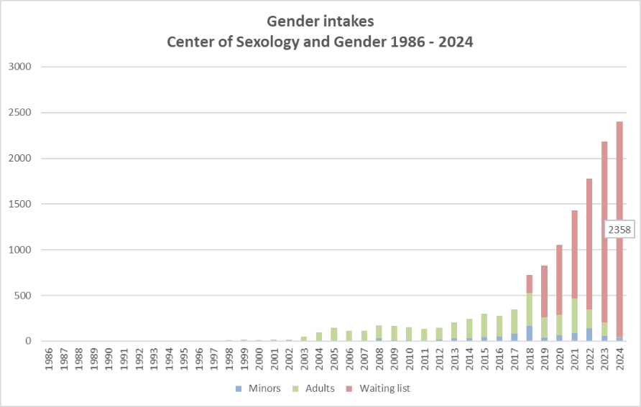


Slide 10
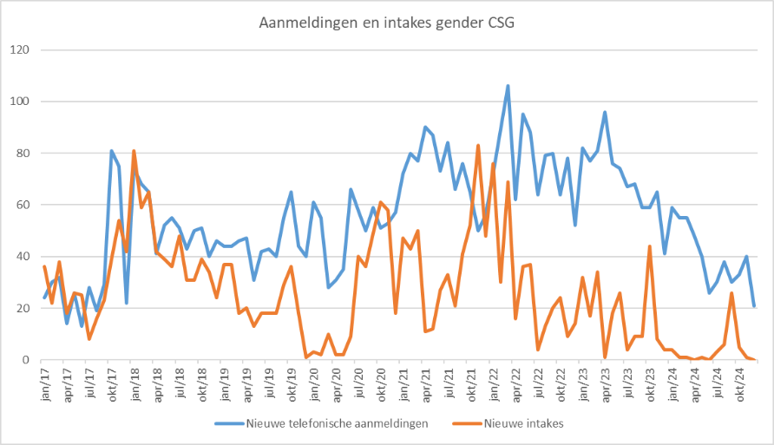
Notes:
New telephonic applications

Slide 11
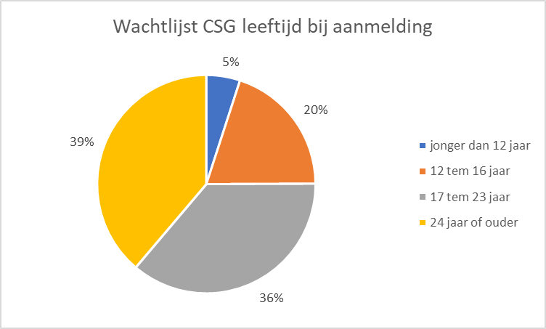
Waiting list : profiles?

Slide 12
3. Transition: a personal pathway

Slide 13

Transition: a personal unique pathway
emotional (selfaccceptance)
social (role, clothing, pronouns)
legal (name, legal gender)
medical (hormones, surgery)
Notes:
Niet enkel medische maar ook emotionele (zelfaanvaarding), sociale (kledij, aanspreekvorm), en juridische transitie (e-id)

Slide 14
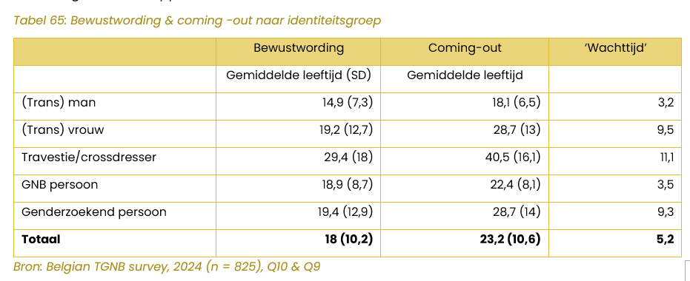
Emotional transition
Age of coming-out (TGNB, 2025)
Notes:
De gemiddelde leeftijd waarop respondenten er zich van bewust werden dat ze transgender, gender non-binair en/of crossdresser zijn, is in deze steekproef 18 jaar (standaarddeviatie 10,2). Wanneer we dit apart bekijken voor de identiteitsgroepen, dan blijken trans mannen zich gemiddeld genomen jonger bewust zijn van hun genderidentiteit en crossdressers eerder ouder zijn. Dit is in lijn met de bevindingen uit het rapport van 2018.
Ongeacht de generatie zagen we dat de helft van de respondentengroep aangeeft het te weten voor hun 15de jaar, en de andere helft na hun 15de, maar ook dat hoe jonger de respondenten, hoe meer personen zich dichter bij de mediaan situeren.
Bijna alle respondenten (93,5%) hebben al met minstens één iemand gesproken over dat ze transgender en/of gender non-binair zijn en/of aan crossdressing doen. Dit percentage ligt iets lager dan in het rapport van 2018. Gemiddeld genomen zit er een verschil van vijf jaar tussen de eerste bewustwording en de eerste keer dat men dit aan iemand vertelde. Deze gemiddelde tijd neemt sterk af van de pragmatische generatie (1971-1985, gemiddeld 12,4 jaar) naar generatie Y (1986-2000, gemiddeld 3,8 jaar). De jongste generatie Z (2001-2015) wacht het minst lang – slechts 1,9 jaar.

Slide 15
Social transition
Genderrol change?
Clothing, hair, make up -> social markers for gender expression (culture and time-bound) (difficult for non-binary people: what script to follow?)
Name/pronouns? (new language for non-binary people)
Notes:
Social transition -> not to underestimate, can be really hard. For example, starting social transition at same time as mecial transition, but medical takes quiet some time. So there is always a phase in which people are not yet fully perceived in the way they want to. And this can make them at risk of experiencing trans phobic micro-agressions but also physical violence.
Especially trans women who do not pass yet as cis women can feel very anxious about going outside, risking verbal comments etc.
For non-binary people social transition can also be a challenge, since there is no cultural script in our western countries to follow. There is no such thing as a “non-binary clothing” or “non-binary haircut”, so you have to invent yourself what feels good as a gender expression. For some that means if they were assigned male, to wear more female clothing to compensate and to be seen by society not as a cisgender male.

Slide 16
Medical transition
Not every trans person has a request for help or/and needs medical care!
Barriers:
  Lack of correct information and referral
  Waiting lists (danger: self-medication!)
  Shame/stigma or fear of prejudice from care providers
  Cost (58% have hospitalization insurance, but only 15% got most expenses back)
Positive evolution: Care is becoming increasingly accessible, visible and affordable
Challenge: large influx, possibly changing profile?
Motmans, J., Wyverkens, E., & Defreyne, J. (2017). Being transgender in Belgium. Ten years later. Brussels: Institute for the equality of women and men.

Slide 17
Psychological counseling: important!
Suicide rates are alarmingly high (Seynaeve, Missiaen, Portzky, Dumon & Motmans, 2016)
80% are currently thinking or have thought about suicide
40% have already attempted suicide
Focusing on factors that strengthen resilience such as:
Family support → involve context
Insight into minority stress model
Invest in community/buddy projects
Coping skills
Expand network (professional and private) …..

Slide 18
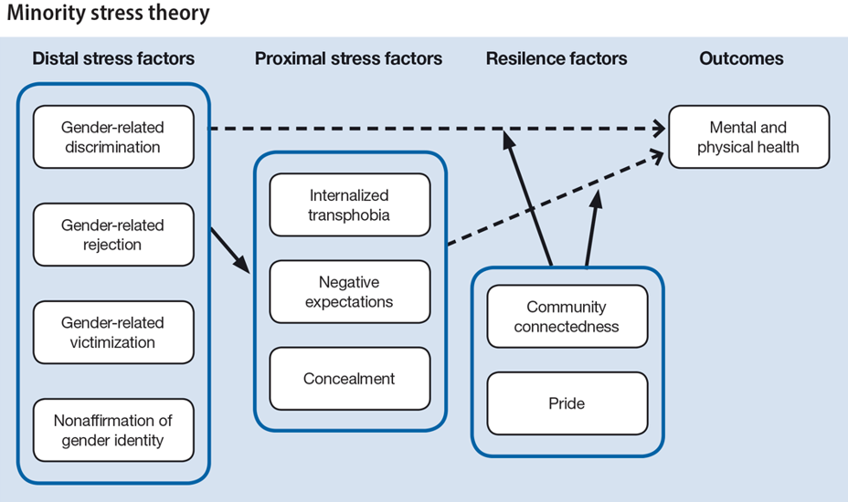
Gender minority stress model (Testa et al., 2017)
rejection, non-affirmation, and victimization were related to suicidal ideation through experiences of internalized transphobia and negative expectations

Slide 19
Key themes
  experience of gender development, gender identity, gender expression, ...
  (recent) coming out and social transition (parents, partner, friends, work...)
  thinking about desired future possibilities regarding desire for children/fertility
  mapping out psychological and/or medical care needs
  psycho-education about possibilities and limitations of gender-affirming treatment
  Sexual experience and relationships
Notes:
Key themes in our psychological counselling

Slide 20
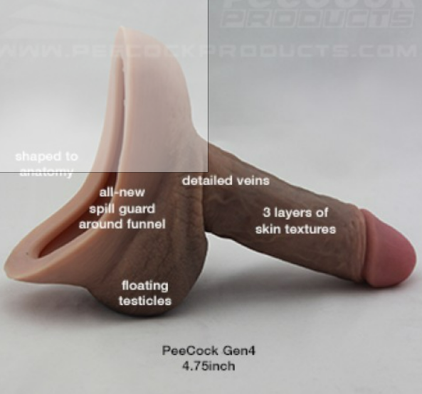
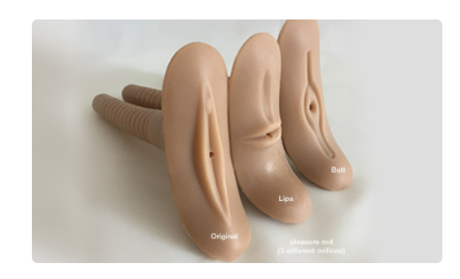
Sexuality/Intimacy
Possibly complicated relationship with their body
Searching for new ways to experience sexuality
  Cf. Tools
  TIP: Separate physical characteristics and sexual behavior from gender when discussing safe sex!
Not every trans person goes through every step in the transition.
SO:
Avoid assumptions about the anatomy of transgender people!
Kerckhof, M., Bruneel, L., & Elaut, E. (2022). Mythes versus feiten over het seksueel leven van transpersonen. Neuron, 26-30.
Notes:
Voorzichtig zijn met assumpties over seksuele ervaringen van trans* personen: denk aan de diversiteit!

Slide 21
Themes shift throughout a trajectory
  coping with shame and guilt
  experiences of violence and discrimination
  (re)discovering sexuality and relationships
  coping with experiences of loss
  Identity
  Fertility
  Seeing transition as wealth
Notes:
Fertility stays an important theme that can come up again later during their transition.
It is getting rediscussed when people take certain steps.
Or for example, one has a new partner relation and the partner does find a biological link important, or what also happened for example trans men is together with cisgender women who is infertile. So he decides that in that case he wants to use his egg cell.

Slide 22
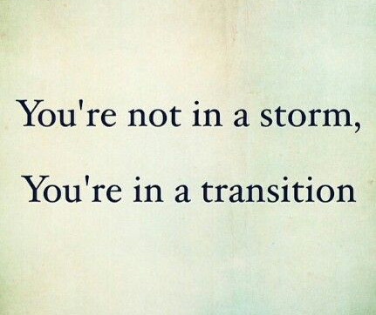
“after the operation the transition is completed”
Transition is never fully completed for most
Complications
Continuing coming out and reactions from others
Self-discovery
Dating
….
Importance of after-care!

Slide 23
4. Parenthood and fertility counseling

Slide 24
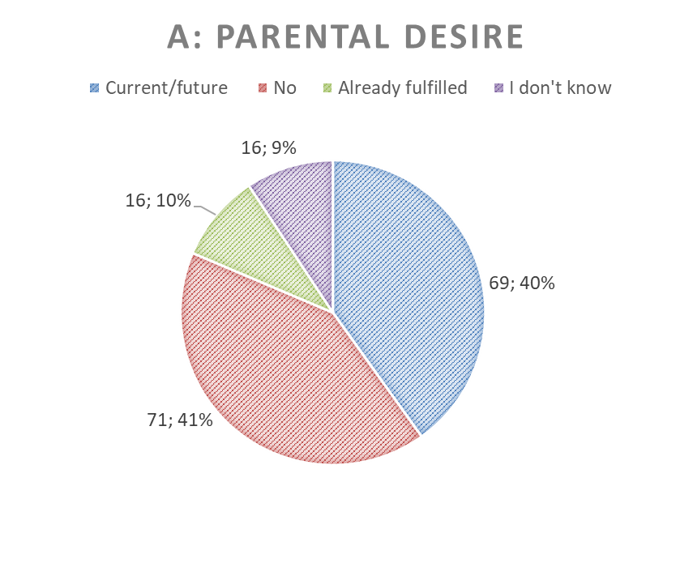
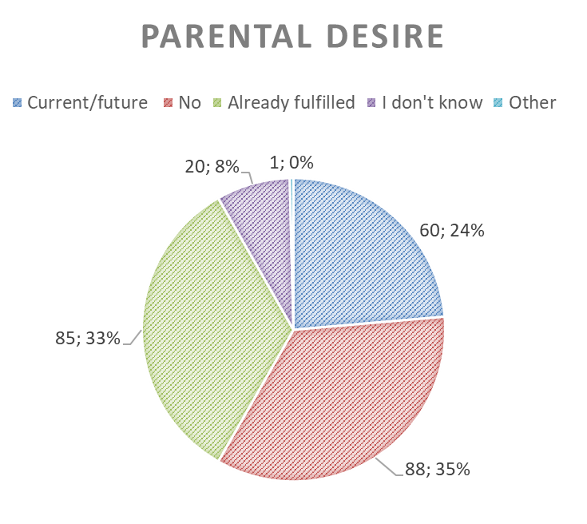
Do transgender persons wish to have children?
AFAB: N = 172
AMAB: N = 254
Motmans, J., Wyverkens, E., & Defreyne, J. (2017). Being transgender in Belgium. Ten years later. Brussels: Institute for the equality of women and men.
Notes:
We conducted research on a community-based sample of over 400 transgender people and found low rates of parental desire, from 24% in AMAB transgender people to 40% in AFAB transgender people. However, I must note that AFAB people were younger.

Slide 25
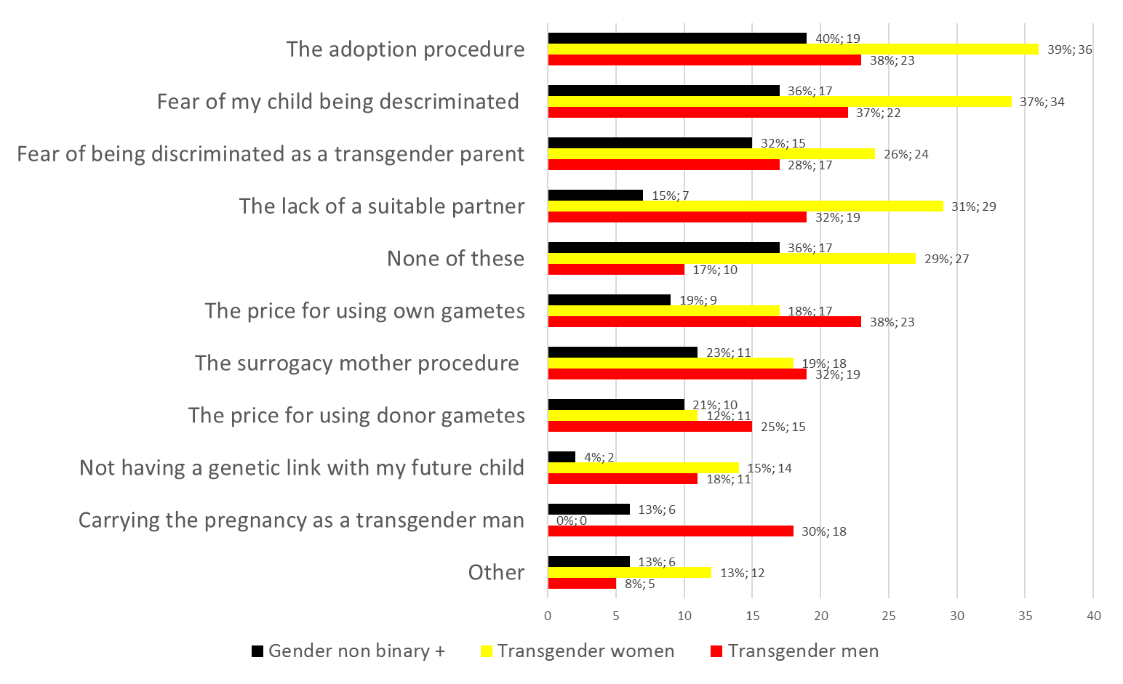
What are the barriers?
Notes:
Barriers for fulfilling child wish are shown for the trans women, the transgender men and the GNB+
Whereas TM found the lack of a suitable partner, carrying a pregnancy, the use of own genetic material and the surracy mother procedure troublesome, the GNB+ group indicated other barriers for fulfilling their child wish, including the adoption procedure and fear of discrimination.

Slide 26
Impact on the child?
Studies on the outcomes for children with transgender parents have found no evidence that having a transgender parent affects a child's gender identity or sexual orientation development, nor has an impact on other developmental milestones.
Stotzer, Herman, Hasenbush (2014). Transgender Parenting. A review of existing research. Williams Institute
Dierckx M, Motmans J, Mortelmans D, T'sjoen G. Families in transition: A literature review. Int Rev Psychiatry. 2016;28(1):36-43.

Slide 27
Fertility counseling
Take sufficient time
Explain options for fertility preservation
Is there a desire to have (genetically related) children?
How does one see this fulfilled?
Reintroducing reality
Have a letter written to oneself
Possible processing
Notes:
Fertility is an important topic in counseling at early but also later stages in a gender transition.
Pts get explained options for fertility preservation;
How does one see this fulfilled?
Genetically own children
Via future partner
Adoption/Foster care
→ introducing reality of adoption (e.g. the long waiting lists)

Slide 28
Let’s meet Thomas
30 years old
Identifies as transmasculine
Started social at 20 years old
Medical transition: hormone therapy, mastectomy
At first thought about himself as asexual
Later on, explored sexuality, now identifies as gay men
Bottom dysphoria got less after getting in relationship with cisgender man
Notes:
If the partner really acknowledge him as a men, helps him to cope with bottom dysphoria. He also learned about other gay trans men, saying front hole instead of vagina, and this renaming of body parts also helps him to feel more comfortable in his body.

Slide 29
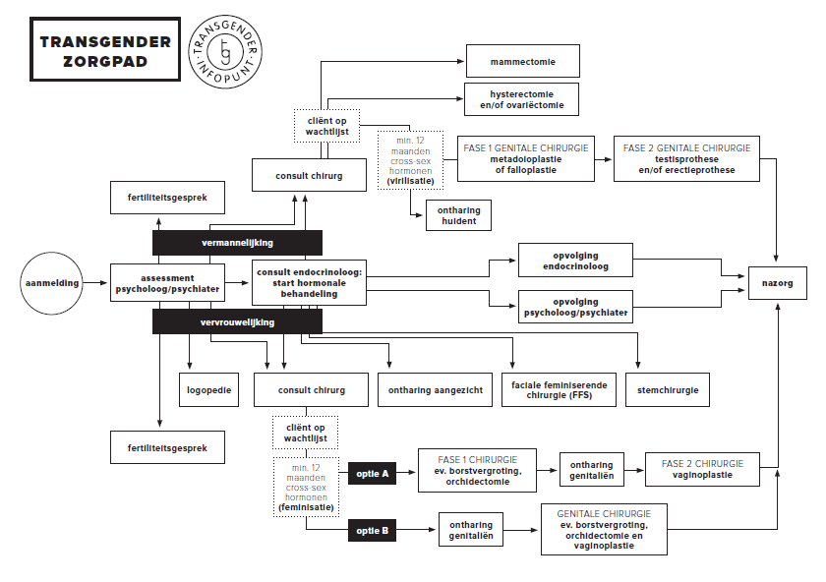
Notes:
Thomas also had a fertility conversation with the doctor in our hospital. And decided not to preserve egg cells.
He at that moment did not have a wish for a genetically related child.
Now, Thomas is together with a cis man, he is happy that he has still his uterus and egg cells, and he thinks about carrying a child himselve.
This was never an option when he started his transition, but because he feels more comfortable and confident as a men, he feels he could be pregnant as a men.
He also read about experiences of other trans men.
He makes a new appointment to discuss this further with the fertility doctor.

Slide 30
Thomas
Decided not to do preservation of egg cells
Did not have a child wish

Slide 31
Challenges in fertility counseling
Young age of patients
Fertility can be seen as less important compared to starting hormone treatment
Financial barriers to gamete preservation
Psychological barriers to gamete preservation
Not that much research yet
E.g. putting emphasis on freezing egg cells or not?
Notes:
Some patients are afraid that fertility preservation will delay too much starting with hormone treatment.
Patients might think they don’t want children, but this can change (e.g. partner changes)
Financial
Psychological: it might cause to much dysphoria, for some trans women difficult to masturbate, an alternative solution is than welcome. For trans men, the idea of extra female hormones can feel as a heavy burden.
Not that much research, sometimes different opinions of doctors, for example regarding freezing egg cells before testosteron treatment
( Until 2018 hysterectomy was obligatory to change your legal sex, now less trans men choose for this operation)

Slide 32
6. Trans person as your patient
Notes:
Two important moments where you can meet a trans person
To discuss the impact of medical steps on fertility and to reflect and get information on gamete preservation
Later on in the trajectory, with a concrete request to full fill their child wish

Slide 33
Thomas (5 years later)
Currently in relationship with cisgender male partner
Thinking about carrying child himself, he and his partner wants more information about this

Slide 34
Experiences of trans masculine individuals and their health care providers within preconception and prenatal care (Senne Misplon, Joz Motmans, Chloë De Roo, 2023)
Qualitative study: interviews with trans masculine individuals (N=4) and health care providers (N=10)
Inductive thematic analysis
Notes:
TM individuals who are or have been pregnant, HCP : psychologist, doctors, midwives

Slide 35
What barriers do they experience?
Macro-level
  Exclusionary focus on femininity and (cisgender) women
  Difficulties with reimbursements or pregnancy-related lab tests, insurance companies and legal restraints
Meso-level
  Misgendering
  Micro-aggressions, ignorant or transphobic reactions
  Misplon et al. (2023)
Notes:
Quote doctor that spend half of a day to get the lab test refunded
Meso level: in the interactions between HCP and TM patients:
All participants tried to navigate and/or avoid misgendering.
Micro aggressions etc can be explained by a lack of cultural competency or personal attitudes or beliefs
Most of reported transphobic happened outside of UZ Ghent

Slide 36
Example of micro-agressions
Julie (she/her) has an appointment with a new nurse for her injection with testosterone blockers. The nurse administers the injection and says, 'I had no idea you were trans. It doesn’t show at all.' Julie doesn’t know how to respond, but resents the remark. To her it feels like being transgender is something that shouldn’t be visible.

Slide 37
Barriers
Micro-level
  HCPs: a lack of experience and a need to break their routine of care or procedures
  Both experience a lack of information or trans-specific knowledge
  Both experience anticipatory anxiety towards each other
    For TM based on previous negative experiences with transphobia, discrimination,… => hypervigilance
    For HCP’s linked to misgendering and being reprimanded by the patient or their partner
  Misplon et al. (2023)
Notes:
Lack of specific knowledge, also resulted in some HCP in presumptions or incorrect advice, such as idea that after trans person started hormone treatment they are infertile.

Slide 38
Results: Ways of navigating misgendering
Using first name of patient to address them
To proactively excuse themselves for making mistakes
“I say that we are all going to do our best […] And that I apologise in advance if we make a mistake, because it is always with the intention of treating correctly. And it’s accidental that we make a mistake, and then they get that.”
  Misplon et al. (2023)
Notes:
- To show their good intentions and willingness

Slide 39
Good practices in gender-inclusive language
Always start the consultation by calling the patient in by last name
Ask what terminology patients prefer to refer to their body(parts)
Copy the language patients use for their body(parts)
The use of gender-inclusive intake forms, letters, and leaflets
The use of separate leaflets for this specific group
  Misplon et al. (2023)
Notes:
And when the patient is inside, you can explain you don’t want to be rude, but that your first question always is how they would like to be addressed? And that is added on the digital file!

Slide 40
Trans-inclusive care
= Practices that make trans people feel welcome, seen and safe
The use of gender-inclusive language and preferred terminology
Extra measurements concerning time and care
  E.g. cover the legs with a cloth when performing a vaginal ultrasound and examination
Being treated as other patients: TM people did not want to be seen as something extraordinary
Trauma-informed care: consent and patient-centred control are central
  Misplon et al. (2023)
Notes:
Because due to gender dysphoria TM patients might experience stress or anxiety

Slide 41
Trans-inclusive care at Uz Ghent preconception care
The use of colours in digital files
Assigning trans patients to a limited group of HCP’s with trans-specific knowledge and experience
Policy and practice which breaks through cisnormative and gender binary assumptions
e.g. ‘What do you have to offer?’ ‘Do you have a uterus?’
  Misplon et al. (2023)
Notes:
1, To highlight important types of applications in a blink of an eye and break through their routine of care. (e.g. when the patient is transgender or non-binary) This helped to correctly address the patient.
2. Helped TM patients to feel safe and supported. And helped HCP’s to build competence.

Slide 42
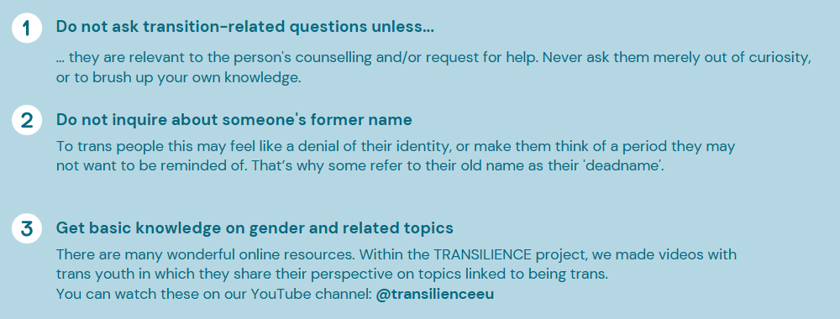
Transsensitive care: general guidelines

Slide 43
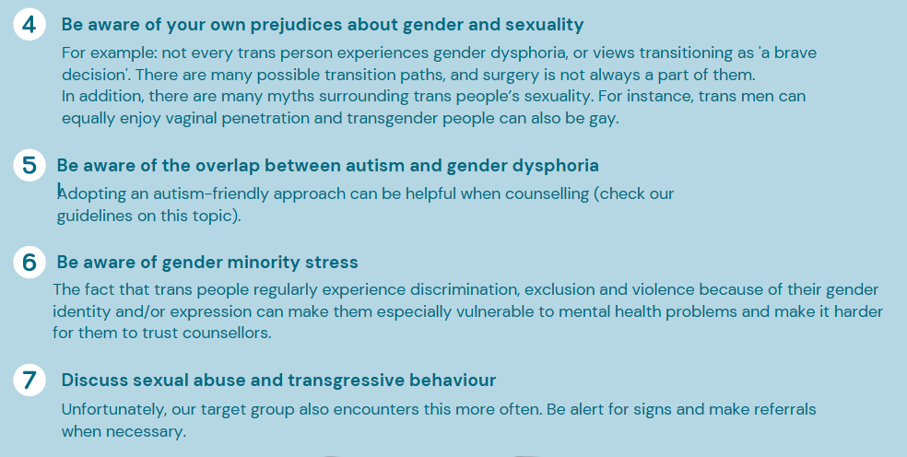

Slide 44
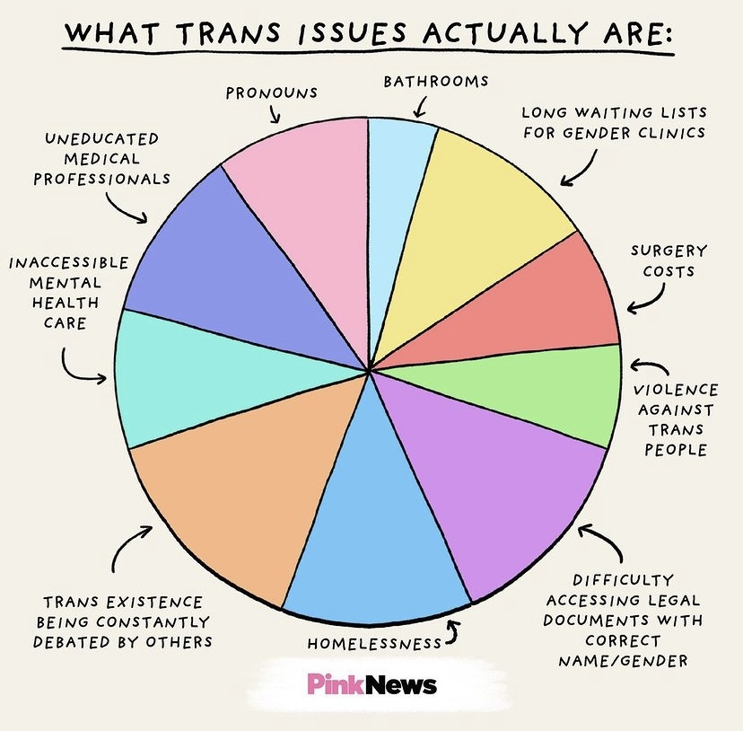
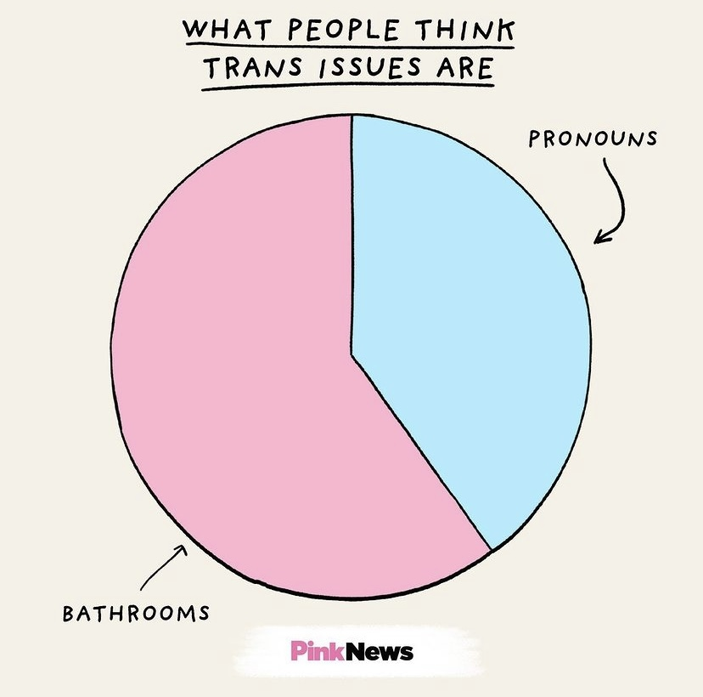
To end..

Slide 45
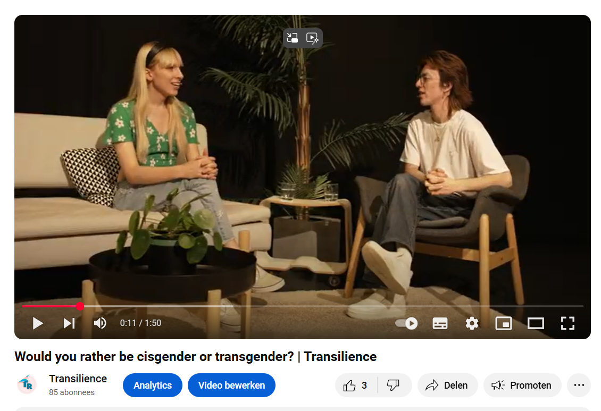
To end..
Transilience – YouTube

Slide 47
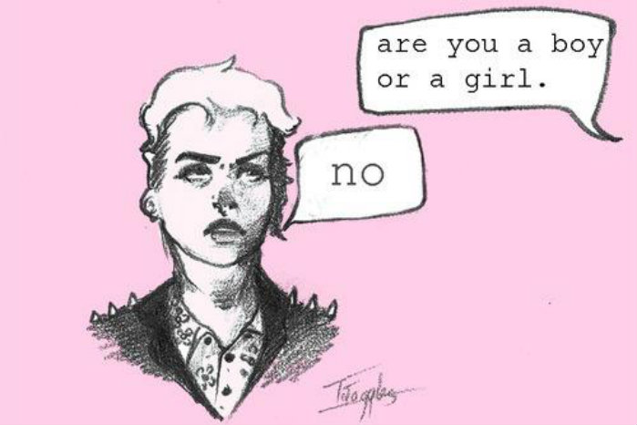
Gender Identities…
Identity = highly personal feeling
Shift away from pathologizing: part of human variation
No clear, fixed meaning (Davidson, 2007)
Does NOT translate 1 to 1 into medical choices / a medical process!!
Notes:
In the past have been pathologized, people were looked at as mentally ill.

Slide 48

Trans binary versus non-binary
FRA LGBTI survey 2019
https://fra.europa.eu/en/publication/2020/eu-lgbti-survey-results

Slide 49

Biggest problem = invisibility
  EU LGBTI Survey II, 2020:
    72% did not take any intervention to change their body so it better matches their gender identity
    76% is not involved in trans or LGBTI organisations
    78% did not change gender marker
Society
Legal transition
Clinical data
Trans communities
Notes:
Recent European study, three quarter said they did not do an intervention to change their body, and….
So the amount of people trans is more common than we think based on legal data, clinical data or trans organizations.
EU – SE – BE – NL
6% active member / volunteer – 11% - 10%- 9%
5% in regular contact – 5% - 9% - 7%
16% follows activvities – 21% - 14% - 16%
3% financial supporter- 10% - 4% - 4%
76% nope- 65% - 72% - 72%

Slide 50
4. Fertility and parenthood

Slide 51
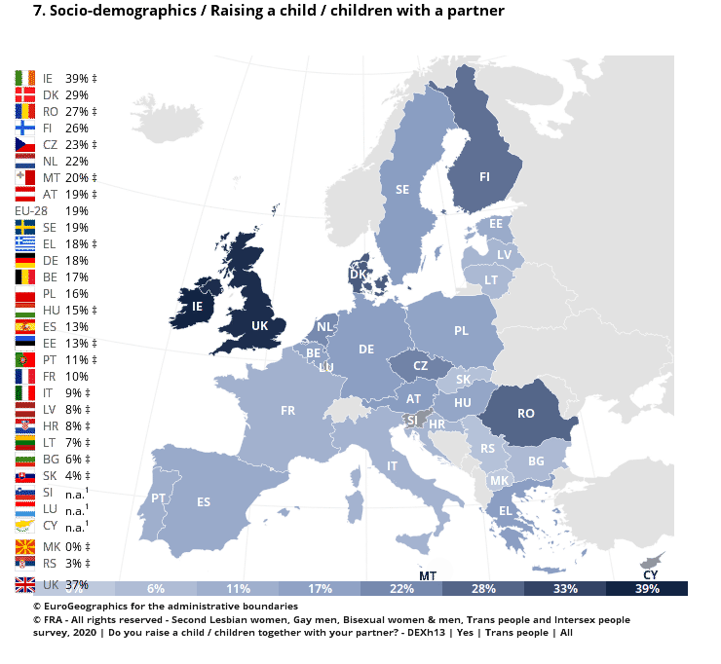
How many trans people have children?
EU: 19%

Slide 52
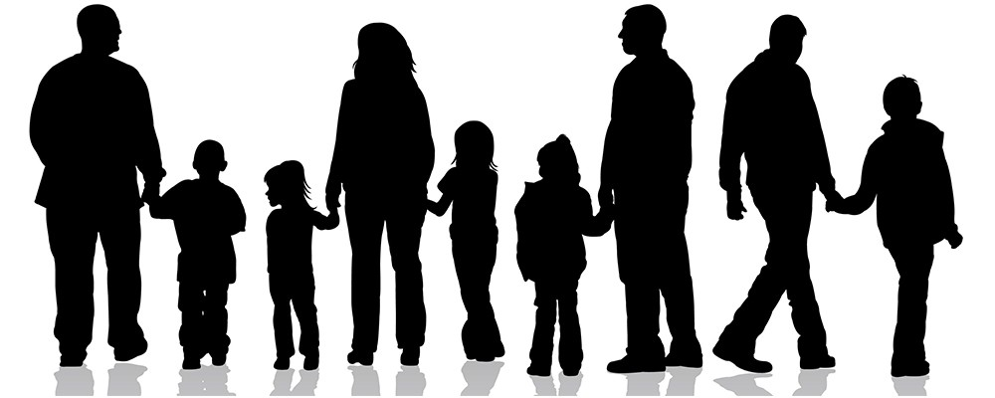
Parenthood in trans people
Life satisfaction in trans persons ~ positively having children
Parenting children ~ suicide protective factor
Loss of fertility ~ perceived as problematic

Slide 53
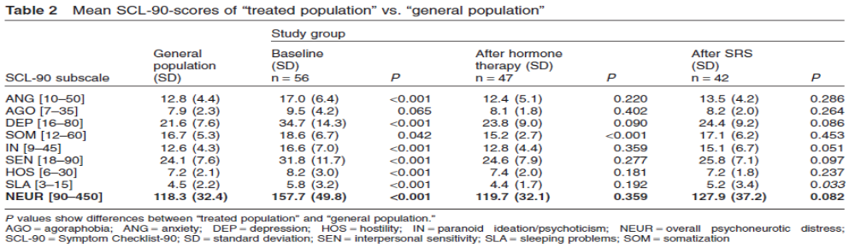
Outcome data?
Agoraphobia - Anxiety - Depression -Somatisation - Paranoid ideation -
Interpersonal sensitivity – Hostility - Sleeping problems - Psychoneurotic distress
Effects of different steps in gender reassignment therapy on psychopathology: a prospective study of persons with a gender identity disorder. Heylens, Verroken, De Cock, T’Sjoen, De Cuypere. Journal of Sexual Medicine 2014,11:119-126
Notes:
We see that there is an decrease in depression and anxiety scores after hormone treatment. (that does not further decreases after SRS).

Slide 54

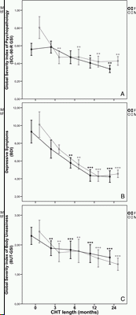
GAHT
Psychopathology
Depressive Symptoms
Body Uneasiness
Cross-sex hormone treatment and psychobiological changes in transsexual persons: two-year follow-up data. Fisher, Castellini, Ristori, Casale, Cassioli, et al. Journal of Clinical Endocrinology and Metabolism 2016, 101(11):4260-4269
Notes:
In a 2 year follow-up study we also see a significant decrease in X, x, x after starting cross-sex hormone treatment.

Slide 55
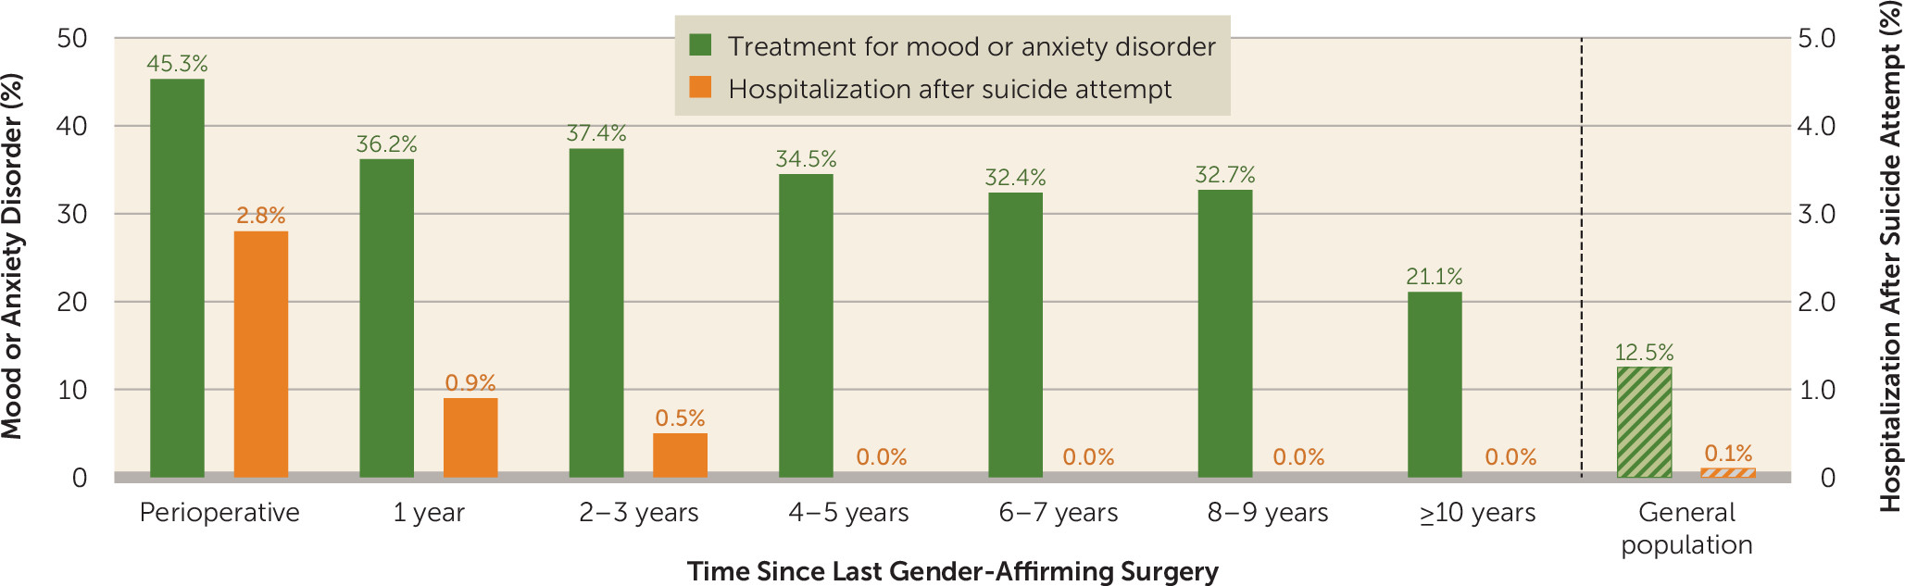
Mental health after surgery
Bränström, R., & Pachankis, J. E. (2020). Reduction in mental health treatment utilization among transgender individuals after gender-affirming surgeries: a total population study. American journal of psychiatry, 177(8), 727-734.
Notes:
In this big study int he population about treatment and hospitalization after suicide attempts, they found a decrease in treatment and hospitalization after gender-affirming surgery.

