Slide 1
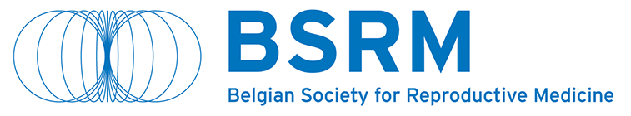





Bérengère Ducrocq
Lille University Hospital, France
What happened in France after anonymity stopped ?
Notes:
Hello everyone
I'm really pleased to be here this afternoon
I would like to thank the organising committee for inviting me to your conference.
I have been asked to share with you the French experience of ending anonymity for gamete and embryo donors.
I work at the Lille University Hospital, at the Agence de la biomdecine and I am a member of CAPADD, the Ministry commission responsible for implementing the procedure for access to origins.

Slide 2

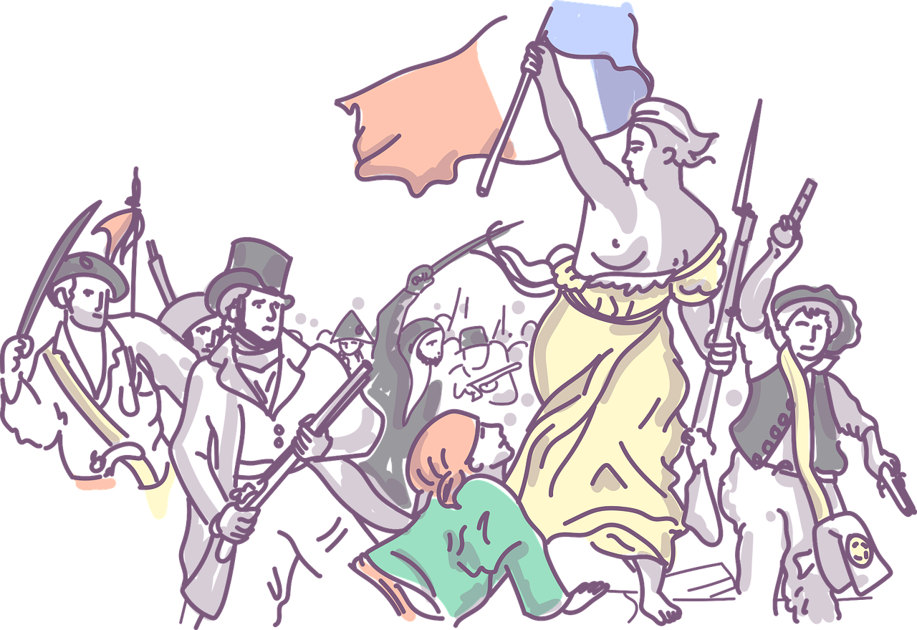

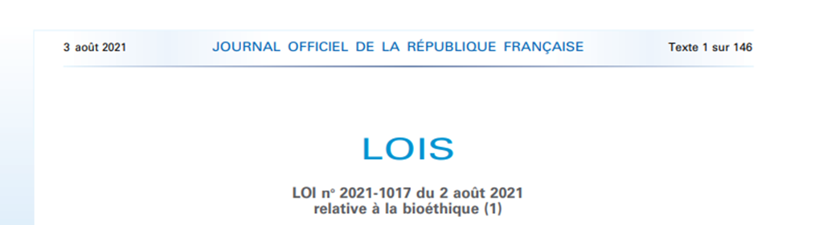




THE NEW BIOETHIC LAW
Borcelle Company
ART FOR ALL WOMEN
FERTILITY PRESERVATION
FOR NON MEDICAL REASONS
END OF ANONYMITY OF GAMETE DONATION
Notes:
The Bioethics Act was passed in August 2021.
It was a real revolution in the world of reproduction in France.
3 major points
- the extension of ART to all women (before the law, only heterosexual couples had the right to access ART and sperm donation). From now on, women in couples and single women can have access to donation.
- The possibility of fertility preservation for non-medical reasons, i.e. for societal reasons, has been extended from the age of 29 to 37.
- The third important aspect of the law : ending the anonymity of gamete and embryo donors.

Slide 3


STOP ANONYMITY
HOW DOES IT WORK ?

Slide 4

Section 5 of bioethic law 2021
NOT STOP ANONYMITY
BUT
ACCESS TO ORIGINS
FOR PEOPLE CONCEIVED BY DONOR
(sperm, oocyte, embryo)
Notes:
Article 5 of the bioethics law does not talk about the end of anonymity but about access to the origins of people born from a third-party donor.
Anonymity is a major rule for the donation of human body elements in France. In this case, the parents and society do not know any information about the donor, so the donation remains anonymous.

Slide 5


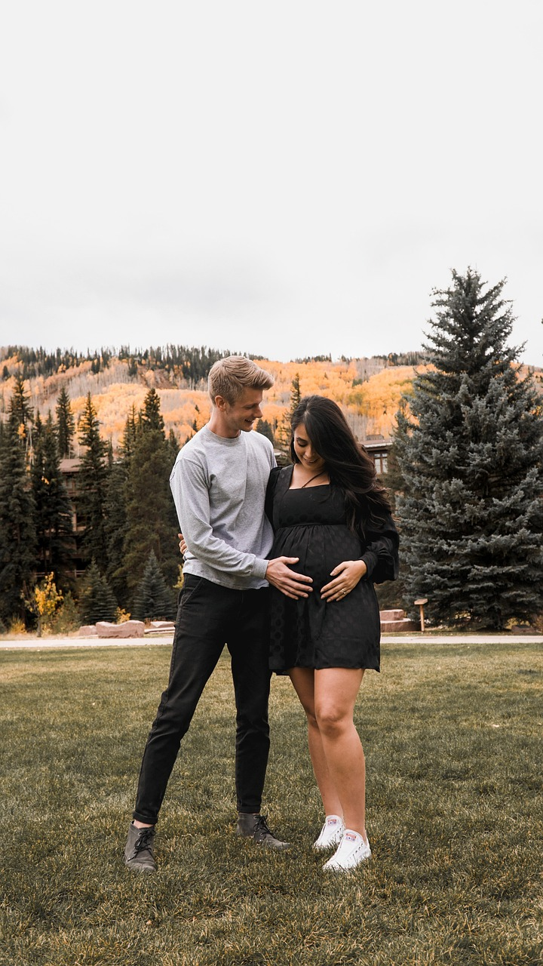

DONORS
PARENTS
CHILDREN
All donors = “new-donors” have to consent to the new system since september 2022
The informations are recorded in the national register (Agence de la biomédecine)
“Ex- donors” can give their consent any time
They know nothing from the donor
Before 31/03/2025 : ART is possible with “ex” and “new” donors
After 31/03/2025 : ART is only with “new” donor
-> implementing decree
If they were conceived by “ex-donor”, they can contact CAPADD
-> the donor will be contacted to possibly consent
If they were conceived by “new-donor”,
-> they are guaranteed to know the donor’s informations after majority if they wish
Notes:
so what happens now?
for donors
Now, since septembre 2022, all donors, whom we will call ‘new donors’, have been required to sign a consent form and agree to the new system.
the information (which I will explain next) is registered on a national register managed by the agence de la biomedecine (biomedicine agency). this register requires the information to be kept for at least 100 years.
Old donors (who donated before September 2022) may consent to the new system. They should contact CAPADD and the centre where they made their donation.
for parents
They have no information about the donor.
ART techniques completed before 31/03/2025 may be conducted using old donors.
ART techniques done after 31/03/2025 must be done with new donors.
So We have had 2 years and a half to constitute the new stock of donors.
Finally, children
If they were conceived with a old donor, they can contact CAPADD. The donor will then be informed of the possibility of changing his consent.
If they are conceived with a new donor, they are guaranteed access to the donor's informations. The parents are informed of the donor's status if they wish, in this way informing the child after birth of this opportunity.

Slide 6

WHAT INFORMATION ?
NON-IDENTIFYING = DNI
Données Non Identifiantes
IDENTITY = DI
Données Identifiantes
AGE
PHYSICAL CHARACTERISTICS
MARITAL STATUS
NUMBER OF KIDS
JOB
GENERAL PHYSICAL AND PSYCHOLOGICAL HEALTH
MOTIVATION TO DONATE (LETTER)
NAME
FIRST NAME
BIRTH DATE
CITY OF BIRTH
Notes:
what information must be collected
non-identifying data
age, physical characteristics family status, profession, physical characteristics and general physical and mental health data (good or not good), and finally motivation (donors may write a letter if they wish).
identifying data
surname
first name
date and place of birth
this information will be made at the disposal of the child born of the donation when he or she attains the age of majority, if he or she so wishes.

Slide 7




CAPADD WAS CREATED
Commission d’Accès des Personnes nées d’une Assistance médicale à la procréation aux Données des tiers Donneurs
Borcelle Company
WHEN ?
WHO ?
FOR WHAT ?
Section 5 of bioethic law 2021
Application of the access to origins system in September 2022
16 binomes
President : Magistrate
Ministry health, justice, social affairs
Experts qualified (jurist, psychologist, ART specialist, sociologist/anthropologist)
Patient associations : AGPL/BAMP/Mam’en solo/PMAnonyme, Don de gamètes solidaire, SMR
Answer the requests of people conceived by donor
Ask the ART center for identity of “old” donor
Ask the “old” donor for consent to the new law
Notes:
Capadd was created in September 2022 to introduce this system.
This commission reports to the French Ministry of Health.
The commission is composed of 16 members:
A magistrate is president
People from the Ministries of Health, Justice and Social Affairs
Experts: jurists, psychologists, doctors specialising in ART, sociologists, anthropologists
Patients' associations: parents, people born of donated blood and donors.
CAPADD's mission is to answer the wishes of people born from donations.
It must also ask the centres about the identity of former donors and ask former donors about their desire to give their consent as soon as there is a request for a child born from their donation.

Slide 8







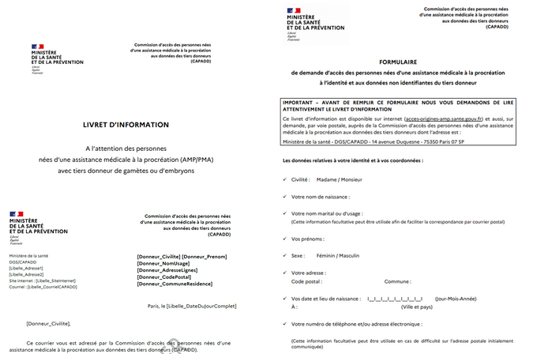
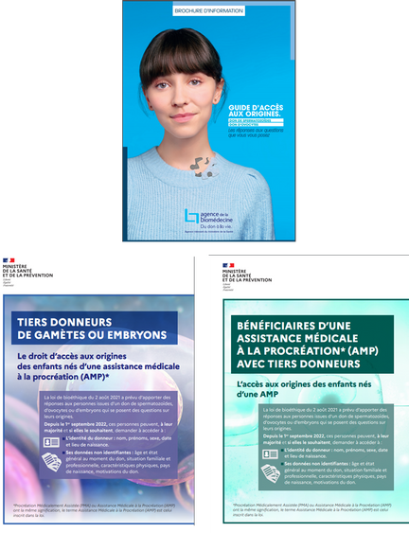
Which activities since 2 years ½ ?
Preparation forms/letters/who to informed
Development of communication medias
Psychological support services
20 meetings
Assistance to donation centers : 3 webinar/year
Visit 5 donation centers :
Organisation/old archives
Notes:
What has capdd done in the past two and a half years ?
We have met 20 times
We started from zero, so we created models of consent, thought about how to inform donors and people born of donations, and decided on model letters.
We took inspiration from the Swiss model
We visited 5 centres. It was very interesting for the other members to find out how donation was organised in these centres, to see the old archives and to understand the difficulties facing the centres.
We educate the centres and give them information about the data. We work very closely with the centres because their collaboration is essential.
In collaboration with the Ministry, we have created communication aids for professionals, parents, donors and children conceived by donation.
We have implemented psychological support, with psychologist consultations available within capadd

Slide 9
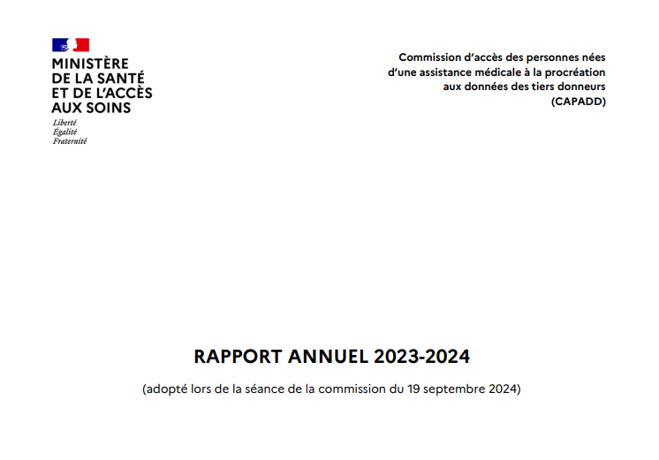
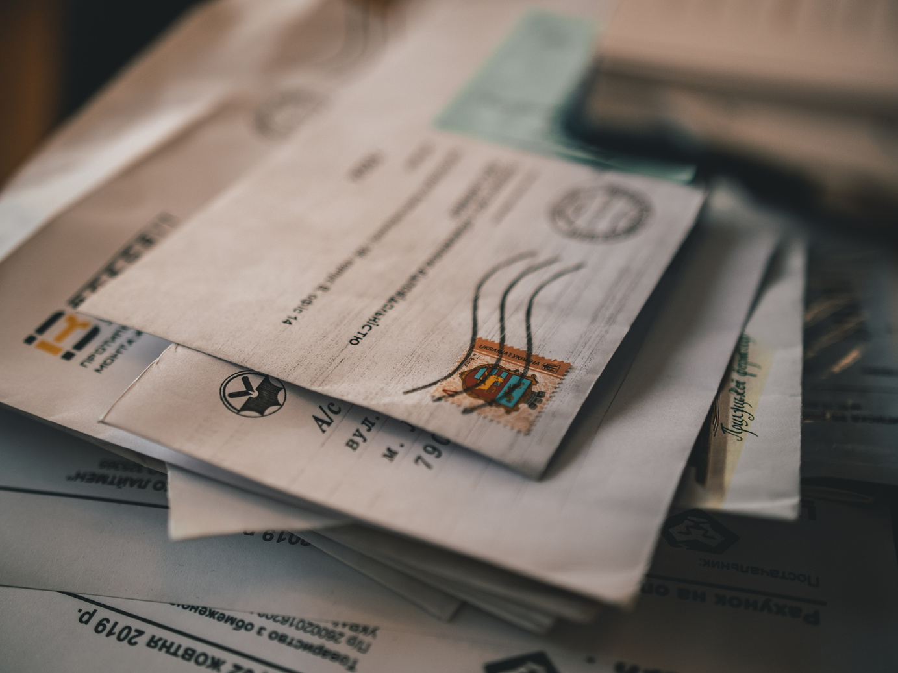
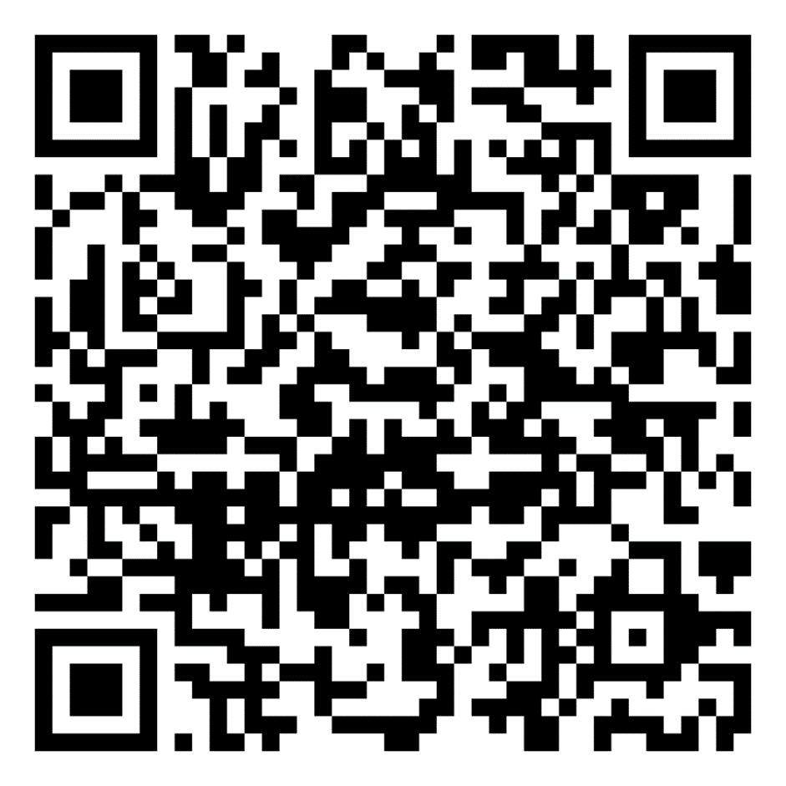
RECENT DATA
MEETING ON 02 FEBRUARY 2025
2 ½ YEARS ACTIVITY
01
02
03
701 requests
medium age = 34 years
women = 75%
512 answers send to the requesters
274 : the donor was identify
238 : not possible to identify the donor
73 answers
with DI/DNI
65 death notifications
66 refusal notifications
65 no answer notifications
We estimate in France
100 000 children conceived by donor
50 000 adult > 18 ans
10 % CAPADD-requesters received a positive reply
MEDIUM AGE OF DONORS
71 YEARS
> 50 % identification was possible
Notes:
What is the latest activity data (from our last meeting in February)?
After 2 and a half years of activity (the September 2024 activity report is available on the French Ministry of Health website)
Capadd has received 700 requests from people born from donation (majority sperm donation only10 requests for oocyte donation, 1 request for embryo donation).
The median age of these people is 34.
75% of applicants are women
For information, we estimate that there are 100,000 people born from donation in France and probably 50,000 over the age of 18.
500 responses have been sent to date. In half of these cases, the donor was identified by the centre.
Of these responses, 73 included the donor's ID/ID. In the other cases, the response was that the donor was dead (he could not consent to the donation, so no positive response was possible), in a quarter of the cases the response was that the donor had refused, and in the rest of the cases capadd had received no response from the donor.
It should be remembered that the average age of the donors concerned is 74, as most of these requests were made between 1970 and 1990.

Slide 10



DIFFICULTIES ENCOUNTERED
OLD ARCHIVES
Donation since 1970-1990
Closed center
Destroyed archives
Until 1994, no official sperm bank
CENTERS ARE OVERLOAD
ART open to all women
Societal preservation
-> high activities +++
-> CAPADD not the priority …
REQUESTERS ARE DISAPPOINTED
Litigation against centers
Litigations against CAPADD
Sensibiliser les parents au nouveau dispositif et à l’information du mode de conception
Notes:
What difficulties have we experienced?
The archives are very old and it is difficult for some centres to find the identity of donors. Previous bioethics laws did not allow donors to be re-contacted.
Some centres have closed and the archives have disappeared.
Before France's first bioethics law in 1994, directed donations or fresh sperm were possible. Many inseminations took place directly in doctors' offices. These clinics are now closed and it is impossible to access the archives. In Addition, the donors could certainly not be identified because these practices were clandestine even if they were authorised.
90% of requesters are disappointed with CAPADD's responses. A number of legal proceedings are in progress against CAPADD and the donation centres.

Slide 11
WHAT ABOUT SPERM DONORS ?

Slide 12
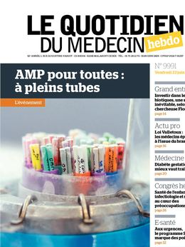




LONG WAITING TIME FOR ALL
2 years to have sperm donor insemination …
13 %
41 %
46 %
Notes:
What impact does access to origins have on donor numbers?
Do we have less donors?
The last bioethics law opened up ART with sperm donation to couples and single women.
Our requests have exploded and we have 7 times more requests.
So we need donations.
In France, we are not allowed to import straws from other countries, such as Denmark.
We have to use our own local donors.

Slide 13

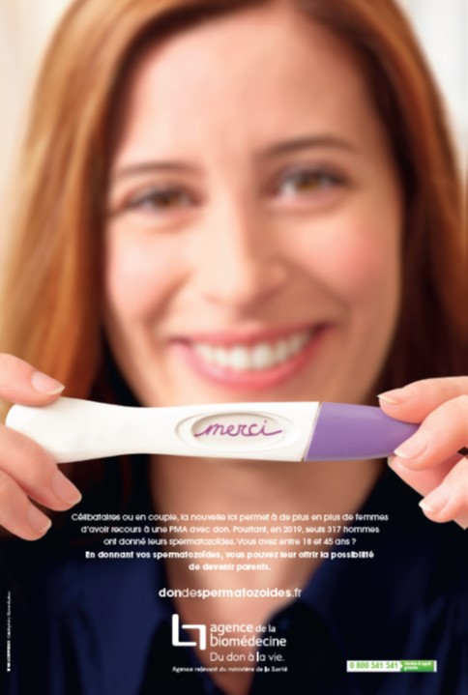
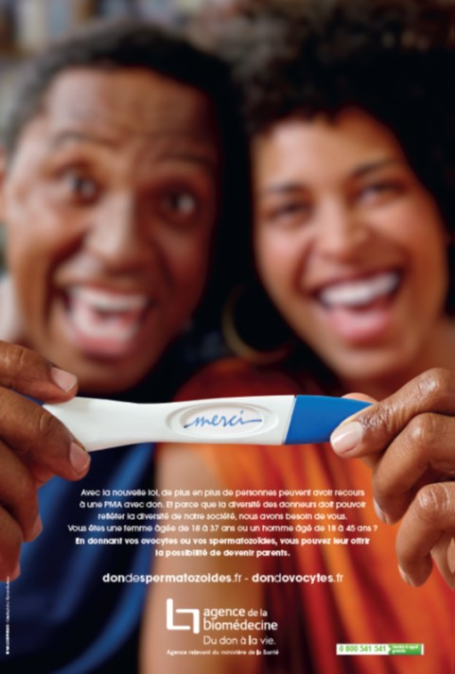

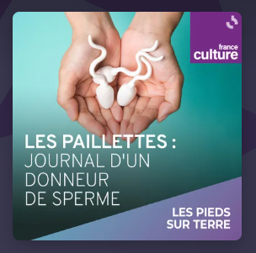


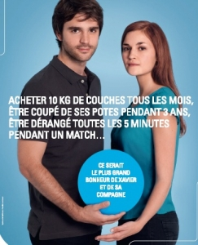
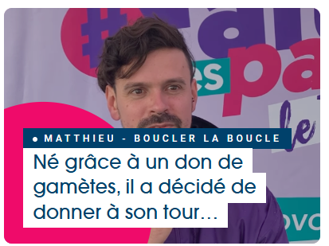

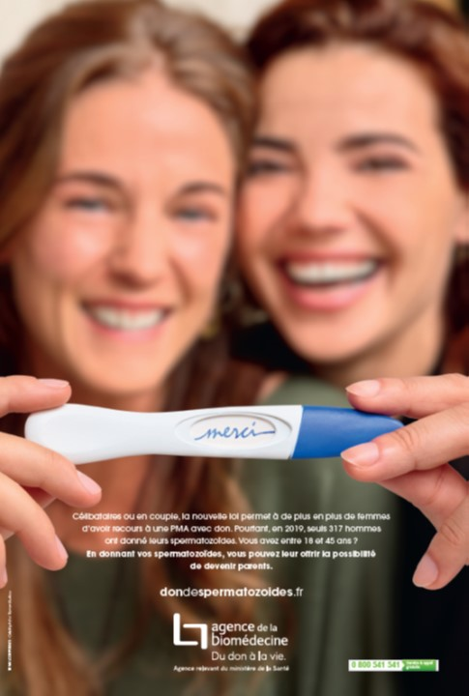




Evolution du nombre de donneurs
x2
Accepted donors
Presented donors
In France
2023 -> 700 sperm donors
2024 -> 1000 sperm donors
Notes:
The number of donors finally grew last year, by a factor of 2.
The Agence de biomédecine's communication campaigns are highly effective and are now focused on the aim of attracting the public's attention using the right communication materials.

Slide 14
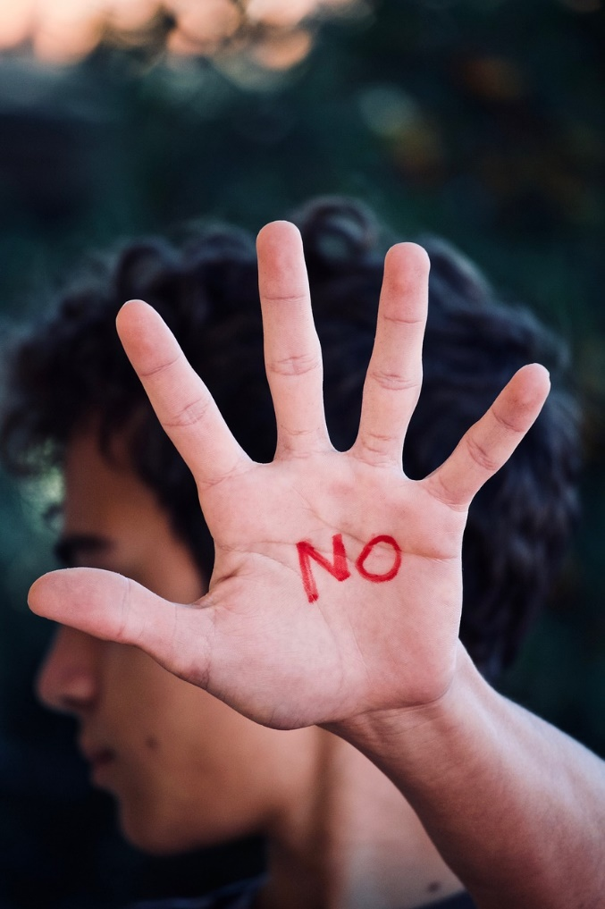


Particular cases
Man identify answering that he has never be a sperm donor
Person conceived by sperm donor but the center answer “spontaneous pregnancy”
Serial donor
Notes:
Some particular cases
One donor we interviewed told CAPADD that he had never donated. In his dossier was written: do not send results home.
The recent case of a serial donor.
35 people had genetic tests and found that they were conceived by the same donor. They were conceived in more than 15 centres and doctors' offices in France.
Some people sent requests to capadd and the information received from the centre was all different: surname, first name, date and place of birth. It was therefore impossible to identify them.
One person made a request to capadd. The information noted in the parents' medical dossier was “spontaneous conception”. the child was therefore not the result of a donation from the centre.

Slide 15



Thank-you !
Any questions ? Des questions ?
« Le donneur a-t-il bien reçu les courriers envoyés par la CAPADD ? ».
« Le donneur est-il décédé longtemps avant ma demande ? ».
« le centre de don s’est trompé », « le donneur a-t-il bien compris ? »,
« Vous avez réveillé un vieux souvenir et ça me touche psychologiquement. Ça me perturbe, je ne peux pas survoler ça et fermer les yeux ».
« Il n’y a pas un jour où je ne me suis pas demandé si un enfant était né de mes dons ».
« C’était anonyme, je veux rester anonyme même si je comprends l’importance pour la personne qui en fait la demande ».
Notes:
Thank you for your attention.
I'm ready for your questions.
I'll leave you to read a few sentences from exchanges between the capadd secretariat and donors or requesters.

