Slide 1
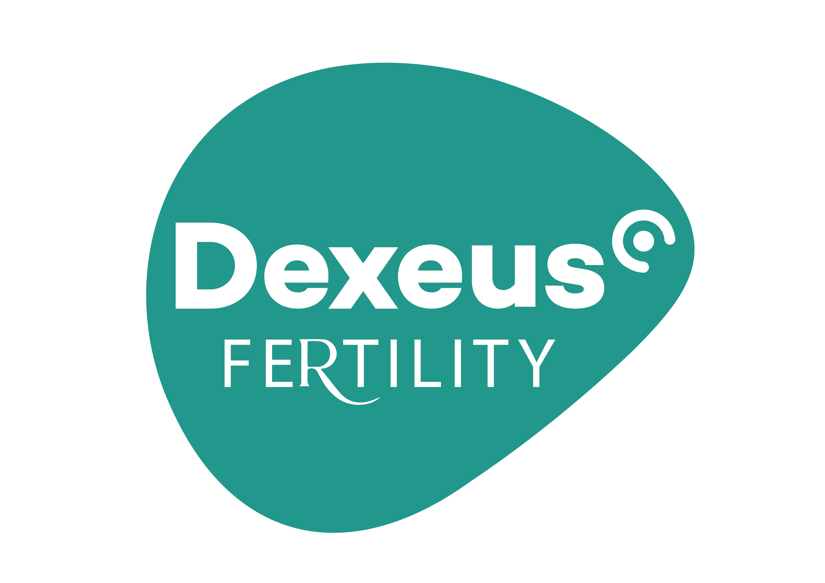
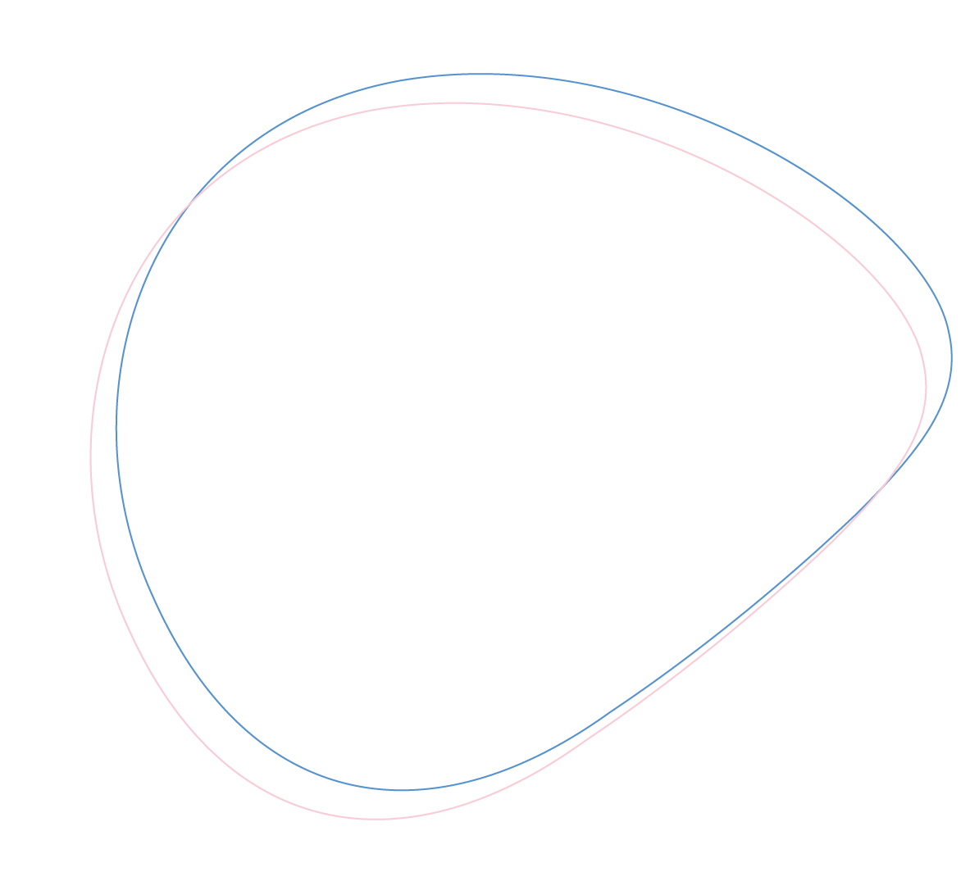

PPOS: pros and pitfalls
Valeria Donno, MD
Dexeus Fertility
Dexeus University Hospital, Barcelona.

Slide 2

No conflicts of interest to declare

Slide 3
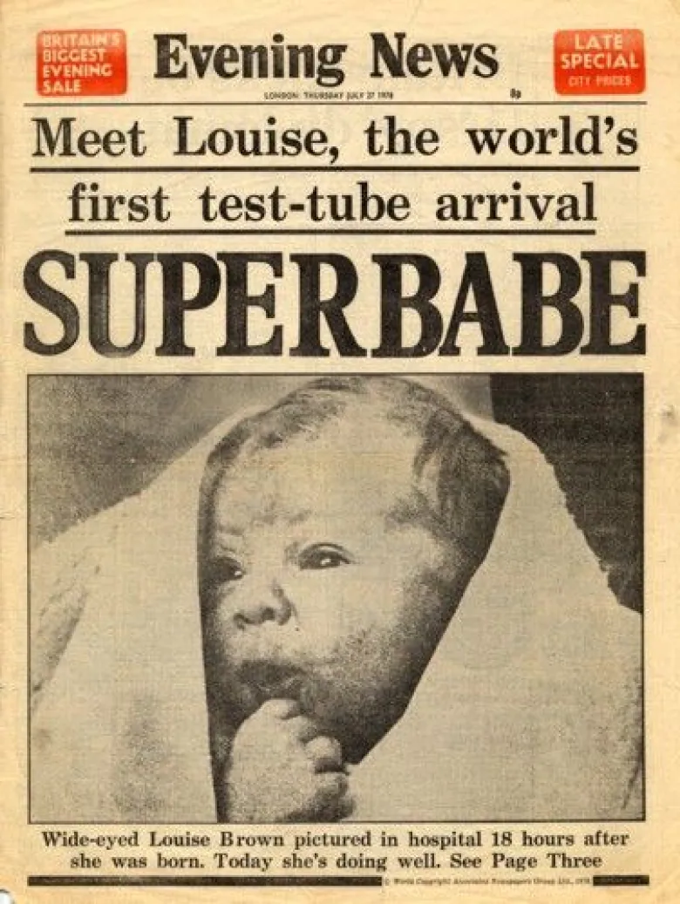
The first IVF baby
No gonadotropins
No LH suppression

Slide 4

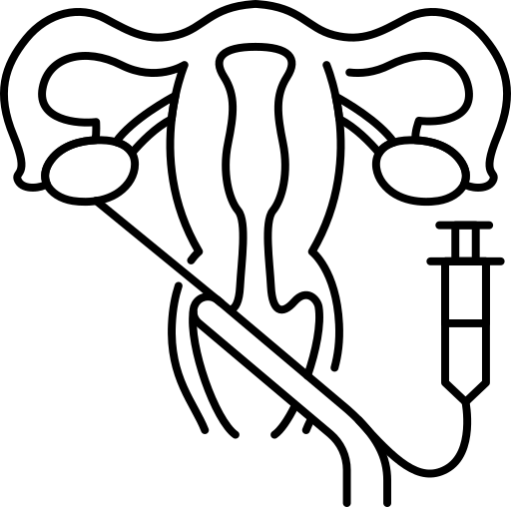


The IVF journey
Controlled Ovarian Stimulation
Ovarian stimulation
LH suppression
OPU
ℬ-hCG

Slide 5
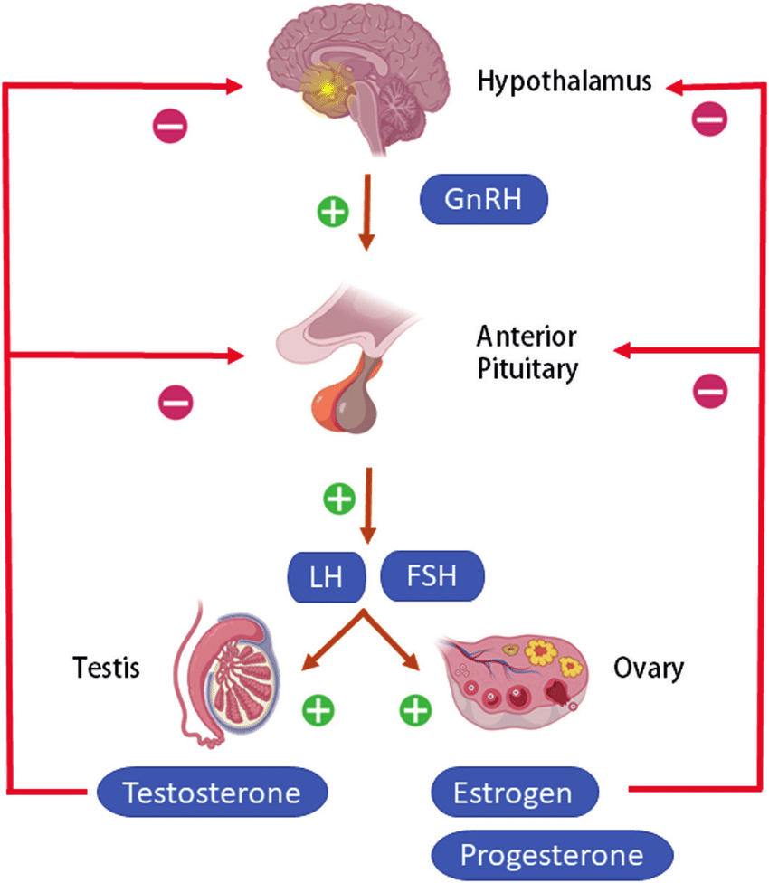
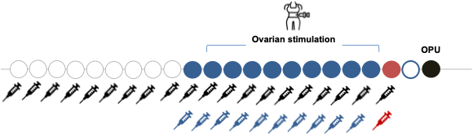
The Hypothalamic–pituitary–gonadal axis
GnRH - Agonist
vz
Flare-up
Pituitary
downregulation
LH
Time
Racca et al., 2020
Notes:
The first strategy to control the hypothalamic-pituitary-gonadal axis was introduced in 1983 the administration of a GnRH agonist.
As an analog of endogenous GnRH, it binds to GnRH receptors in the anterior pituitary, causing an initial flare-up effect with an increase in both FSH and LH. And then a downregulation.
However, this approach has the disadvantages of multiple injections and risk of OHSS in high responders.

Slide 6
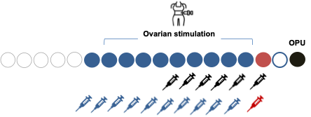
The Hypothalamic–pituitary–gonadal axis
GnRH - Antagonist
Direct LH suppression
LH
Time
Racca et al., 2020
Notes:
We had to wait 20 years to introduce a second strategy for LH suppression: the GnRH antagonist.
this molecule binds to the same GnRH receptors of anterior pituitary without activating them, leading to direct and immediate LH suppression.

Slide 7
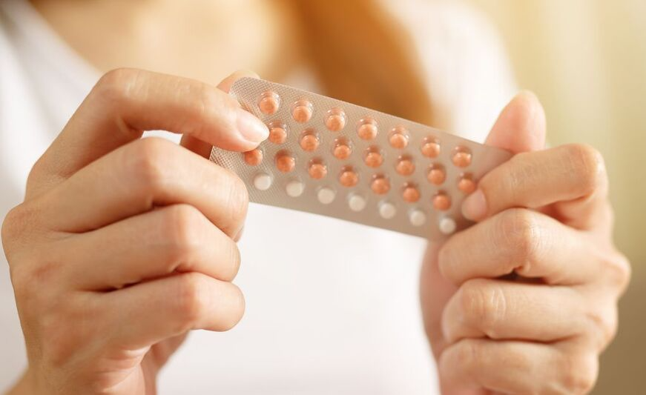
…another strategy in front of us
Progestogen-only pill (POP)
Desogestrel 75 mcg vs Levonogestrel 30 mcg
Rice et al., Hum Rep 1999
Notes:
However, another strategy for LH suppression had been in front of us for a long time, it belogs to the fild of contracepcion… the progestegen only pill.
It was introduced in 1970s anf the contraceptive effect was mediated by the action of progesterone at endometrium level. However, in 1999 was intorduced the first POP with desogestrel and it was demostrated that along with the endometrial effect, that pill had un effect also at LH level since this RCT demonstrated that the ovulation rate with a 3 % in desogestrel gruop versus a 39% in the levonogestrel…
So it was quite clear that progesterone had a role in LH suppression…

Slide 8

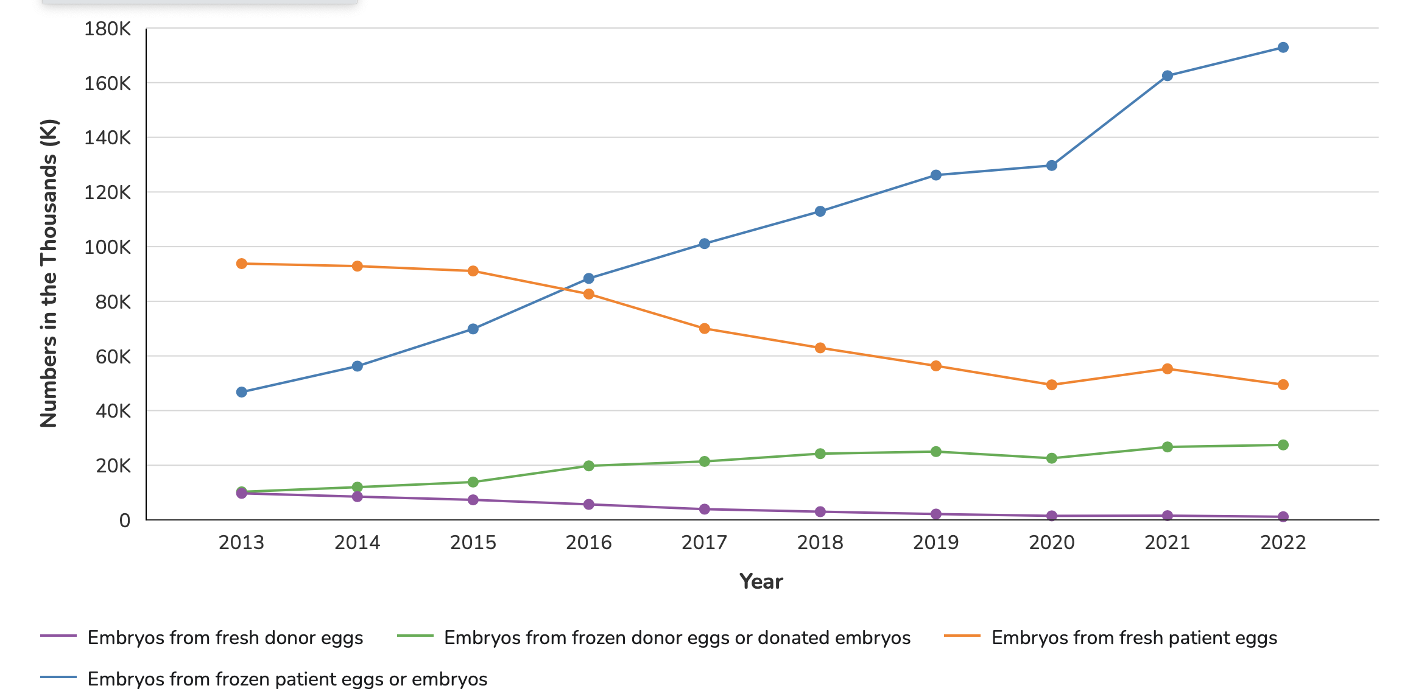


Freeze-all: the game changer
https://www.cdc.gov/
Notes:
but we were not to use it in IVF since fresh embryo transfers was the standard practice…..
Untill the big change in IVF history that was the Freeze all era…the possibility of performing the ovarian stimulation stop thinking to the embryo transfer.

Slide 9

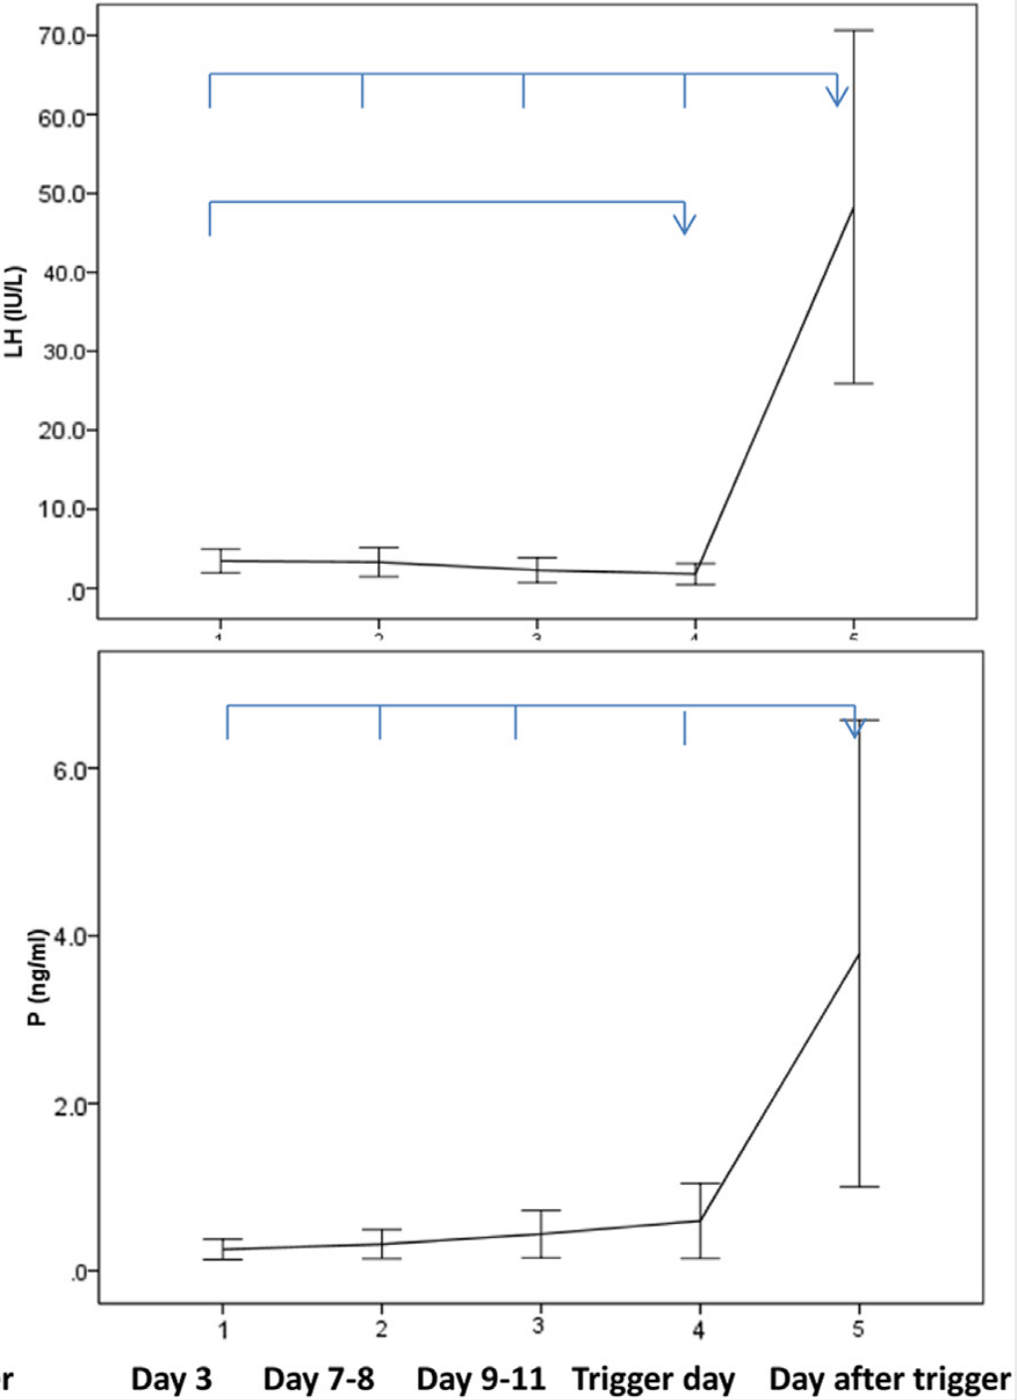
PPOS protocol. The first evidence
MPA (n=150) vs. GnRH-a short protocol (n=150)
1/150 premature LH surge
Stimulation outcomes
LH suppression in MPA group
Kuang et al. 2015
Notes:
And it was when the role of progesterone was reconsidered in IVF…
In 2015 we had the first strong evidence: a RCT in which 300 patients were randomized to receive whether MPA or agonist. The study results demonstrated comparable results in terms of stimulation outcomes, a slight longer stimulation in MPA group and a good control of LH in MPA group

Slide 10



PPOS
Outcomes
Population
Side effects
Safety
Notes:
So, that study marked the birth of PPOS, the use of oral progesteronefor LH supression
and in the following slides we will analyse:
The outcomes with different progestins
For whom? Can we use PPOS in all the cycle without a fresh ET?
Side effects. Can we eliminate or at list minimize the side effects?
What we knoew about safety?

Slide 11
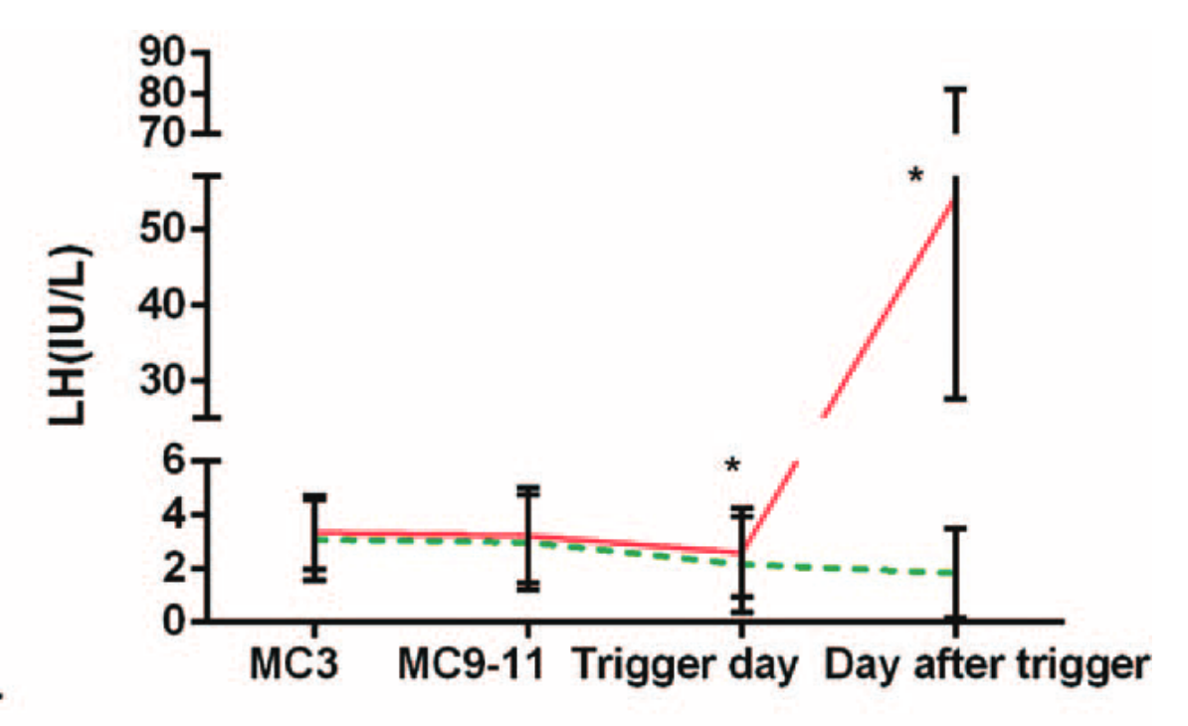
PPOS vs. GnRH agonist
Micronized progesterone
Progesterone 200 mg/d (n=187) vs. short protocol (n=187)
Stimulation outcomes
LH suppression
Zhu et al., 2015
Notes:
In the same 2015, another RCT was published arounf the role of micronized progesterone in PPOS.
More than 360 patients were randomized to receive MIP or agonist….

Slide 12
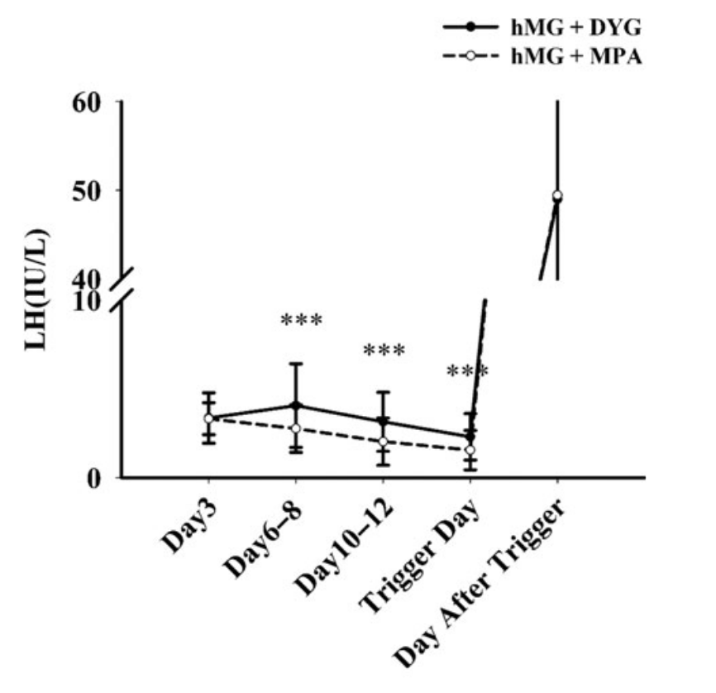
PPOS. DYG vs MPA
Dydrogesterone
DYG 20 mg/d (n=260) vs. MPA 10 mg/d (n=256)
Stimulation outcomes
LH monitoring
Yu et al., HumRep 2018
Notes:
And what about dydrogesterone?
It appered as a potetional alterative to MPA in 2018 when this RCT was published. More than 500 patients
During the whole process of ovarian stimulation, the mean LH level in the hMG + DYG group was always higher than that in the hMG + MPA group (P < 0.001); however, no patient from either group experienced a premature LH surge

Slide 13
PPOS vs GnRH antagonist
RCT: MPA (10 mg/day) vs. ganirelix (0.25 mg/day)
Stimulation outcomes
Reproductive outcomes in recipients
Beguería et al., HumRep 2019
Notes:
So far we demonstrated that PPOS is as effective as agoniost protocol. But what happen if it is compare to anatgonst protcol?
Well, this RCT was conducted in ooocyte donors demonstrating no difference in oocytes and stimulation lenght. However it was quite surprising the reproductive outcomes in recipients as they demonstrated lower clinical pregnancy rate and LBR.

Slide 14
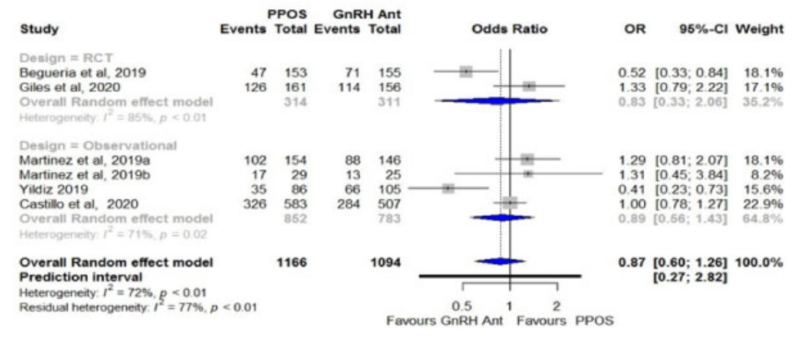
PPOS vs. GnRH antagonist
Clinical pregnancy rate in recipients
MPA, MIP, DSG
Meta-analysis
6 studies: 2 RCTs, 4 observational
Martinez et al., 2021
Notes:
However following evidence, summarized in this matanalysis, did not confirme these results, demostrating comparative clinical pregnancy rate in recipients when PPOS was used in donors with MPA, MIP and also DSG.

Slide 15
PPOS
Outcomes
Population
Notes:
Starting form 2015, accumulation evidence supported the PPOS and in the following slides we will analyse:
results, in terms of stimulation and pregnancy rate
For whom? Can we use PPOS in all the cycle without a fresh ET?
Side effects. Can we eliminate or at list minimize the side effects?
What we knoew about safety?

Slide 16
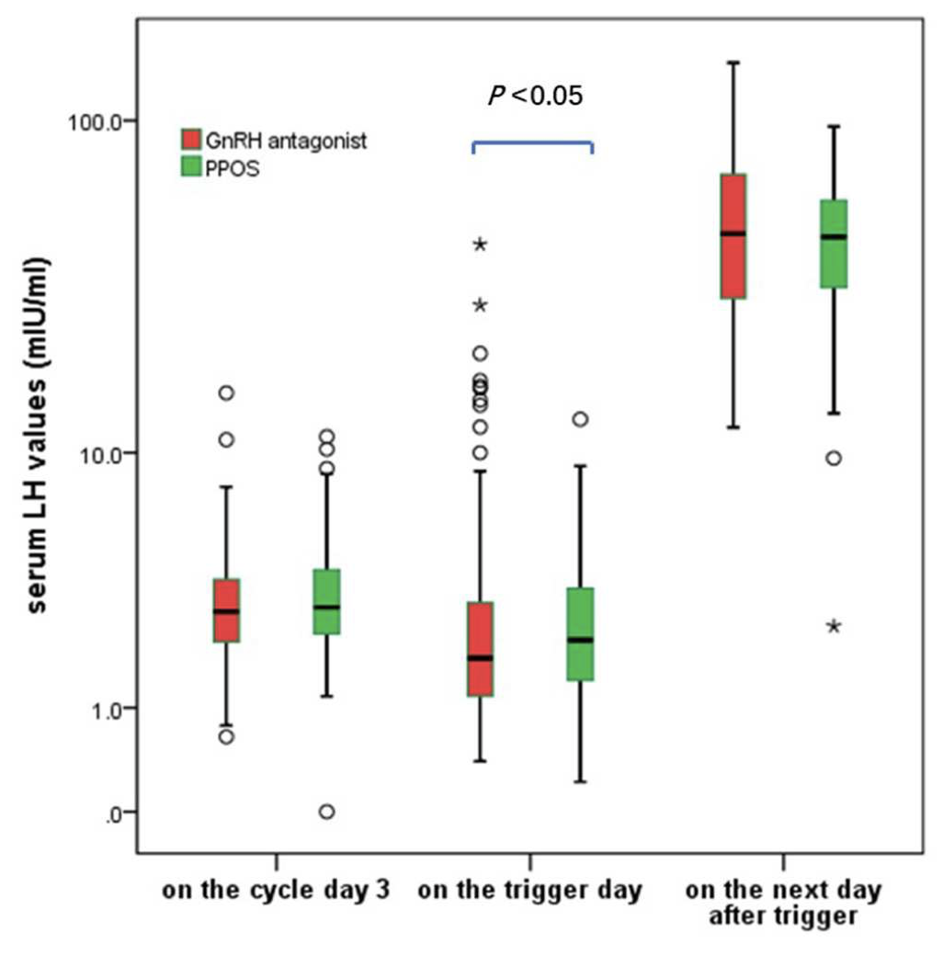
PPOS. For whom?
MPA (Poor Responders
0 vs. 5.88%
RCT, 340 patients
Stimulation outcomes
LH suppression
Chen et al., 2019
Notes:
The primary outcome was the incidence of premature LH surge
The results showed that the incidence of premature LH surge in PPOS group was lower than that in antagonist group (0 vs. 5.88%, P < 0.05).

Slide 17
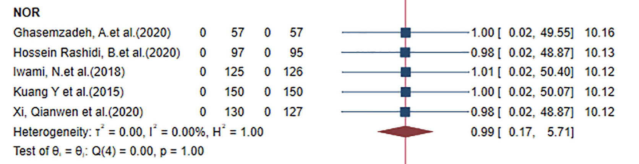
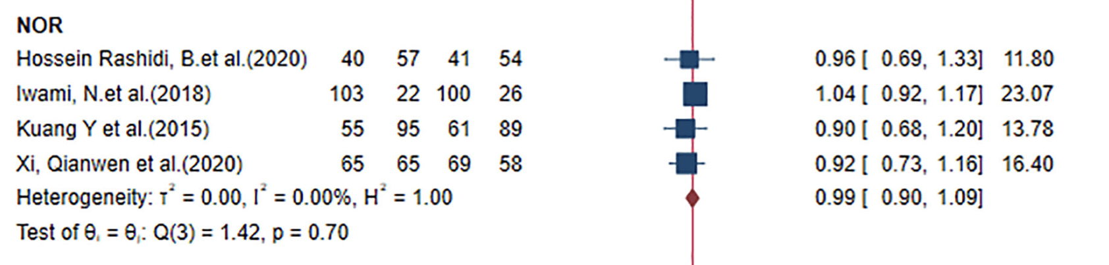
PPOS. For whom?
MPA (Normal Responders
MPA (LH suppression
MPA (CPR
Guan et al., 2021

Slide 18
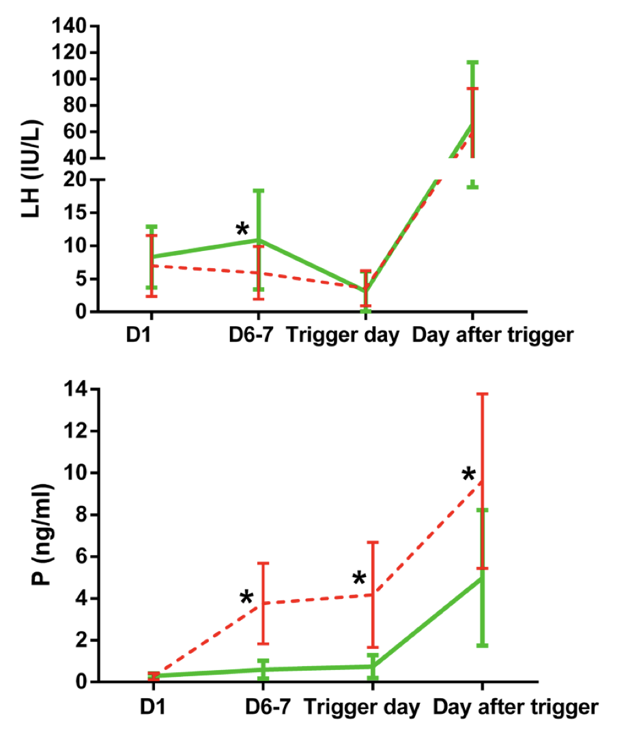
PPOS. For whom?
MPA (PCOS
RCT, n=120
Stimulation outcomes
Hormonal monitoring?
Zhu et al., 2021

Slide 19
PPOS
Outcomes
Population
Side effects
Notes:
Starting form 2015, accumulation evidence supported the PPOS and in the following slides we will analyse:
results, in terms of stimulation and pregnancy rate
For whom? Can we use PPOS in all the cycle without a fresh ET?
Side effects. Can we eliminate or at list minimize the side effects?
What we knoew about safety?

Slide 20
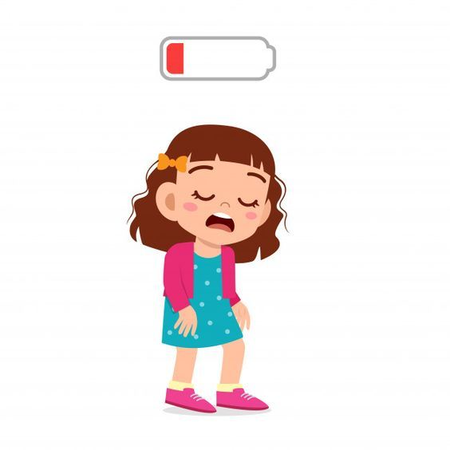
PPOS. Side effects with oral progesterone
When?
How?
How long?
Notes:
We know that oral progesterone is often associeted with side effects. Even if the administration interval for PPOS ios quite shor,10-12 days, some patient reports tiredness, dizzyness, nause…and can we reduce these side effects?
Could we consider when we give progesterone? In the morning or at night? How and how long…

Slide 21
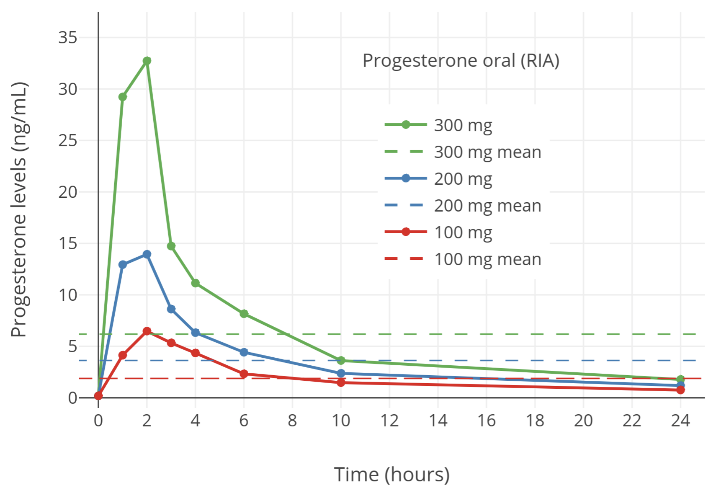
When?
Can progesterone be administration at bedtime be a solution?
Simon et al., F&S 1993
Notes:
Starting from the first point, why a bedtime administration could help
Pharmacokinetics

Slide 22
How?
Vaginal PPOS
No premature LH surge
No premature LH surge
MVP 200 mg/12 h vs. DYG 10mg/8h
MIP 200 mg/day (n=291) vs antagonist (n=67)
Souza et al., 2024; Gosalvez et al. 2023 - ESHRE

Slide 23
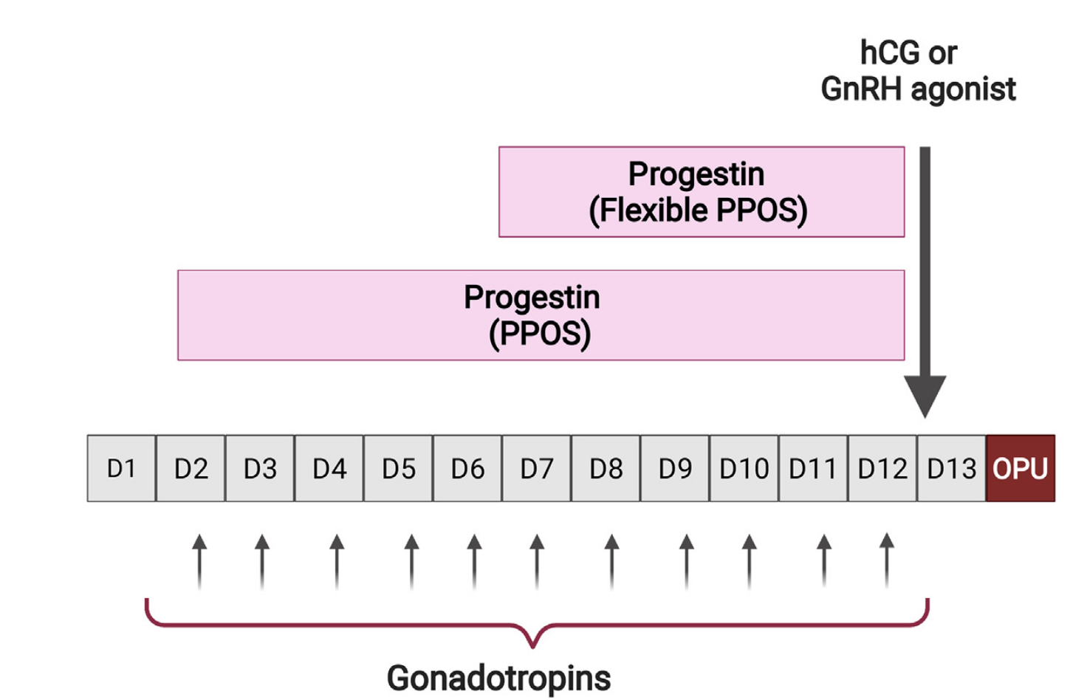
How long?
Fixed or flexible PPOS?
Fixed: from Day 1 OS
Flexible: on stimulation day 7 or when the leading follicle has reached 12-14 mm
Ata et al., 2024

Slide 24
Flexible PPOS
MPA
DYG
< 40 y, AFC < 10
RCT: fPPOS (n=216) vs. Antagonist (n=233)
Retrospective in oocyte donors
Cai et al., 2024; Hendrickx et al., 2024

Slide 25


Slide 26
PPOS. Safety
Embryo ploidy: PPOS vs. Antagonist (
44 women
Prospective study
1st cycle
2nd cycle
Triptorelin 0.2 mg
Triptorelin 0.2 mg
Micronized Progesterone 200mg/d
GnRH-Ant 0.25 mg/d
rFSH 225-300
rFSH 225-300
OPU
OPU
ICSI
ICSI
Biopsy
PGT-A
Biopsy
Vidal et al., Hum Rep 2024

Slide 27
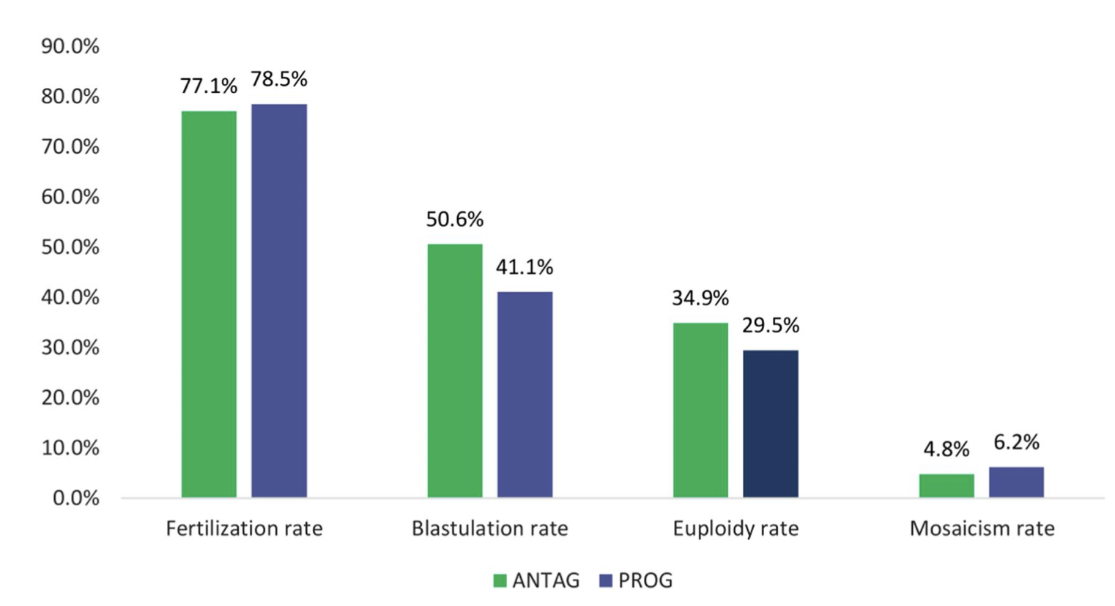
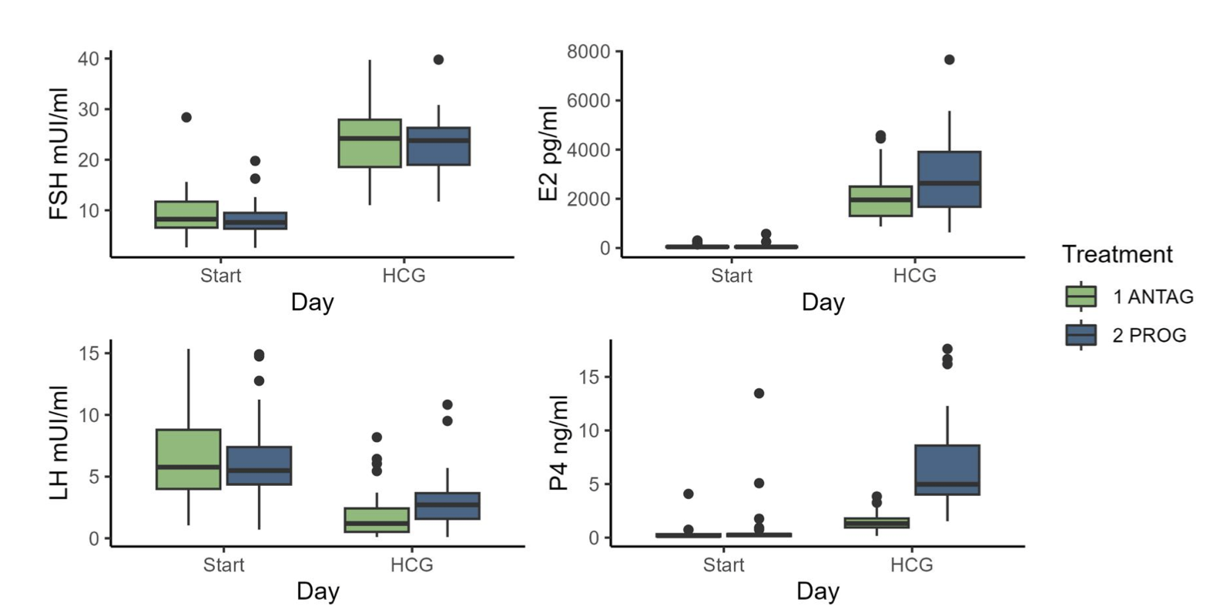
PPOS. Safety
Embryo ploidy: PPOS vs. Antagonist (
 | PPOS | Antag | P value
COCs | 12.68 (8.09) | 10.27 (5.84) | 0.006
MII | 9.09 (6.12) | 7.34 (4.15) | 0.01
LAB Outcomes
Stimulation outcomes
Vidal et al., Hum Rep 2024

Slide 28
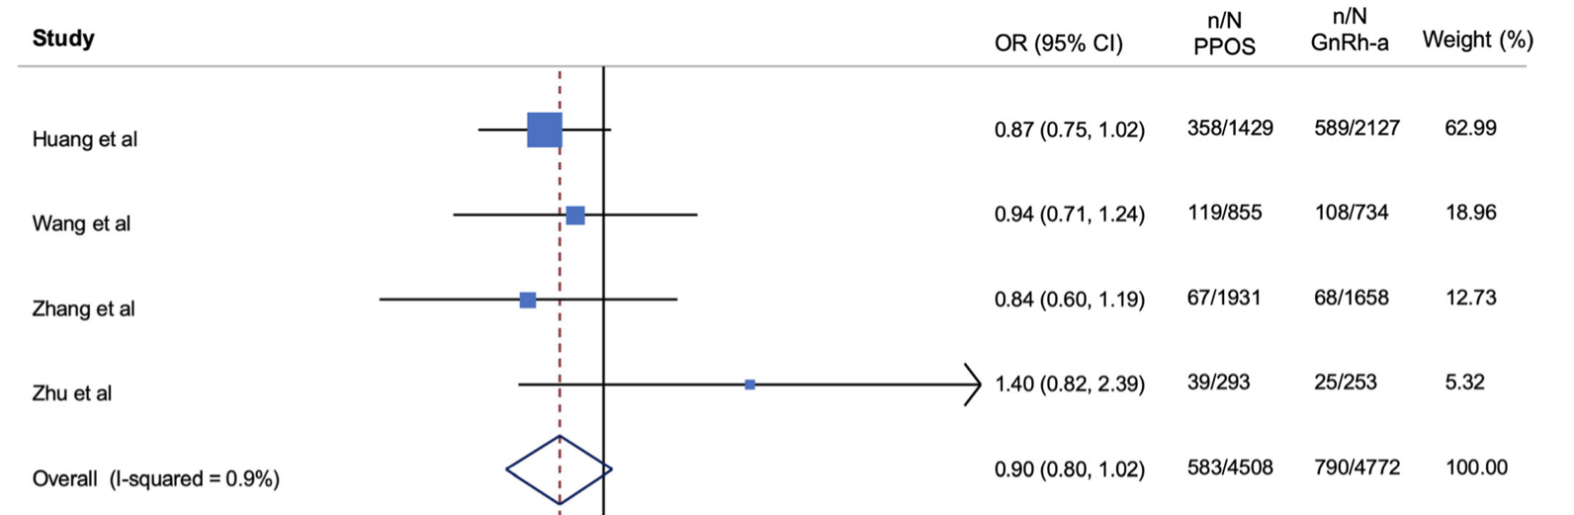
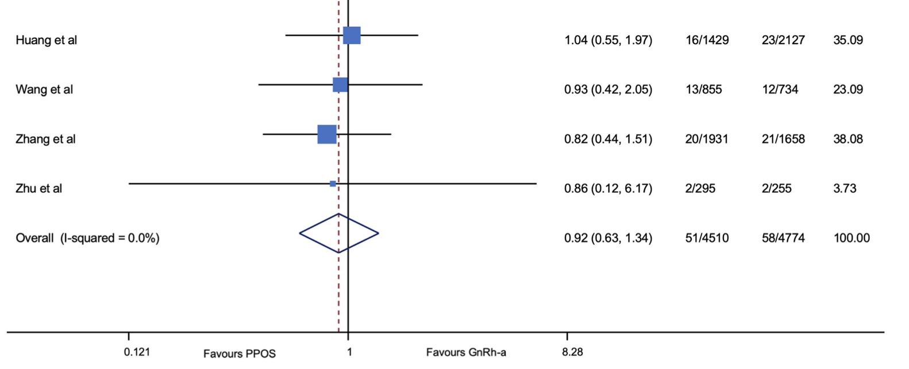
PPOS. Safety
Perinatal Outcomes
Preterm birth
Congenital malformations
- 4 retrospective studies:
MPA 10 mg, DYG 20 mg, MIP (100 mg, 200 mg)
Zolfaroli et al., 2020

Slide 29
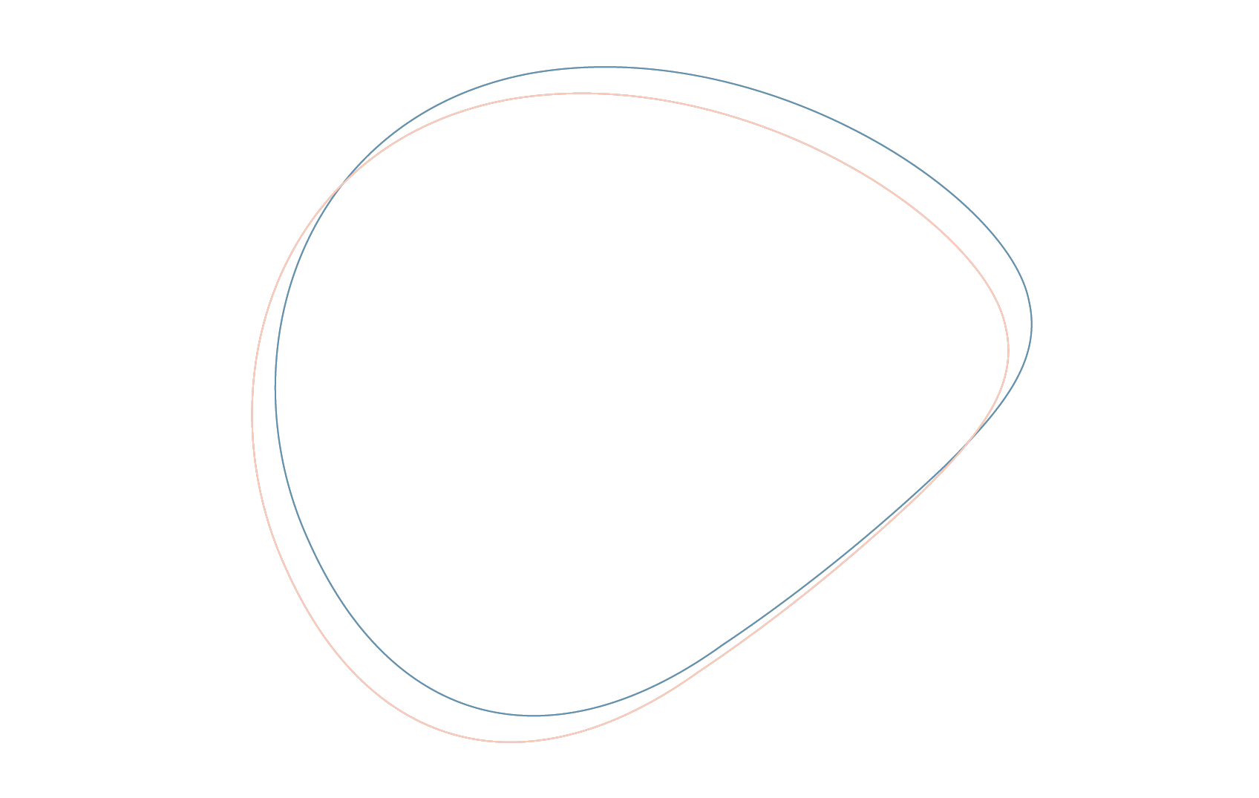
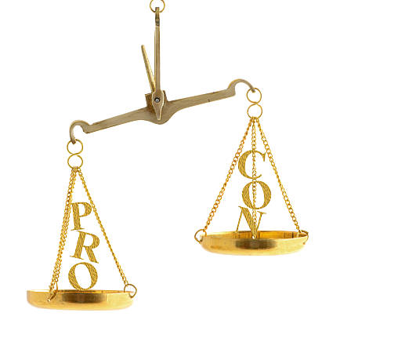
Conclusion
I
The PPOS protocol represents an efficient strategy for LH suppression.
What are the advantages? It is a patient-friendly option that reduces the number of injections and lowers the cost. It should be considered a standard strategy for elective fertility preservation, oocyte donation, and IVF cycles with freeze-all.
II
It is not recommended in IVF with fresh ET and fertility preservation in patients with positive progesterone receptors.
III
Notes:
You will agree with me that these conditions do not represent the majority of cycles in our centers

Slide 30
Thank you
for your attention
valdon@dexeus.com

