Slide 1

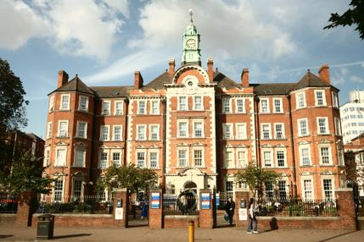
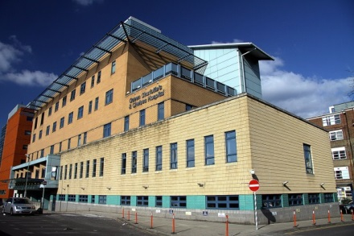
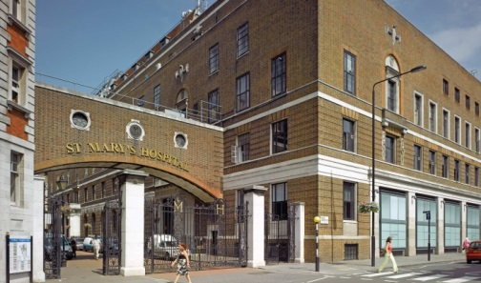
Testosterone & ageing in men
Prof. Channa Jayasena
Imperial College London
Hammersmith, Charing Cross & St. Mary’s Hospitals, London, UK

Slide 2
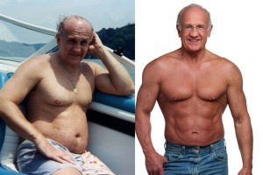
T prescription rates are rising
Classical hypogonadism is uncommon
Men > 40y: Serum T declines by 1% per year
33-50% of middle-aged men have decreased serum T
Rates of obesity and diabetes are rising
Wu et al. EMAS study NEJM 2010
Massachusetts Male Aging Study. J Urol. 1994

Slide 3
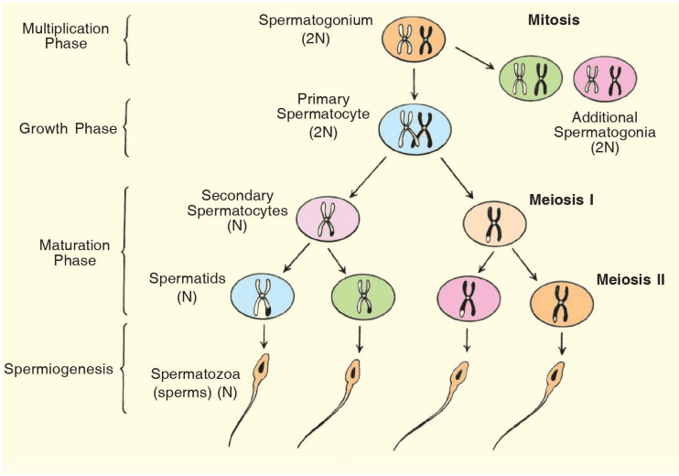
Healthy men
Kisspeptin / dynorphin /
NKB
GnRH
FSH LH
Sertoli cells
Testosterone synthesis in Leydig cells
Testes: 500 nmol/L
Serum: 10-30 nmol/L
Notes:
Spermatocytes derive from immature germ cells called spermatogonia.
Primary spermatocytes are diploid (2N) cells.
After Meiosis I, two secondary spermatocytes are formed.
Secondary spermatocytes are haploid (N) cells

Slide 4
What types of hypogonadism affect older men?
Notes:
Dr Life
Healthy eating
Exercise
Testosterone

Slide 5
Types of hypogonadism
  Healthy (young man)
  Normal LH / FSH
  Normal Testosterone
  Secondary hypogonadism
  Low LH / FSH
  Low Testosterone
  Primary hypogonadism
  High LH / FSH
  Low Testosterone
  Functional hypogonadism
  Normal LH / FSH
  Low Testosterone
REVERSIBLE!
Notes:
D = aspartate
H = histidine
cAMP >10-fold above basal

Slide 6
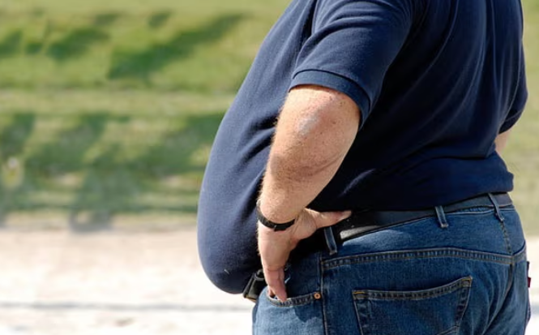
Low T in man with functional hypogonadism
Subtle improvements
NO (structural) pathology
Obesity
Diabetes
Other co-morbidities
Age-related reduction in health
Theoretically reversible

Slide 7
How can you diagnose hypogonadism in older men?
How common is it?
Notes:
Dr Life
Healthy eating
Exercise
Testosterone

Slide 8
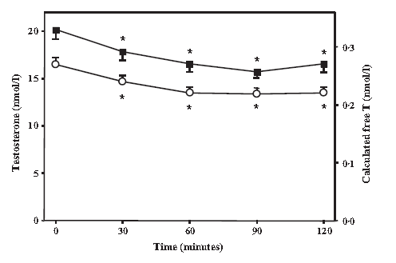
Need morning + fasted testosterone
20% reduction in T following glucose load
Caronia et al. Clin Endo 2013

Slide 9
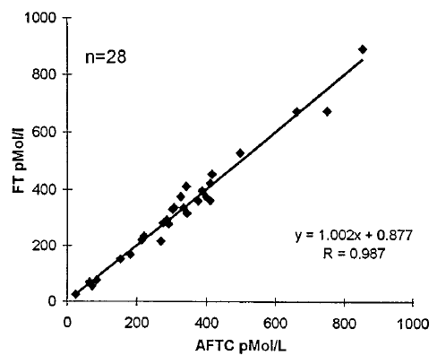
Calculate free T when total T is borderline low, or SHBG is altered
Online calculators:
Total T
SHBG
Albumin
Vermeulen et al. JCEM 1999

Slide 10
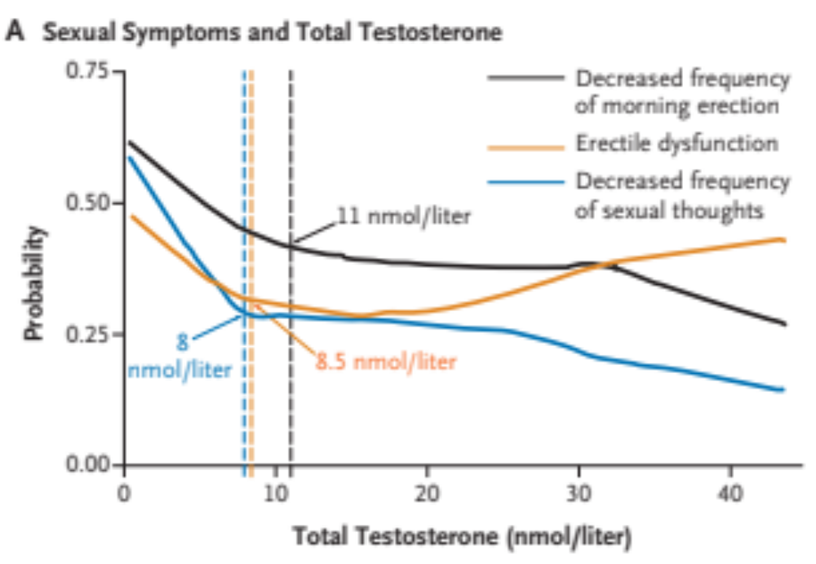
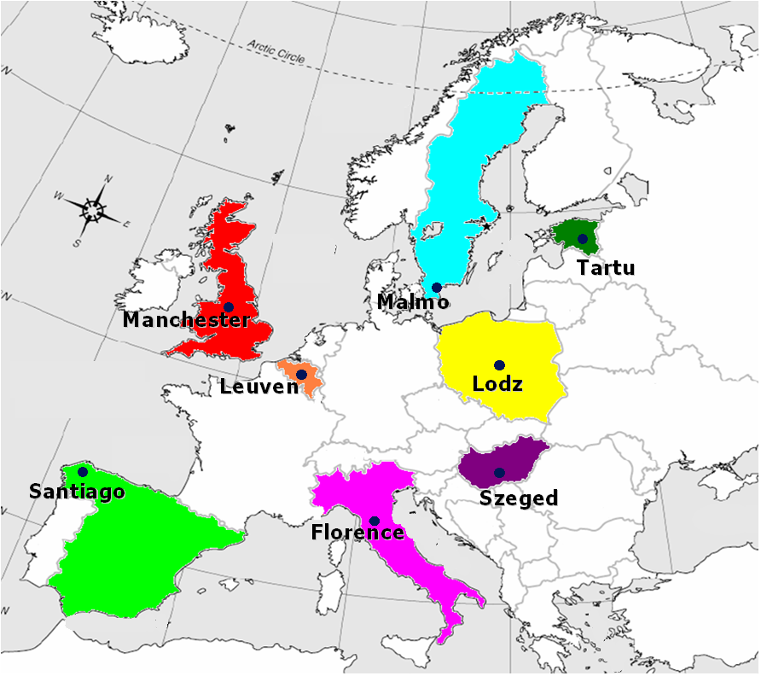
European Male Ageing Study
3369 men
40-79 years
EMAS study. Wu et al. NEJM 2010
Notes:
OR for 3 sexual symptoms (after adjustment for age, BMI and co-morbidity)
T<8 OR 2
T<11 OR 1.6
T<11 + cFT <220pmol/L OR 1.8

Slide 11
Late-onset hypogonadism (LOH)
33% to 50% of middle-aged men have decreased serum T.
BUT only 3 sexual symptoms are related to low T:
  Erectile dysfunction
  Reduced frequency of sexual thoughts
  Reduced morning erections
Only 2% of 40-80 year olds have true LOH
  EMAS criteria for LOH:
  1. 3 x Sexual symptoms
  2. Low T defined as either:
  Total T < 8nmol/L
    OR
  Total T <11 AND cFT < 220pmol/l
Wu et al. NEJM 2010
Notes:
OR for 3 sexual symptoms (after adjustment for age, BMI and co-morbidity)
T<8 OR 2
T<11 OR 1.6
T<11 + cFT <220pmol/L OR 1.8

Slide 12
Efficacy and safety of TRT in older men?
Notes:
Dr Life
Healthy eating
Exercise
Testosterone

Slide 13
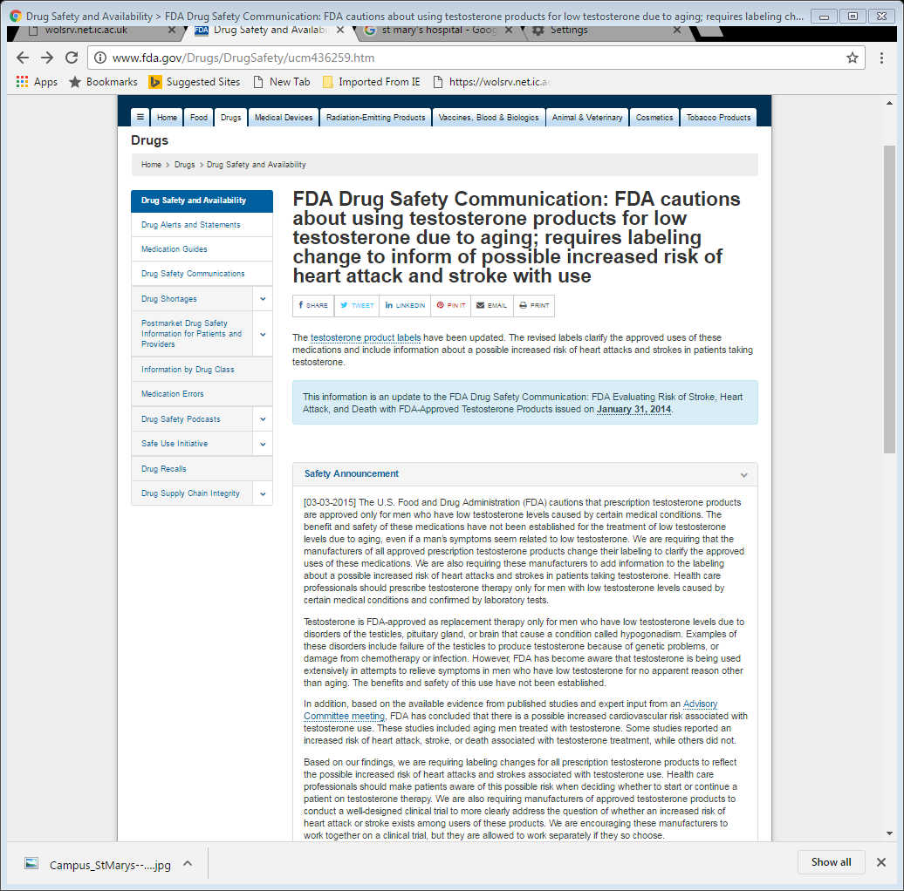
http://www.fda.gov/Drugs/DrugSafety/ucm436259.htm

Slide 14

Testosterone Efficacy and Safety Consortium (TestES)
Hernandez et al. Andrology 2023
Individual Patient Data Meta-analysis
Qualitative
Economic analysis
3000 men
17 clinical trials
11 countries
Aceves Martins et al. Andrology 2022
Hudson et al. Lancet HL 2022
Hudson et al. Lancet HL 2023

Slide 15
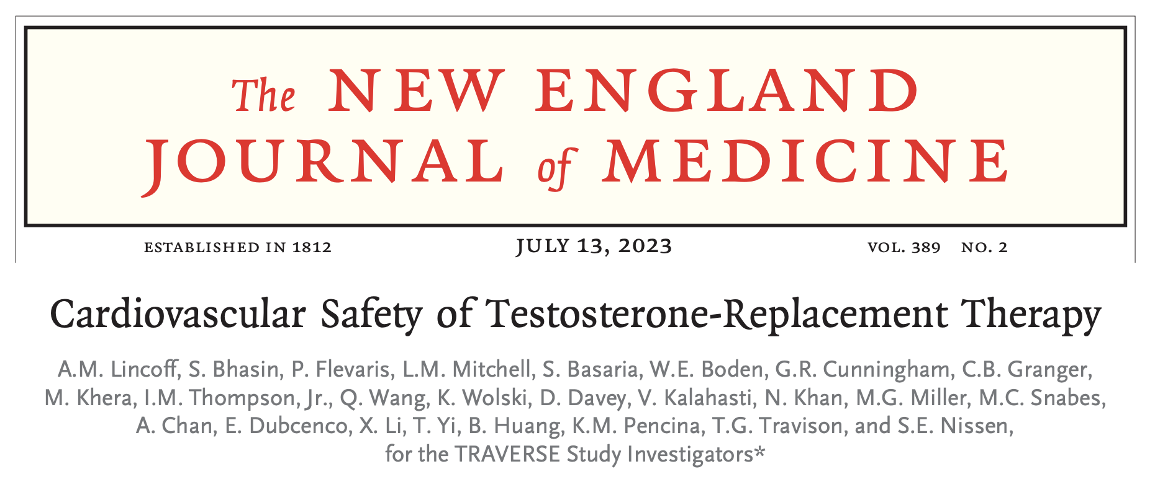
Notes:
We conducted this phase 4, randomized, double- blind, placebo-controlled, noninferiority, event- driven trial at 316 clinical-trial sites in the United States
Dose adjustments to main- tain testosterone levels between 350 and 750 ng per deciliter (12.1 to 26.0 nmol per liter) or to respond to a hematocrit greater than 54% were managed centrally by an automated algorithm (additional details are provided in the Supple- mentary Appendix). Patients who were randomly assigned to placebo underwent sham adjust- ments to maintain blinding.
Exclusion criteria included congenital or ac- quired severe hypogonadism (testosterone level, <100 ng per deciliter [3.5 nmol per liter]), a history of prostate cancer or prostate nodules, an elevated screening prostate-specific antigen (PSA) level, thrombophilia, and uncontrolled heart failure. Patients could not be enrolled within 4 months after an acute coronary syndrome, stroke, or coronary or peripheral revascularization or with- in 6 months after treatment with testosterone or

Slide 16
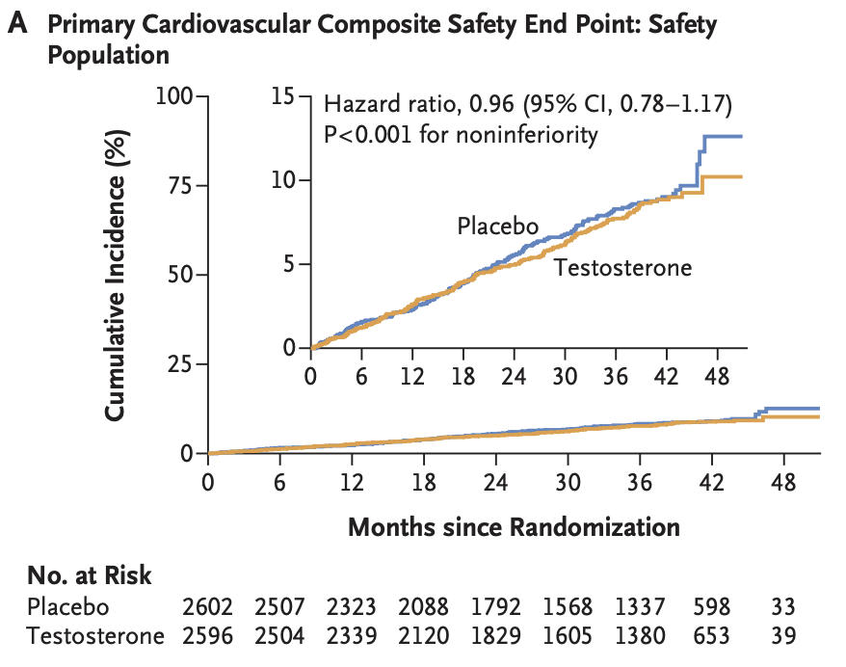
MACE risk not increased by TRT vs. placebo
NEJM 2023

Slide 17
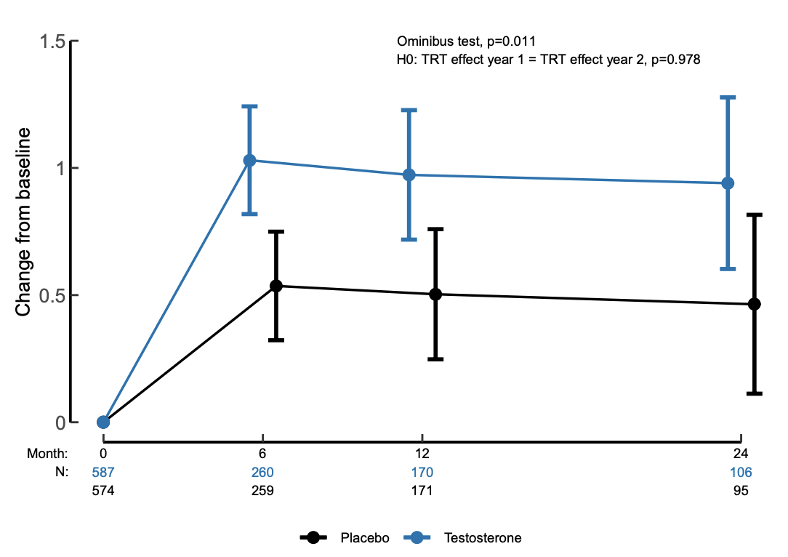
Change in sexual activity from baseline (PDQ-4)
BLUE = Testosterone
BLACK = placebo
T modestly improves sexual symptoms in men with functional
hypogonadism
Bhasin JCEM 2023
Notes:
Model-estimated changes from baseline in overall sexual activity (PDQ-4 score) in participants enrolled in the Sexual Function Study. A linear mixed model was fit with fixed effects for treatment, visit, and treatment–visit interaction, baseline PDQ-4 score and pre-existing cardiovascular disease and a random per-subject repeated measures effect with an unstructured covariance matrix. The mean and the corresponding 95% CI are shown by treatment group and time p

Slide 18
The efficacy + safety of TRT for functional hypogonadism is recently established
Treatment of men may increase
Notes:
Dr Life
Healthy eating
Exercise
Testosterone

Slide 19
What happens to semen quality with ageing?
Notes:
Dr Life
Healthy eating
Exercise
Testosterone

Slide 20
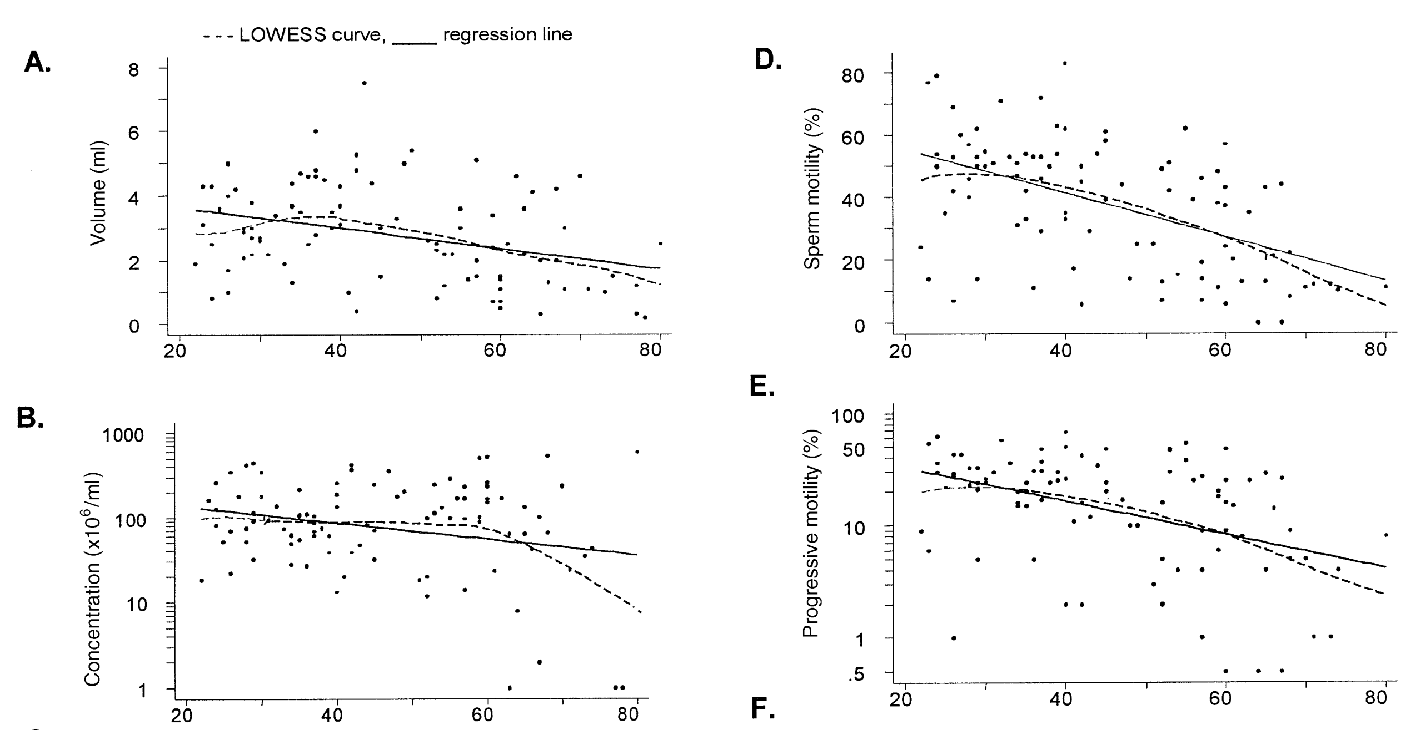
Reduction of semen quality with age
Eskenazi et al. Hum Reprod 2003
Notes:
BACKGROUND: Although the effect of maternal age on fertility is well known, it is unclear whether paternal age also affects fertility. This cross-sectional study sought to characterize the association between age and semen quality, a well-known proxy of fertility status. METHODS: A convenience sample of 97 non-smoking men (aged 22±80 years) without known fertility problems was recruited from a national government laboratory. The men provided semen samples and information relating to lifestyle, diet, medical and occupational details. Semen volume (ml), sperm concentration (3106/ml), total sperm count (3106), motility (%), progressive motility (%) and total progressively motile sperm count (3106) were measured. RESULTS: After adjusting for covariates, semen volume decreased by 0.03 ml per year of age (95% CI: ±0.05, ±0.01); motility decreased by 0.7% per year (95% CI: ±0.92, ±0.43); progressive motility decreased by 3.1% per year (95% CI: ±4.5, ±1.6); and total progressively motile sperm count decreased by 4.7% per year (95% CI: ±7.2, ±2.2). There was a suggested decrease in sperm concentration and count. The proportion of men with abnormal volume, concentration and motility was signi®cantly increased across the age decades. CONCLUSIONS: In a convenience sample of healthy men from a non-clinical setting, semen volume and sperm motility decreased continuously between 22±80 years of age, with no evidence of a threshold. Key words: age/semen volume/

Slide 21
How does testosterone affect semen quality?
Notes:
Dr Life
Healthy eating
Exercise
Testosterone

Slide 22
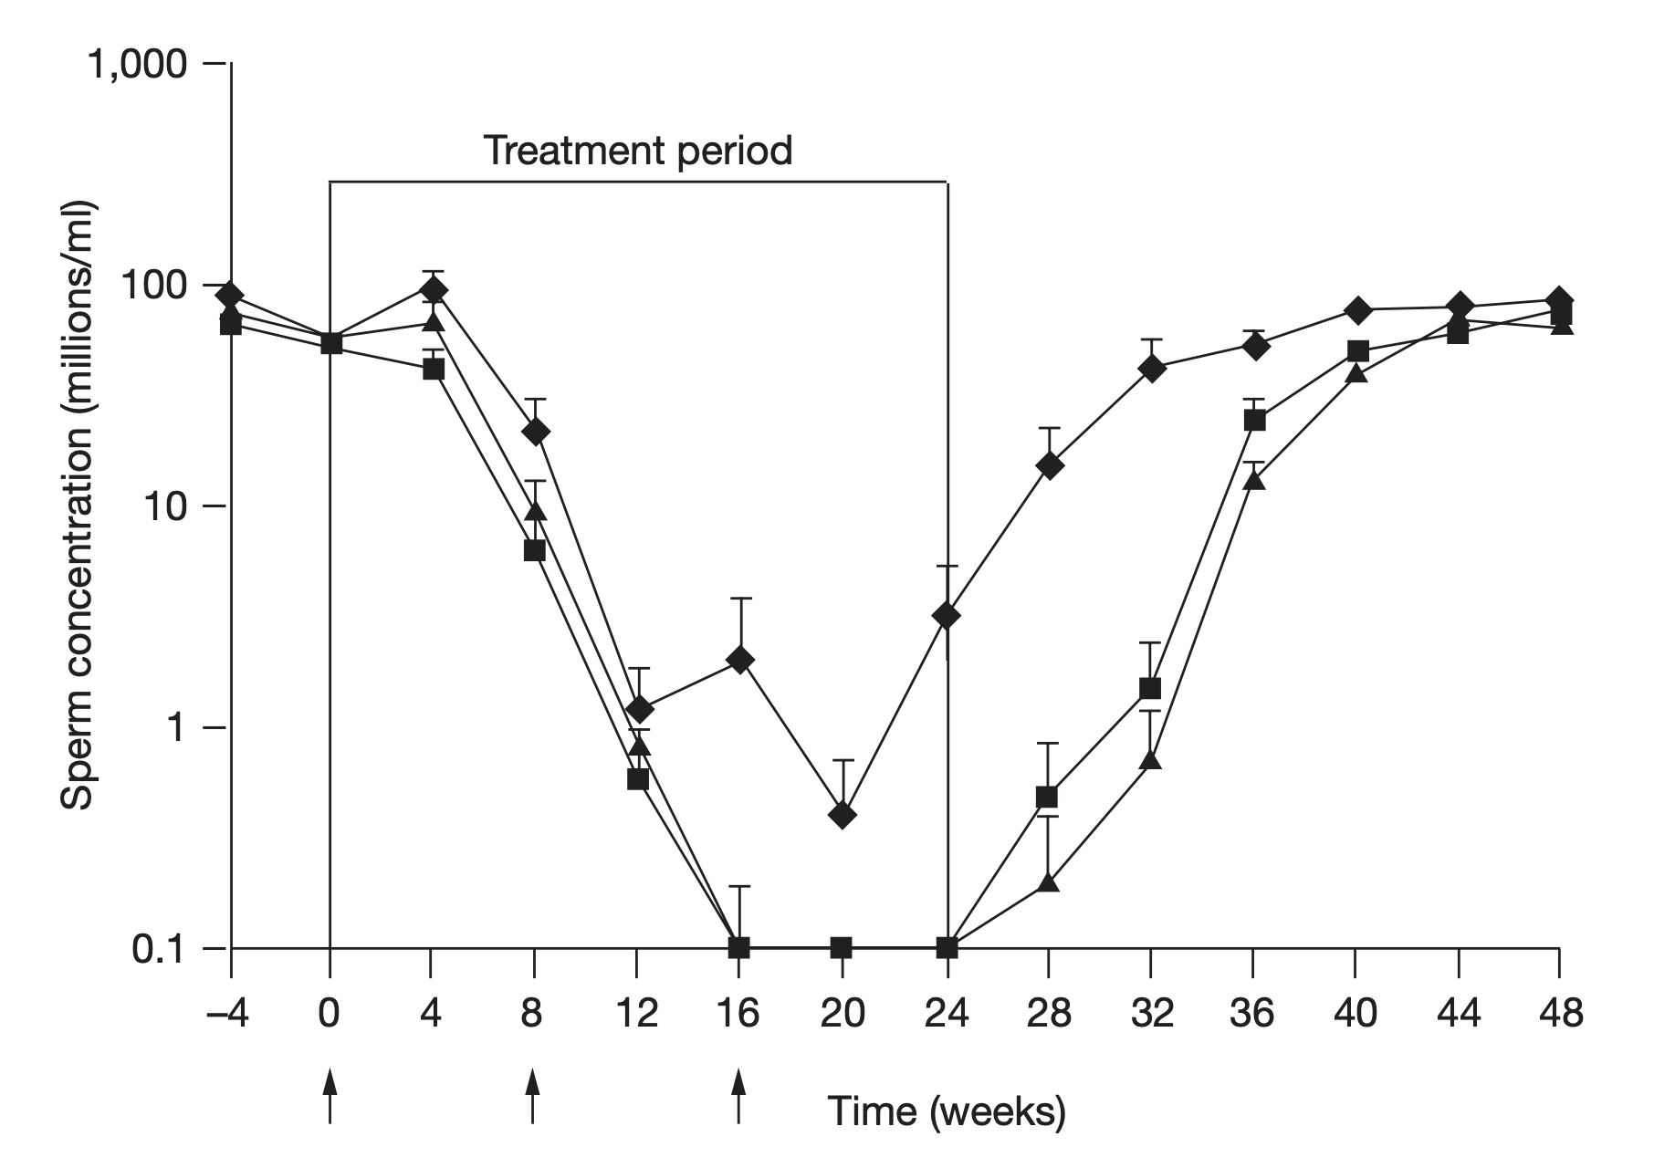
Physiological T replacement temporarily reduces semen quality in men
Gu et al. JCEM 2004
Amory, Page & Bremner Nature Clin Pract 2002
Notes:
D = aspartate
H = histidine
cAMP >10-fold above basal

Slide 23


“Self-confessed steroid user Spencer Matthews reveals UK is in the grips of an 'epidemic' with up to a million taking the drugs”
1-5% of population
3-fold increased mortality risk
Notes:
N=209.
Placebo vs. Testosterone gel 5-15g
Serum 9am T < 12nmol/L

Slide 24
Time to recovery for reproductive function after androgen use (Australia):
LH: 10 months
FSH: 20 months
Inhibin B: 32 months
Sperm concentration: 10 months
Sperm motility: 38 months
Shankara-Narayna et al. J Clin Endocrinol Metab 2020

Slide 25
Physiological T replacement temporarily reduces semen quality in men
Supra-physiological testosterone causes male infertility
Gu et al. JCEM 2004
Amory, Page & Bremner Nature Clin Pract 2002
Notes:
D = aspartate
H = histidine
cAMP >10-fold above basal

Slide 26
More male partners are on testosterone
Classical hypogonadism is uncommon
Functional hypogonadism is increasing problem
More men are INCORRECTLY having TRT
  High dose = Anabolic steroids
  Low dose = Longevity / low T / ageing optimisation

Slide 27
How to treat male hypogonadism during fertility treatment for couple?
Notes:
Dr Life
Healthy eating
Exercise
Testosterone

Slide 28
Healthy men
Kisspeptin / dynorphin /
NKB
GnRH
FSH LH
Sertoli cells
Testosterone synthesis in Leydig cells
Testes: 500 nmol/L
Serum: 10-30 nmol/L
Notes:
Spermatocytes derive from immature germ cells called spermatogonia.
Primary spermatocytes are diploid (2N) cells.
After Meiosis I, two secondary spermatocytes are formed.
Secondary spermatocytes are haploid (N) cells

Slide 29
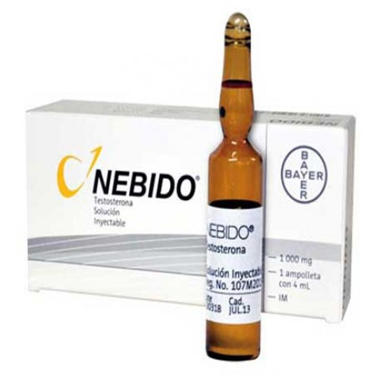
Testosterone treatment
Kisspeptin / dynorphin /
NKB
GnRH
FSH LH
Sertoli cells
Exogenous Testosterone
Notes:
Spermatocytes derive from immature germ cells called spermatogonia.
Primary spermatocytes are diploid (2N) cells.
After Meiosis I, two secondary spermatocytes are formed.
Secondary spermatocytes are haploid (N) cells

Slide 30
Alternatives for male hypogonadism
SERM e.g. clomiphene 50mg every 2 days
hCG 1500-2500IU twice-weekly
(Aromatase inhibitors)
Maintain intra-testicular T
Suitable for <2 years

Slide 31
T and ageing: Take-home messages
Classical hypogonadism is uncommon
2% of men have functional hypogonadism – treatment is increasing
More men are INCORRECTLY having TRT
  High dose = Anabolic steroids
  Low dose = Longevity / low T / ageing optimisation
SERM / hCG good alternatives to TRT during fertility treatment

